Slide 1
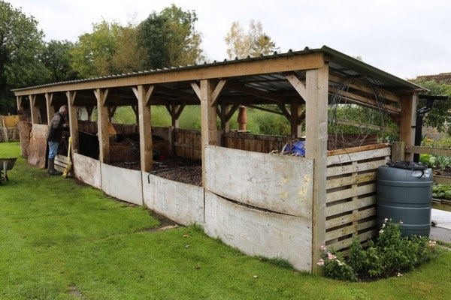
One Turn System
Pros
Makes compost fast
only needs turning once
if it doesn't get turned, it just becomes cold compost
Cons
Uses wood we don't have
Large structure
Needs to be monitored closely to make sure C:N is correct
Can set up water catchment system
Ingredients:
Kitchen scraps
Weeds
Bed clearings
Cardboard
Paper
Chicken bedding
Chicken manure
Image; Charles Dowding, 2019
Beds need to be at least 1.2 m 2
Roof prevents rain from slowing process down, maintaining oxygen levels

Slide 2
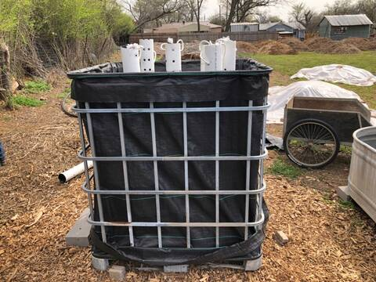
Johnson Su Bioreactors
Creates high quality, nutrient-rich compost, using fungal activity.
If built using recycled IBC tanks, they may provide thermal mass and growing space in polytunnel 3.
Benefits of Johnson-Su Bioreactor Compost:
Increases soil carbon sequestration
Increases crop yield
Increases soil nutrient availability
Increases soil water-retention capacity
Produces biologically diverse compost
Produces nutrient–rich compost
Results in a low-salinity compost
Improves seed germination and growth rates
Benefits of Johnson-Su Bioreactor Composting System:
Reduces water usage up to six times
Reduces composting labour time by 66 percent
Requires no turning and little manpower
Is a low–tech process that can easily be replicated
Can be made using a diversity of compost materials
Produces no odours or associated insects
Materials are cheap and can be used for up to 10 times
No leaching or groundwater contamination
(ref. regenerationinternational.org)
Image: squarefoot.forumotion.com

Slide 3
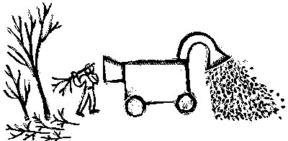
Ramial Woodchip
Can be spread directly on beds, breaks down quickly adding high-nutrient matter to soil
Will make excellent mulch for in forest garden
Pros
Instant 'fertiliser'
Simple process
Uses willow and hazel from site
Uses waste product
No nitrogen lock up if used correctly
Easy and quick to process
Makes use of 'weed' trees that are too big to take down
Cons
Need shredder
Mustn't be incorporated into soil, so needs to be used in areas that will not be cultivated, at least until it has decomposed.
Image: Toki Oshima tokiart.com from mofga.org

Slide 4
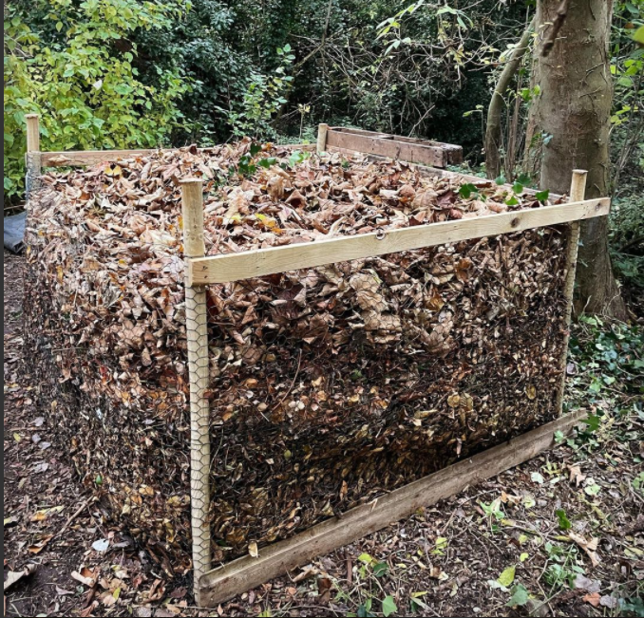
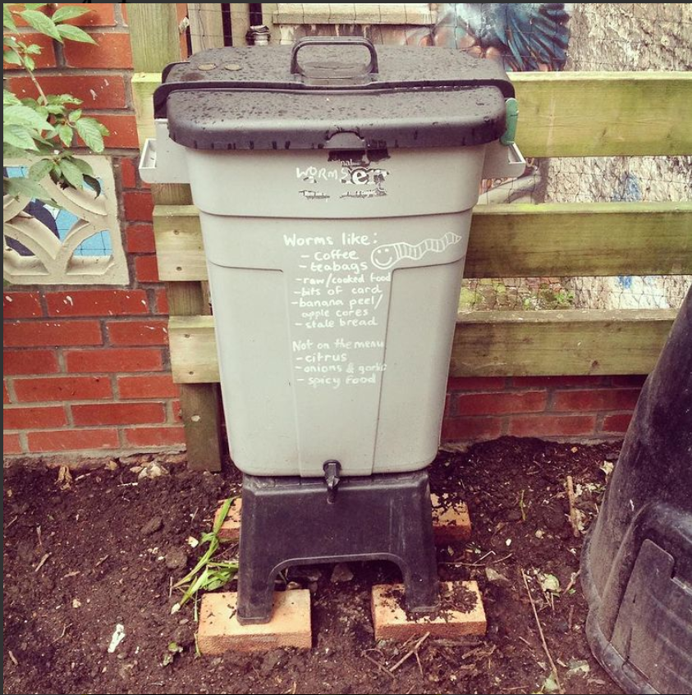
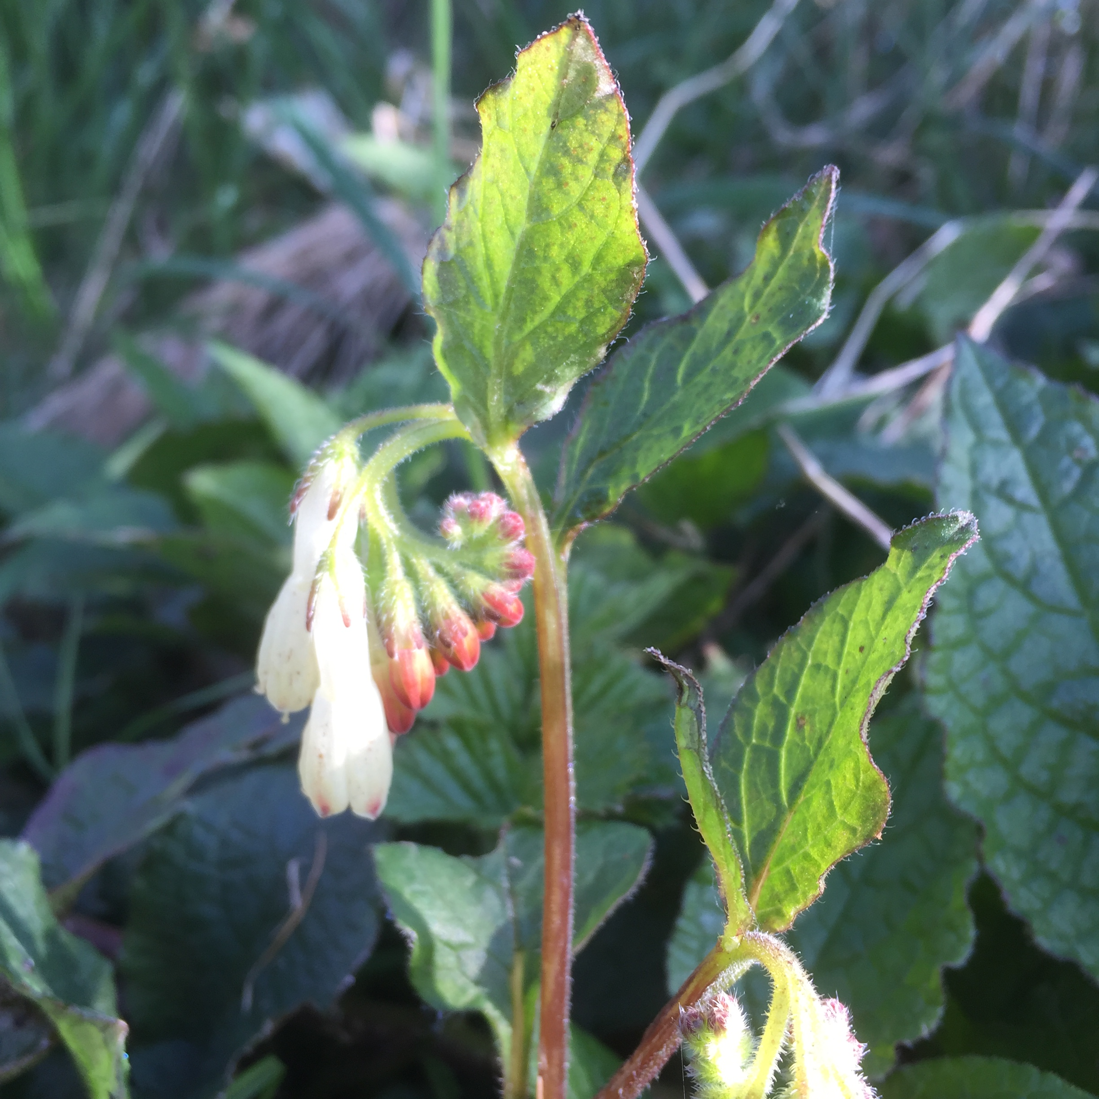
Image: thespruce.com
Image: @the_truant_gardener
Image: @onca_arts
Image: author’s own
Leafmould is an excellent soil conditioner. All you need to do is collect leaves, put them in a leafmould bin and leave to decompose for a few years
Wormery
Worm composting is an efficient method of turning
kitchen waste and small amounts of garden waste
into nutrient-rich compost and a concentrated liquid fertiliser.
Comfrey fertiliser
Comfrey and nettle leaves are left to breakdown in a tub, and the resulting liquid is drawn off and fed to plants as a rich fertiliser

