Slide 1
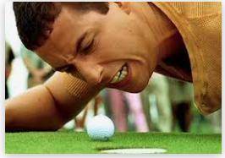

PGA Tour Golf Model
Killian Farrell

Slide 2
Introduction
Objective
Create a Model that can predict future golf scores on PGA Tour events
Learn about Bayesian statistics and Hierarchical Modelling (Python package pymc3)
Motivation
Golf data from the PGA Tour is readily available online
Suitable for modelling - most of the information about a performance is contained within the score
This is different from low scoring sports like soccer/ ice hockey

Slide 3
Data
Every golf course has a par score – number of strokes a proficient golfer should require to complete course
For Augusta the par score for 18 holes (1 round) is 72
Golfers aim to score as far below par as possible
Dustin Johnson scored -7 which is an overall score of 65
Golfer Score to Par can be compared across multiple courses
Data ranges from October 2018 to March 2021 for PGA Tour events
304 golfers (Approx 100-200 observations per golfer)
Golfer | Tournament | Course | Date | Round | Golfer Score to Par
Dustin Johnson | Masters Tournament | Augusta | 12/11/2020 | 1 | -7
Justin Thomas | Masters Tournament | Augusta | 12/11/2020 | 1 | -6
Hideki Matsuyama | Masters Tournament | Augusta | 12/11/2020 | 1 | -4

Slide 4
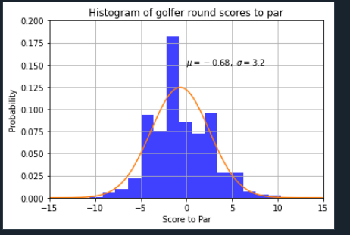
EDA: Golfer Round Scores
Golfer scores are whole numbers
PGA tour mean score -0.68 par with std dev 3.2
Normal Distribution with same parameters in orange (Continuous Distribution)

Slide 5
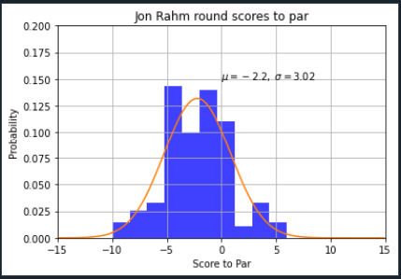
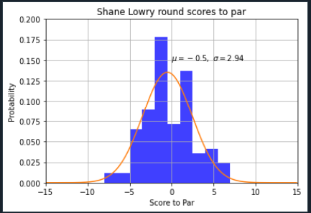
EDA: Jon Rahm vs Shane Lowry
Jon Rahm has a mean score of -2.2 par with a standard dev of 3.02 (Ranked 2nd OWGR)
Shane Lowry has a mean score of -0.5 par with a standard dev of 2.94 (Ranked 40th OWGR)
Jon Rahm is a superior player so is expected to have a lower mean score

Slide 6
Model & Data Split
Linear Regression Model:
Model will use ‘Golfer Score to Par’ as the dependent variable
Independent variable will be each golfer [i_golfer]
Each golfer will have a different coefficient (Golfer mean score i)
Round model output to nearest whole number to get score (-1.2 to -1)
Golfer Score to Par = (Golfer mean score i)[i_golfer] + Intercept
Data Split:
Training Data from October 2018 to September 2020 (80%) (29K obs from 304 golfers)
Test Data from October 2020 to March 2021 (20%)

Slide 7
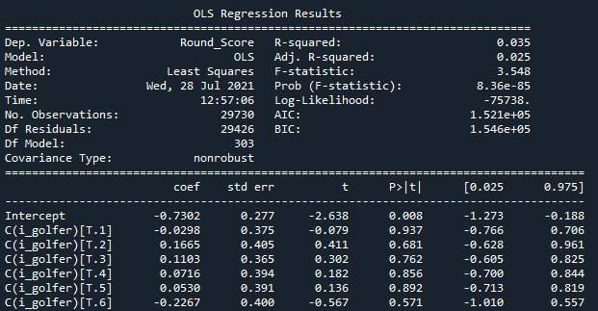
Frequentist: Statsmodel Linear Regression
1 variable C(i_golfer) for each golfer (one hot encoding)
Coefficients are fixed values – generated to best fit the data
Output will be single number (E.g. Golfer 1 = -0.7302 – 0.0298 = -0.76 = -1 Par)
Lower Coefficient means golfer is better and will score lower
P values all way above 5% indicating that this estimate is not reliable (too many categories)

Slide 8
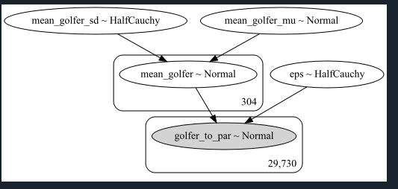
Bayesian: Hierarchical Model
Model:
Mean_golfer_mu ~ Normal(mean=0,std=1) – Prior
Mean_golfer_sd ~ HalfCauchy (beta=1) – Prior
Mean_golfer[i_golfer] ~ Normal (mean=mean_golfer_mu, std=mean_golfer_sd) (304)
Eps ~ HalfCauchy (beta=1) – Prior Model Error used as standard deviation in model
Golfer_to_par(data) = Normal(mean = mean_golfer[golfer i] , std = error term (eps)) (29,730 obs)
Prior Distributions are set by user and will affect prediction from model
Coefficients are not fixed and can take on a range of values
Coefficients are estimated using Bayesian Inference combining data and priors (see Appendix)
Number of samples for each variable set by user and contained in “trace” (set to 2k values)

Slide 9
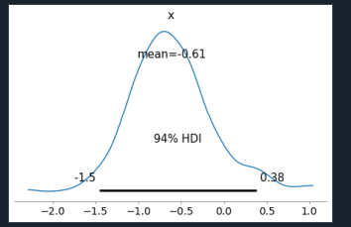
Shane Lowry mean_golfer coefficient (trace)
Coefficient can take on a range of values unlike frequentist statistics where it is fixed
94% of the values for mean_golfer coefficient lie between -1.5 and 0.38 (Highest Density Interval)
A value will be drawn from this distribution and fed into ‘Golfer_to_par’ Normal Distribution to generate a score for Shane Lowry’s round

Slide 10
Generate Golfer Scores (Posterior Predictive)
Samples drawn from “trace” to generate golf scores for each observation
For each of the 29k observations (training) - 1k samples were generated (29k X 1K) from trace
These samples are Normally Distributed around each golfers ‘mean_golfer’ coefficient
Samples are rounded to give golf scores (E.g. -1.2 goes to -1)
Can estimate probability of scoring -1 by counting observations
E.g. -1 occurs 100 times, 100/1000 = 10% chance of scoring -1
Example:
Player | Tournament | Course | Date | Round | Golfer Score to Par (Actual) | Sample 1 | Rounded_sample 1 | ...Sample 1000 | Rounded Sample 1000
Dustin Johnson | Masters Tournament | Augusta | 12/11/2020 | 1 | -7 | -3.2 | -3 | 1.72 | 2

Slide 11
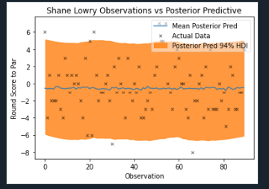
Shane Lowry Posterior Pred vs Actual
Approx 90 rounds of golf played by Shane Lowry (Xs in graph)
Model outputs a range of golf scores (Posterior Pred) for each observation
94% of scores in Orange
Can estimate probability of winning (E.g. Lowry will score -1 to par 20% of the time)
Frequentist Linear Regression only provided a point estimate with most likely value

Slide 12
Next Steps
Add in variable for course played
Continuous Distributions with larger tails (Cauchy)
Prediction on test set and evaluate

Slide 13
Use Cases
Cases where we need to know probability for a range of different scenarios (Random Forest Averages predictions)
Data is limited and we have some prior domain knowledge
Models where each variable parameter must be interpretable (Credit Risk, health, insurance)

Slide 14
Resources
My Code: https://github.com/killianfarrell2/PGA_Golf
PYMC3 website: https://docs.pymc.io/notebooks/getting_started.html
PYM3 example: https://docs.pymc.io/notebooks/rugby_analytics.html
PGA Tour data: https://www.advancedsportsanalytics.com/pga-raw-data
MCMC: https://towardsdatascience.com/mcmc-intuition-for-everyone-5ae79fff22b1#:~:text=Markov%20Chain%20Monte%20Carlo%20(MCMC,sample%20of%20the%20desired%20distribution.
Bayesian statistics: https://towardsdatascience.com/what-is-bayesian-statistics-used-for-37b91c2c257c
Bayesian vs Frequentist: https://towardsdatascience.com/frequentist-vs-bayesian-approaches-in-machine-learning-86ece21e820e

Slide 15
Appendix

Slide 16
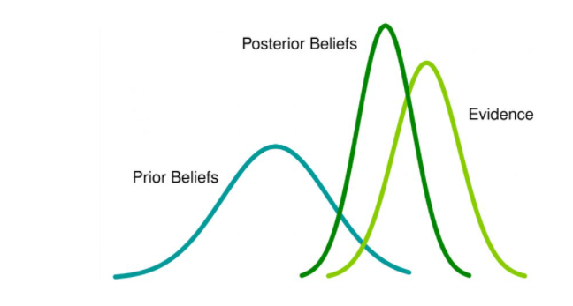
Bayesian Inference
Bayesian Inference uses Bayes Theorem to update the probability of a hypothesis (golfer scores are normally distributed) as more evidence becomes available
Prior beliefs is what we think the distribution of a parameter looks like before taking any data into account (mean_golfer_sd, mean_golfer_mu, eps, mean golfer)
Evidence is the data that we have obtained (golfer_to_par for each golfer)
Posterior Beliefs is a distribution that combines the prior distribution we defined and the data that we have (generated for mean_golfer_sd, mean_golfer_mu,eps,mean_golfer)
The more observations you have the less of an affect the prior will have on the posterior

Slide 17
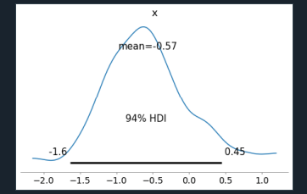
Jon Rahm Posterior Distribution for (mean golfer)
Jon Rahm has a wider HDI than Shane Lowry (His Std will be larger)
Interestingly his mean parameter is slightly worse than Shane Lowry (-0.57 vs -0.61)
Again to generate John Rahm’s score we feed this parameter into ‘golfer_to_par’ Normal Distribution

Slide 18
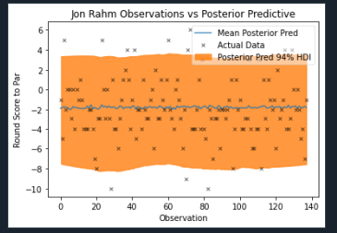
Jon Rahm Posterior Pred vs Actual
Approx 140 rounds of golf played by Jon Rahm (x in graph) (obs 1: actual was -1)
Posterior Pred is 1k samples generated for each observation(obs 1: Range(-8,+3))
9% of these observations fall outside the 94% HDI (Highest Density Interval)
A distribution with larger tails (Cauchy) may be more appropriate than a Normal Distribution

Slide 19
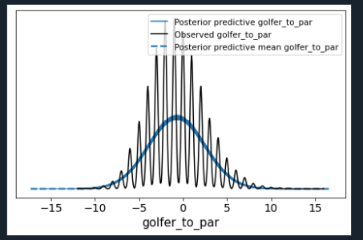
Posterior Predictive Check (Pre Rounding)
Graph shows generated samples for all golfers from Normal Distribution vs Actual scores from training data
Normal Distribution is in blue – doesn’t fit the data that well
Golf scores are whole numbers which is why there is downward lines in between

Slide 20
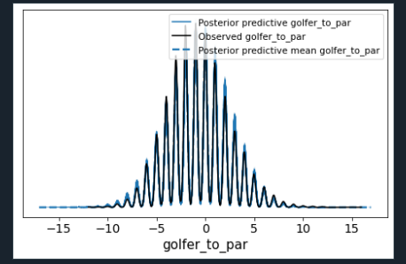
Posterior Predictive Check (Post Rounding)
Rounded data from Posterior Predictive fits the observed data better

