Slide 1
PGA Tour Golf
Killian Farrell

Slide 2
Bayesian vs Frequentist

Slide 3
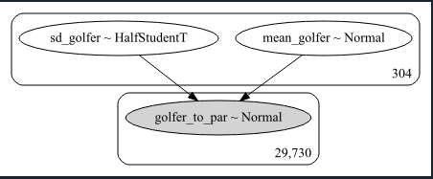
Pymc3 Model

Slide 4
MCMC Sampler

Slide 5
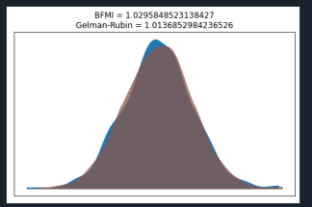
Convergence

Slide 6
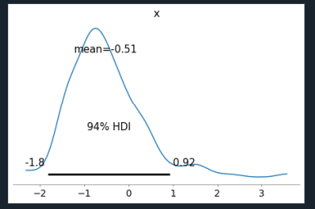
Mean Score Golfer 0 (Normal Distr)

Slide 7
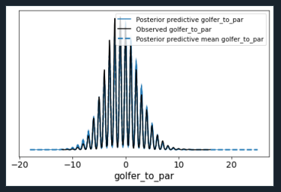
Rounded Scores (100 samples)

Slide 8
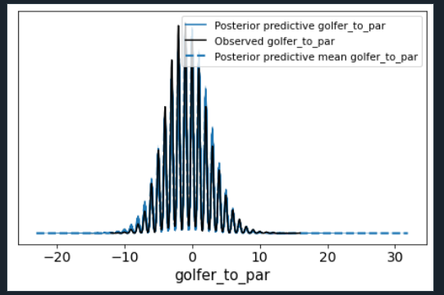
1000 samples

