Slide 1
PGA Tour Golf
Killian Farrell

Slide 2
Bayesian vs Frequentist

Slide 3
Exploratory Data Analysis
Put Graph of all Round Scores here

Slide 4
EDA: Jon Rahm vs Other Player

Slide 5
Model options
Pooling of Measurements – 1 alpha and 1 beta for all golfers
Golfer Score (i,r) = alpha + Beta(golfer)
Separate regressions
Golfer Score(I,r) = alpha(i)+ Beta(i)(golfer)
Hierarchical regressions
Alpha ~ N(mu(alpha),sd(alpha)
Beta ~ N(mu(beta), sd(beta))
Cofficients different for each golfer, but all come from common group distribution
Alpha is centred around

Slide 6
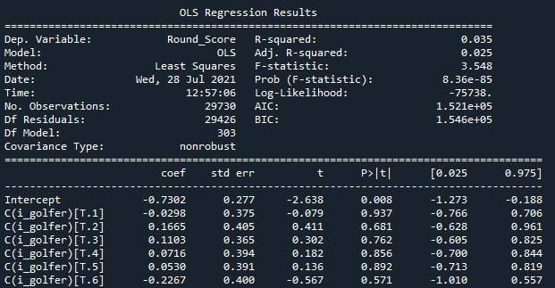
Ordinary Least Squares
1 parameter for each golfer
P values all way above 5% due to large number of golfers

Slide 7
Hierarchical Regression
Although mean score to par is different for each player – all come from common distribution
Standard deviation will also be different for each player but again all
https://twiecki.io/blog/2014/03/17/bayesian-glms-3/

Slide 8
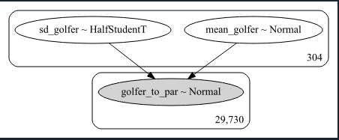
Pymc3 Model

Slide 9
MCMC Sampler

Slide 10
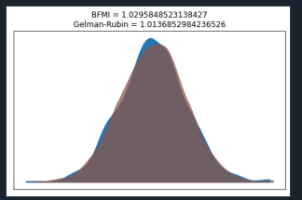
Convergence

Slide 11
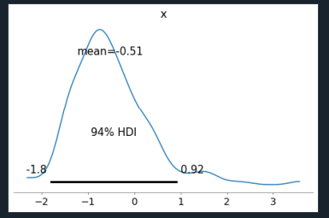
Mean Score Golfer 0 (Normal Distr)

Slide 12
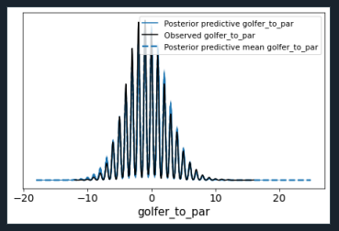
Rounded Scores (100 samples)

Slide 13
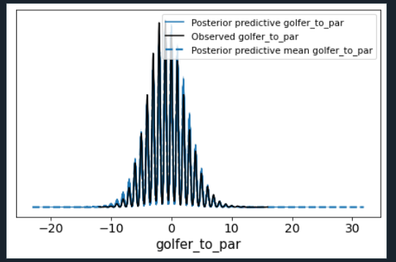
1000 samples

Slide 14
Issues
Shrinkage -

