Slide 1
Haplotype Phasing
Patrick Killian Jackson
CS CM124 Final Project
June 10,2016

Slide 2
Haplotype Phasing
Haplotype – the sequence of nucleotides along a single chromosome
Often difficult to discern two chromosomes in a pair leading to a combined haplotype, or genotype
Haplotype phasing is a method used to discover haplotypes when given the genotypes

Slide 3
Motivation
Haplotype phasing provides a complete view of individual’s genome
Haplotypes provide more information that genotypes
Has many applications
Association studies
Detecting positive selection
estimating recombination rate
understanding gene function
Analysis of regions of the genome that are functionally related
My algorithm for achieving Haplotype phasing uses an adaptation of Clark’s method to determine a list of haplotypes corresponding to a given set of genotypes

Slide 4
Computational Problem
Input: a text file containing genotypes translated into {0,1,2}
0 – Homozygous Reference
1 – Heterozygous
2 – Homozygous Alternate
Output: a text file containing haplotypes derived from the input list of individual genotypes. My goal is for this list to contain two haplotypes that correspond to each inputted genotype. Overlap is allowed since multiple genotypes may map to the same haplotypes
Benchmarks are computational time and the accuracy of the computed haplotypes

Slide 5
Baseline Method: Clark’s Method
Scan through genotypes compiling a haplotype list determined from unambiguous genotypes (one’s that consist of only 0’s and 2’s)
Scan through remaining ambiguous genotypes:
If two haplotypes in the building haplotype list can resolve an undetermined genotype, do nothing and move onto next genotype
If one known haplotype and combined with a new haplotype not in the haplotype list can resolve the genotype, add the new haplotype to the list

Slide 6
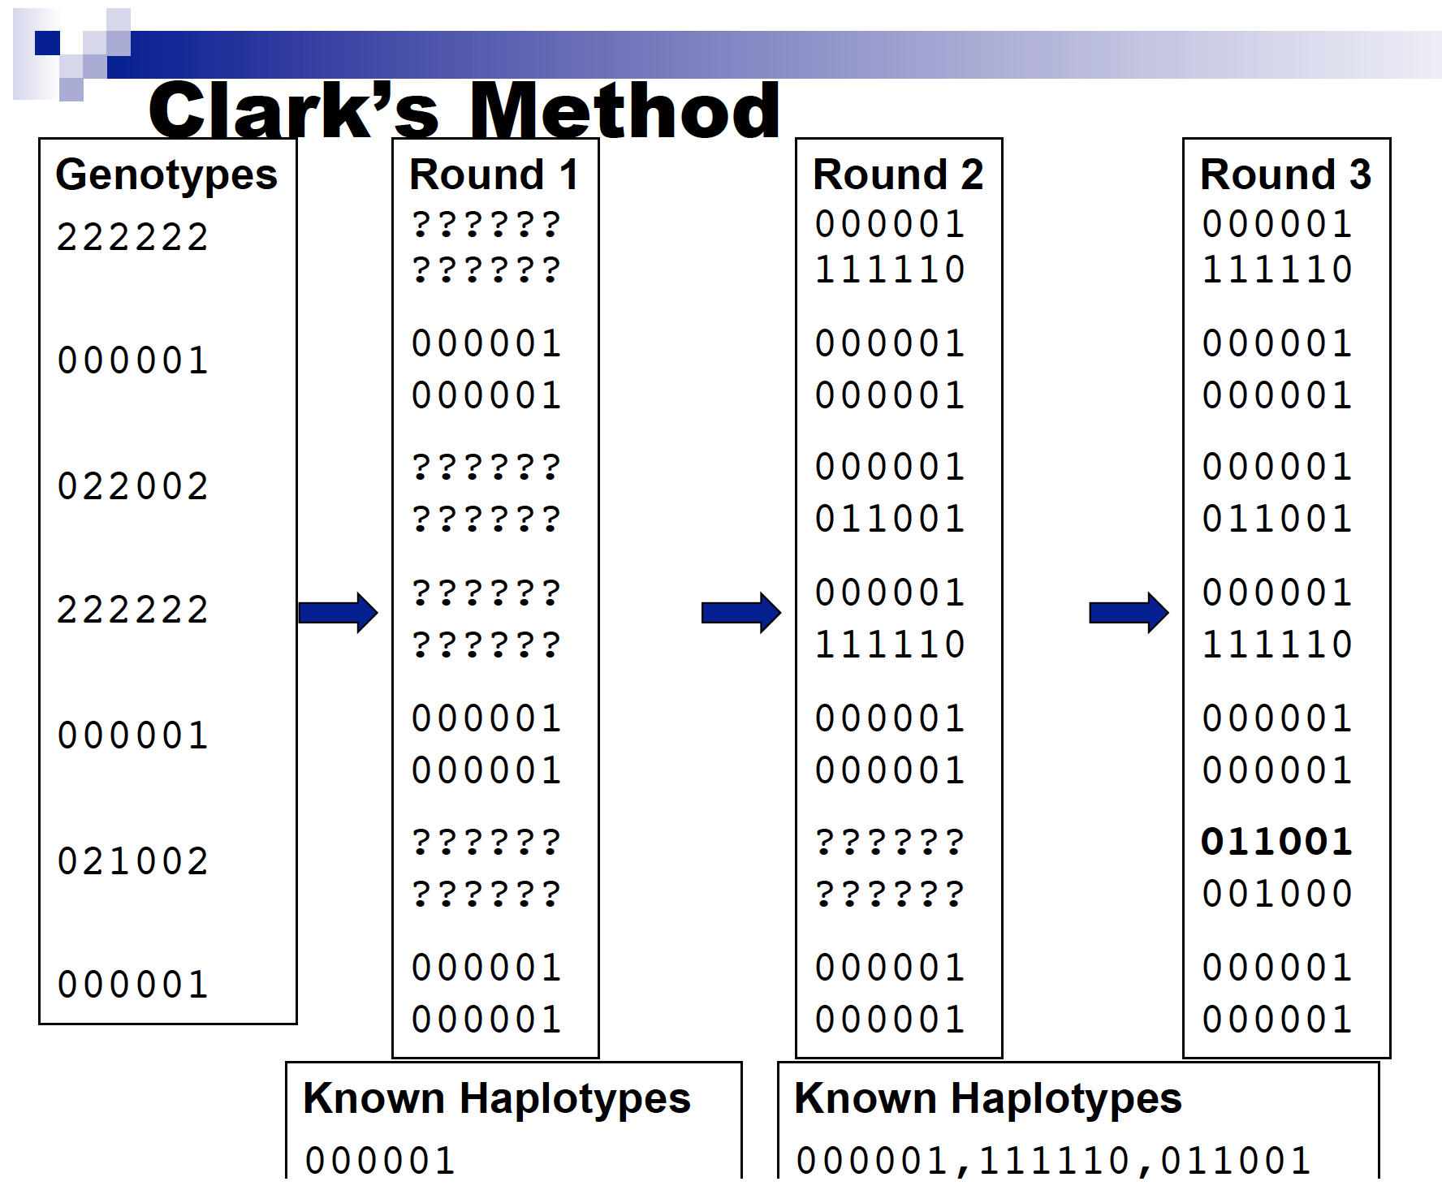
Baseline Method: Clark’s Method (cont’d)

Slide 7
My Adaptation of Clarke’s Method
Read input file and store genotypes in global variable genotypes
Scan through genotypes compiling a list in a global variable, haplotypes, of haplotypes derived from unambiguous genotypes. Additionally, store remaining ambiguous genotypes in global variable undetermined
Scan through undetermined
For each genotype, generate a list, stored in buffer, of all the possible haplotypes for that genotype
Compare each item in buffer to haplotypes
If there is a match, add the corresponding haplotype (“flipped version”) to haplotypes
Output members of haplotypes to output text file

Slide 8
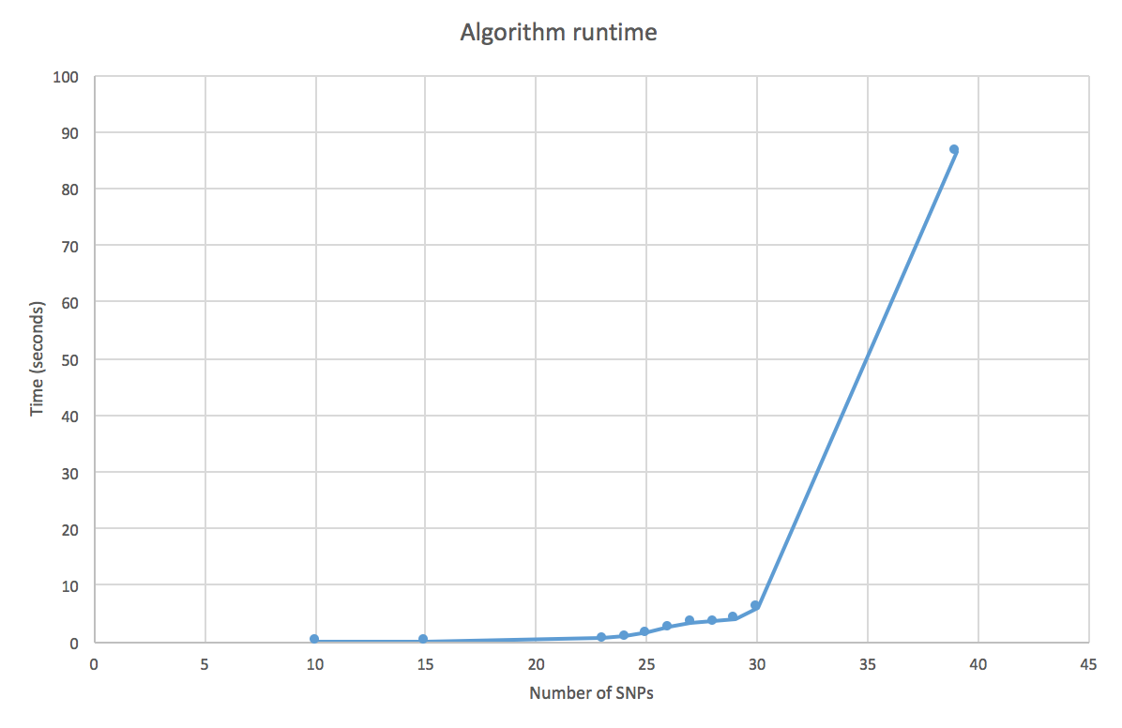
Performance Analysis
Ran the easy test case and additional cases varying the number of SNPs but keeping the number of genotypes constant at 60
Exponential increase in runtime as the number of SNPs increases

Slide 9
Performance Analysis Cont’d
very_easy_training_genotypes.txt results:
Generated an output file containing haplotypes matching those in very_easy_training_haplotypes.txt
easy_training_genotypes.txt results:
Generated an output file containing haplotypes matching those in easy_training_haplotypes.txt and one additional haplotype.
Extra haplotype due to algorithm not being minimal

Slide 10
Future Improvements
Unlike Clark’s method, my algorithm only passes through the ambiguous genotypes once as opposed to iteratively.
This is sufficient for genotypes with limited numbers of SNPs but multiple passes may be necessary for larger data sets. An iterative feature would improve my algorithm
Overhead of generating all possible haplotypes
Sometimes generates as many as 200,000 possible haplotypes for each genotype
Another strategy may be more efficient
Incorporate independence from unambiguous genotypes
My algorithm fails if there are not unambiguous genotypes in the original data set

