Slide 1
L4 Maths Report Writing

Slide 2
Learning Objectives
By the end of this session you will have:
Explored some key considerations of working in a group.
Discussed key aspects of report presentation and structure.
Analysed sections of an example report.
Examined the PEEL method of paragraph structuring.
Notes:
2

Slide 3
Getting started as a group
What do you want to accomplish in your first meeting?
Introductions
What can you bring to the team?
Allocate team roles
By negotiation and consent.
Agree a mode of communication
Email?
Social media?
Teams?
Ground rules
More on these soon.
Allocate a team leader?
Keep meeting notes?
Co-ordinate communication?
Agree next meeting
Date
Time
Place
Review assignment brief
Check understanding.
Break down into sub-tasks.
Agree objectives.
Draw up a time plan
What sub-tasks need achieving by when?
Notes:
3

Slide 4
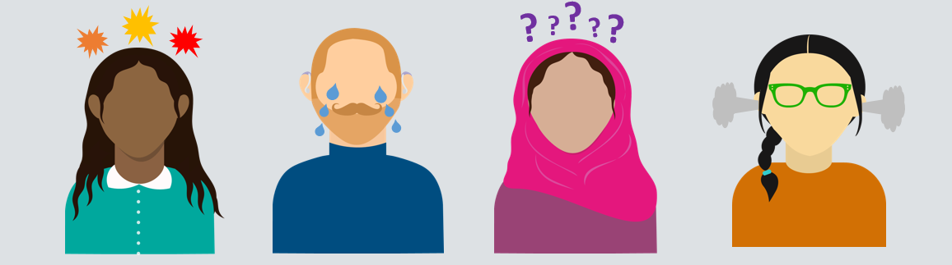
Ground rules
What are some useful things to agree on early on?

Slide 5
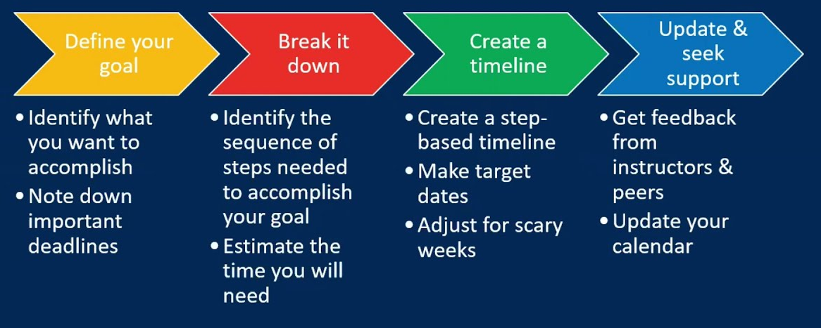
Some suggested ground rules
Assign group roles and responsibilities by negotiation.
Will everyone contribute to the reading?
Who will write which sections of the report?
Agree when / where / how you want to meet and at what points in the assignment.
Factor in some contingency time!

Slide 6
Your graduate development and employability assignment
Research a topic relating to your course and present your findings as a formal scientific report.
Your report should be 3,000 – 5,000 words in length, excluding appendices.
Your report should consist of the following elements:
Title
Abstract
Introduction
At least one numbered display equation
At least one inline equation
At least one figure or table with an appropriate numbered caption
At least one cross reference to a numbered document element (e.g., equation, figure, table, section etc.)
At least three citations to valid sources cited using Cite Them Right Harvard
Conclusion
A reference list
Notes:
For reference, this is some info on that assignment – for content and subject specific info, ask your unit leader (Jon). You will have other sessions supporting this assessment.
Title (in bold): conduct some research into the topic (you’ve been given a list of ten, including the use of mathematics in sport, prime numbers and diversity in mathematics).
The assignment brief gives you a length (three pages) and also specified some things the report should include (see list), including specific sections and features.
This session is going to focus on how to structure this assignment, based upon the brief, the template and an example. One thing to be aware of, is that this structure will differ slightly from a traditional scientific report, as it will not have a methods / results section. It is most similar to the ‘short report’ example on the previous slide.
6

Slide 7
How should a report be formatted?
Adequate headings, sub-headings and numbering.
Some headings are pre-determined (Abstract, Introduction, Conclusion).
Headings for central sections are free for you to decide.
Ensure the separate parts of your report stand out clearly.
Use plenty of white space.
Adequate margins.
Use consistent and appropriate formatting
Notes:
7
Always allow time in completing your report to ensure that the presentation is up to scratch. All these aspects should be considered during the ‘editing & proofreading’ process. It may be useful to signpost to the screencast at his point: The Dissertation Project: Editing and Redrafting - mmutube

Slide 8

Tables, graphs, images and diagrams
Make sure that any graphics are:
Good quality.
Have a purpose.
Clearly labelled.
Do not replace text extensively. You should write some text by way of explanation of an illustration.
Figure 1. Pie Chart Example
Notes:
Inclusion of graphs / images etc is an essential element of Report Writing and distinguishes it from an ‘essay’.
If done well it can enhance the report and give you a good chance of improving your marks.
Our numeracy Advisers can provide support on how to analyse data and display it in your reports in the most effective manner.
8

Slide 9
Academic Style
Use formal English
No contractions (e.g. don’t, aren’t, it’s).
No phrases that sound like speech (“do you get me”).
No clichés (“the flaws in this argument stand out like a sore thumb”).
No subjective descriptions (“it was a brilliant idea”).
Use plain language
Complicated language can obscure your message.
Shorter sentences are usually clearer than long complex ones.
Be brief and concise
Avoid using three words when one will do!
Notes:
9
There is a lot consider when trying to improve the style of your academic writing and these two slides give a very brief overview. There are a lot of resources on our Moodle area which will be of assistance: Course: Academic Study Skills (mmu.ac.uk)
You may also want to consider The Writing Project: Short courses · Manchester Metropolitan University (mmu.ac.uk)
Report writing is likely to involve more jargon than essay writing as in the majority of cases reports are written for a particular audience who may already have specialist knowledge, rather than for a generic educated audience without detailed specialist knowledge.
However, technical terms should still not be overused as they can make for a very dense and cumbersome text which will inhibit, rather than aid, understanding.

Slide 10
Replace with one word:
At this point in time
Due to the fact that
High degree of accuracy
In the event that
Prior to
Subsequent to
Now
Because
Accurate
If
Before
After
Notes:
Ask students to consider the benefit of editing their writing as they progress with an assignment. Substituting an individual word for a phrase may not seem like much but over an extended piece of writing it can free up a substantial amount of the word count which will then allow for the inclusion of more beneficial content.
It also improves readability and makes for a far more direct and engaging piece of writing.
Signpost to Concise Writing screencast: Writing Concisely – YouTube
10

Slide 11
Hedging
Each extra qualifier reduces the force of the sentence. Sometimes you can say nothing at all:
‘The cause of the tiredness is unknown but possibly one cause may be staying up too late to write this assignment at the last minute, perhaps’.
Once is enough!
Notes:
Hedging is when we use cautious language to define our arguments. A lack of hedging can lead to broad sweeping statements which should be avoided, but equally we need to be careful not to be so cautious as to effectively say nothing at all.
Signpost to Hedging screencast: Hedging in academic writing – YouTube
11

Slide 12
Introductions
1. General statements.
Provide your reader with the context or setting.
2. Thesis statements
Tell the reader what you intend to do in this report.
Tell the reader how you will do this task and what your approach will be.
3. Route map
Help guide the reader through the text by providing a route map of the things you will cover.
Notes:
Now let’s move on to looking at the structure and content of certain key sections of your report.
Run through intro structure.
Stress how it goes from general to specific: start with general topic, then move to your specific focus, then onto how you will present this.
12

Slide 13
Activity: breaking down an introduction
Read through this introduction and highlight: the general statement, the thesis statement and the route map.
Long before Sudoku became famous, people were solving another family of square-grid puzzles: Magic Squares. Magic Squares have been around for over 4,000 years and have been used in different cultures for their astrological, divinatory qualities, their usage ensuring longevity and prevention against diseases (or so claimed). For example, Indian and Egyptian cultures engraved magic squares onto stone or metal, which were then worn by talismans. Within this short essay, the construction and use of of Magic Squares will be explored in more detail. First, the North East Method will be considered, before exploring a method for constructing doubly even magic squares. Finally, further reading and avenues for future research will be considered.
Notes:
So let’s have a look at how that words in practice. The example on the slides is adapted from one of Daria’s reports. I want you to go through and highlight these key elements. So where has the overall context or topic been introduced? Where is the specific area of study narrowed down? Where does it say how this will look in the essay?
[5 mins]
13

Slide 14
Answers
Read through this introduction and highlight: the general statement, the thesis statement and the route map.
Long before Sudoku became famous, people were solving another family of square-grid puzzles: Magic Squares. Magic Squares have been around for over 4,000 years and have been used in different cultures for their astrological, divinatory qualities, their usage ensuring longevity and prevention against diseases (or so claimed). For example, Indian and Egyptian cultures engraved magic squares onto stone or metal, which were then worn by talismans. Within this short report, the construction and use of of Magic Squares will be explored in more detail. First, the North East Method will be considered, before exploring a method for constructing doubly even magic squares. Finally, further reading and avenues for future research will be considered.
Notes:
General statement: overall topic, some background.
Thesis: specific topic (i.e. construction and use).
Route map: order of discussion.
14

Slide 15
Conclusions
Start with a brief statement of your central ideas.
Briefly run through your key points (from body paragraphs).
Summarise how you have answered or addressed the question.
Remember:
Emphasise especially anything valuable.
Acknowledge any possible limitations your work might have.
Make recommendations where appropriate.
Do not introduce any new ideas or facts.
Notes:
Explain three key elements. Again, start specific (general argument) then more specific (key points) and close with a summary.
Remember:
Emphasise valuable points
Acknowledge limitations
Make recommendations (NOTE: For this assignment, you are also asked to make a recommendation and consider further reading or research)
Do not include new concepts or ideas (although you can as a signpost to future research/reading).
15

Slide 16
Activity: breaking down a conclusion
Read through this conclusion and highlight: brief statement of central ideas, summary of key points and a final statement. Also highlight the recommendations and further reading/research suggested.
In this report we have defined what is meant by a magic square and presented methods for constructing these objects. First, the North East method allowing the filling in of any off magic squares was explained in detail. Second, the methods for even magic squares was described in depth. An area which might be explored further is whether a single magic square can be transformed into another square which preserves is magic property. This question opens door for operations, called magic square-preserving transformations, which resemble row operations in linear algebra. The first linear area magic square (L-AMS) was constructed by a maths and physics teacher Walter Trump in 2017 (Loly 2009), following initial ideas of William Walkington and Inder Taneja. Thus, the use and construction of magic squares has been considered in depth and recommendations have suggested that the concept of linear area magic squares could be explored further.
Notes:
So let’s do a similar activity breaking down a conclusion. Again, this is adapted from Daria’s example. Highlight the three key elements: general statement, key points, final statement. Also, within this I’ve included recommendations and further reading/research so try highlight these elements too.
[5 mins]
16

Slide 17
Answers
Read through this conclusion and highlight: brief statement of central ideas, summary of key points and a final statement. Also highlight the recommendations and further reading/research suggested.
In this report we have defined what is meant by a magic square and presented methods for constructing these objects. First, the North East method allowing the filling in of any off magic squares was explained in detail. Second, the methods for even magic squares was described in depth. An area which might be explored further is whether a single magic square can be transformed into another square which preserves is magic property. This question opens door for operations, called magic square-preserving transformations, which resemble row operations in linear algebra. The first linear area magic square (L-AMS) was constructed by a maths and physics teacher Walter Trump in 2017 (Loly 2009), following initial ideas of William Walkington and Inder Taneja. Thus, the use and construction of magic squares has been considered in depth and recommendations have suggested that the concept of linear area magic squares could be explored further.
Notes:
Run through answers
NOTE: the final statement here appears right at the end, wrapping everything up (even after the further reading/research).
17

Slide 18
Central sections / paragraphs
Topic sentence
Claim 1
Claim 2
Claim 3
Concluding sentence
One sport where mathematics plays a big role is gymnastics.
Maths in the scoring system
Maths in the mechanics of the skills
Maths in the ranking
As demonstrated, mathematics plays a big role in various aspects of gymnastics as a sport.
Notes:
In between your introduction and conclusion will come your central section(s). You may choose to break this up into several parts, each with their own sub-heading, or instead to simply structure this using paragraphs.
Run throughs structure:
Note: we will use a new example relevant to one of the assignment prompts on use of maths in sport – for body paragraphs we might consider use of maths in three different sports, for example.
Topic sentence: One sentence summarising the main idea in this paragraph
e.g. One sport where mathematics plays a big role is gymnastics.
Claims – we will come back to these in a minute, but these are the argument your put forward to support that main idea in the topic sentence. You can include as many as you like (but usually three is more than enough!).
Concluding sentence:
e.g. As demonstrated, mathematics plays a big role in various aspects of gymnastics as a sport.
So we have detailed examples of the topic sentence and the concluding sentence, now let’s look at claims in more depth, as it is not as simple as just a single sentence…
18

Slide 19

Structuring your paragraphs
The successful communication of your argument depends on the structure of your paragraphs.
To help you, you can use the acronym: PEEL
P
Point
A topic sentence stating the point you are making.
E
Evidence
Provide evidence and examples from your research to support your topic sentence.
E
Evaluate
Evaluate the evidence and show your agreement/disagreement. Comment on how the evidence connects to your argument. Present possible counter arguments and evaluate these, too.
L
Link
A ‘so what?’ summary of the evidence in this paragraph. Link it to your thesis statement.
Notes:
You need more depth to your argument and, as mentioned at the start, this a key element of each argument or each claim is using and explaining EVIDENCE….
One easy way you can structure this and build a strong claim is using the PEEL acronym.
EXPLAIN EACH SECTION
19

Slide 20
Activity: breaking down paragraph content
Identify the PEEL (point, evidence, explain, link) elements within this central paragraph.
The mathematical elements underpinning the score system of gymnastics are of central importance to the integrity of the sport as a competitive pursuit. The International Gymnastics Federation (FIG) presents a Code of Points outlining the scoring system used in international competition. Within this system, numerical scores are awarded for execution (where points are deducted from a maximum 10.0 start value) and difficulty (where points are awarded to the complexity of the move) (FIG, 2021). This numerical scoring system allows for a degree of objectivity in judging in competitive international gymnastics, which in turn allows for more fair and reliable scoring. Thus, one might argue that the mathematical element of scoring contributes significantly to the credibility of competitive gymnastics at international level.
Notes:
So this is an example from claim 1: maths playing a role in the scoring system, contributing to the overall argument of maths playing a role in gymnastics
Like with previous tasks, tyr to break this down into the PEEL components
[5 – 10 mins]
20

Slide 21
Activity: breaking down paragraph content
Identify the PEEL (point, evidence, explain, link) elements within this body paragraph.
The mathematical elements underpinning the score system of gymnastics are of central importance to the integrity of the sport as a competitive pursuit. The International Gymnastics Federation (FIG) presents a Code of Points outlining the scoring system used in international competition. Within this system, numerical scores are awarded for execution (where points are deducted from a maximum 10.0 start value) and difficulty (where points are awarded to the complexity of the move) (FIG, 2021). This numerical scoring system allows for a degree of objectivity in judging in competitive international gymnastics, which in turn allows for more fair and reliable scoring. Thus, one might argue that the mathematical element of scoring contributes significantly to the credibility of competitive gymnastics at international level.
Notes:
Run through answers
Point = main claim/argument
Evidence = scoring system references
Evaluate = what does this evidence mean for the argument – i.e. the numbers help fairness
Link = how does this link to the topic sentence (in this case, how maths is important for gymnastics)
21

Slide 22
Abstracts
A short summary of your report, usually about a paragraph (approx. 6-7 sentences / 150-250 words) long.
The first section the reader reads…but should be the last section the writer writes!
Gives readers the gist of your paper quickly.
Prepares readers to follow the argument in your full paper.
Can help readers remember key points from your paper.
Notes:
Definition: An abstract is a brief summary of a research article, thesis, review, conference proceeding, or any in-depth analysis of a particular subject and is often used to help the reader quickly ascertain the paper's purpose.
A well-written abstract serves multiple purposes:
lets readers get the gist or essence of your paper or article quickly, in order to decide whether to read the full paper;
prepares readers to follow the detailed information, analyses, and arguments in your full paper;
later, an abstract helps readers remember key points from your paper.
It’s also worth remembering that search engines and bibliographic databases use abstracts, as well as the title, to identify key terms for indexing your published paper. So what you include in your abstract and in your title are crucial for helping other researchers find your paper or article.
If you are writing an abstract for a course paper, your professor may give you specific guidelines for what to include and how to organize your abstract. Similarly, academic journals often have specific requirements for abstracts. So in addition to following the advice on this page, you should be sure to look for and follow any guidelines from the course or journal you’re writing for.
22

Slide 23
Summary
Follow the guidance given in your assignment brief closely. Ensure you include all required sections in your report.
Format your report clearly using appropriate headings / sub-headings.
Include relevant graphics and embed these into your text correctly.
Use the PEEL structure to help you produce effective paragraphs.

Slide 24

What questions do you have?

Slide 25
General writing and study skills support
For more gernerqal support on writing and study skills from the university, please visit the study skills webpages.
​
Notes:
25

