Slide 1
Docker container
How to use:
Install docker
https://docs.docker.com/get-docker/
Setup the docker container
Download the docker image from the drive
Load the docker images
Create a working path
What it can do
The docker image comes with built TensorFlow and pyipopt environment (including all necessary python packages)
Automatic interaction between the host machine
Allow user changes
Shared direction (UCLA box)
User computer (host machine)
run
Work path
container
save

Slide 2
Compare to VM
Docker
OS : Linux
Share file : local
Allow save and share
Allow install addition software or package
Visualization by Jupyter notebook
VM
OS : Linux
Share file: with authorization (or by Dropbox)
Hard to share around the group
Allow install addition software or package
Ubuntu visualization
container
save

Slide 3
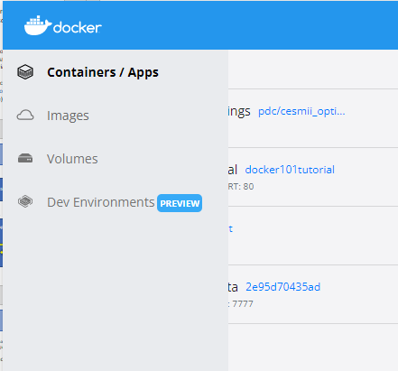
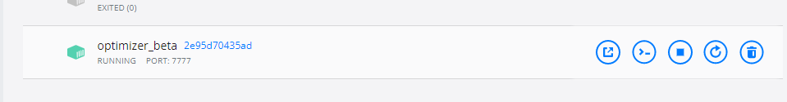
Setup and Use
Setup
1. docker load -i "image.tar"
2. docker run -it -d -p 7777:8888 -v "host_path":"container_path" --name="container name (user define)" image_id /bin/bash -c "jupyter notebook"
Demo:
docker run -it -d -p 7777:8888 -v "C:\Users\Junwei\Desktop\DOE project\Docker test":/home/source --name="optimizer_beta" 2e95d70435ad /bin/bash -c "jupyter notebook"
# The above command is just for setting up.
After setting up the container, you don't need to run the above command any more to use it.
To use the container:
After setting up the container, you can open it with the docker window every time you use it.
sav
Open Jupyter notebook
Open the terminal

