Slide 1
BC-105: Great Escape
A Working Title

Slide 2
Description
This is a single-player 2D platformer in which the player is a lab experiment trying to escape the lab. You can find Modification Gems around the lab that give you special abilities.

Slide 3
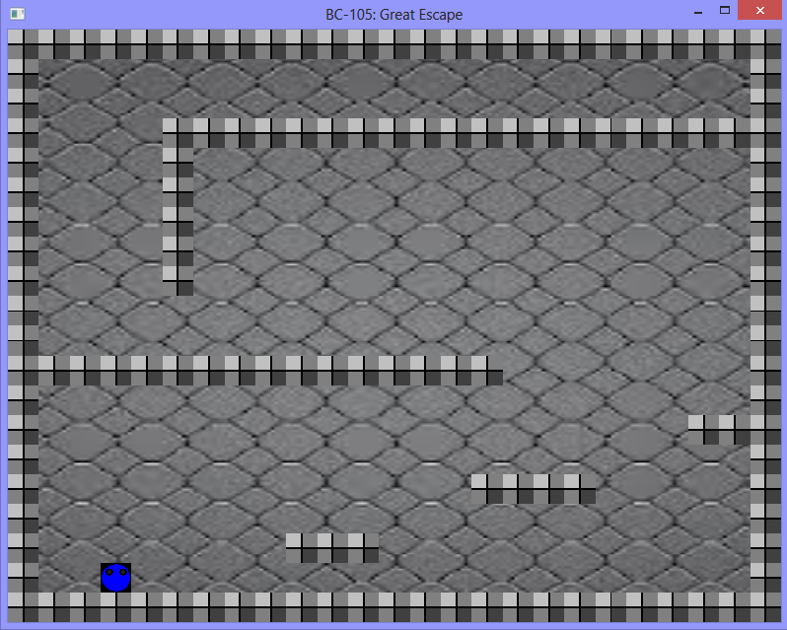
Features
Adorable main character
Puzzles
A lot of levels
Easily Expandable
Beta: Special Powers
Beta: Enemies

Slide 4







Special Powers
Red: Basic form, can run and jump
Blue: Breathes in water. Can swim
Green: Bounces off walls
White: Slowly floats in air, like a hot air balloon
Black: Will sink in water, roll down hills. Can be invincible.
Yellow: Can climb non-hazardous surfaces
Orange: Can grow and shrink
Purple: Throws certain objects

Slide 5


Please Enjoy this Demo

Slide 6
Lessons Learned- Phil
Too much planning can be very bad.
As a Project Lead, you need to be much more active than passive.
Taking three project classes simultaneously can be a burden, and a detriment to one or more of those classes.
Sometimes, using old code can make things more difficult, even if you think things will be easier for it. This is especially true if it’s not YOUR code.

Slide 7
Lessons Learned- JJ
Study preexisting code. Don’t take it for granted.
Learn to adapt to others work styles.

Slide 8
Lessons Learned- James
Start earlier, we almost got burned by it.
Teach other programmers technical requirements

Slide 9

Thanks For Listening

