Slide 1
TON DUC THANG UNIVERSITY • FACULTY OF INFORMATION TECHNOLOGY
Mobile Sensor Architecture & Research Findings
Reactive hardware telemetry, lifecycle safety, and threshold calibration in Jetpack Compose
Authors: Huỳnh Trung Tín (524K0033) & Trần Minh Nghĩa (524K0032)
Advisor: Mr. Dương Hữu Phước • Mobile Apps Development (2026)

Slide 2



01 / PROJECT SCOPE
Core Research Objectives
Motion Telemetry
Ambient Light UI
Velocity Tracking
Tri-axial accelerometer shake detection.
Lux-driven adaptive color interpolation.
Permission-safe GPS speed telemetry.

Slide 3
02 / SYSTEM ARCHITECTURE
Reactive Sensor Pipeline
STEP 01
STEP 02
STEP 03
STEP 04
Hardware Layer
Lifecycle Scope
State Stream
Compose UI
SensorManager & FusedLocation callbacks.
DisposableEffect binds active listeners.
MutableState emits real-time values.
Scoped Material 3 card recomposition.

Slide 4
03 / RESOURCE MANAGEMENT
Lifecycle Resource Safety
•
Scoped Registration: Attaches sensor callbacks on composition entry.
DisposableEffect(context) {
val sensorManager = context.getSystemService(...)
val light = sensorManager.getDefaultSensor(TYPE_LIGHT)
sensorManager.registerListener(
listener, light, SensorManager.SENSOR_DELAY_UI
)
onDispose {
sensorManager.unregisterListener(listener)
}
}
•
Automatic Cleanup: Unregisters listeners inside onDispose block.
•
Leak Prevention: Stops background battery drain upon exit.
•
UI Polling Rate: Samples hardware via SENSOR_DELAY_UI constant.

Slide 5

04 / MOTION ALGORITHM
Tri-Axial Shake Detection
Normalized against Earth gravity (g ≈ 9.81 m/s²)
Exceeding 2.5g triggers AnimatedVisibility banner with 500ms coroutine auto-reset.

Slide 6
05 / ENVIRONMENTAL CONTEXT
Ambient Light Theme Mapping
Lighting Environment | Sensor Threshold | Target Surface | Text Contrast | Animation Spec
Dark Environment | < 50 lx | #121212 (Dark) | White Foreground | 1000ms Tween
Standard Indoor | 50 – 1000 lx | Theme Default | Black Foreground | 1000ms Tween
Bright Sunlight | > 1000 lx | #FFF9C4 (Warm) | Black Foreground | 1000ms Tween

Slide 7
06 / SPATIAL TELEMETRY
Location & Permission Flow
Permission Granted State
Permission Denied Fallback
•
•
Fallback Card: Renders LocationPermissionCard UI prompt.
High Accuracy: Polls FusedLocationProvider every 2000ms.
•
•
Zero Crashes: Bypasses location client registration safely.
Fastest Interval: Caps minimum update floor at 1000ms.
•
•
Dual Scope: Accepts Fine or Coarse permission grants.
Live Velocity: Streams real-time speed in m/s.

Slide 8
CHAPTER 02
Experimental Findings & Evaluation
Empirical testing of UI frame stability, runtime permission resilience, and accelerometer noise calibration.

Slide 9

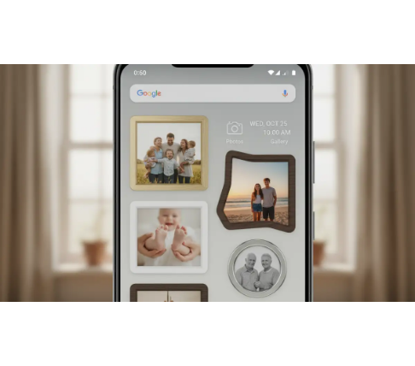
07 / EXPERIMENTAL FINDING 01
Finding 1: UI Responsiveness
•
Scoped Recomposition: High-frequency streams update only telemetry cards.
•
Static Isolation: Educational PPG and compass cards skip redraws.
•
Smooth Interpolation: animateColorAsState blends themes without frame drops.
•
Concurrent Streams: Simultaneous light and motion events render fluidly.

Slide 10
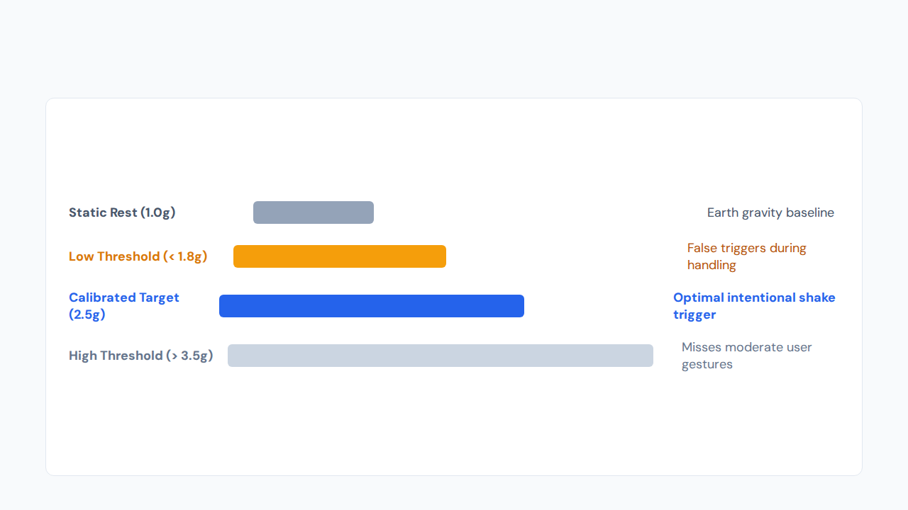
08 / EXPERIMENTAL FINDING 02
Finding 2: Shake Threshold Calibration

Slide 11
09 / KEY BENCHMARKS
Verified System Parameters
2.5g
500ms
1000ms
1–2s
Calibrated Shake Threshold
Shake Banner Auto-Reset
Lux Theme Tween Duration
GPS Velocity Poll Window

Slide 12
CONCLUSION & DISCUSSION
Thank You & Q&A
Lifecycle-bound Compose state management delivers leak-free, responsive mobile sensor telemetry.
Huỳnh Trung Tín (524K0033) • Trần Minh Nghĩa (524K0032)

