Slide 1








PHASE 4 GROUP 1
Tweets
Project
Group Members
Eddy Wiwatsu, David Clement, Grace Wangui, Christine Mutwiri, Salma Jediel and Charity Kilonzi

Slide 2
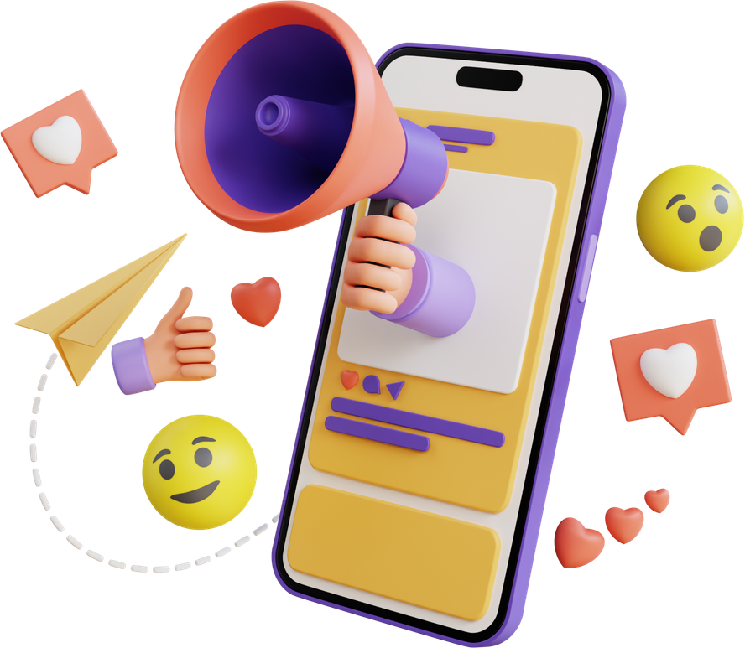
Table of
01
Business Understanding
05
Evaluation
02
Problem Statement
06
Recommendation
03
Stakeholders
07
Thank You
04
Modeling
Content
PHASE 4 GROUP 1

Slide 3


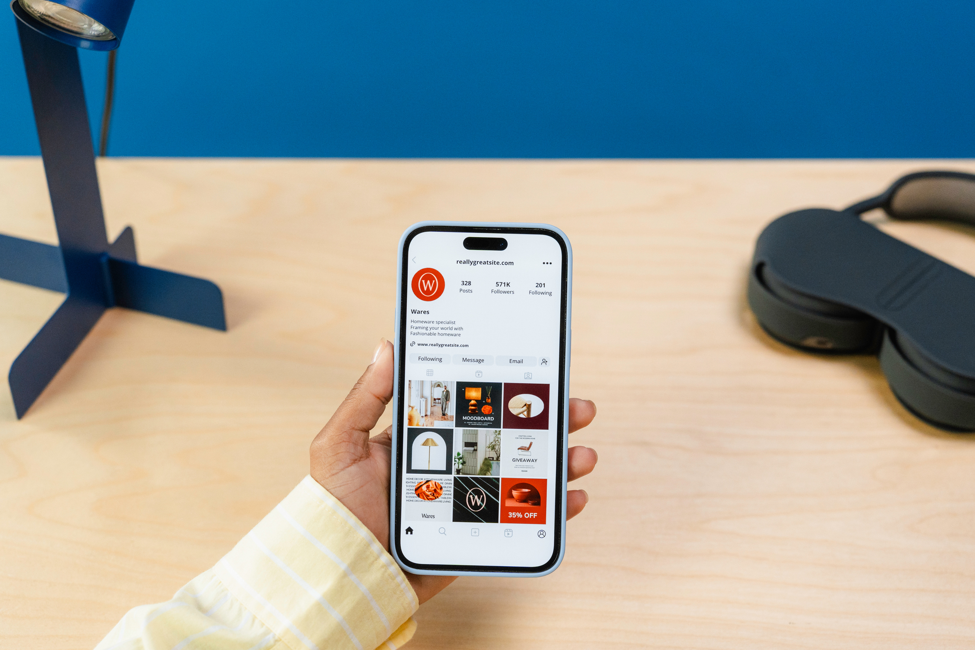
PHASE 4 GROUP 1
Business Understanding
On social media, consumer perceptions of technology products change quickly and openly. As two of the most talked-about tech companies in the world, Apple and Google receive thousands of mentions every day on Twitter. However, neither company nor its partners have a scalable method to track the real-time reception of product launches, updates, or service outages. This amount of tweets cannot be manually reviewed, and traditional survey-based feedback is too slow and too limited to capture natural public opinion.

Slide 4
PHASE 4 GROUP 1
Problem Statement
This project develops a natural language processing model that automatically categorises tweet sentiment as positive, negative, or neutral using a labelled dataset of more than 9,000 tweets about Apple and Google products. The objective is to offer a proof-of-concept sentiment classification system that can assist stakeholders and technology brands in comprehending public opinion at scale without the need for manual review.

Slide 5


Stakeholders
Product Teams
Marketing
Product decisions are directly influenced by the model's output. Without waiting for official feedback cycles, product teams can determine where user pain points exist and which features are resonating by knowing whether sentiment surrounding a product is primarily negative, positive, or neutral.
In real time, marketing must determine whether campaigns and product launches are succeeding. They can instantly assess public opinion by using a sentiment classifier on Twitter data, which enables them to modify messaging if negative sentiment is rising.

Slide 6
Stakeholders
Corporate Communications
Investors
This group oversees brand reputation and public perception. Before it becomes a news story, automated sentiment classification provides them with early warning when negative sentiment surrounding a product or event is growing, so they are able to take action
Investors can use the model's output to track brand sentiment trends over time, giving them an early signal on public perception of Apple and Google products. Shifts in sentiment, especially around major product launches or controversies, can inform investment decisions and risk assessments.

Slide 7


Modeling
Model Selection
Given the text classification nature of this problem, we selected XGBoost as our secondary primary model for several reasons:
Handles sparse data well: TF-IDF features produce sparse matrices, which XGBoost can process efficiently
Robust to class imbalance: Built-in mechanisms to handle imbalanced datasets
High performance: Consistently achieves strong results in text classification tasks
Feature importance: Provides interpretability through feature importance scores

Slide 8
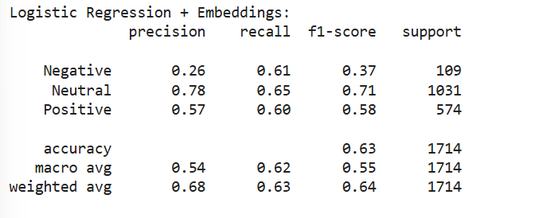


Logistic Regression
Overall accuracy: 63%
Strong performance on Neutral class (F1-score 0.71)
Poor performance on Negative class (F1-score 0.37, precision only 0.26)
Moderate results on Positive class (F1-score 0.58)
Model struggles significantly with identifying negative sentiment

Slide 9
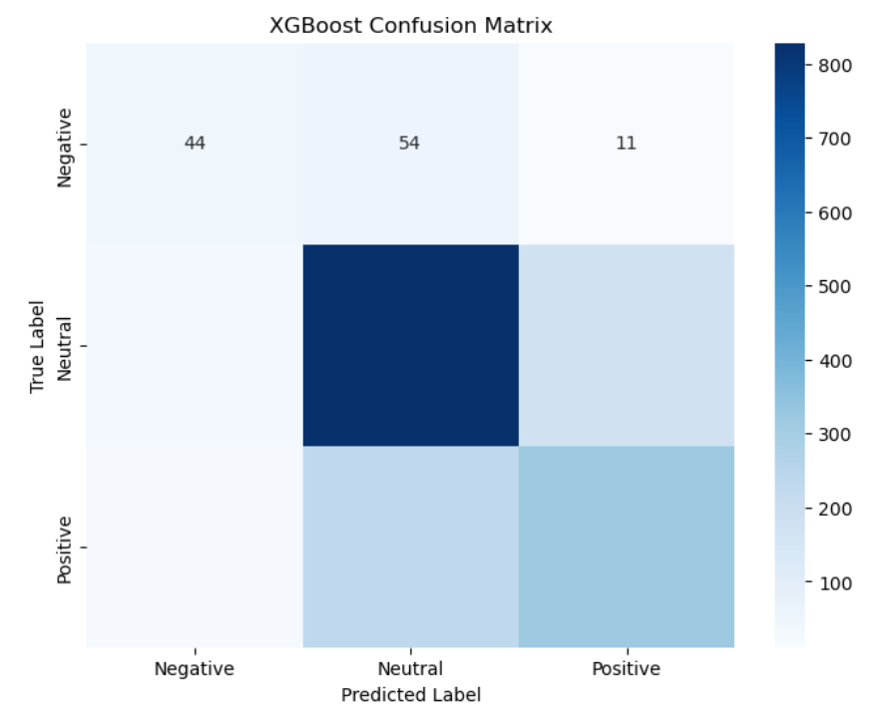
Confusion Matrix
Model correctly classified most Neutral instances (dark blue square)
High confusion between Neutral and Positive classes
Very poor performance on Negative class:
Only 44 correctly predicted as Negative
54 Negative instances misclassified as Neutral
Shows the model has difficulty distinguishing Negative sentiment

Slide 10
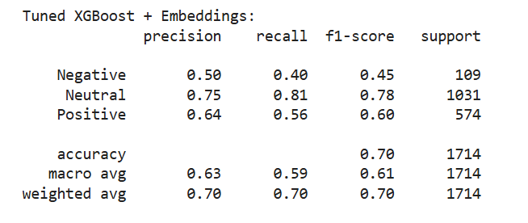
Tuned XGBoost
Overall accuracy improved to 70%
Balanced performance across classes (weighted avg F1-score 0.70)
Neutral class remains strongest (F1-score 0.78)
Noticeable improvement on Negative class (F1-score increased from 0.37 → 0.45)
Better precision and recall balance compared to baseline Logistic Regression

Slide 11


Competitor Analysis
 | Logistic Regression | Brand A
Strength | Higher Negative recall (0.61) hence useful if the priority is catching every negative tweet even at the cost of false alarms, for example in brand reputation monitoring where missing a negative is costly Faster to train, simpler to interpret and deploy Less prone to overfitting on small datasets | Best performance across every aggregate metric accuracy, macro F1, weighted F1 More balanced precision recall tradeoff on the Negative class — less noisy predictions Handles non-linear relationships in the 384 dimensional embedding space through ensemble tree splitting Hyperparameter tuning (max_depth=8, subsample=0.8, colsample_bytree=1.0) reduces overfitting while capturing complex patterns subsample=0.8 introduces regularization that prevents the model from memorising dominant Neutral patterns at the expense of minority classes
Weakness | Severely low Negative precision (0.26) nearly three quarters of its Negative predictions are wrong, making it unreliable in practice Lower overall accuracy (0.63) and macro F1 (0.55) Assumes a linear decision boundary between classes, which is insufficient for the complex non-linear relationships in sentiment embedding space Poor Neutral recall (0.65) suggests it struggles to hold the boundary between Neutral and the other two classes | Lower Negative recall (0.40) still misses 60% of actual negative tweets, which remains a real weakness Computationally expensive grid search took significantly longer than Logistic Regression Less interpretable than Logistic Regression harder to explain individual predictions Still limited by the 109 Negative training samples no model can fully overcome this data scarcity

Slide 12




Recommendations
Since this model covers both Google and Apple, it naturally positions itself as a competitive intelligence tool. Stakeholders should establish sentiment baselines for each brand and track them over time, particularly around shared competitive moments such as annual flagship launches, price changes, or OS updates.
Establish a Sentiment Baseline for Competitive Benchmarking
Invest in Continuous Social Media Monitoring
Both brands should invest in a real-time monitoring pipeline that continuously tracks sentiment across product lines, enabling faster response to emerging negative trends before they escalate.
Twitter sentiment data captured around product launches provides a real-time signal of market reception that traditional market research cannot match in speed. Google and Apple should integrate sentiment trend analysis into their post-launch review process,
Use Sentiment Trends to Inform Product Launch Strategy
Develop Brand-Specific Sentiment Dashboards
develop separate sentiment dashboards per brand and per product line, iPhone vs MacOS vs Google Maps vs Pixel so that product managers can monitor sentiment relevant to their specific area of ownership rather than a broad aggregated score.

Slide 13
Thank
You

