Slide 1
Predicting Customer Churn
SyriaTel • Phase 3 (Business Stakeholder Summary)
Goal: identify customers at high risk of leaving so retention teams can intervene early and reduce lost revenue.
Output: a churn risk score per customer + a recommended outreach threshold.
Prepared for business stakeholders (plain language, action-focused).
Notes:
[Sources]
- All visuals in this deck are generated from the project notebook outputs (see /images).
[/Sources]

Slide 2
Why churn prediction matters
Churn is expensive. Retention is usually cheaper than acquisition, but retention capacity is limited.
What the model enables
How to think about success
• Prioritize outreach to the right customers
• Reduce missed churners
• Avoid wasting offers on low-risk customers
• Measure lift with A/B testing
We focus on catching churners (recall), while keeping the outreach list manageable (precision + volume).
A probability score lets the business choose: “target top 10%” or “target all above threshold X”.
Retention decision = model score + business capacity.
Notes:
[Sources]
- Visuals are project-generated.
[/Sources]

Slide 3
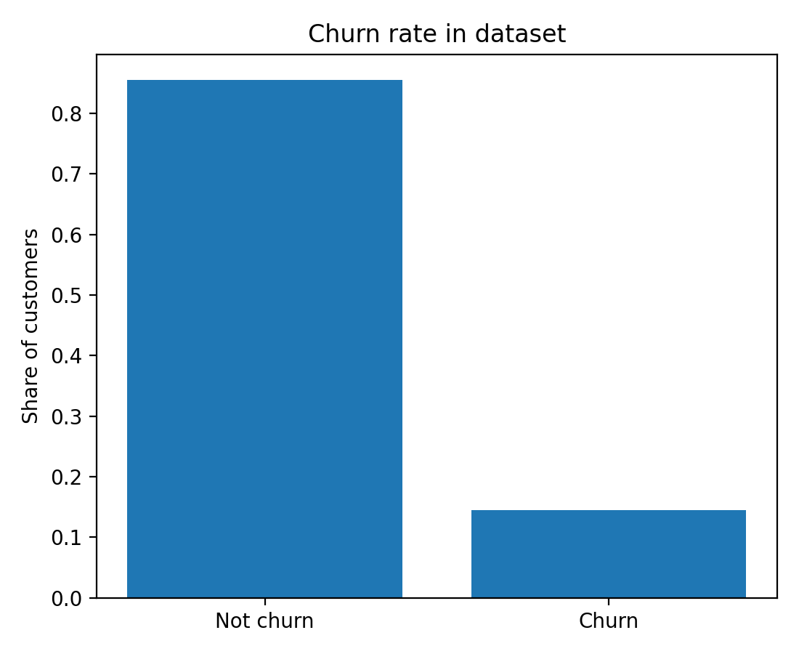
Data used (what we know about each customer)
Dataset: 3,333 customers with usage + service signals and a churn label.
Feature groups
Churn rate
• Call usage (day/eve/night/intl minutes + calls)
• Plans (international plan, voicemail plan)
• Account tenure (account length)
• Customer service calls (service friction signal)
• Geography (state, area code)
We removed obvious identifiers (phone number) and redundant charge fields.
Notes:
[Sources]
- churn_rate.png generated from project notebook outputs.
[/Sources]

Slide 4
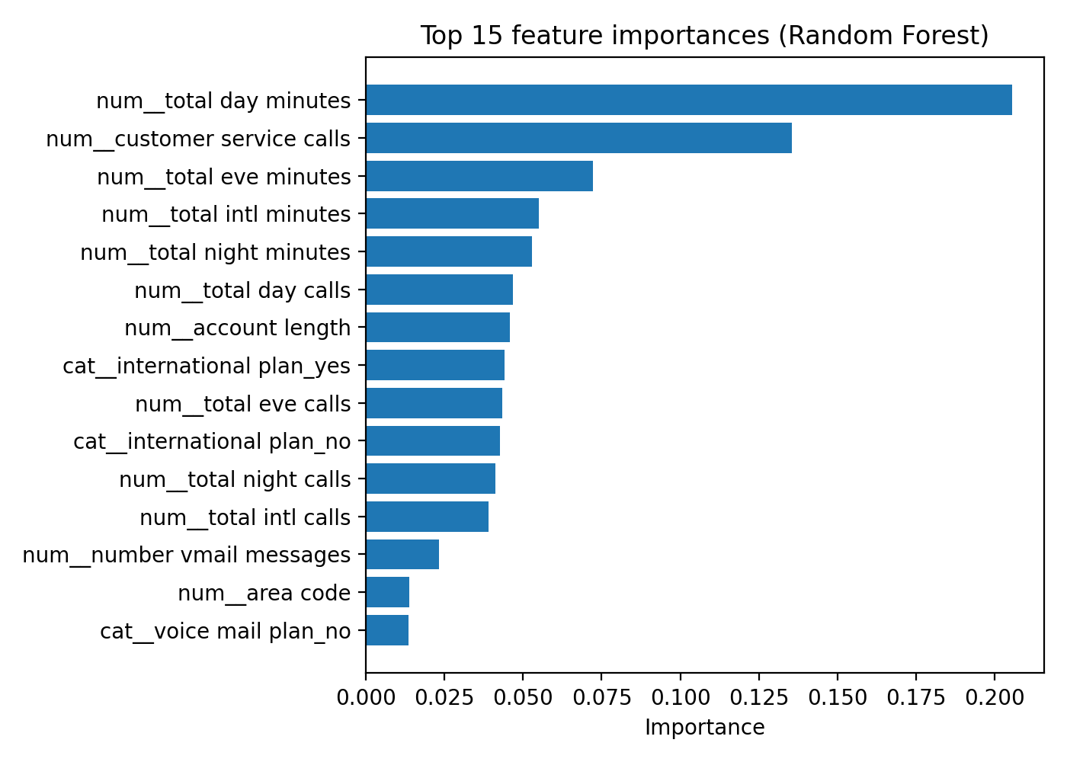
Predictable patterns (what tends to signal churn)
The model learns patterns that correlate with churn. These are signals to investigate—not proof of causation.
Business interpretation (examples):
• Many customer service calls can indicate unresolved issues
• Heavy day/evening usage may reflect price sensitivity or plan mismatch
• Plan features (international/voicemail) can segment risk profiles
Notes:
[Sources]
- feature_importance_rf_top15.png generated from project notebook outputs.
[/Sources]

Slide 5
Method (in plain terms)
We train a model on past customers: it learns which combinations of signals tend to precede churn.
Customer data
Model
Risk score
Usage, plans,
service calls
Learns patterns
from history
Probability of churn
per customer
Decision rule (business-controlled)
Choose a threshold to fit capacity. In this project we use 0.35, which flags ~14% of customers for outreach.
If capacity changes, move the threshold up/down (or target top N% of highest-risk customers).
Key point: the model scores risk; the business chooses the outreach cut-off.
Notes:
[Sources]
- Diagram is original; no external assets.
[/Sources]

Slide 6
Results (test set)
At the chosen threshold, the model catches most churners while keeping the outreach list focused.
Recall (catch churners)
Precision (low waste)
ROC-AUC (ranking quality)
Flagged for outreach
73.6%
74.8%
0.885
14%
How to interpret these numbers
• If 100 customers would churn, the model flags about 73.6% of them in time to intervene.
• Of the customers we flag, about 74.8% truly churn (so offers aren't wasted).
• Only ~14% of customers are flagged at this threshold (manageable outreach).
Notes:
[Sources]
- Metrics computed from project train/test evaluation (see README and notebook).
[/Sources]

Slide 7
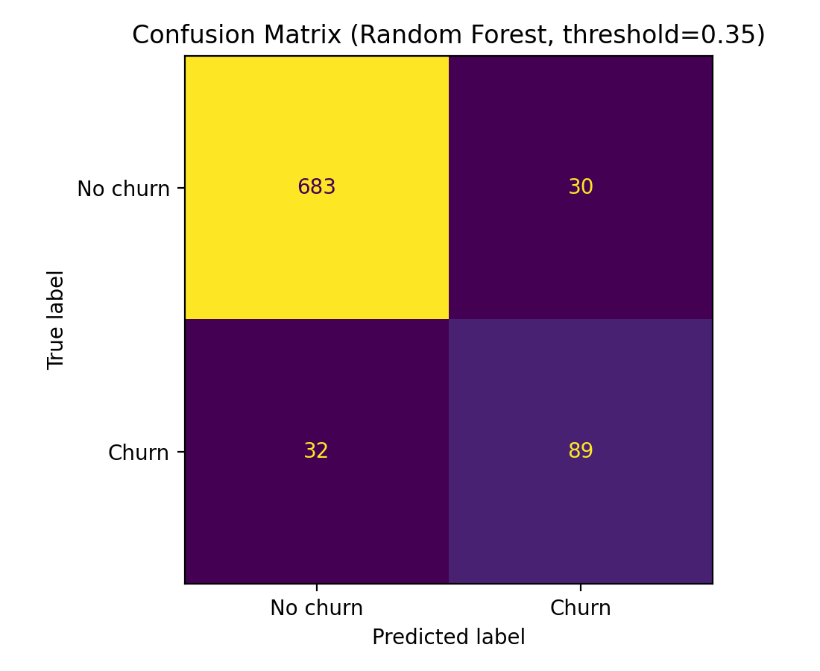
What errors look like (confusion matrix)
This shows how many customers we correctly/incorrectly flag for retention outreach.
In business terms
• True positives: churners we catch (high value)
• False negatives: churners we miss (lost revenue)
• False positives: we contact a non-churner (some cost)
We tune the threshold to reduce missed churners without overloading the retention team.
Notes:
[Sources]
- confusion_matrix_rf_t035.png generated from project notebook outputs.
[/Sources]

Slide 8
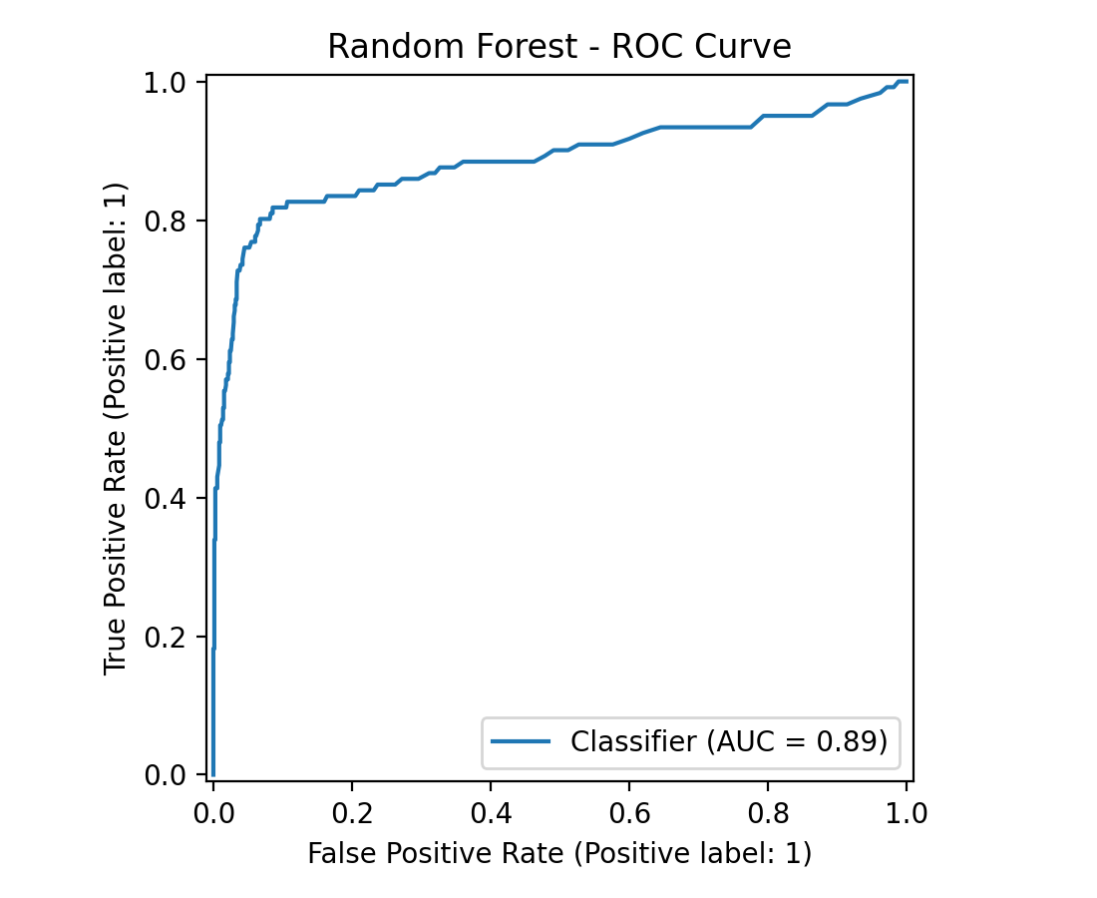
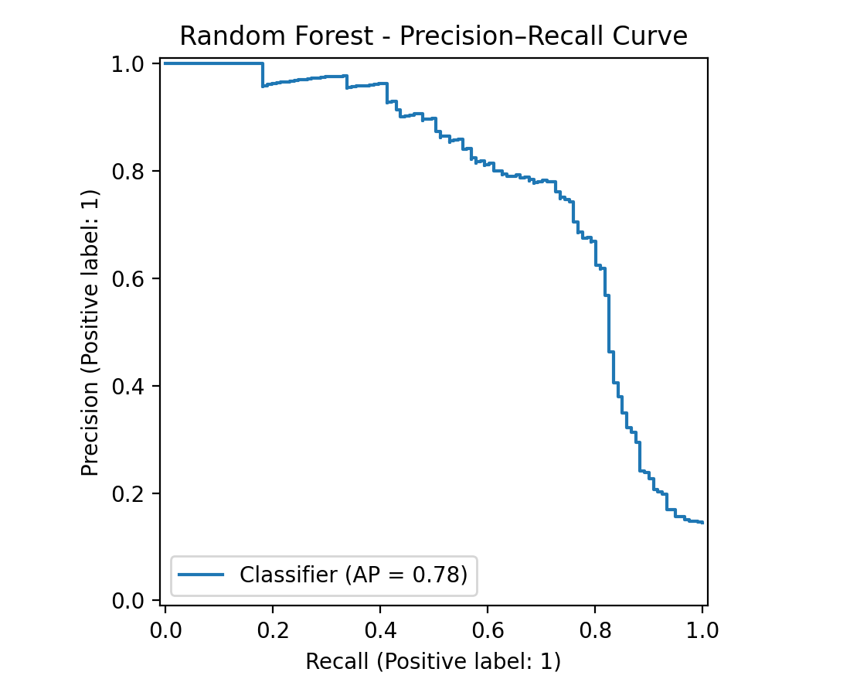
Model quality (ranking performance)
These curves summarize how well the model separates churners from non-churners across all thresholds.
ROC curve
Precision–Recall curve
Notes:
[Sources]
- roc_curve_rf.png and pr_curve_rf.png generated from project notebook outputs.
[/Sources]

Slide 9
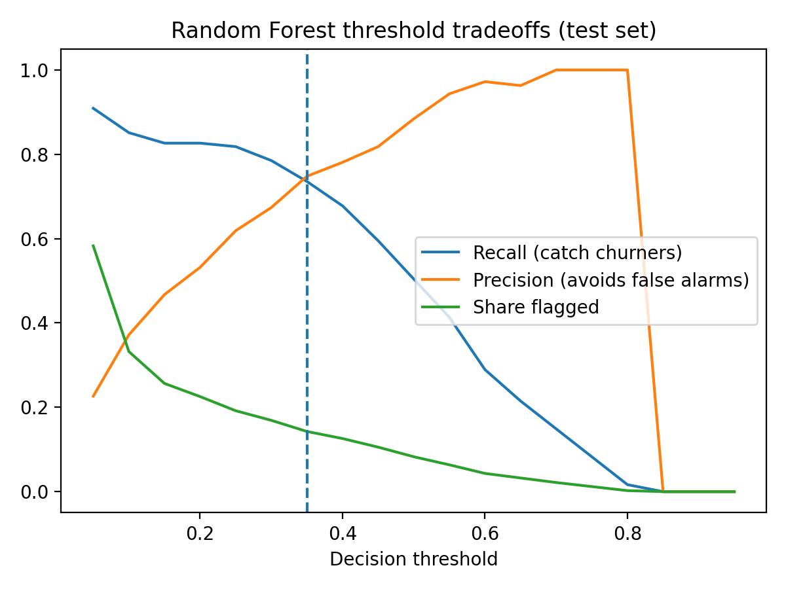
How to operationalize (simple rollout plan)
Recommended workflow
Threshold tradeoff
1) Score customers weekly/monthly
2) Rank by churn probability
3) Select top group (threshold/top N%)
4) Route to retention playbook
5) Track outcomes (saved vs churned)
6) Re-train + monitor drift quarterly
Notes:
[Sources]
- threshold_tradeoff_rf.png generated from project notebook outputs.
[/Sources]

Slide 10
Conclusion & next steps
Bottom line
This model can flag ~14% of customers for outreach while catching ~73.6% of churners (test set).
Next steps
• Pilot the retention list for 4–6 weeks
• Run an A/B test to measure churn reduction
• Build a simple dashboard: flagged volume, conversion, churn saved
• Retrain periodically and monitor performance drift
Limitations (important)
This dataset is a snapshot. Real-world churn changes over time, so production performance should be monitored and the model retrained.
Thank you — questions?
Notes:
[Sources]
- Metrics and visuals are project-generated.
[/Sources]

