Slide 1
Privman
A Library for Partitioning Applications

Slide 2
Unix Permissions
All-or-nothing privilege
  Root or non root
  Need privilege for minor things, like binding to a low port
Results
  Programs run with excessive privilege
  Programs keep privilege for too long
  Any bug in a trusted program compromises the entire system

Slide 3
Hardening techniques
chroot
  Privileged processes can escape jail
Posix.1e capabilities
  Not widely implemented, Still fairly coarse.
MAC systems
  Even less widely used. Correct policy is hard.
Process Partitioning
  Tricky Programming. Must be built in from the ground up.

Slide 4
Process Partitioning
Many small separate programs
  Example: postfix
  Clear interfaces between sections
  Ground up design
Privilege Server
  Example: OpenSSH privsep
  techniques not widely spread
  Policy difficult to specify

Slide 5
Privman
Mirrors libc/POSIX API
  Developers already know the APIs
Hides details of proxying.
Explicit policy configuration
  Program’s privileges easy to see,change.
  Fine grained permissions approach least-privilege.
Userspace, portable library
  Solaris, Linux, FreeBSD, MacOS X

Slide 6
API
Priv-Cat
int main(int argc, char *argv[])
{
char buf[4096];
priv_init("mycat");
for (int i=1; i < argc; ++i) {
/* Privileged use of "fopen" */
FILE *f=priv_fopen(argv[1],"r");
while (( n = fread(buf, 1, 4096, f)) > 0 ) {
fwrite(buf, n, 1, stdout);
}
}
exit(0);
}

Slide 7
Implementation
Splits in priv_init()
  Child continues execution as main program.
  Parent continues as Privman server (monitor)
calls to priv_foo() passed to parent
  Checks against configuration in parent
  Small code footprint (1400 lines)
Can return file descriptors (rights)

Slide 8
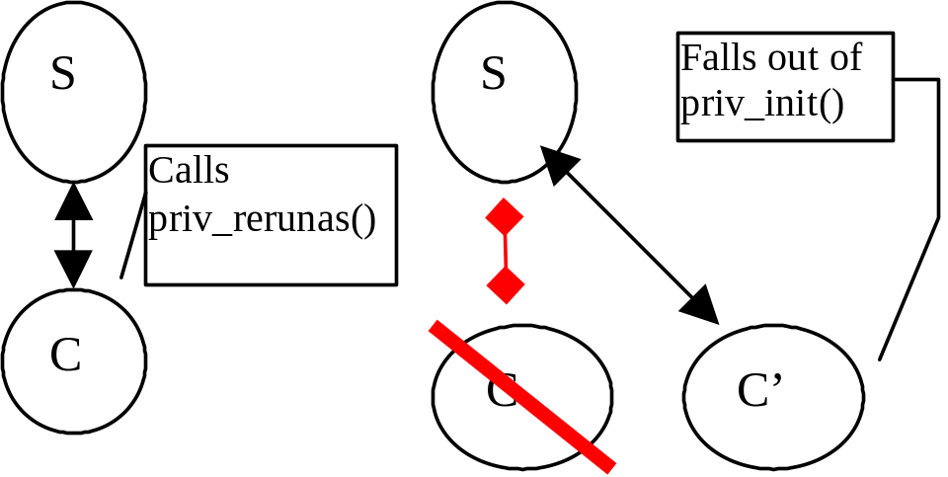
priv_rerunas()
Re-exits from main as a second child.
New child has new uid, chroot jail.
New child has original state.

Slide 9
Policy
Files (read only, read-write, append, unlink)
Bind Ports
rerunas users
PAM
fork, auth_rerunas, etc.

Slide 10
Policy
open_ro {
/var/foolog
/etc/conffile
}
bind {
80
ftp-data
}
rerun {
nobody
}
auth true
auth_allow_rerun true

Slide 11
Annoyances
priv_daemon()
  Needs to be proxied so that the parent detaches from the terminal.
priv_rerunas()
  Only method for uid change.
  ulimit, other process context changes don’t work
priv_pam_why_is_this_proxied()
  If any method from a library requires privilege, may need to proxy all the methods from a library to keep library state consistent.

Slide 12
How To Port
Identify Privilege requirements.
  open
  bind
  setuid
Replace “foo()” with “priv_foo()”
  priv_open, priv_fopen
  priv_bind()
Work out least amount of state required for setuid.

Slide 13
Wu-ftpd
Files
  pid file
  configuration files
  log file
PAM
bind
  ftp
  ftp-data
Daemon

Slide 14
Wu-ftpd
setuid: Minimal state
  Authenticated user
  chroot jail
  home directory
passed pwent string as argument to rerunas
  “user:*:uid:gid::dir:/bin/false”
  Minor changes to allow “start as authenticated user”

Slide 15
Conclusion
Easy to use
Fine Grained Access
Approximates least privilege
Latest release: 0.9.1
http://opensource.nailabs.com/privman

