Slide 1

Scientific Discovery
Molecular biology

Slide 2
Agenda
• About us
• Product overview
• History of molecular biology
• Growth strategy
• Financials
• Summary
Scientific Discovery : Molecular biology
1

Slide 3
Product Overview
What we study and why it matters
Scientific Discovery : Molecular biology
2

Slide 4
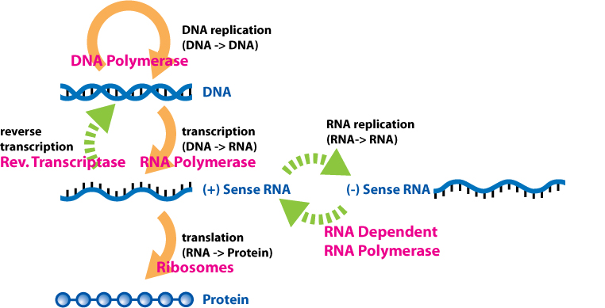
The Central Dogma
Molecular biology seeks to understand the molecular structures and chemical processes underlying biological activity within and between cells. It centers on nucleic acids (DNA, RNA) and proteins, and how they orchestrate replication, transcription and translation.
Scientific Discovery : Molecular biology
3

Slide 5
History of Molecular Biology
Molecular biology sits at the intersection of biochemistry and genetics. As these disciplines evolved through the 20th century it became clear they both sought the molecular mechanisms behind vital cellular functions.
• 1866 - Mendel describes the laws of inheritance
• 1953 - Watson & Crick, the DNA double helix
• 1970s - Recombinant DNA technology
• 2003 - Human Genome Project completed
Scientific Discovery : Molecular biology
4

Slide 6
Three Pillars
• Structure
• X-ray crystallography
• Cryo-EM
• Function
• Enzyme kinetics
• Signalling
• Interactions
• Protein-protein
• Protein-DNA
Scientific Discovery : Molecular biology
5

Slide 7
Growth Strategy - Ansoff Matrix
Market Penetration: sell more existing products to existing markets. The safest approach.
Market Development: bring existing products to new markets and demographics.
Product Development: launch new products to the existing customer base.
Diversification: new products for new markets - highest risk, highest reward.
Scientific Discovery : Molecular biology
6

Slide 8
Financials
Quarter | Revenue | Expenses | Net profit
Q1 | $200,000 | $150,000 | $50,000
Q2 | $220,000 | $155,000 | $65,000
Q3 | $240,000 | $160,000 | $80,000
Q4 | $260,000 | $165,000 | $95,000
Scientific Discovery : Molecular biology
7

Slide 9
Summary
• Positioned for success in a dynamic market.
• Focus on innovation, user experience and strategic growth.
• Commitment to user satisfaction across operations.
• Strong market positioning
• Robust growth strategy
• Innovative product development
Scientific Discovery : Molecular biology
8

