Slide 1
Mapping the Wind
Using Drones for Smarter Wind Energy Decisions
Gihyun Kim
The University of Hong Kong
ghkim1106@connect.hku.hk

Slide 2
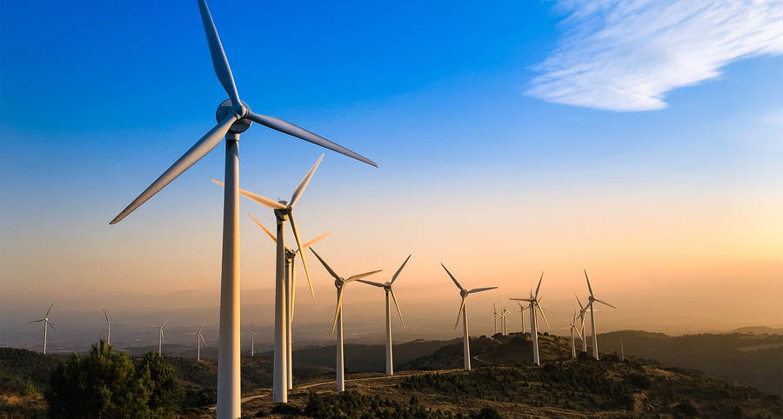
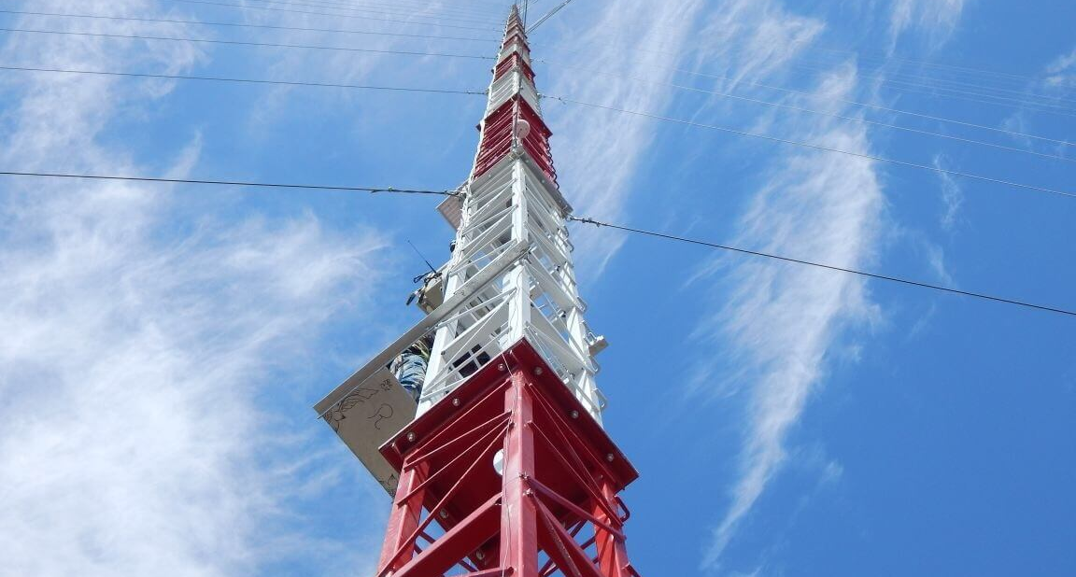

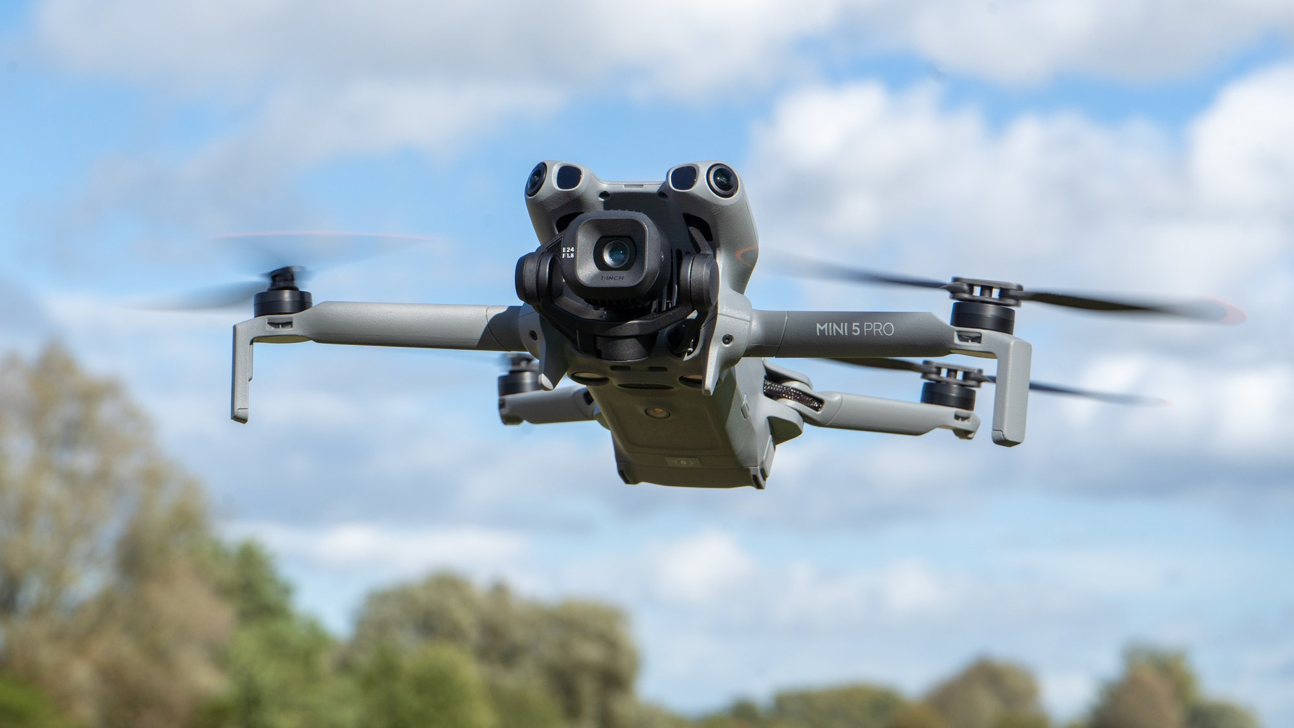
Wind Data Drives Critical Decisions
Wind turbines
Weather masts
Tall buildings
Drones & aviation
(Chu & MIT News Office, 2022)
(Froese, 2017)
(Cheung, 2025)
(Juniper, 2022)
1,299 GW
of wind power installed worldwide, with 165 GW added in 2025 alone
10% → 33%
a 10% error in wind speed becomes a ~33% error in turbine power
Reliable decisions depend on accurate wind measurement
Sources: GWEC, Global Wind Report 2026. Turbine power scales with wind speed cubed (1.1³ ≈ 1.33).

Slide 3




Introduction
Weather masts
Accurate, but fixed in one place
€1–5 m per offshore mast
Lidar & sodar
Blurs sharp changes near the ground
Large drones
Accurate, but heavy and costly
5–30 kg aircraft
Small drones
Portable, but propeller air disturbs readings
>1.3 m/s error in sharp gusts
Research question: can a small, commercial drone measure wind reliably?
Sources: EWEA, Wind Energy – The Facts; Yang et al. 2025; Sriyasawin et al. 2024; Kistner et al. 2024, Atmos. Meas. Tech. 17, 4941.

Slide 4
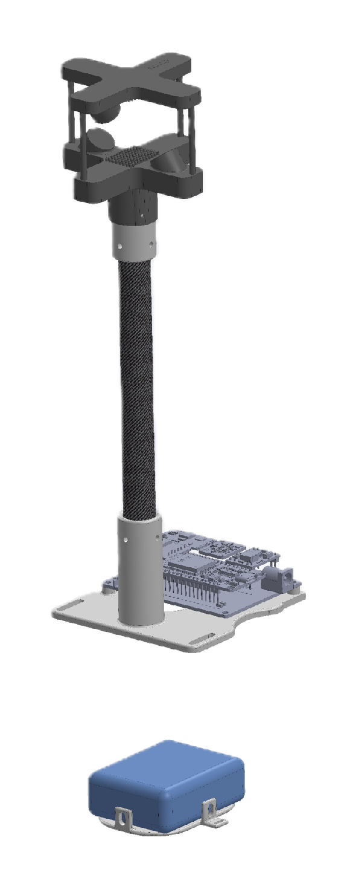
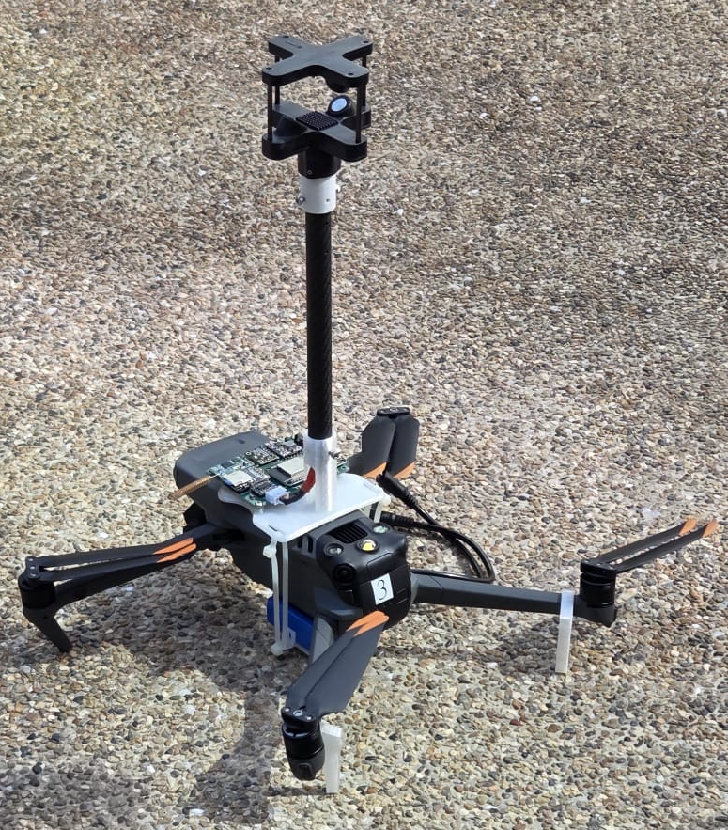
Method
Anemometer
A wind sensor mounted on a short rod above a commercial drone
  Indoor tests (still air): rod lengths compared to find the optimal sensor position
  Outdoor flights: hovers at six heights up to 120 m, in the morning and afternoon
Carbon Fiber Rod
Data Logger
Battery

Slide 5
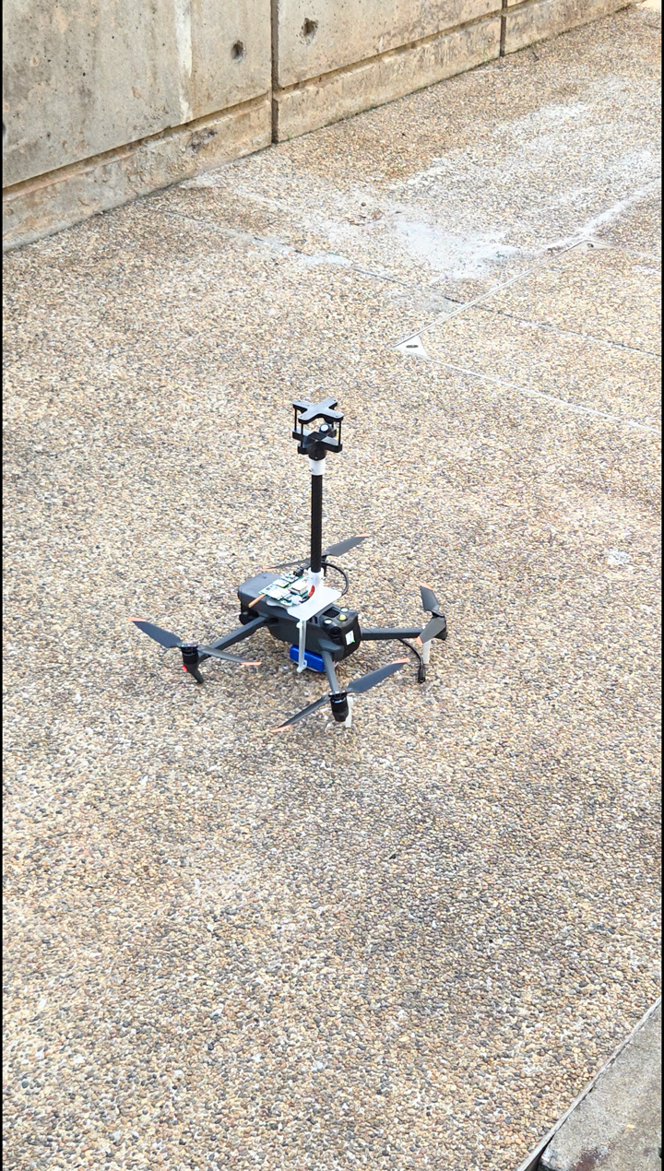
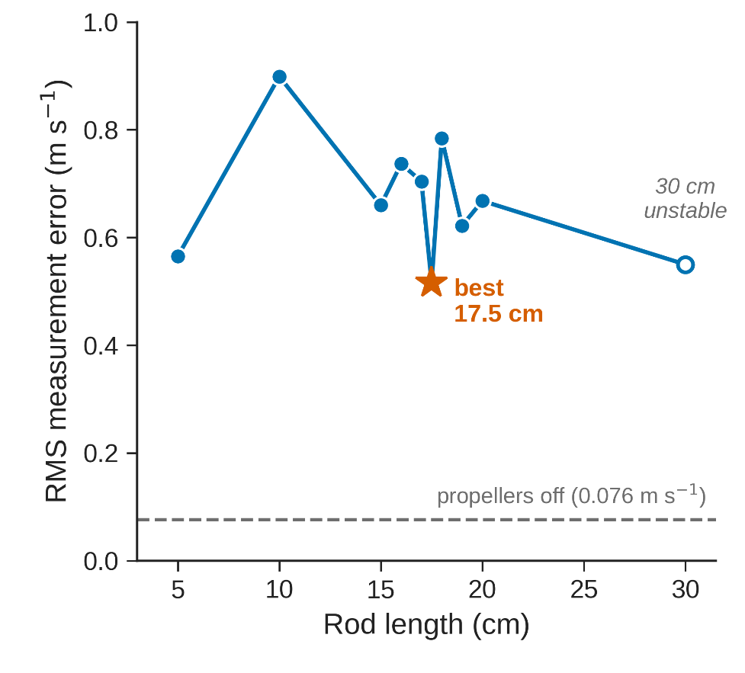
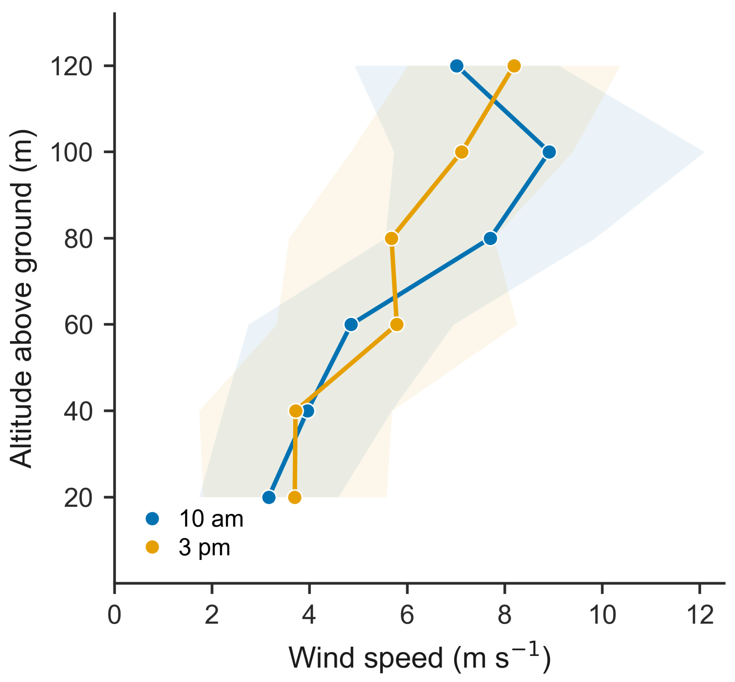
Results
Test flight
1
Rod Length Testing Results
2
Outdoor Wind Testing

Slide 6



Applications
Wind farm siting
Survey candidate sites before building a wind turbine
Urban wind
Measure airflow between city buildings
Turbine wakes
Measure flow behind working turbines

Slide 7
References
Sources
European Wind Energy Association. (2009). Wind energy – the facts: Measurement offshore. https://wind-energy-the-facts.org/measurement-offshore.html
Global Wind Energy Council. (2026). Global wind report 2026. GWEC. https://www.gwec.net
Kistner, J., Neuhaus, L., & Wildmann, N. (2024). High-resolution wind speed measurements with quadcopter uncrewed aerial systems: Calibration and verification in a wind tunnel with an active grid. Atmospheric Measurement Techniques, 17, 4941–4955. https://doi.org/10.5194/amt-17-4941-2024
Sriyasawin, K., Sumpavakup, C., & Sridech, W. (2024). Design and development of multirotor mounted with 3D ultrasonic anemometer for wind assessment. Applied Mechanics and Materials, 923, 11–17. https://doi.org/10.4028/p-vf7qud
Yang, Y., Zhang, Y., Han, T., Xie, C., Liu, Y., Huang, Y., Zhou, J., Sun, H., Zhao, D., Zhang, K., & Li, S.-M. (2025). A correction algorithm for rotor-induced airflow and flight attitude changes during three-dimensional wind speed measurements made from a rotary unoccupied aerial vehicle. Atmospheric Measurement Techniques, 18, 3035–3050. https://doi.org/10.5194/amt-18-3035-2025
Images
Cheung, C. (2025, July 29). Hong Kong ranked as the city with the most skyscrapers in the world. Time Out Hong Kong; Time Out. https://www.timeout.com/hong-kong/news/hong-kong-has-the-most-skyscrapers-in-the-world-with-asian-cities-dominating-the-top-10-072925
Chu, J., & MIT News Office. (2022, December). A healthy wind. MIT News | Massachusetts Institute of Technology. https://news.mit.edu/2022/wind-health-impact-1202
Froese, M. (2017, July 13). RK Systems designs India’s tallest lattice met tower. Windpower Engineering & Development. https://www.windpowerengineering.com/rk-systems-designs-indias-tallest-lattice-met-tower/
Juniper, A. (2022, October 24). The best camera drones in 2026: take your photography & video to the skies. Digital Camera World. https://www.digitalcameraworld.com/buying-guides/the-10-best-camera-drones

Slide 8

          Thank you!
          Acknowledgements: Prof. C. H. Liu and the Faculty of Engineering,
          The University of Hong Kong

