Slide 1
Word Frequency of Works by William Shakespeare and Homer

Slide 2
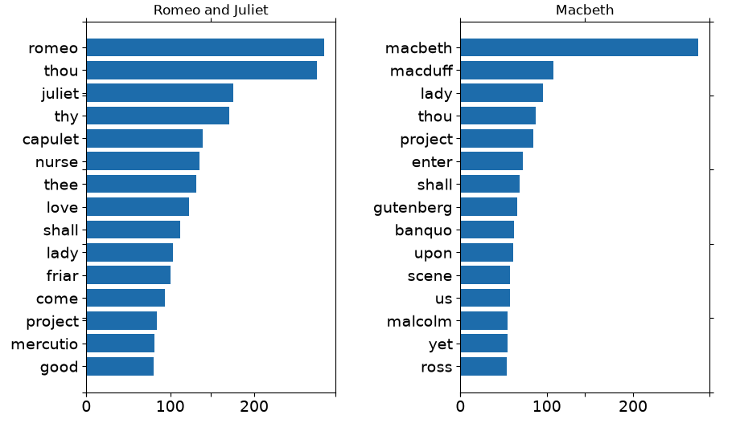
Romeo and Juliet VS Macbeth by William Shakespeare
In both works, Shakespeare uses the character(s) name(s) most often
He also consistently referred back to the overall theme of love (Romeo and Juliet) and house/home (Macbeth)
Other than pronoun words, ‘shall’ is a part of the top 15 words

Slide 3
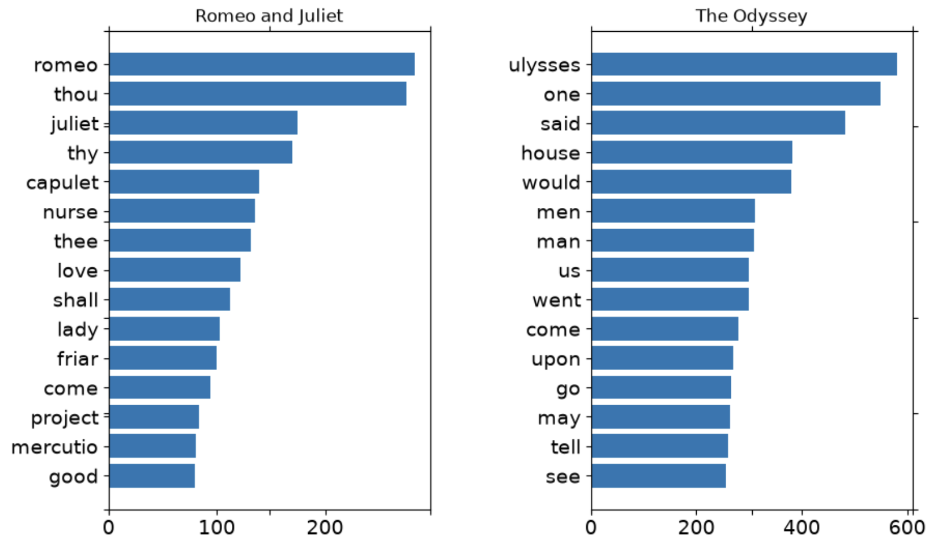
Romeo and Juliet by William Shakespeare vs The Odyssey by Homer
Shakespeare uses more singular personal pronouns (‘thou’, ‘thy’)
Homer uses more group oriented identification (‘men’, ‘man’, ‘us’)
Both use character names the most in their respective works

Slide 4
Shakespeare vs Homer Summary
SIMILARITIES
Use words to reference back to the theme often
Focus on character names rather than just point of views
DIFFERENCES
Homer refers to people in a general more group-like way
Shakespeare’s works are more plays so the common words are more aligned with dialogue whereas Homer is more associated with storytelling

Slide 5
Limitations of This Data
The stop words are the default of the NLTK library so the equivalent of those words in Old English are not filtered out
Could have also considered what the distribution of word frequency would look like if words specific to the theme are filtered out to see a true comparison between each work and authors

Slide 6
Different words but similar intentions

