Slide 1
Data Visualization
EPI 514 2025 Sp Julie Kim

Slide 2
Agenda
Principles of data visualization
Introduction to ggplot2 package
Exercise using ggplot2 package
Notes:
The slides were created using Rmarkdown and its replication material is available on Github for any replication exercise: https://github.com/kim-julie/epi_514_data_viz/tree/main

Slide 3
Principles of data visualization
Five principles of scientific visualization laid out by Edward Tufte (1983)
Avoid chartjunk
Maximize data, minimize ink and space
Avoid distortions, minimize lie factors
Show the data and facilitate comparison
Small multiples or repetitions of basic design

Slide 4
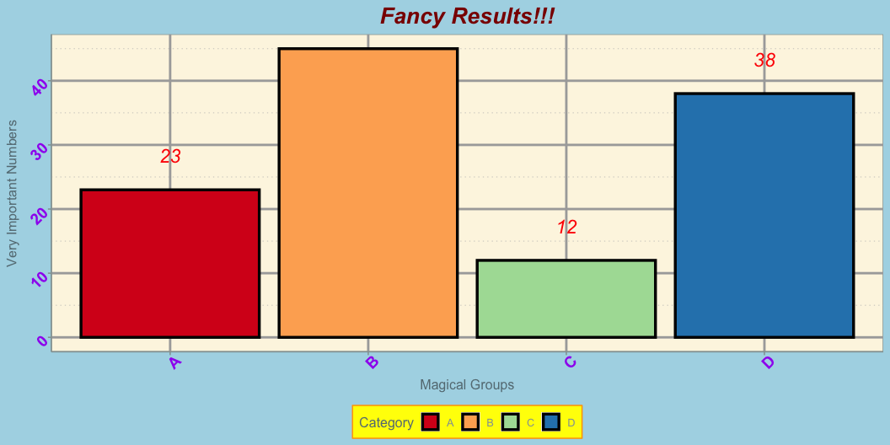
What are the problems?
Based on the principles by Edward Tufte, discuss potential problems of this chart with your table members

Slide 5
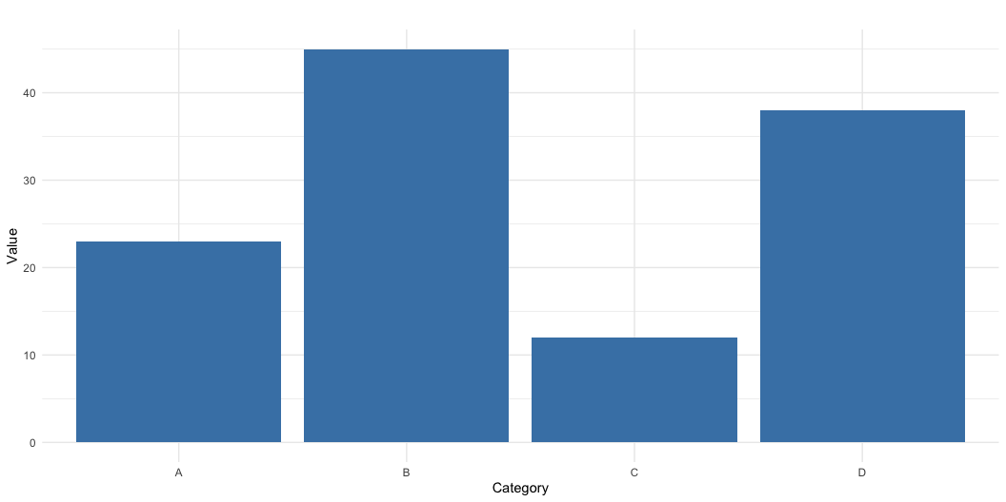
What can be the solution?
Focus on the main message

Slide 6
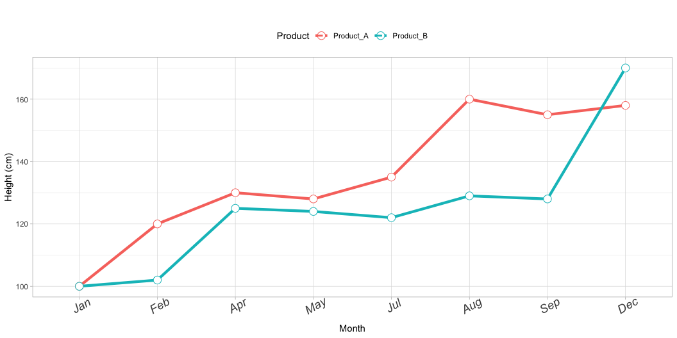
What are the problems?
Based on the principles by Edward Tufte, discuss potential problems of this chart with your table members

Slide 7
Principles of data visualization
Additional advice:
Be NICE to your viewers - never assume that people will know what you’re trying to show
ALWAYS include axis titles in plain text (not variable name) and it’s scale
Include detailed captions - captions should be self-explanatory
Think about the morale of the story before you plot.
Many journals only allow 4-6 tables/figures combined in the main text - be strategic about what you want to show.
Visualization is a way of simplifying
While some levels of granularity are important for readers to know, figure should be understandable.

Slide 8
Visualization for publication
Format
4-5 figures and tables: Make sure you reference all figures/tables in the main text.
It might be something that people only read other than your titles - think about the priorities.
Most journals want vectorized image (vectorized pdf, svg, eps, adobe illustrator)
jpeg/jpg, png, etc are sometimes permitted for initial submission, but eventually vectorized image can be required.

Slide 9
Visualization for publication
At some point of your review process, the reviewers or editors will comment about image quality, captions, choice of colors and axis labels/scale/titles.
If image quality is too low, it might appear blurry in your paper.
Provide details for caption
Add details even if you included in your main text.
Colors
it’s not about making it pretty.
Also consider “intuitiveness” of colors.
Axis labels, scale and titles should be detailed as long as it doesn’t hurt your figure
If using multiple panes in one figure, be consistent with the scales
Many journals now allow supplementary materials
Any sensitivity analysis or background analysis (e.g. describing the sample that is not directly related to your main analysis) typically goes into supplementary figures.
Validation (e.g. comparison to other data sources) also goes into supplementary materials.

Slide 10
Introduction to ggplot2 package
Popular R package for data visualization, particularly well-known for its implementation of the “Grammar of Graphics.”
High formatting flexibility
WIDE variety of visualization options (from scatter plots to maps and 3D plots)

Slide 11
Installing and loading ggplot2
Installation
if (!require(ggplot2) install.packages('ggplot2'))
Load package
library(ggplot2)
ggplot2 is part of tidyverse package
library(tidyverse)

Slide 12
Example - Loading data
Let’s dive directly into some examples. We will use our data after cleaning from the individual assignments for this exercise.
library(tidyverse)
Warning: package 'purrr' was built under R version 4.3.3
library(ggpubr) brfss <- read_csv("/Users/sojink/Documents/GitHub/epi_514_data_viz/data/individualhw_post.csv") # Change directory and filename to your choice

Slide 13
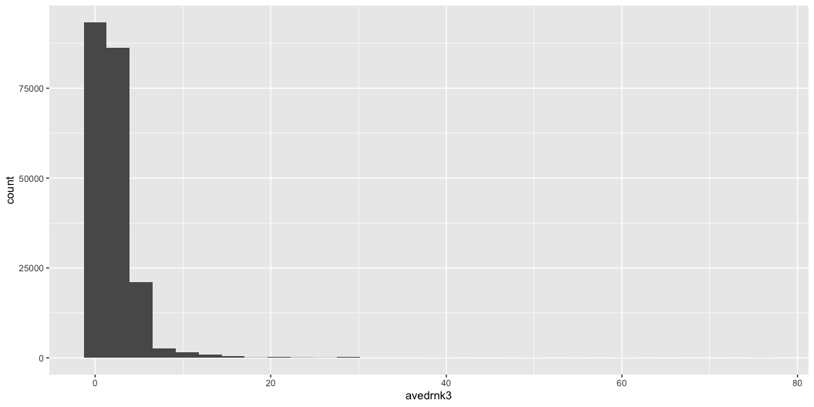
Plotting - Histogram
Say we want to look at the distribution of avedrnk3 variable in our data.
Do you see any problem here?
ggplot(data = brfss, aes(x = avedrnk3))+ geom_histogram()

Slide 14
Plotting - Histogram
Many of us might know what avedrnk3 means, but your readers/preceptors don’t know what it means.
We will specify axis titles using labs layer.
Option 1
If you put data and mapping arguments into ggplot(), it will automatically inherit to all layers below (geom_histogram in this case).
ggplot(data = brfss, mapping = aes(x = avedrnk3))+ geom_histogram()+ labs(x = "Number of drinks per day", y = "Count of individuals", title = "Distribution of average alcoholic drinks per day (on days when drank) in past 30", subtitle = "Source: BRFSS 2021")

Slide 15
Plotting - Histogram
Many of us might know what avedrnk3 means, but your readers/preceptors don’t know what it means.
We will specify axis titles using labs layer.
Option 2
Both data and mapping arguments can go into geometry argument (geom_histogram in this case) too
But note that this will only apply to the geometry you’re specifying (more examples coming)
ggplot()+ geom_histogram(data = brfss, mapping = aes(x = avedrnk3))+ labs(x = "Number of drinks per day", y = "Count of individuals", title = "Distribution of average alcoholic drinks per day (on days when drank) in past 30", subtitle = "Source: BRFSS 2021")

Slide 16
Plotting - Histogram
It’s difficult to read some numbers in the axis because the numbers are too sparse.
We will add more numbers using:
scale_x_continuous: for x-axis labels
scale_y_continuous: for y-axis labels
argument: breaks to specify values for axis breaks
ggplot()+ geom_histogram(data = brfss, mapping = aes(x = avedrnk3))+ labs(x = "Number of drinks per day", y = "Count of individuals", title = "Distribution of average alcoholic drinks per day (on days when drank) in past 30", subtitle = "Source: BRFSS 2021")+ scale_x_continuous(breaks = seq(0, 80, 5))+ scale_y_continuous(breaks = seq(0, 90000, 10000))

Slide 17
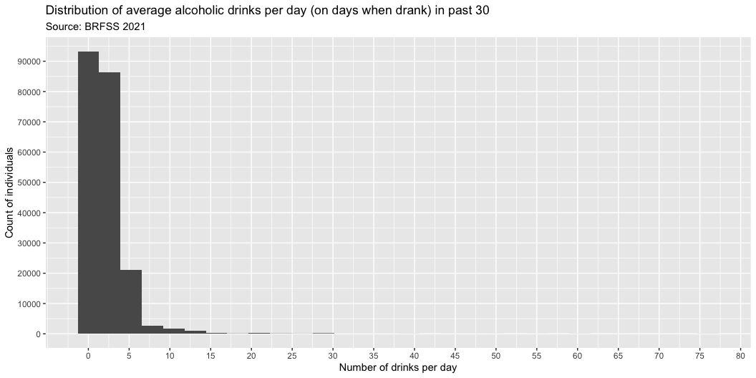
Plotting - Histogram

Slide 18
Plotting - Histogram
Based on what we know about avedrnk3 variable, we would rather want to look at closer look at numbers between 0-20, instead of 0-20
We will add more arguments in:
scale_x_continuous: for x-axis labels
argument: limits to specify values for axis limits
ggplot()+ geom_histogram(data = brfss, mapping = aes(x = avedrnk3))+ labs(x = "Number of drinks per day", y = "Count of individuals", title = "Distribution of average alcoholic drinks per day (on days when drank) in past 30", subtitle = "Source: BRFSS 2021")+ scale_x_continuous(breaks = seq(0, 20, 5), limits = c(0, 20))+ scale_y_continuous(breaks = seq(0, 90000, 10000))

Slide 19
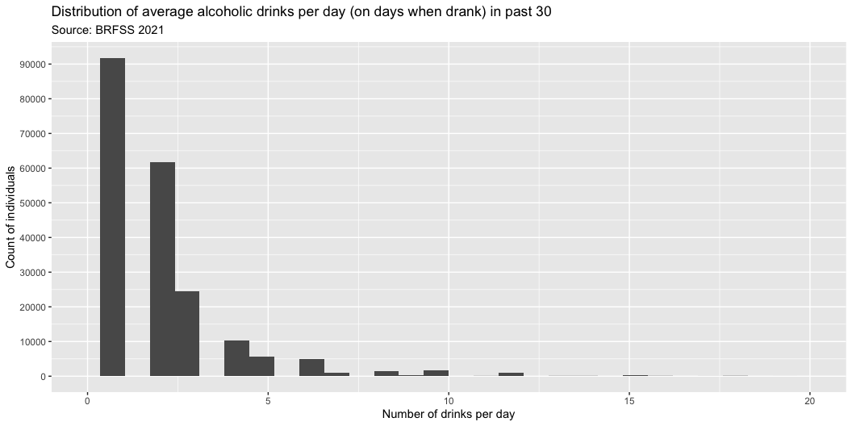
Plotting - Histogram

Slide 20
Plotting - Scatter
For this course scatter plots do not really make sense - why?
But we’ll still learn how to do this
Now, we will start looking at the relationship between variables.
Say we want to look at the relationship between avedrnk3 and marijan1.
Any problems here?
ggplot(data = brfss, mapping = aes(x = avedrnk3, y = marijan1))+ geom_point()+ labs(x = "Average alcoholic drinks per day", y = "Days of Marijuana use")
Warning: Removed 369986 rows containing missing values or values outside the scale range (`geom_point()`).

Slide 21
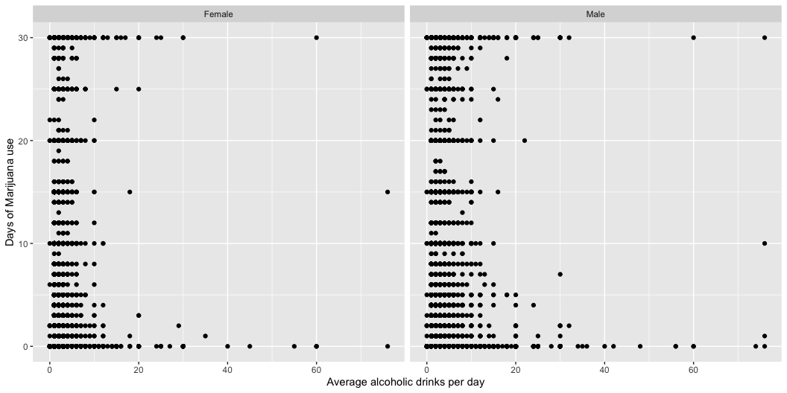
Plotting - Scatter

Slide 22
Plotting - Scatter
Now you wonder: how old are they?
One option to do this could be repeating faceting but also by age.
ggplot(data = brfss, mapping = aes(x = avedrnk3, y = marijan1))+ geom_point()+ labs(x = "Average alcoholic drinks per day", y = "Days of Marijuana use")+ facet_wrap(sexvar~age_g, ncol = 6)
Warning: Removed 369986 rows containing missing values or values outside the scale range (`geom_point()`).

Slide 23
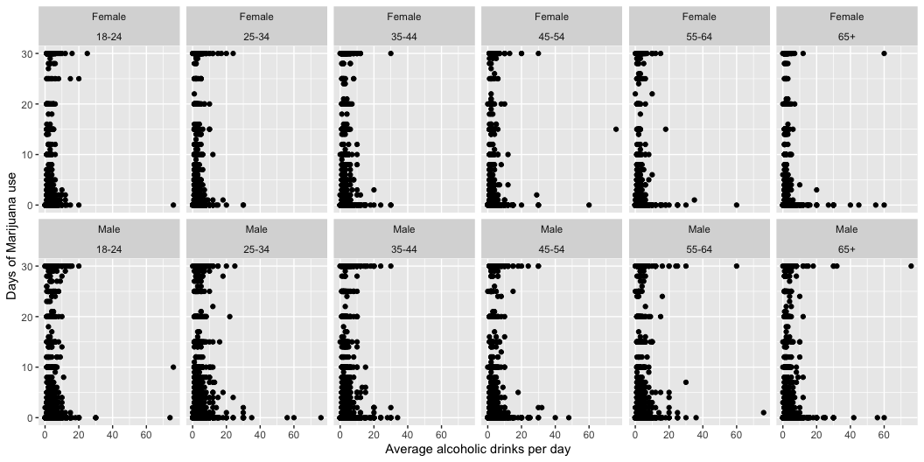
Plotting - Scatter

Slide 24
Plotting - Scatter
Now you wonder: how old are they?
Another option could be using the color instead of creating 12 panes of plots.
ggplot(data = brfss, mapping = aes(x = avedrnk3, y = marijan1, col = age_g))+ geom_point()+ labs(x = "Average alcoholic drinks per day ", y = "Days of Marijuana use")+ facet_wrap(~sexvar)
Warning: Removed 369986 rows containing missing values or values outside the scale range (`geom_point()`).

Slide 25
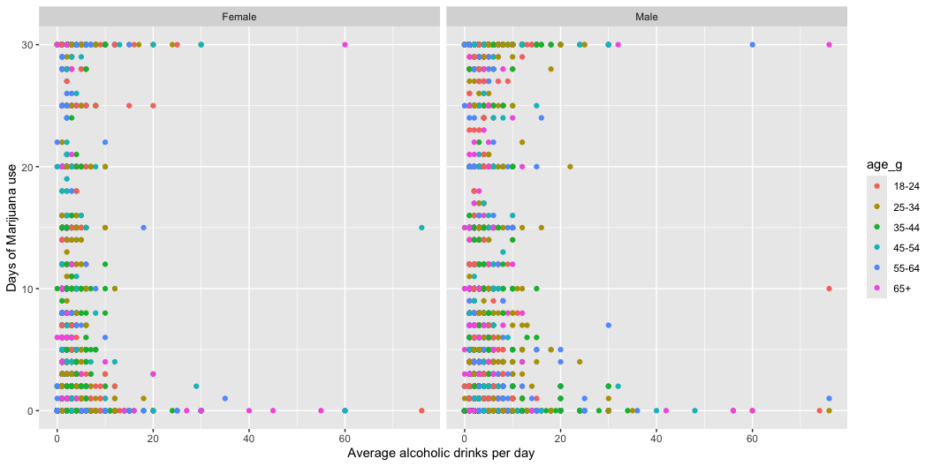
Plotting - Scatter

Slide 26
Plotting - Scatter
If the journal your submitting to required black/white-only figures, you can do this using the shape of the points instead of colors.
ggplot(data = brfss, mapping = aes(x = avedrnk3, y = marijan1, shape = age_g))+ geom_point()+ labs(x = "Average alcoholic drinks per day", y = "Marijuana use")+ facet_wrap(~sexvar)
Warning: Removed 369986 rows containing missing values or values outside the scale range (`geom_point()`).

Slide 27
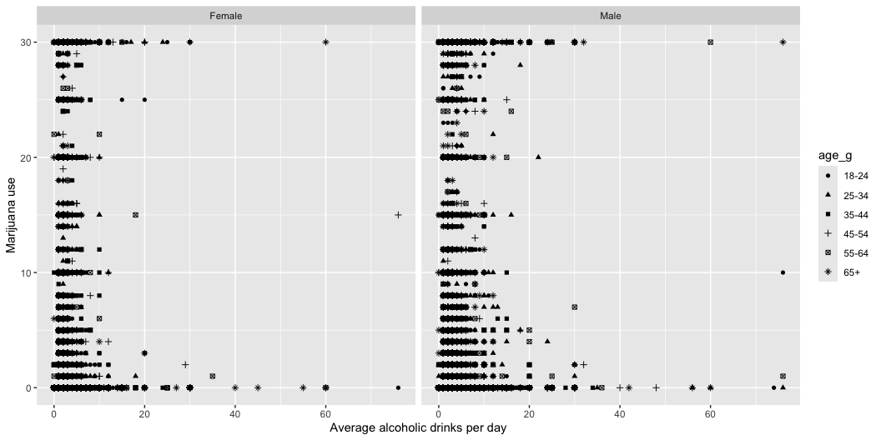
Plotting - Scatter

Slide 28
Plotting - Scatter
One last thing - it’s actually pretty difficult to read the axis titles and texts because the font size is too small.
ggplot(data = brfss, mapping = aes(x = avedrnk3, y = marijan1, shape = age_g))+ geom_point()+ labs(x = "Average alcoholic drinks per day", y = "Marijuana use")+ facet_wrap(~sexvar)+ theme(axis.title = element_text(size = 18), axis.text = element_text(size = 15), strip.text = element_text(size = 15)) # for facet titles
Warning: Removed 369986 rows containing missing values or values outside the scale range (`geom_point()`).

Slide 29
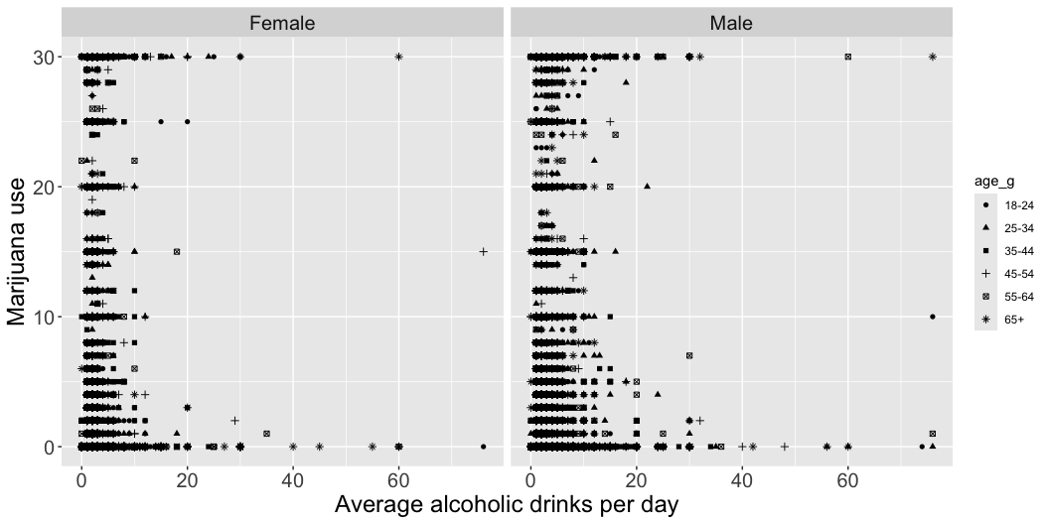
Plotting - Scatter

Slide 30
Which one did you like the most?

Slide 31
Plotting - Line
Use geom_line() instead of geom_point() for line plots.
Helpful for visualizing time-trends or relationships.
Example:
ggplot(data = brfss, mapping = aes(x = avedrnk3, y = marijan1, shape = age_g))+ geom_line()+ labs(x = "Average number of drinking days", y = "Marijuana use")+ facet_wrap(~sexvar)+ theme(axis.title = element_text(size = 18), axis.text = element_text(size = 15), strip.text = element_text(size = 15)) # for facet titles

Slide 32
Plotting - Bars
Histogram is one type of bar graph that shows frequency of observations.
Bar graph are especially helpful for binary/categorical variables.
Scatter and line plots might not work well for categorical variables.
What is the distribution of race by gender?
Stacking
By default, geom_bar would set position = 'stack':
ggplot(brfss)+ geom_bar(aes(x = sexvar, fill = imprace))+ labs(x = "Sex", y = "Count")

Slide 33
Plotting - Bars
Histogram is one type of bar graph that shows frequency of observations.
Bar graph are especially helpful for binary/categorical variables.
Scatter and line plots might not work well for categorical variables.
What is the distribution of race by gender?
Dodging
We can also put it side-by-side:
ggplot(brfss)+ geom_bar(aes(x = sexvar, fill = imprace), position = 'dodge')+ labs(x = "Sex", y = "Count")

Slide 34
Data wrangling to visualization
One advantage of ggplot2 is that it’s highly flexible.
You can directly plot wrangled data without having to save it to another object.
In this example, we will visualize the proportion of race (imprace) in each sex (sexvar).
First, wrangle our individual-level data to show proportion of each race by sex.
brfss%>% group_by(sexvar, imprace)%>% summarise(num = n())%>% # calculate count by sex and race ungroup()%>% group_by(sexvar)%>% mutate(denom = sum(num), # calculate count for all race by sex proportion = round(100 * num/denom,2))%>% knitr::kable()
sexvar | imprace | num | denom | proportion
Female | American Indian/Alaskan Native, Non-Hispanic | 3954 | 234883 | 1.68
Female | Another race, Non-Hispanic | 7684 | 234883 | 3.27
Female | Asian, Non-Hispanic | 5374 | 234883 | 2.29
Female | Black, Non-Hispanic | 19593 | 234883 | 8.34
Female | Hispanic | 20467 | 234883 | 8.71
Female | White, Non-Hispanic | 177811 | 234883 | 75.70
Male | American Indian/Alaskan Native, Non-Hispanic | 3456 | 203810 | 1.70
Male | Another race, Non-Hispanic | 8000 | 203810 | 3.93
Male | Asian, Non-Hispanic | 6183 | 203810 | 3.03
Male | Black, Non-Hispanic | 13539 | 203810 | 6.64
Male | Hispanic | 18221 | 203810 | 8.94
Male | White, Non-Hispanic | 154411 | 203810 | 75.76

Slide 35
Data wrangling to visualization
Then, we use information from wrangled data for ggplot.
Note that we’re using stat = 'identity' so that we’re plotting the value of a variable, instead of count of rows in the data.
brfss%>% group_by(sexvar, imprace)%>% summarise(num = n())%>% # calculate count by sex and race ungroup()%>% group_by(sexvar)%>% mutate(denom = sum(num), # calculate count for all race by sex proportion = num/denom)%>% ggplot()+ geom_bar(aes(x = sexvar, y = 100*proportion, fill = imprace), stat = 'identity')

Slide 36
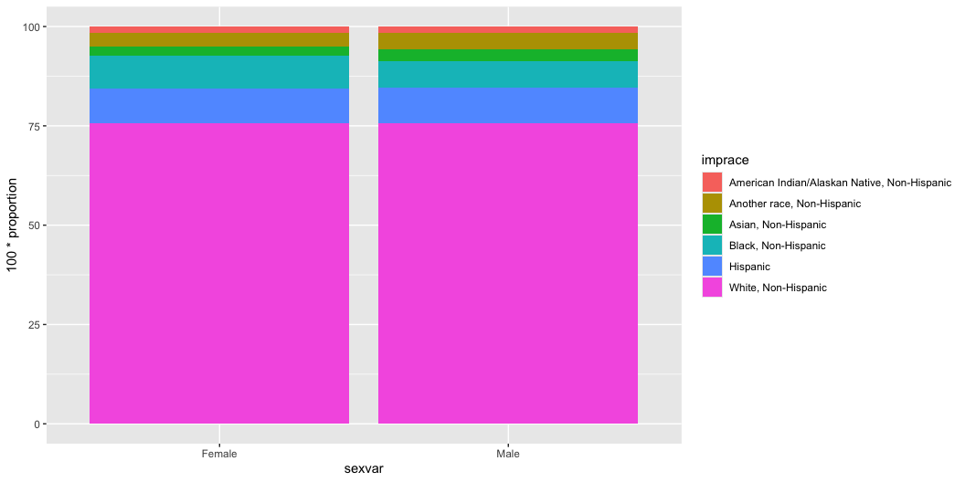
Data wrangling to visualization

Slide 37
Plotting - Figure formatting
You may now want to polish your design a little bit.
There are A LOT of formatting that needs to/can happen, but the important thing is that the purpose of plotting is to facilitate communication.
No shortcut: Trial-and-error and exposing yourself to various ways of plotting are really the keys to become proficient.
Which one makes more sense?

Slide 38
Plotting - Figure formatting
Pastel2
ggplot(brfss)+ geom_bar(aes(x = sexvar, fill = imprace), colour = 'grey30')+ labs(x = "Sex", y = "Count", title = "Option 1")+ scale_fill_brewer(palette = 'Pastel2', name = "Race")+ theme_bw()+ theme(legend.position = 'right')

Slide 39
Plotting - Figure formatting
Blues
ggplot(brfss)+ geom_bar(aes(x = sexvar, fill = imprace), colour = 'grey30')+ labs(x = "Sex", y = "Count", title = "Option 2")+ scale_fill_brewer(palette = 'Blues', name = "Race")+ theme_bw()+ theme(legend.position = 'right')

Slide 40
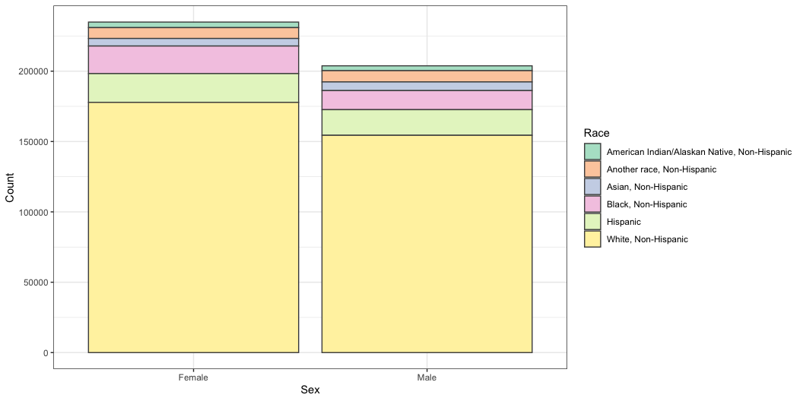
Plotting - Figure formatting
Note that your upper layer will automatically override decisions.
ggplot(brfss)+ geom_bar(aes(x = sexvar, fill = imprace), colour = 'grey30')+ labs(x = "Sex", y = "Count")+ scale_fill_brewer(palette = 'Blues', name = "Race")+ scale_fill_brewer(palette = 'Pastel2', name = "Race")+ theme_bw()+ theme(legend.position = 'right')

Slide 41
Other considerations
Make sure you use color-blind friendly palette when using multiple colors.
Estimates suggest that red/green color blindness affects approximately 8% of males and around 0.5% of females of Northern European descent.
Colors on other screens (esp. projectors!!) can look different than your laptop screen:
Make sure you have enough contrast between colors so that the audience can still detect the difference even if the color slightly fades out

Slide 42
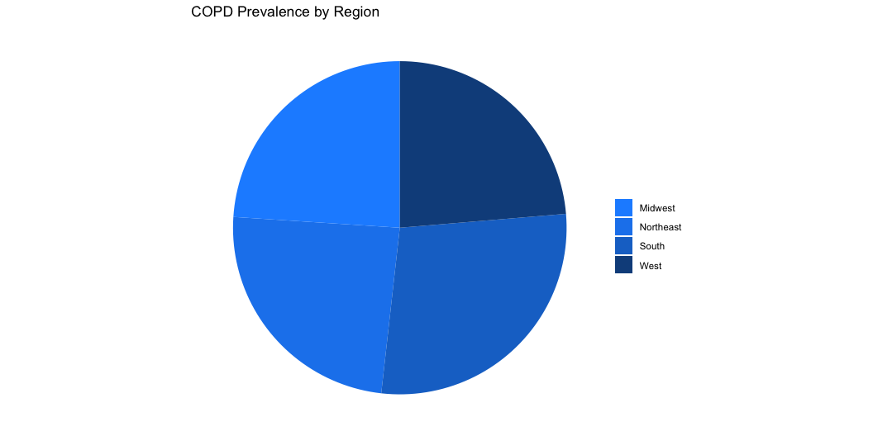
What are the problems?
Based on what we learned so far, discuss potential problems with this chart with your table members

Slide 43
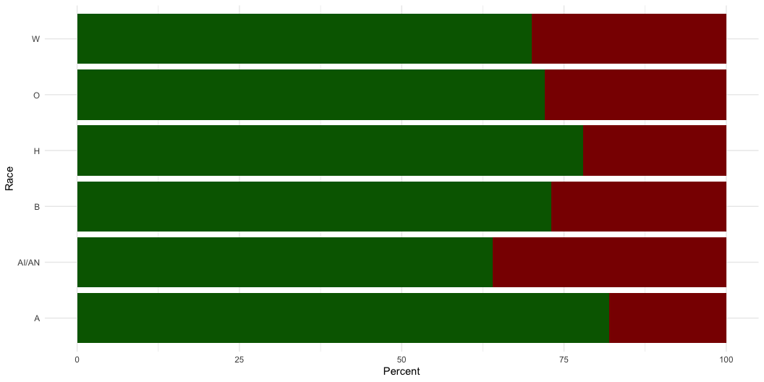
What are the problems?
Based on what we learned so far, discuss potential problems with this chart with your table members

Slide 44
Useful resources
CS&SS 569 Visualizing Data and Models
Course website has great learning materials and practice sets
Link to website
ggplot2 package document: link
ggplot2 cheatsheet: link
Stackoverflow

Slide 45

Questions?
Talk to your neighbors - what questions do you have?

