Slide 1

LIGHT, CAMERA, ACTION.
TEAM 1
(c) 2019-2026 Electronic Arts

Slide 2
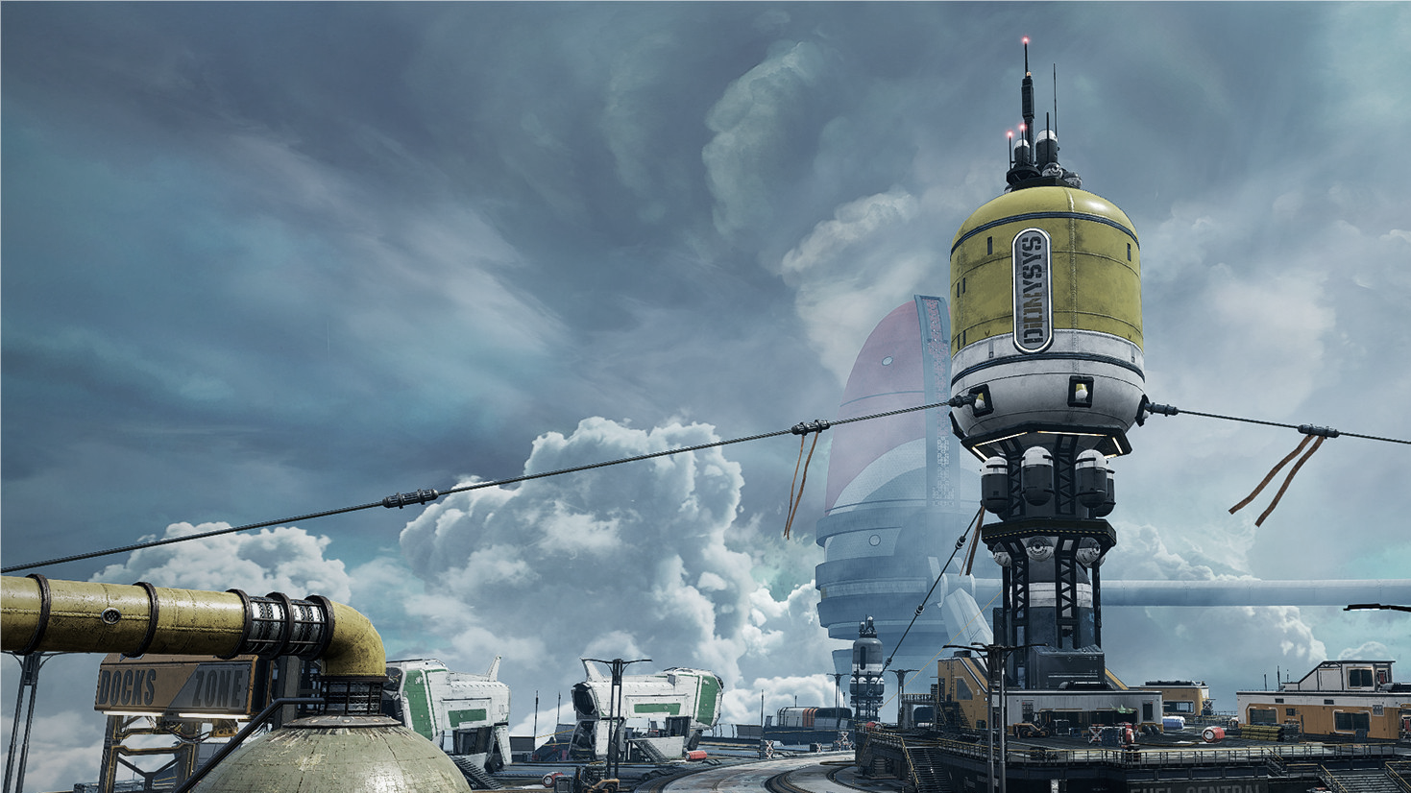
CONTENTS
(c) 2019-2026 Electronic Arts
CAMERA ARCHITECTURE
BEZIER TRANSITION
CINEMATIC OVERLAY
DYNAMIC CAMERA & POST PROCESSING
TIME DILATION
HIT SQUASH & KNOCK BACK

Slide 3
1. CAMERA ARCHITECTURE

Slide 4
2. BEZIER TRANSITION

Slide 5
3. CINEMATIC OVERLAY

Slide 6
4. DYNAMIC OVERLAY & POST PROCESSING

Slide 7
5. TIME DILATION

Slide 8
6. HIT SQUASH & KNOCK BACK

