Slide 1
Where to stay in London?
IBM DATA SCIENCE PROJECT
KIM NGOC HA
May 2020.

Slide 2
1. PROBLEM
There is a large number of international students choose London as a ideal place for studying. Their main concern would be where is the safest location so that they can settle down.
This project focuses on analyzing and find out where is the safest areas.

Slide 3
Data
DATA ABOUT CRIME:
https://data.london.gov.uk/dataset/recorded_crime_summary
DATA ABOUT POPULATION AND COORDINATES
https://en.wikipedia.org/wiki/List_of_London_boroughs

Slide 4

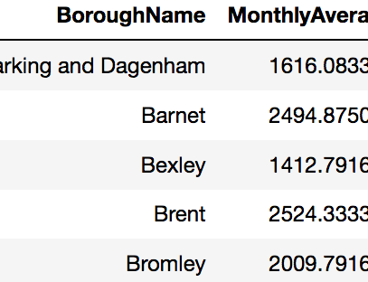

METHODOLOGY
For the purpose of finding safest place, calculate the total crimes and montly average for all boroughs to get an overview

Slide 5
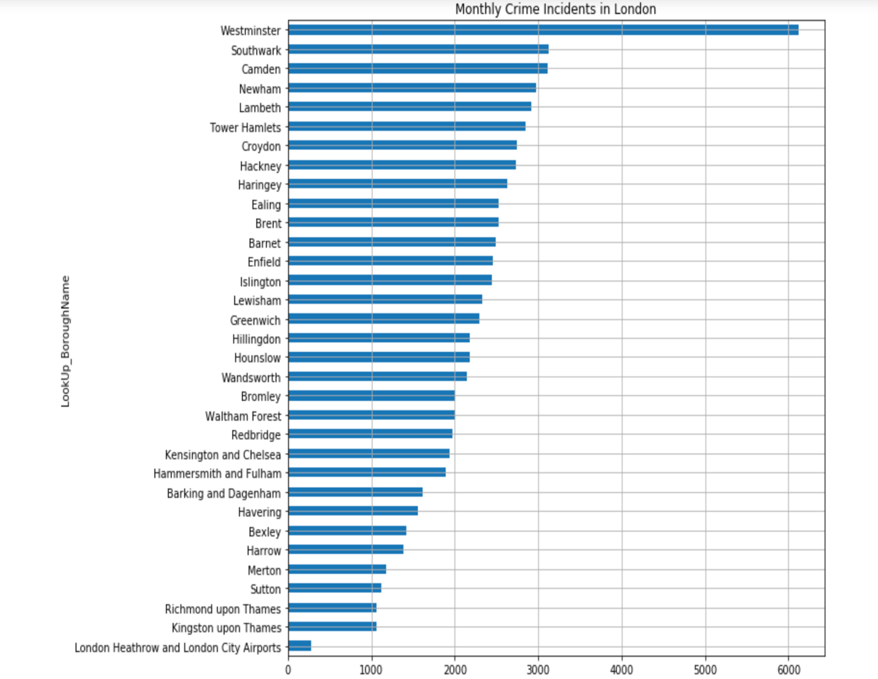

Slide 6
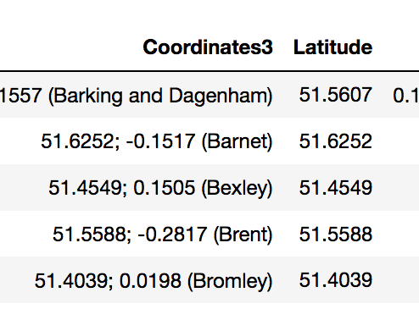
Using the Beautiful Soup to import data about borough and population from website

Slide 7
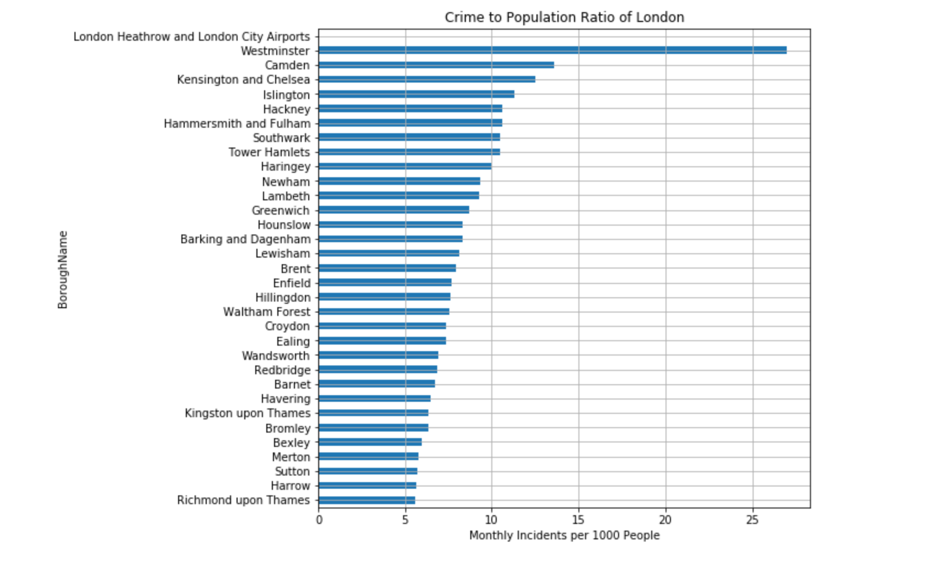

Slide 8
RESULTS AND RECOMMENDATIONS
It can be seen that Westminster has the highest crime ratio. In addtion, compared with Camden, the second highest ratio, Wastminster ratio is two times higher.
Besides, the safest areas are Richmond upon Thames, Harrow and Sutton, all three of these area have similar ratio rate.

