Slide 1
Class Diagrma v1.0
‘ 아이예찬 ‘
작성자 : 김성준

Slide 2
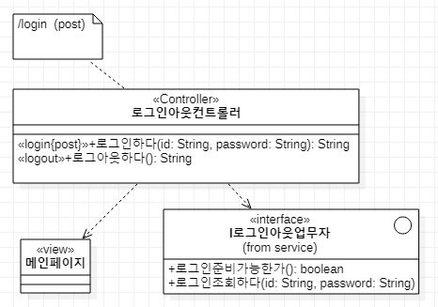
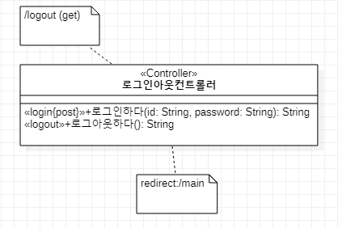
LoginOut – presentation
로그인하다
로그아웃 하다

Slide 3
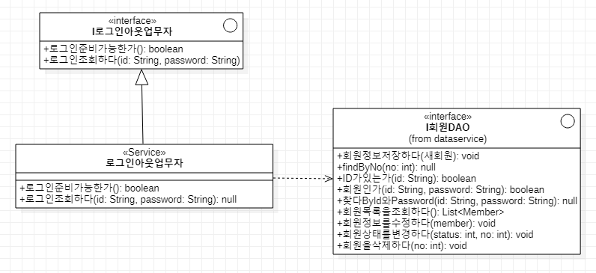
LoginOut – service

Slide 4
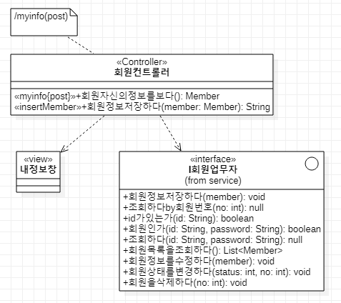
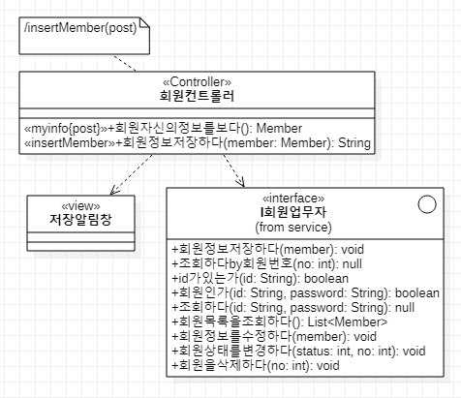
Member - presentation
회원자신의정보를보다
회원정보를저장하다

Slide 5
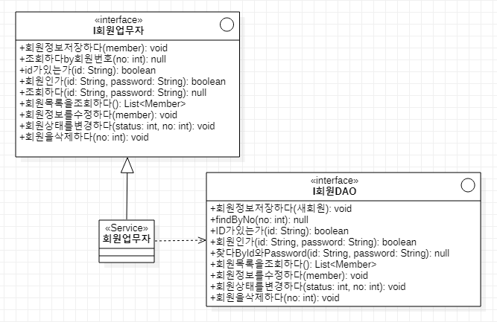
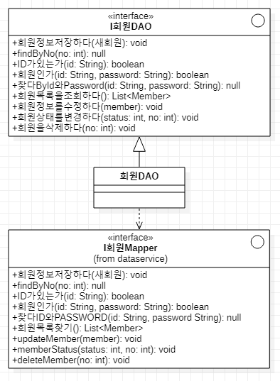
Member – service, dataservice
service
dataservice

Slide 6
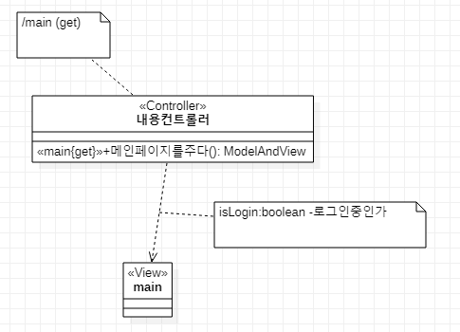
contents – presentation
메인페이지를보다

Slide 7
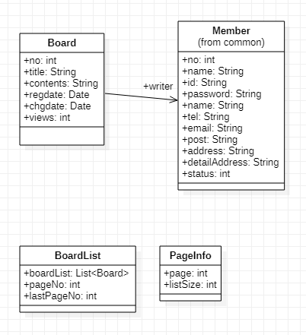
board – common

Slide 8
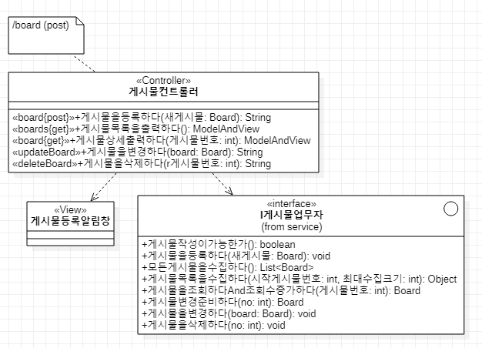
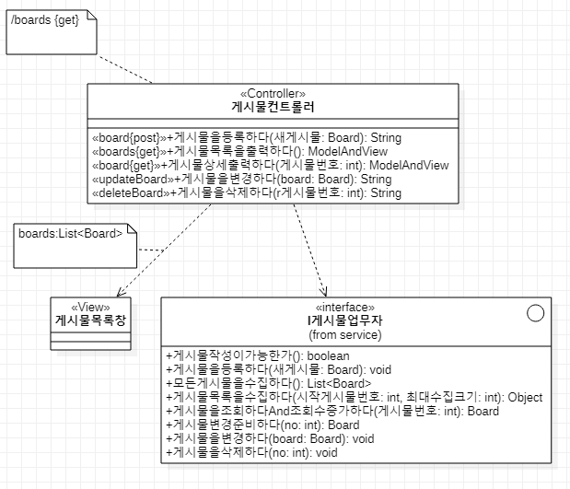
board – presentation
게시물을등록하다
게시물목록을출력하다

Slide 9
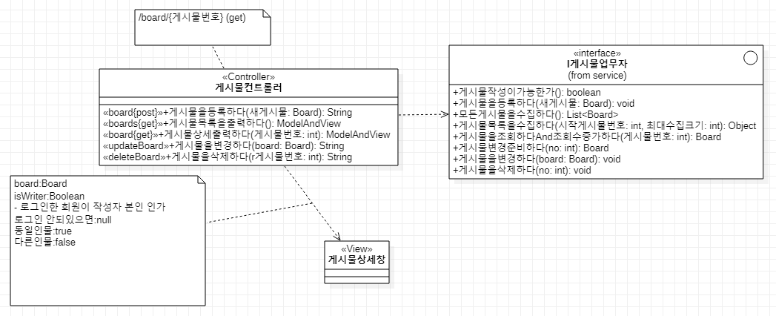
board – presentation
게시물상세를출력하다

Slide 10
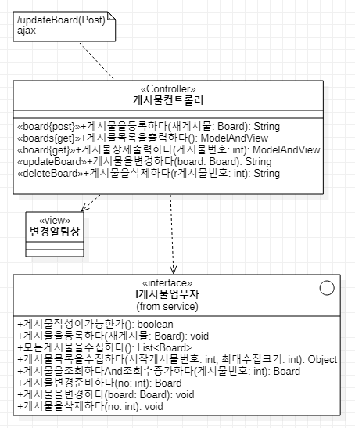
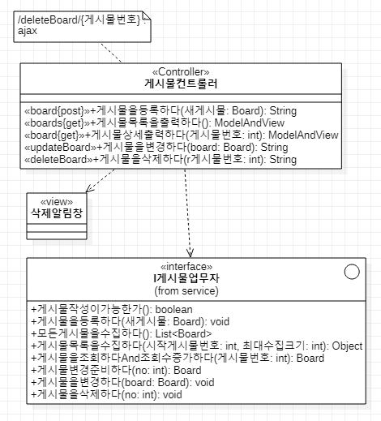
board – presentation
게시물을변경하다
게시물을삭제하다

Slide 11
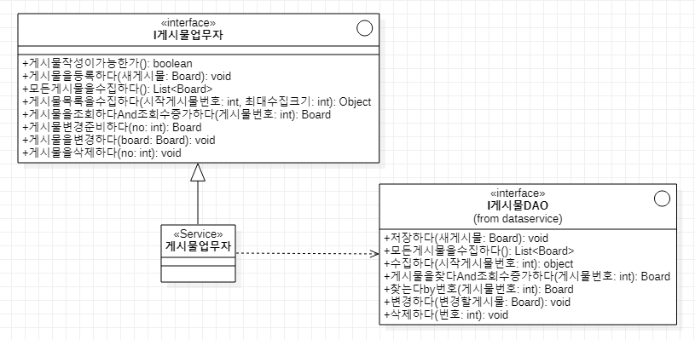
board – service

Slide 12
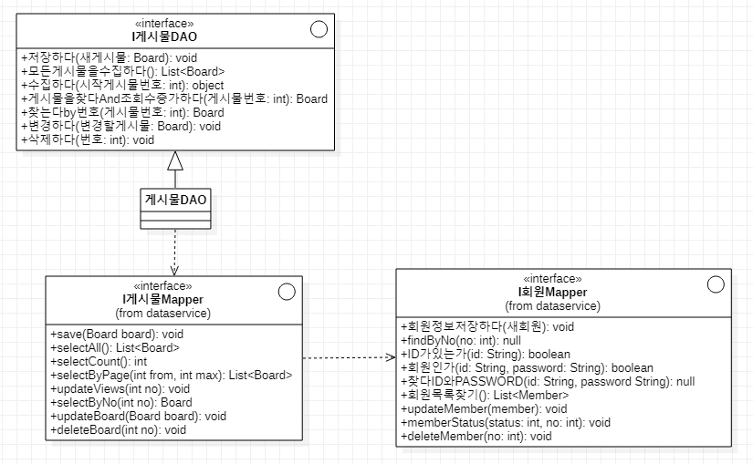
board – dataservice

Slide 13
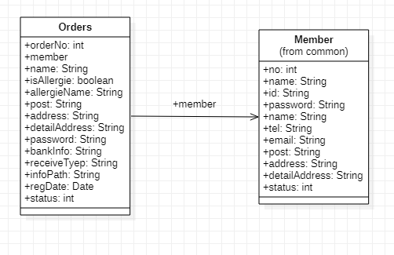
orders - common

Slide 14
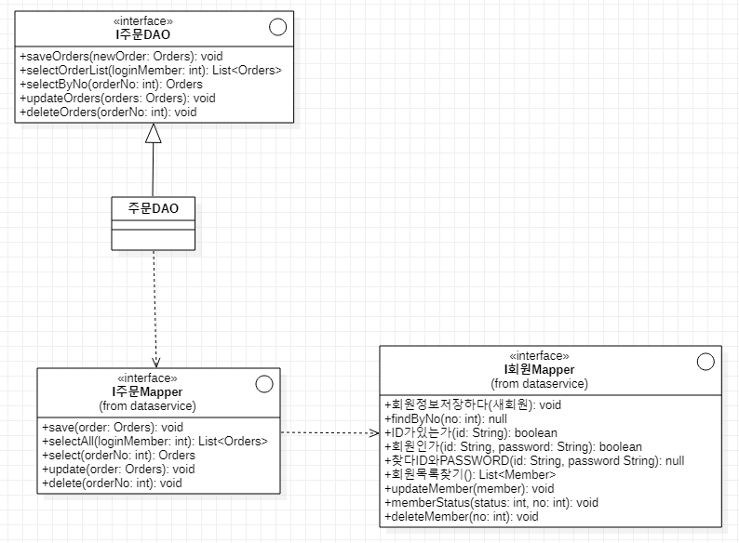
orders - dataservice

Slide 15
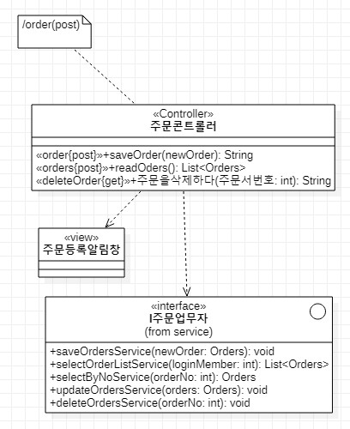
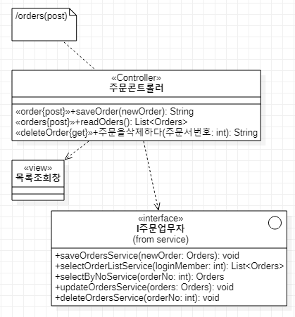
orders – presentation
주문서를저장하다
주문서목록을조회하다

Slide 16
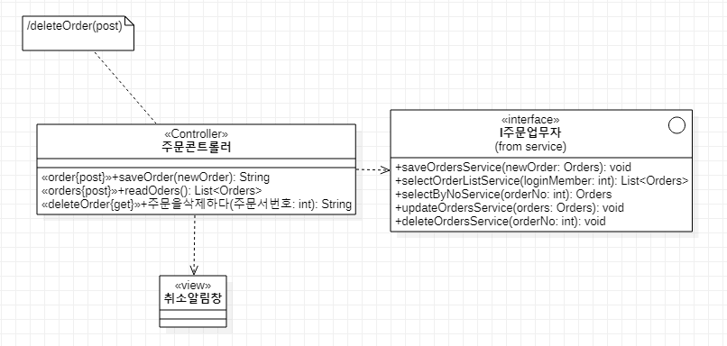
orders – presentation
주문서를취소하다

Slide 17
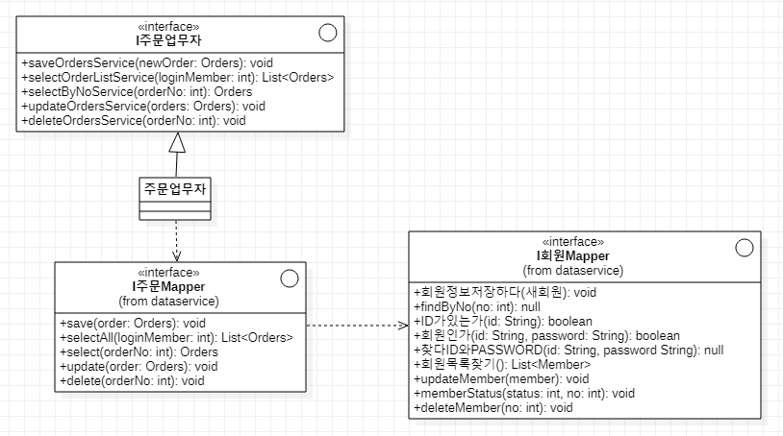
orders – service

