Slide 1

Recommendation System Application Development by using Association Analysis Apriori Algorithm
សាកលវិទ្យាល័យ ភូមិន្ទភ្នំពេញ
ROYAL UNIVERSITY OF PHNOM PENH
Advisor: Dr. SRUN Sovila
SAO Kimsong

Slide 2
Project analysis slide 2
Contents
Introduction
Literature Reviews
Methodology
Experiments
Conclusions and Future Works

Slide 3
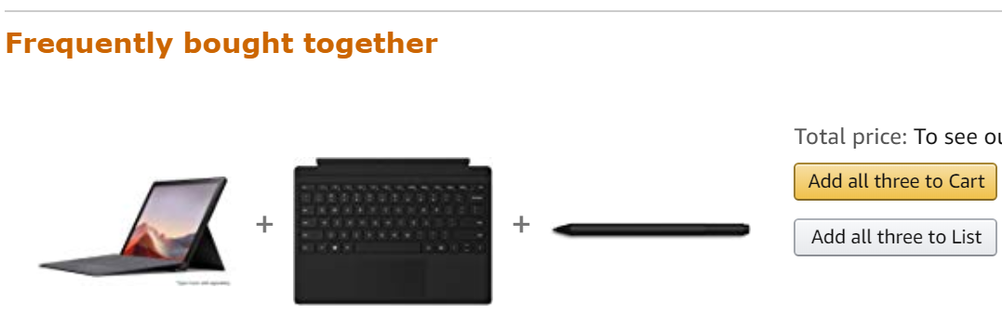
Project analysis slide 2
Introduction
E-commerce and retail companies are using the power of data and boost sales by implementing Recommendation System (RS) on their websites.
What is a RS?
Why do we need RS?
Example:
Notes:
What is a RS?
Is a software tools and techniques.
providing suggestions for items to be use to a users.
Why do we need RS?
Increase the number of items sold. (Amazon, YouTube, Facebook)
Better understand what the user wants
Increase the user satisfaction
នៅក្នុងការ do recommendation system យើងត្រូការ ដឹងពី how item related

Slide 4
Project analysis slide 2
Introduction – Cont.
Objectives
Proposed the architecture of association item analysis for the Recommendation System.
Developed and conducted experiments of Recommendation System by using Apriori Algorithm.
Notes:
What is a RS?
Is a software tools and techniques.
providing suggestions for items to be use to a users.
Why do we need RS?
Increase the number of items sold. (Amazon, YouTube, Facebook)
Better understand what the user wants
Increase the user satisfaction
នៅក្នុងការ do recommendation system យើងត្រូការ ដឹងពី how item related

Slide 5
Project analysis slide 2
Literature Reviews
Author(s) | Proposed
Bendakir, and E.,Aımeur, 2006 | Using association rules for course recommendation.
T.,Chellatamilan, R.,SURESH, 2011 | An e-Learning RS using Association Rule Mining Technique.
Shadi, et al., 2018 | A Novel Recommendation System Based on Apriori Algorithm for Requirements Engineering.
Notes:
Bendakir, 2006
Idea: User ratings
The advantage of this system is to allow the user (student) to evaluate the previous recommendations
Does not make use of a student’s academic background. And develop in context of course recommendation system only.
Chellatamilan
To provide students with the best selection of learning materials and e-Learning resources.
Idea is to gather data from students using a survey questionnaire (educational background, frequency of their study patterns, demographics data), analyze logs of LMS access behavior.
Using Jaccard measure to
Disadvantage: Gather personal and background data
Shadi
To provide the right information at the right time to requirements engineers.
They used Apriori extract rules from user requirements
It was able to extract the rules very fast.

Slide 6
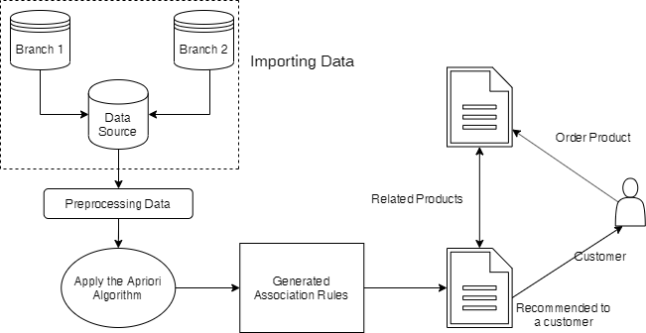
Project analysis slide 2
Methodology
System Overview

Slide 7
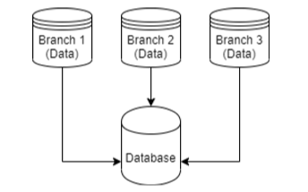
Project analysis slide 2
Methodology – Cont.
Importing Data
TID | Item
T1 | ESPRESSO
T1 | SUGAR
T1 | NEWSPAPER
T2 | ESPRESSO
T2 | SUGAR
T2 | COLA
… | …
Notes:
Collect customer purchase history data taken from any data source and import into relational database.
We need to match the data source column with our relational database formation column called target columns.
The source columns that provide must be the same size of target columns

Slide 8
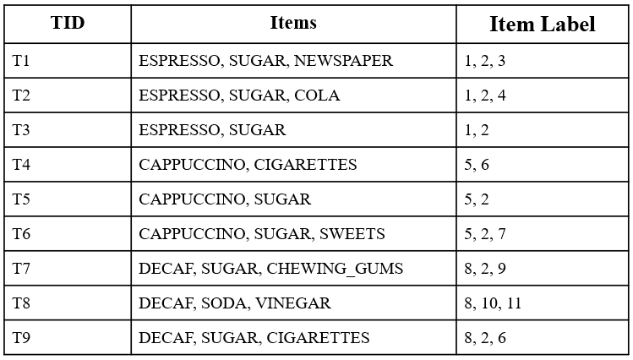
Project analysis slide 2
Methodology – Cont.
Preprocessing Data
Format transaction data to algorithm formation.
Labeled the item as a number.

Slide 9
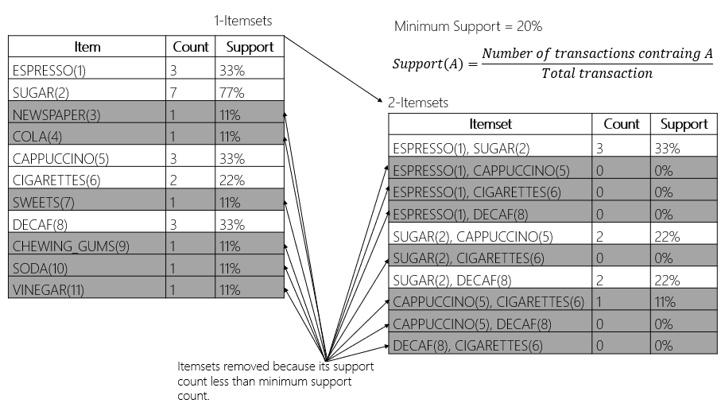
Project analysis slide 2
Methodology – Cont.
Frequent Itemset for Apriori Algorithm
Notes:
Freq. Itemset: Item ដែលកើតឡើងញឹកញប់ជាមួយគ្នា We compare with min_sup
Apriori founder: Rakesh Agrawal and Ramakrishnan Srikant

Slide 10
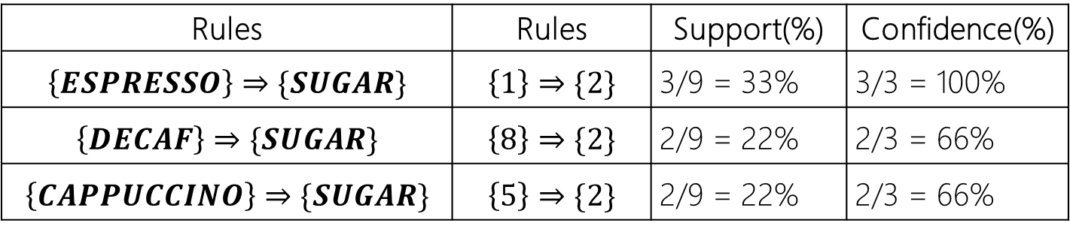
Project analysis slide 2
Methodology – Cont.
Rule Generation
Minimum Confidence = 60%
$$Confidence\left(A⟹B\right)=\frac{Transaction contain both A \& B}{Transaction Contain A}$$
Rules | Rules | Support(%) | Confidence(%)
$$\left\{ESPRESSO\right\}⇒\{SUGAR\}$$ | $$\left\{1\right\}⇒\{2\}$$ | 3/9 = 33% | 3/3 = 100%
$$\left\{DECAF\right\}⇒\{SUGAR\}$$ | $$\left\{8\right\}⇒\{2\}$$ | 2/9 = 22% | 2/3 = 66%
$$\left\{CAPPUCCINO\right\}⇒\{SUGAR\}$$ | $$\left\{5\right\}⇒\{2\}$$ | 2/9 = 22% | 2/3 = 66%
Notes:
All of these association rules are considered strong because they meet the minimum confidence 60% and support 20.

Slide 11


Project analysis slide 2
Experiments
Experiment Setup
Hardware | Software
CPU: Intel Core i5-5200U 2.20GHz, 2 Core(s) | Windows 10 x64 Enterprise
RAM: 8GB | Python 3.7
 | PyQT5, QT Designer
 | Visual Studio Code
Data | Total Transaction | Avg. Items / Transaction
Dataset 1 | 4, 444 | 4.6
Dataset 2 | 16, 466 | 3
Notes:
We used datasets that contains 4,444 and 16,466 transactions.
The average number of items contained in a transaction is

Slide 12
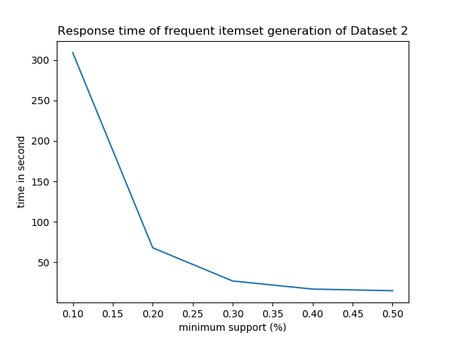
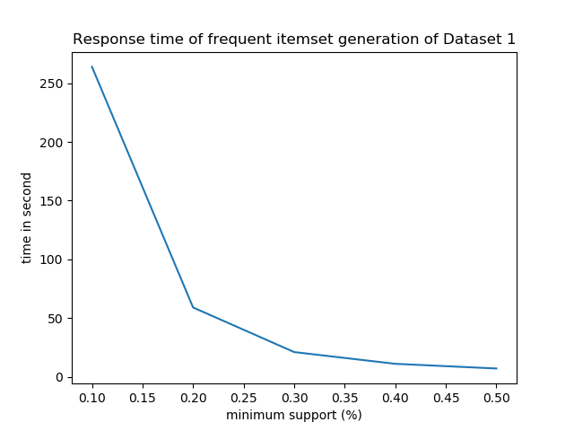
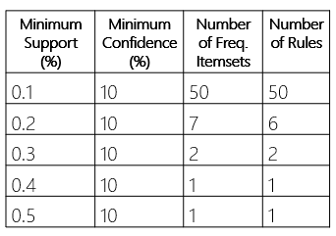
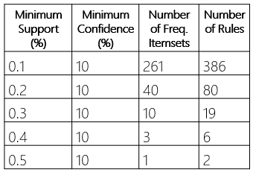
Project analysis slide 2
Experiments – Cont.
Results
Notes:
The performance of our implementation in means of response time (seconds) while the minimum support threshold varies from 0.5% down to 0.1%.
We observe that while the minimum support decreases, the response time of the algorithm increases.
This is expected, since lower values of minimum support result more frequent itemsets to be discovered and consequently more possible extensions.

Slide 13
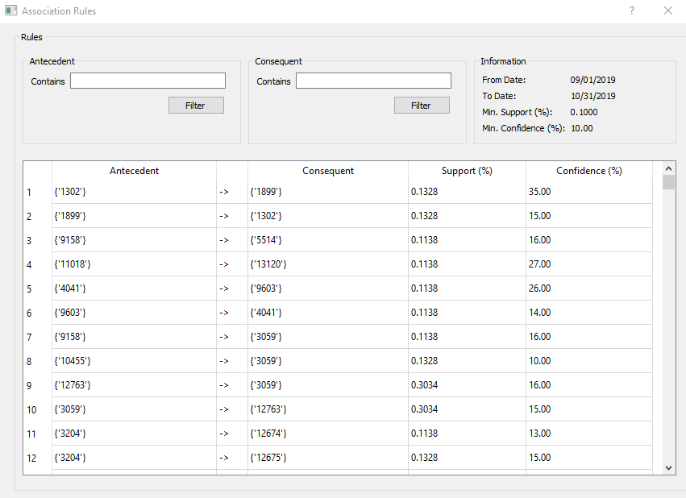
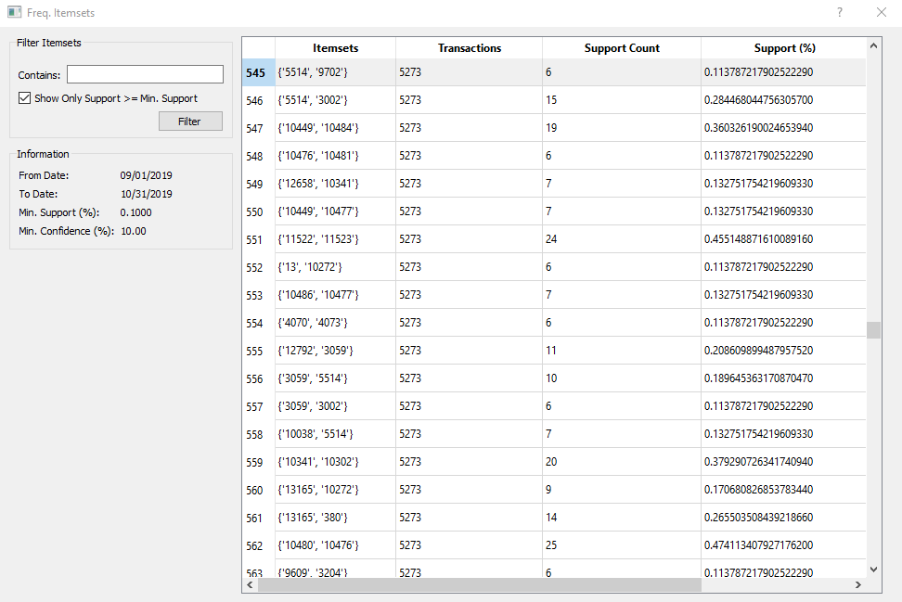
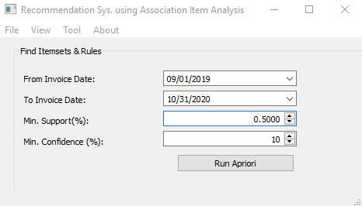
Project analysis slide 2
Experiments – Cont.
Graphical User Interface
Notes:
We used datasets that contains 4,444 and 16,466 transactions.
The average number of items contained in a transaction is 10, while the variance is ± 7 items.

Slide 14
Project analysis slide 2
Conclusions &
Future Works
Conclusions
In this work, we proposed the architecture of association item analysis for the Recommendation System.
This RS used Apriori algorithm to extract rules from customer’s purchase histories.
Experimental work proved that this algorithm is efﬁcient in term of response time.
Future Works
Make a library for recommend product to customers by using association items from proposed frameworks.

Slide 15
Thank You Q&A
Notes:
what you learned from the study you have done.
Recommender System concept
Know it work, and how benefits
why you chose this particular topic or what your inspiration behind this study was.
These patterns are used to help make business decisions, such as, what to put on sale, how to design coupons, how to place merchandise on shelves in order to maximize the profit, and selecting the items required and associated together in a timely manner
What is your motivation/research problem?
Contribute

