Slide 1
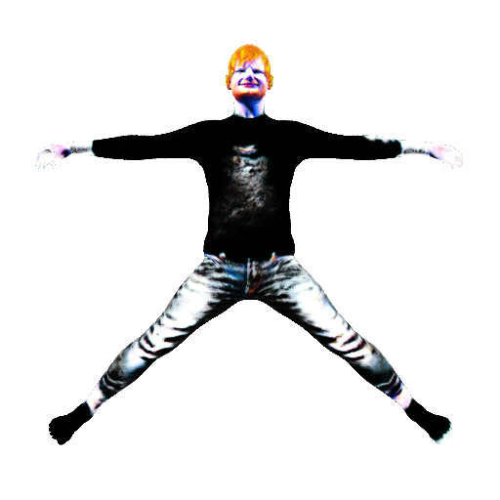
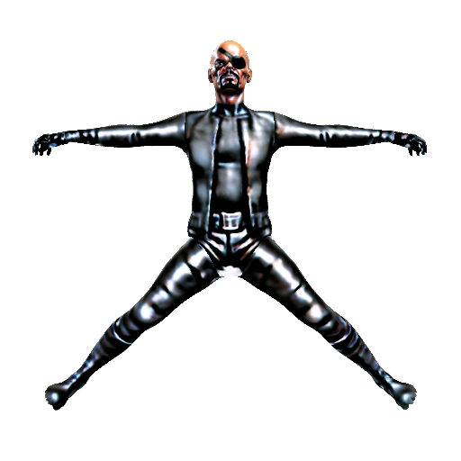
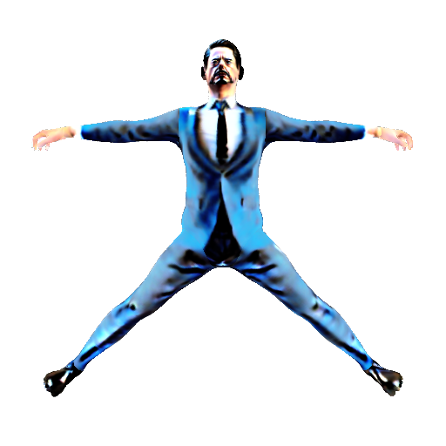
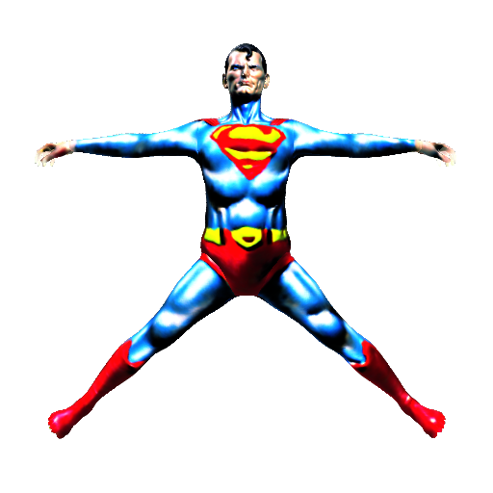
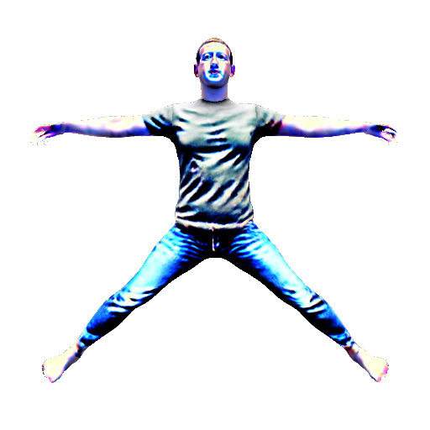
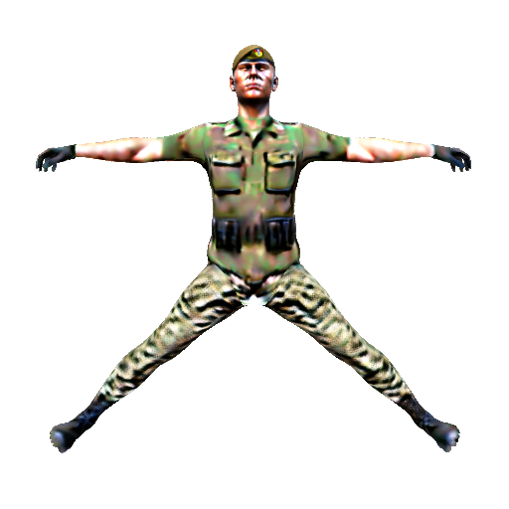
Ed Sheeran
Nick Fury
Tony Stark wearing blue tuxedo
Superman
Mark Zuckerberg
A soldier

Slide 2
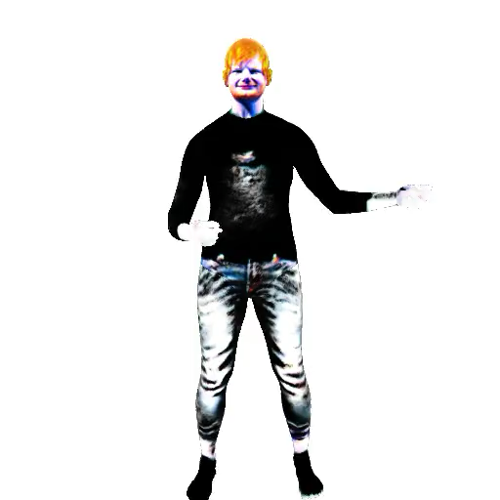
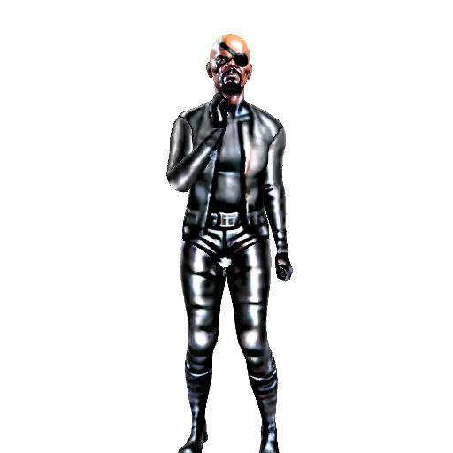
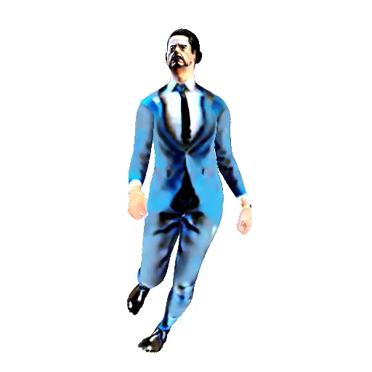
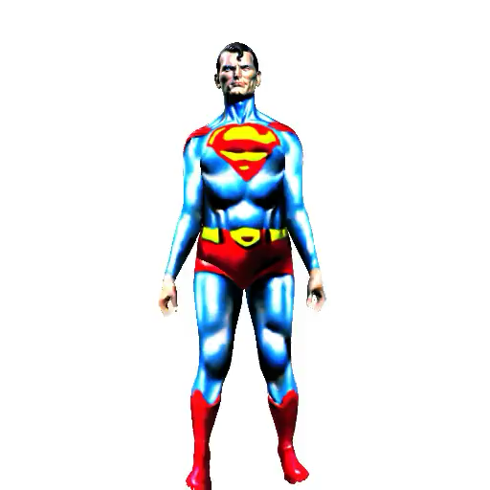
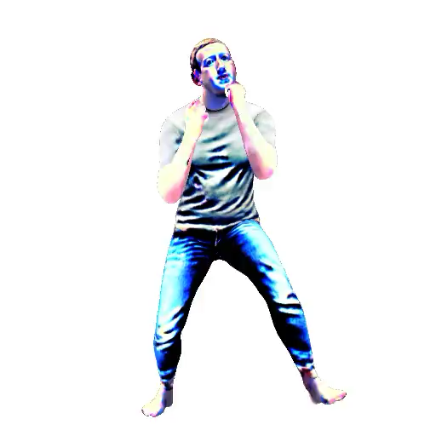
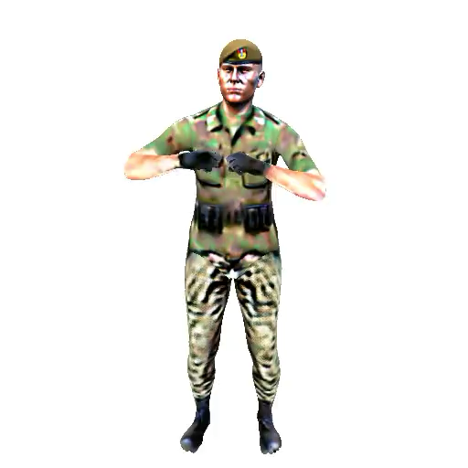
Ed Sheeran is strumming a guitar
Nick Fury is talking on a phone
Tony Stark is walking like a drunk
Superman is doing a jumping jack
Mark Zuckerberg is punching
A soldier is firing a gun

Slide 3
Ed Sheeran
Nick Fury
Tony Stark wearing blue tuxedo
Superman
Mark Zuckerberg
A soldier

Slide 4
Ed Sheeran is strumming a guitar
Nick Fury is talking on a phone
Tony Stark is walking like a drunk
Superman is doing a jumping jack
Mark Zuckerberg is punching
A soldier is firing a gun

