Slide 1
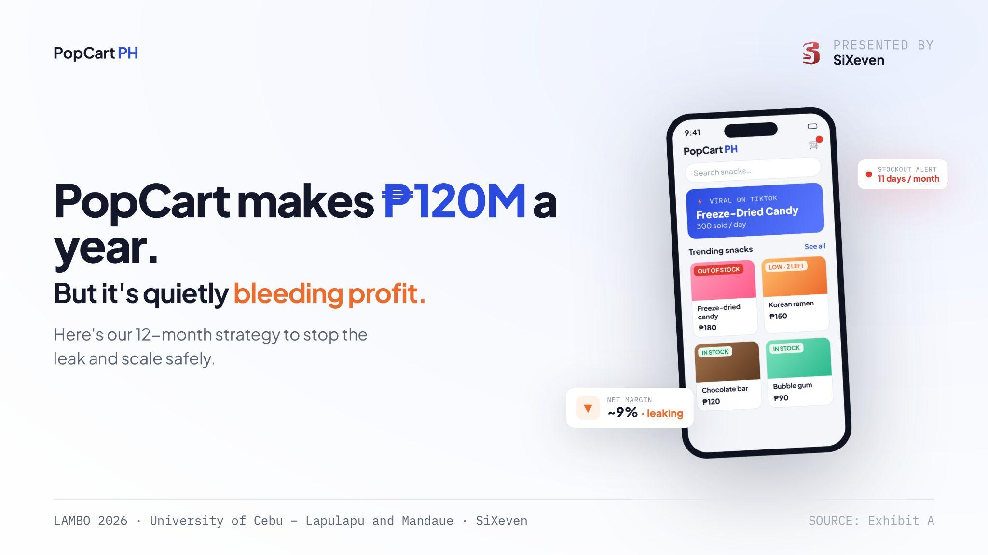

Slide 2
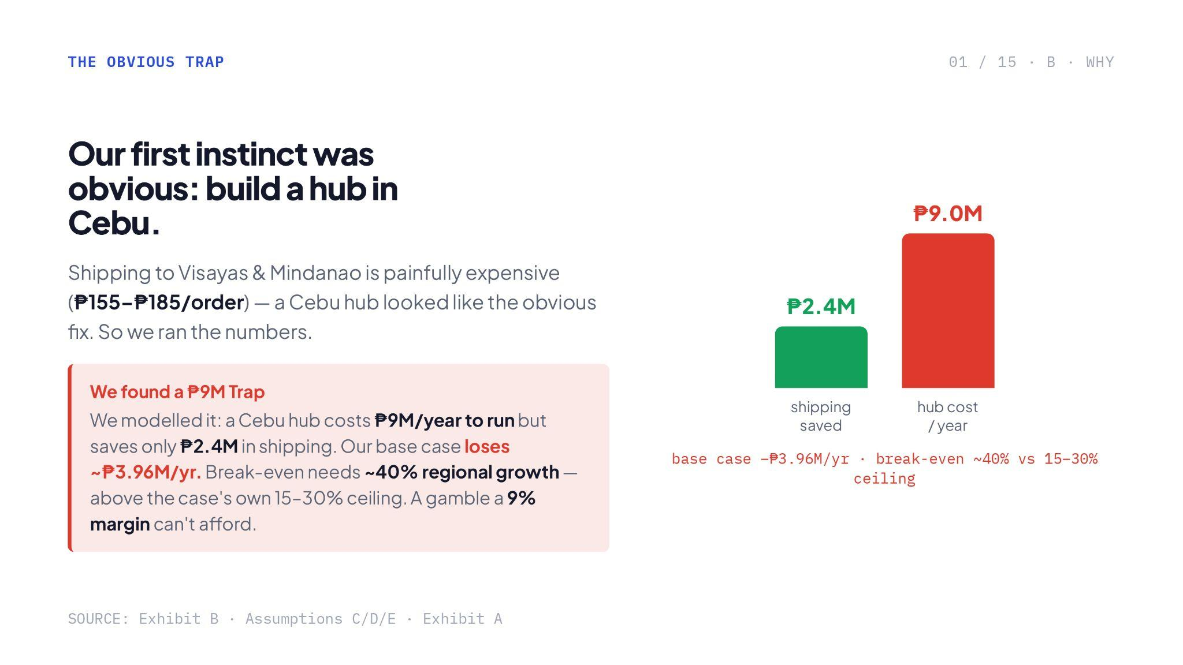
Notes:
Very good insight and due diligence on checking first if the project will pay for itself (which does not).
A lot is going on in this slide that affects the cognitive load of the viewer. The goal is to understand the main takeaway of a slide is 3 to 5 seconds, generally I would look for the headline, bolded numbers, or a key visual before deciding whether to engage or fast-forward
Be wary of bolding texts the next time, these are used to help the viewer focus on that insight and not confuse them. C-levels or managers need to understand what you guys are saying quickly and not for them to read the material and digest it themselves.
Challenge here is you now have the burden to present this compellingly which I think you guys can naman

Slide 3
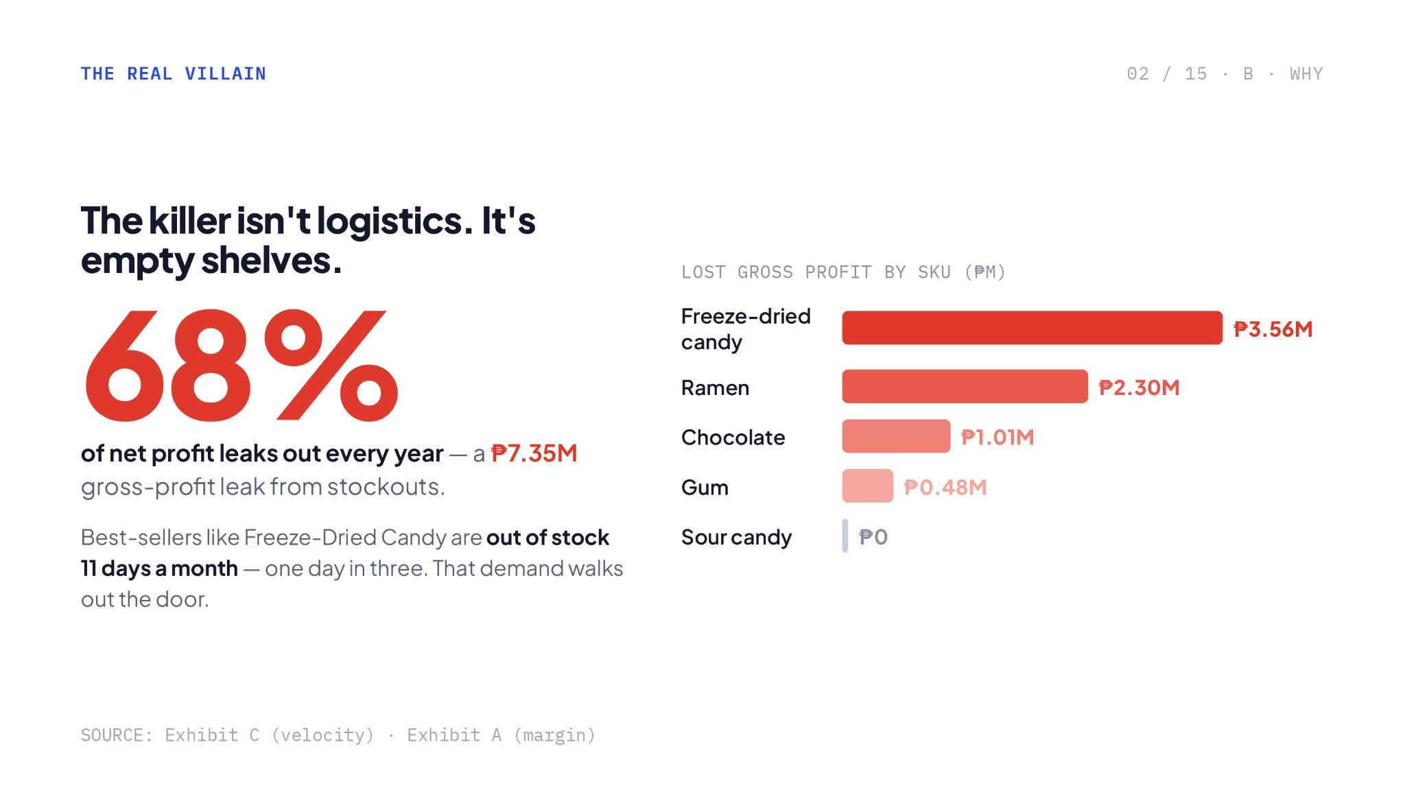
Notes:
Nice data viz here utilizing color gradients.
You got both gross and net profit on the same insight. Make sure you can answer this if this gets questioned by the judges

Slide 4
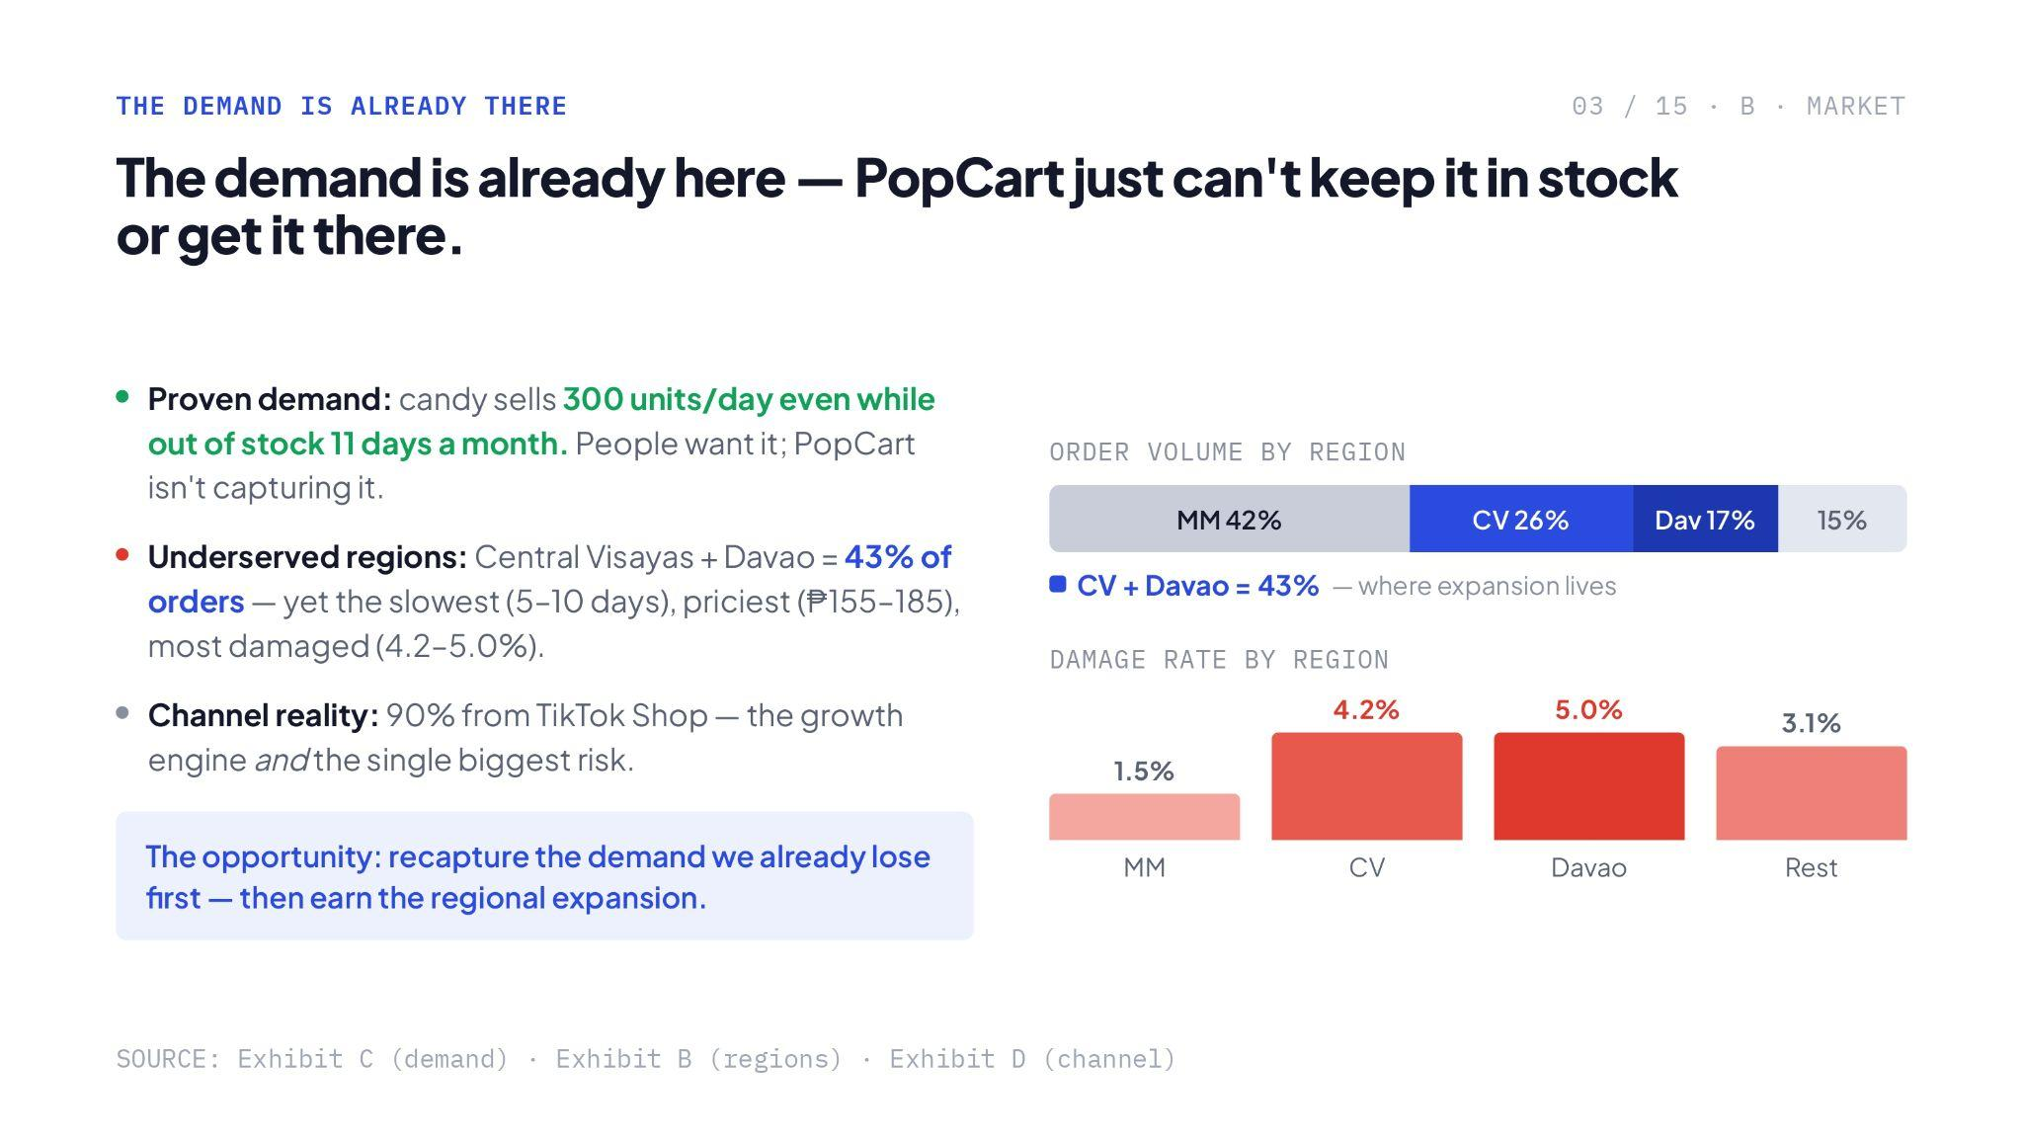
Notes:
Very strong point. Make sure you explain this very well.

Slide 5
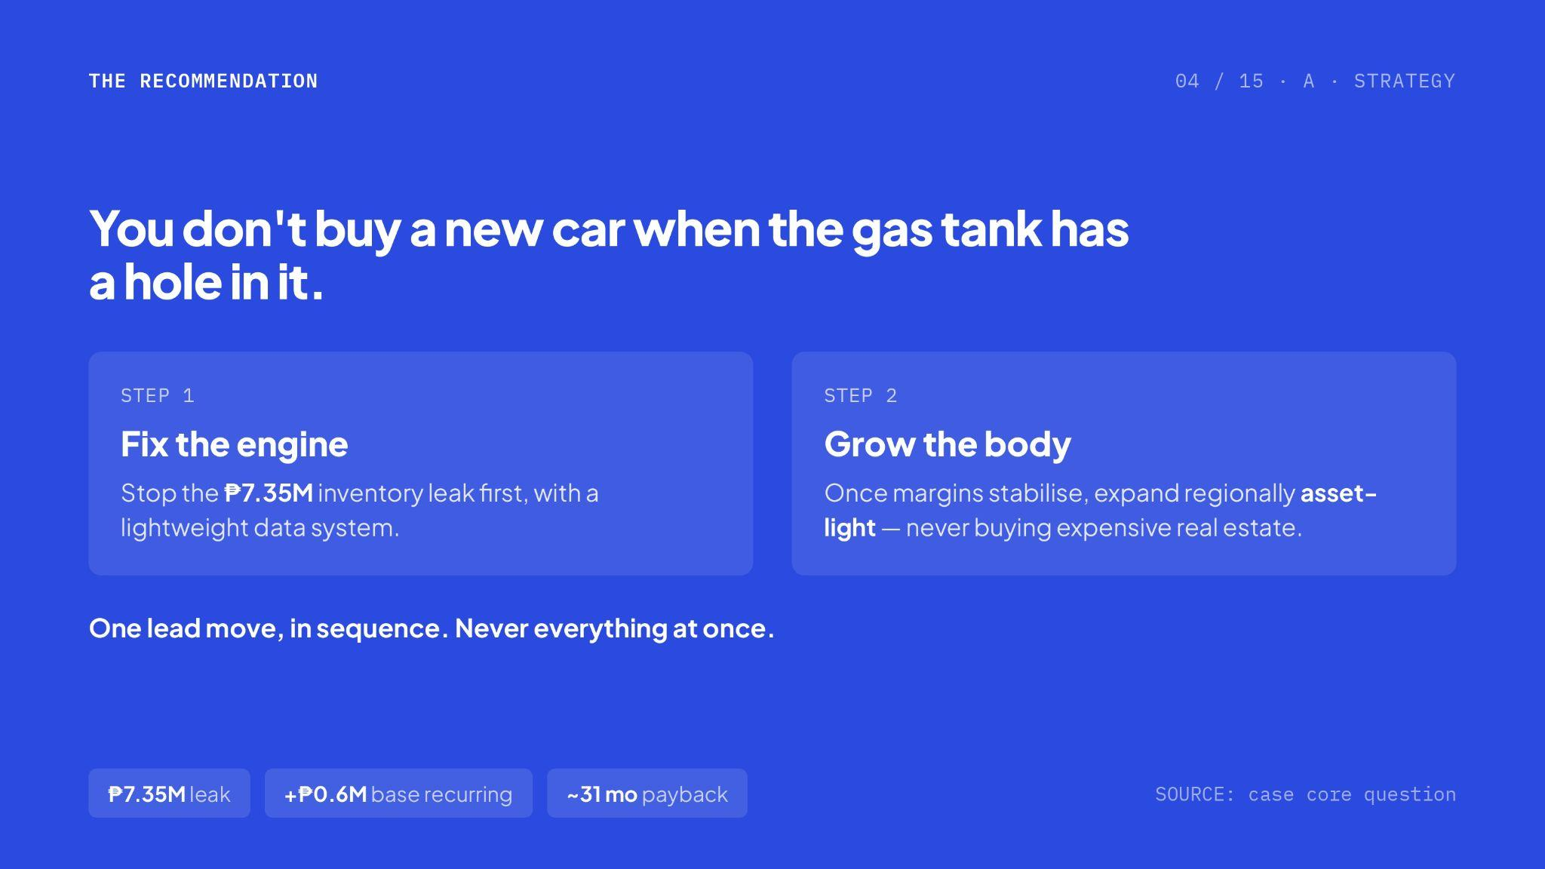
Notes:
Agree. Scaling while everything is leaking is a recipe for disaster. Make sure you can explain the scorecards at the bottom if asked

Slide 6
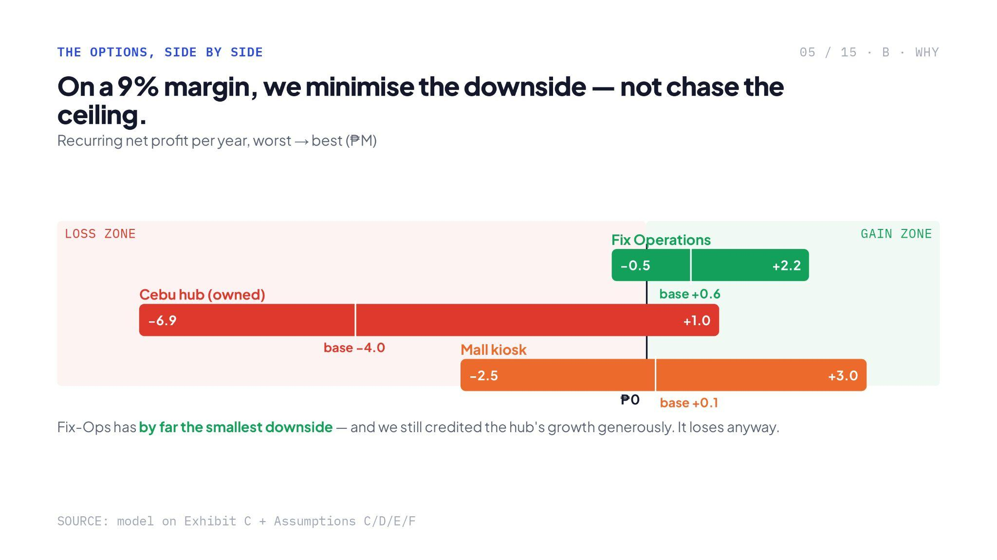
Notes:
Another strong point

Slide 7
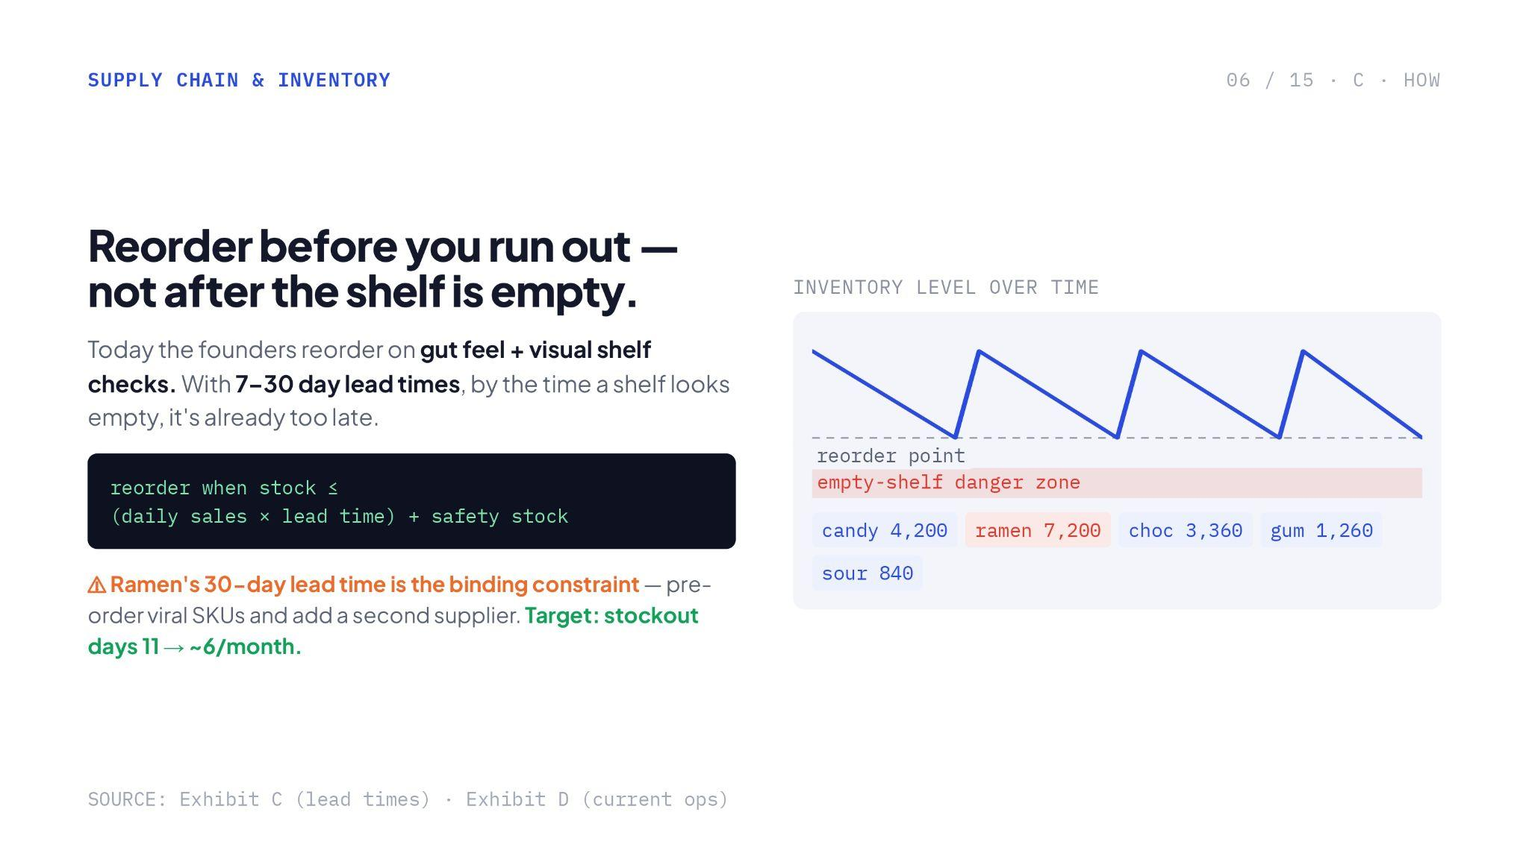
Notes:
Please check calcs here, is safety stock a placeholder value? You guys need to be prepared what value that would be

Slide 8
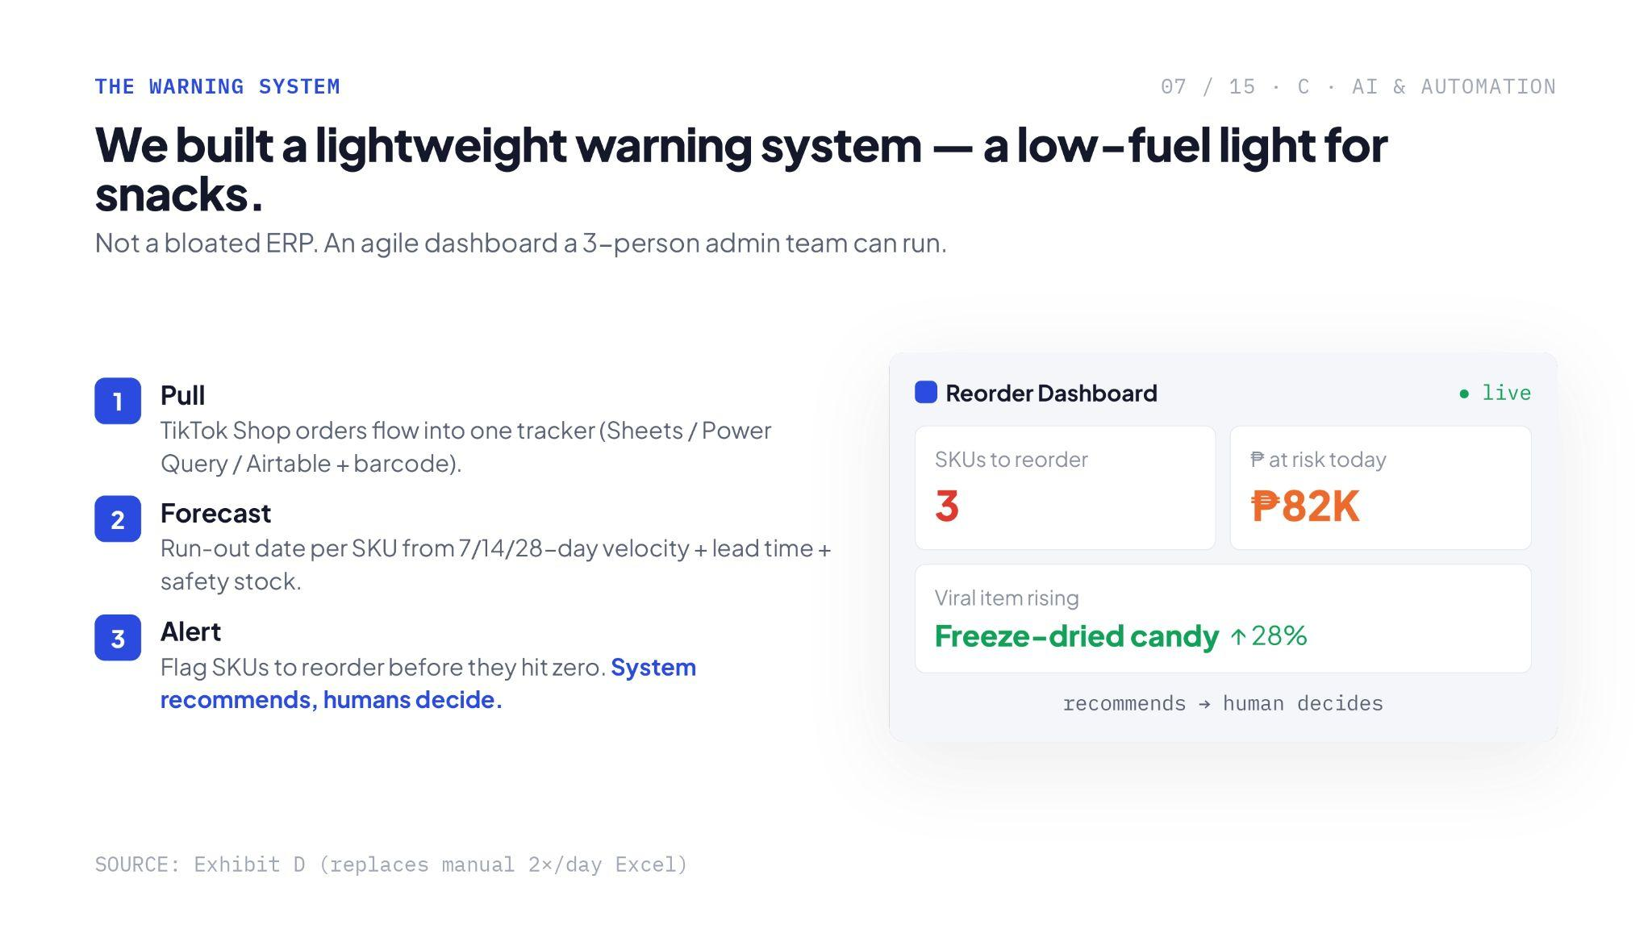
Notes:
You might get asked so be prepared:
On pulling data, walang native connector ang Tiktok to Google sheets or airtable afaik, custom connectors have costs per month. If meron, good pero if wala (pls double check), make sure to account this and be prepared
What’s the forecast methodology? Model metrics? If these are simple 7/14 day averages, lagging indicator/ basic math lang ito and not AI/ ML. Be prepared sa questions
Flag before they hit zero could be alarming to some. It could mean 1 SKU before zero. Make sure to say safety stock

Slide 9
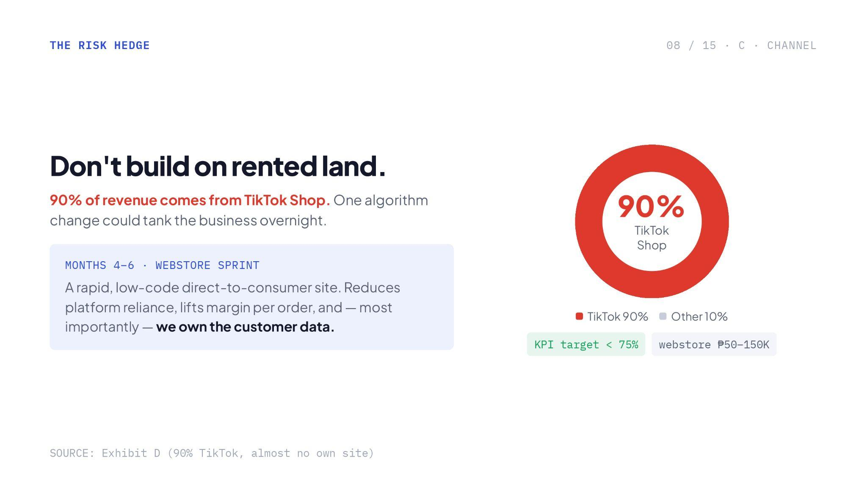
Notes:
Make sure you can defend this. Usual route that companies take when building features is the buy vs buld framework (https://www.thoughtworks.com/content/dam/thoughtworks/documents/e-book/tw_ebook_build_vs_buy_2022.pdf)
Sometimes kasi, it's almost always better to find an existing solution to solve a problem rather than build it from scratch, lalo na if hindi niyo ito core competency. There is also a reason why, for the longest time, mcdo has the most sales in grab and food panda vs their own website. It’s because they benefit already to their existing monthly active users. If you will launch your own website, you will also have to spend maintaining it, marketing and running ads, monitor the cost of acquiring customers, etc.
My suggestion is not to quit tiktok cold turkey but to have a glide path or a plan. Another top of mind is that Tiktok could be the top of the funnel while the website to be built will capture already the existing users and give them incentives to retain loyalty. Possibilities are endless, but for starting point, consider buy vs build

Slide 10
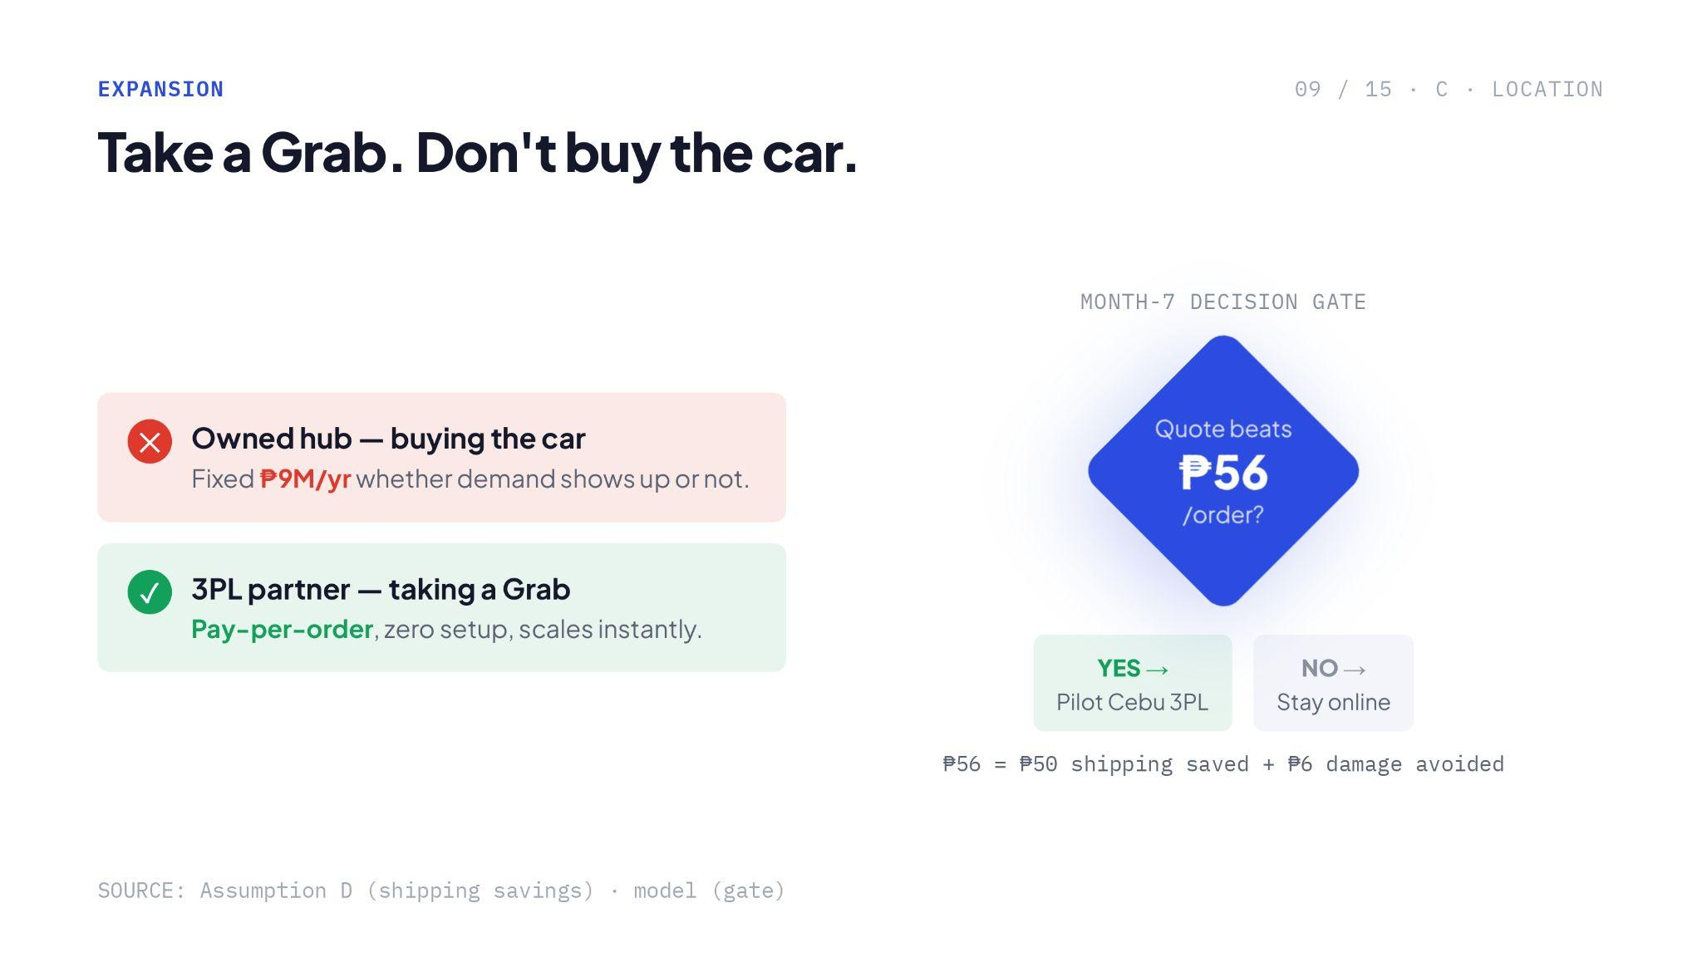
Notes:
Strong point.

Slide 11
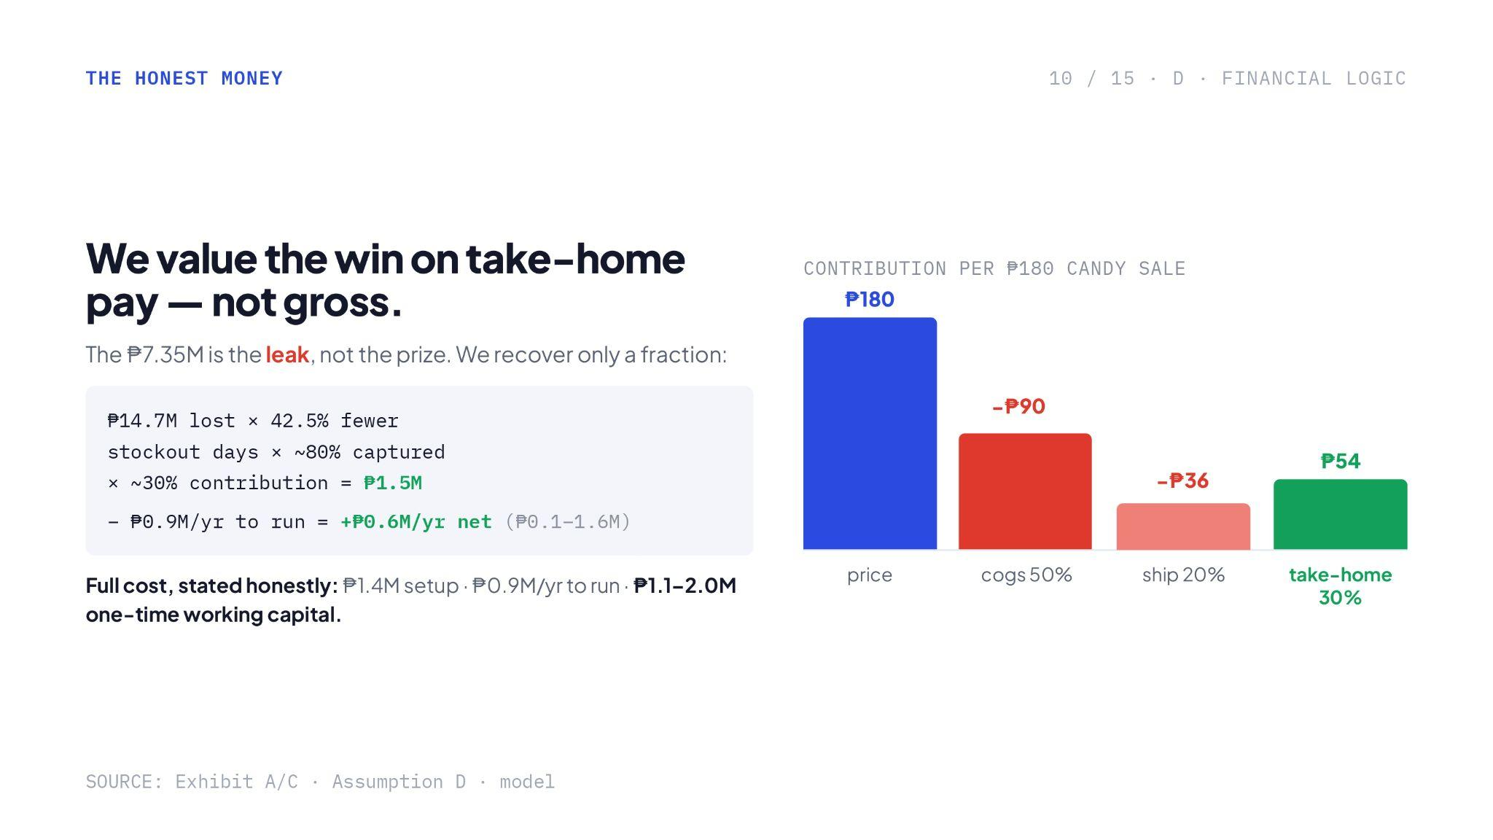
Notes:
Strong point but same comment from slide 2, too much is happening. Make sure you can explain the insight

Slide 12
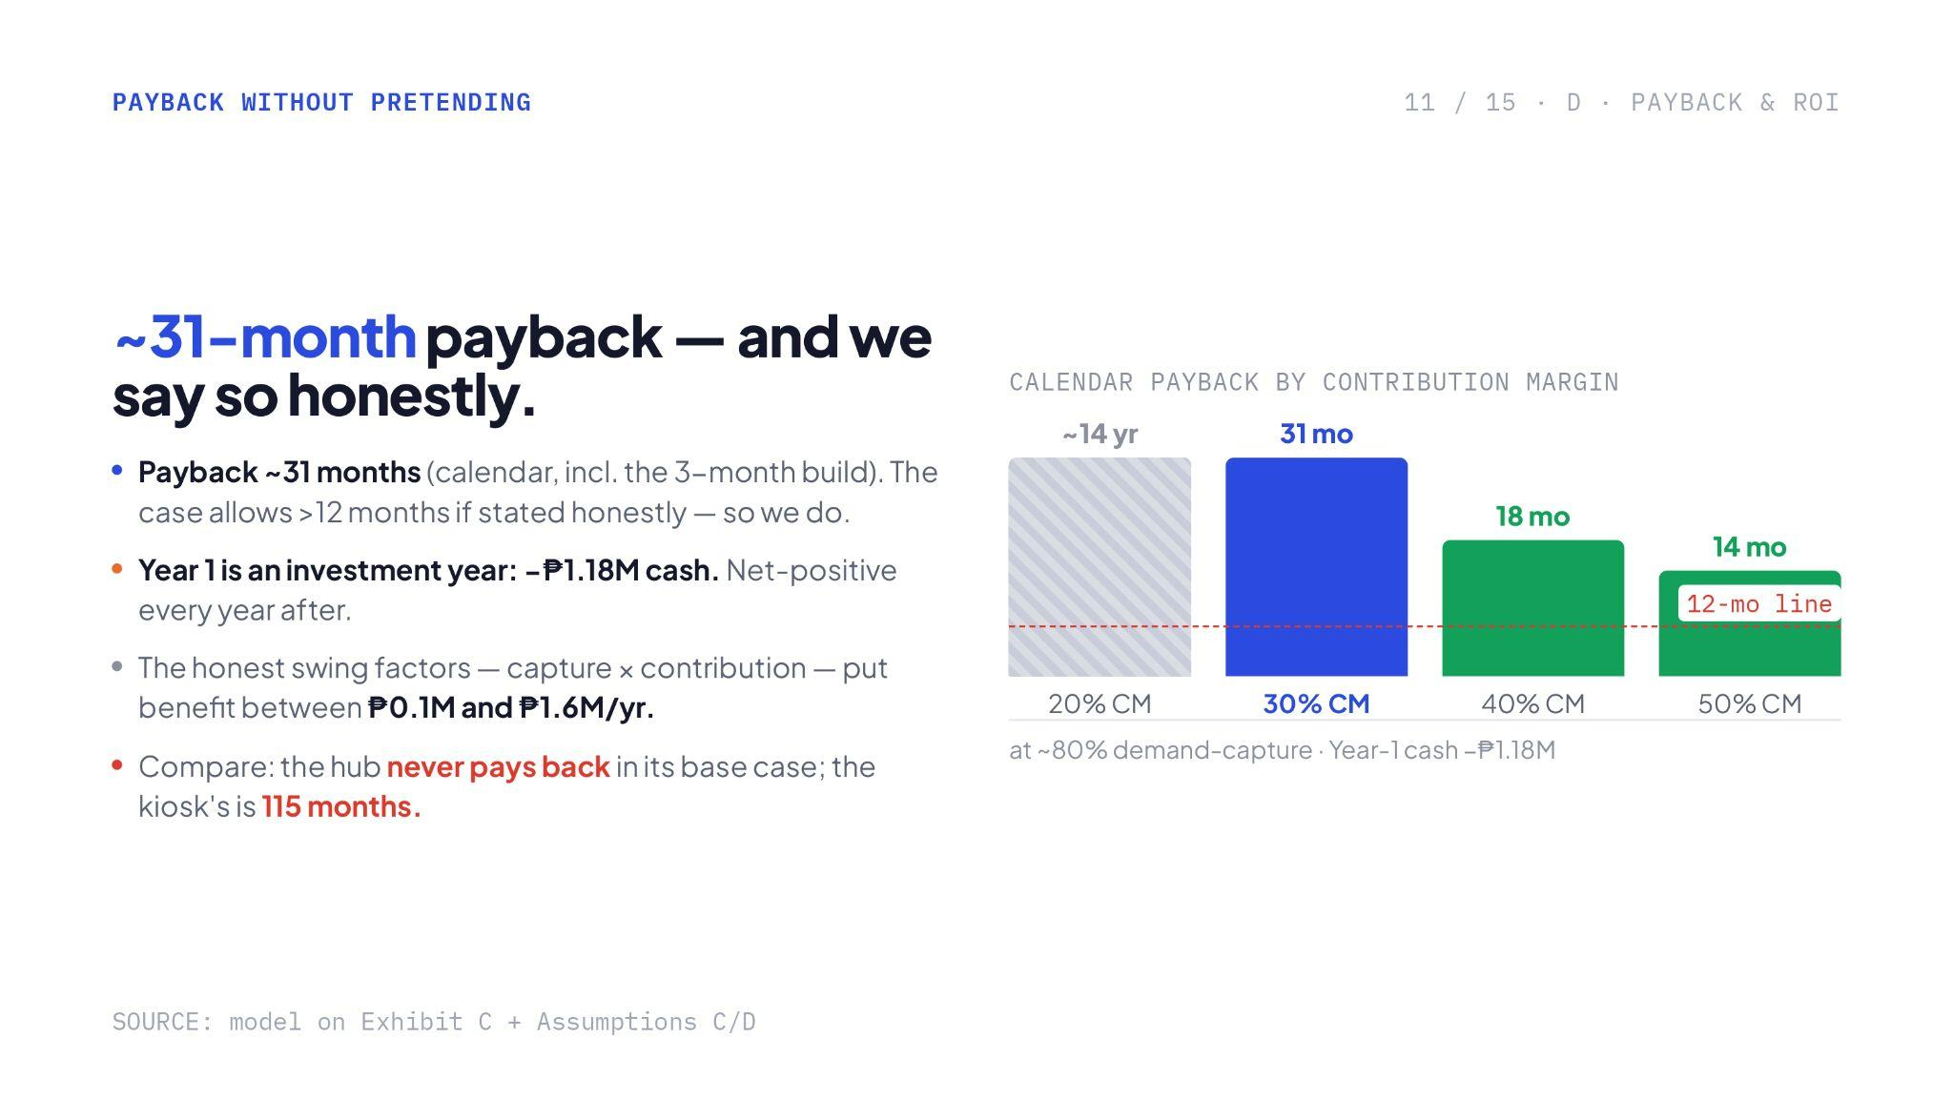
Notes:
You might get questioned of the scaling why 14yr and 31mo is the same in height
Strong points

Slide 13
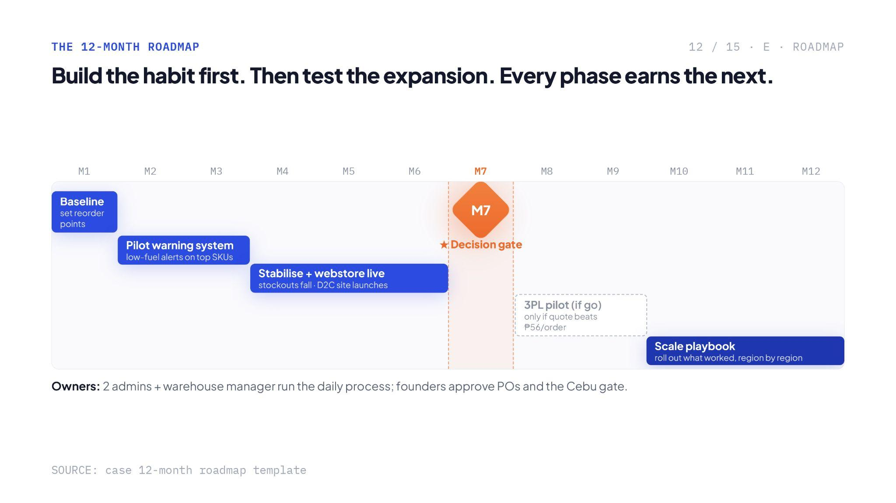
Notes:
I like that you have a decision gate here. Common practice in the industry to evaluate initiatives if it will stop, persevere, or continue.
Though the 12-month implementation roadmap is deeply compressed. Expecting a simultaneous D2C site launch, internal stabilization, and external 3PL pilot onboarding between Months 4 and 7 leaves almost no buffer for real-world execution friction

Slide 14
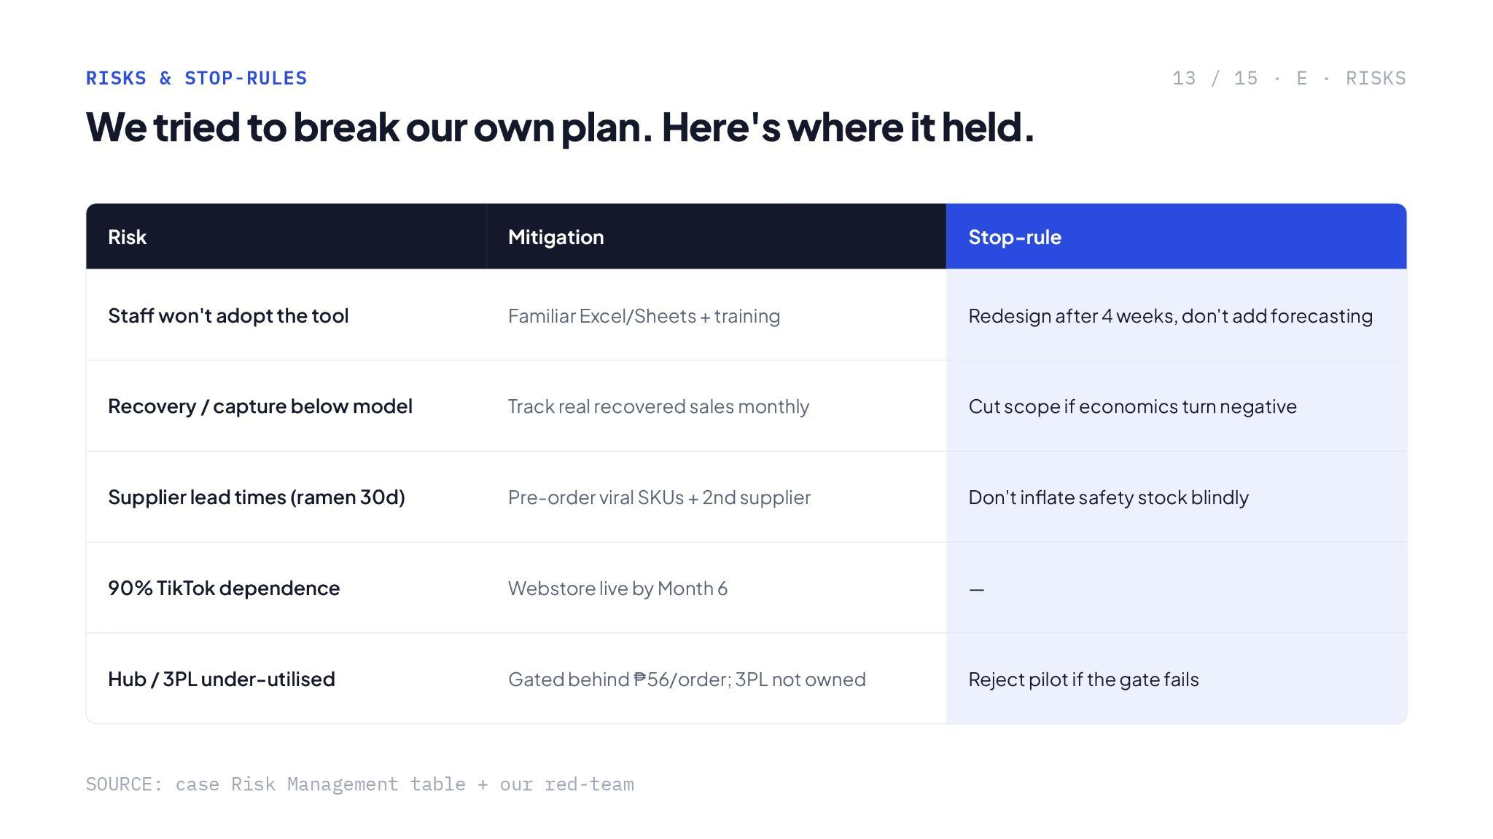

Slide 15
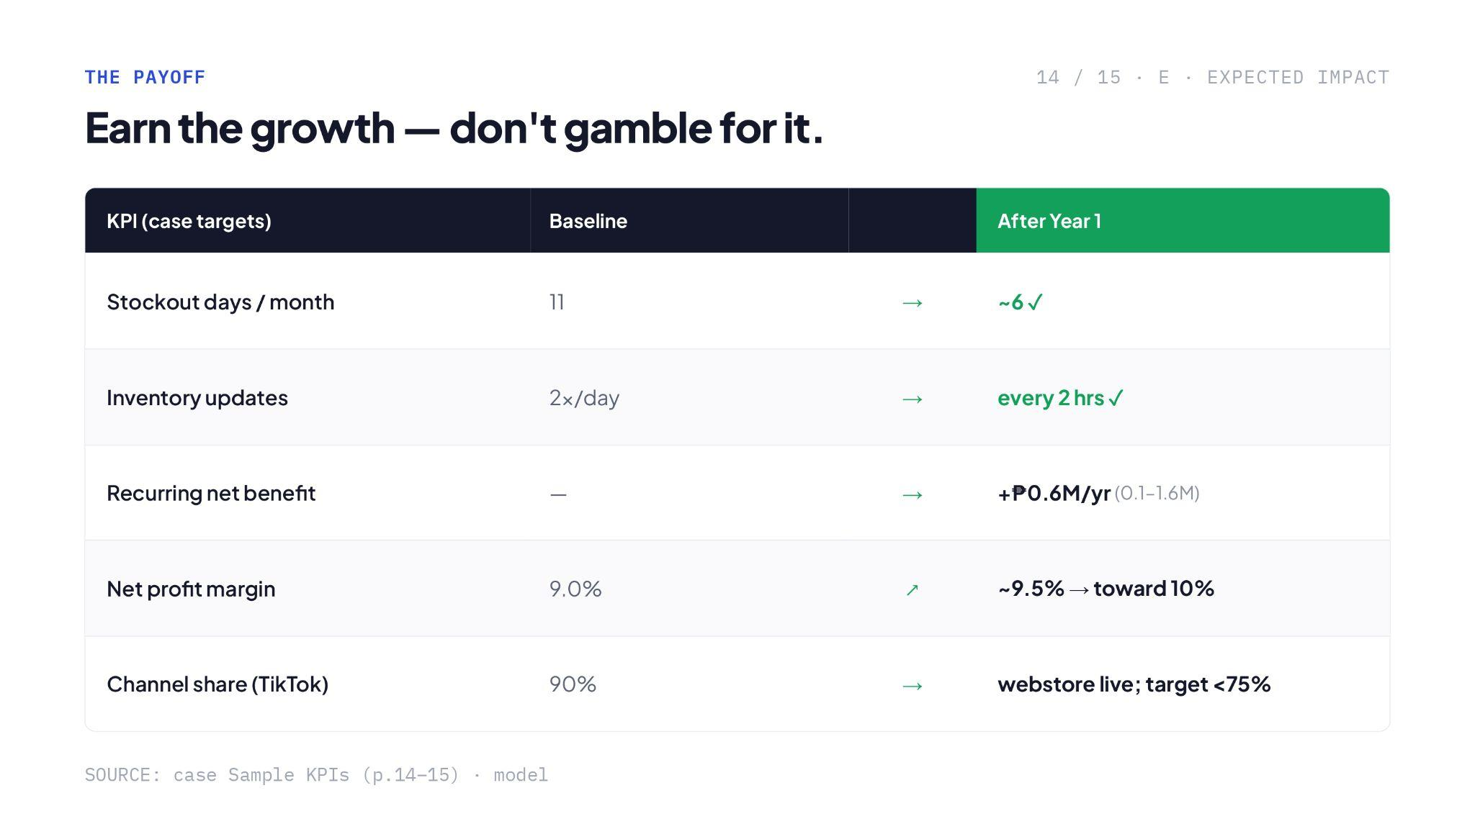

Slide 16
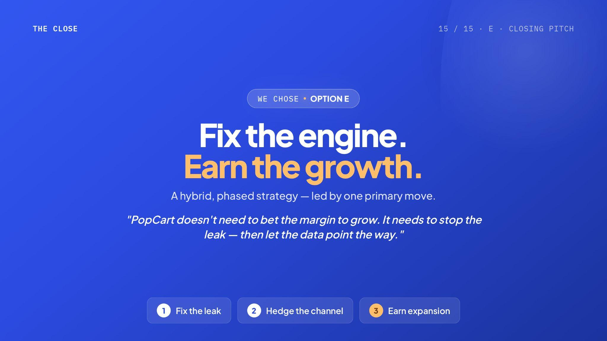
Notes:
Very strong closing

Slide 17
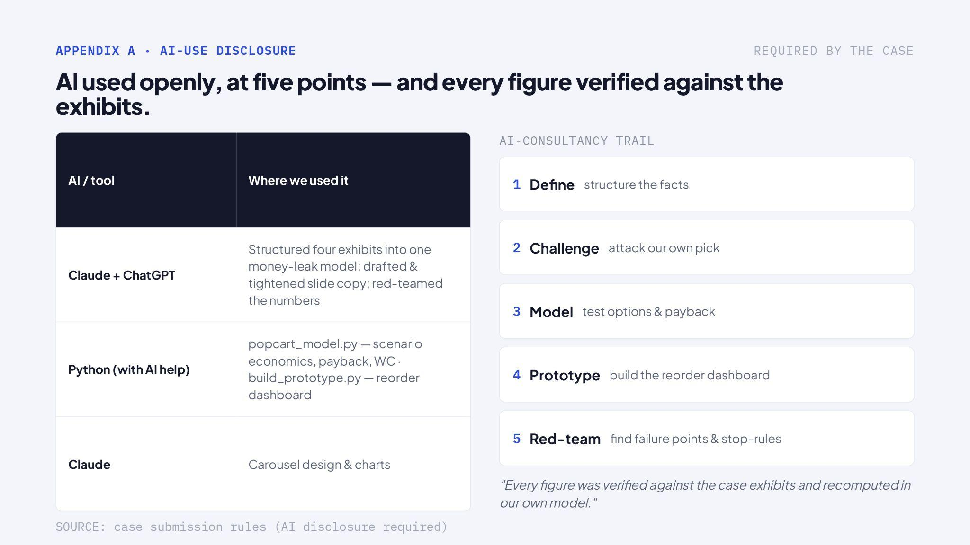

Slide 18
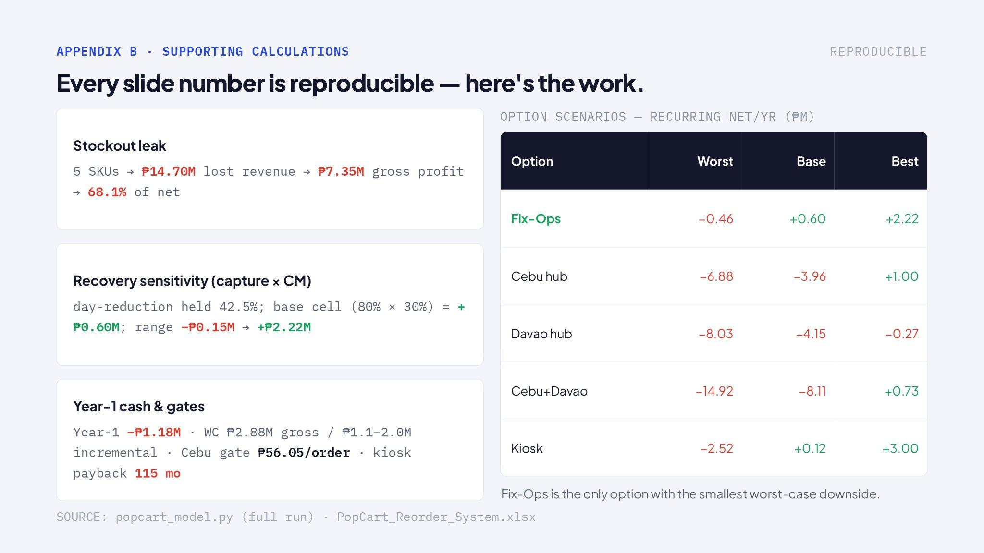

Slide 19
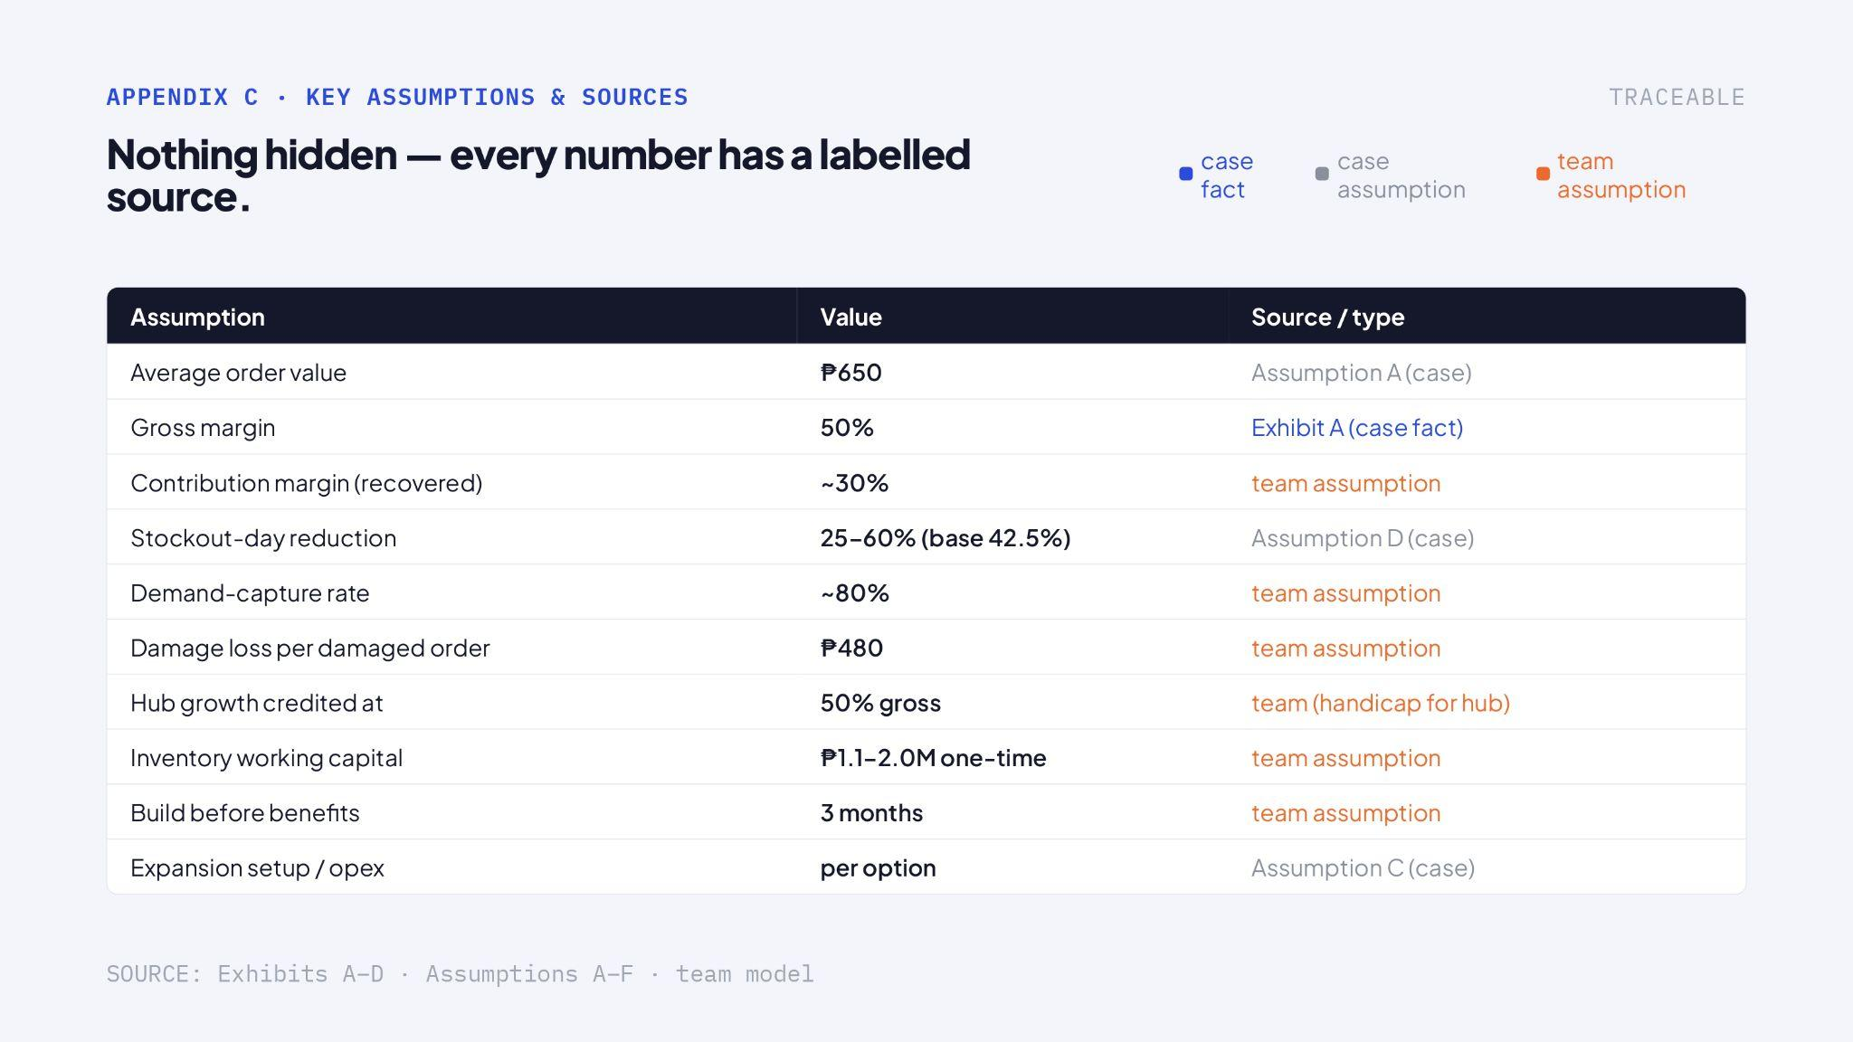

Slide 20


