Slide 1
POPCART PH · LAMBO 2026 QUALIFYING CASE
FIX THE ENGINE
BEFORE YOU GROW THE BODY
PopCart is profitable, viral, and growing fast — ₱120M in sales at a 9% margin (Exhibit A) — and quietly losing two-thirds of its profit to a leak no one is watching.
Here's where the money goes — and the cheapest way to stop it.
[School Name] · [Team Name]
Notes:
Written deck, no presenter. The cover states the paradox (healthy + bleeding) and promises a payoff.

Slide 2
A · STRATEGIC RECOMMENDATION
THE BOTTOM LINE
If you read one slide, read this one — the entire case in five answers.
OUR CALL: Fix operations first. Expand only in sequence — never all at once.
Q1 · Biggest problem Stockouts — ₱7.35M/yr in lost gross profit, not shipping (Exhibit C)
Q2 · Where to expand Nowhere yet — fix ops online; a Cebu 3PL is gated to Month 7
Q3 · The tool A simple dashboard that gives earlier reorder warnings (improves Exhibit D)
Q4 · The impact Stockout days 11 → ~6/mo; inventory updates 2×/day → every 2h (Exhibit C/D)
Q5 · Worth it? Adds ₱1.0–1.6M recurring benefit/yr; ₱1.4M setup; ~13–20 mo payback
₱7.35M gross-profit leak · +₱0.20M cautious recurring floor · 13–20 mo payback
PopCart PH · LAMBO 2026 · [School] · [Team]
01
Notes:
Answer first (BLUF). Everything after this is evidence, in the case's A-E order.

Slide 3
B · WHY IT MAKES SENSE
FIVE PROBLEMS, ONE QUESTION
Before choosing a fix, we asked a sharper question: which problem is quietly the most expensive?
1
Shipping to Visayas / Mindanao is costly
₱155 / ₱185 per order
Exhibit B
2
Delivery is slow
5–7 days (Cebu), 7–10 days (Davao)
Exhibit B
3
Products arrive damaged
4.2% / 5.0% return rate
Exhibit B
4
Stockouts on viral best-sellers
out of stock up to 11 days/mo
Exhibit C
5
90% of sales on one channel
TikTok Shop dependence
Exhibit D
Shipping is the loudest cost. Stockouts are the quietest quantified opportunity — and the cheapest first move to test.
PopCart PH · LAMBO 2026 · [School] · [Team]
02
Notes:
We frame the 'why' section as a hunt for the real culprit, and pre-highlight stockouts.

Slide 4
B · WHY IT MAKES SENSE
FOLLOW THE MONEY
Read Exhibit A with us — where does PopCart's ₱120M actually go?
Revenue
₱120.0M
100%
THE OBVIOUS INSTINCT
− Cost of goods sold
(₱60.0M)
50%
Shipping is 20% of revenue — the biggest controllable line.
So cut it: build a regional hub.
It feels right.
Watch what happens when we test it. →
− Platform fees & marketing
(₱12.0M)
10%
− Logistics & shipping subsidies
(₱24.0M)
20%
− Warehouse OpEx + Admin
(₱13.2M)
11%
= Net profit
₱10.8M
9%
Source — Exhibit A — Simplified Financial Snapshot, FY2025
PopCart PH · LAMBO 2026 · [School] · [Team]
03
Notes:
We let the reader reach the 'build a hub' conclusion — then dismantle it on S5. The ponder setup.

Slide 5
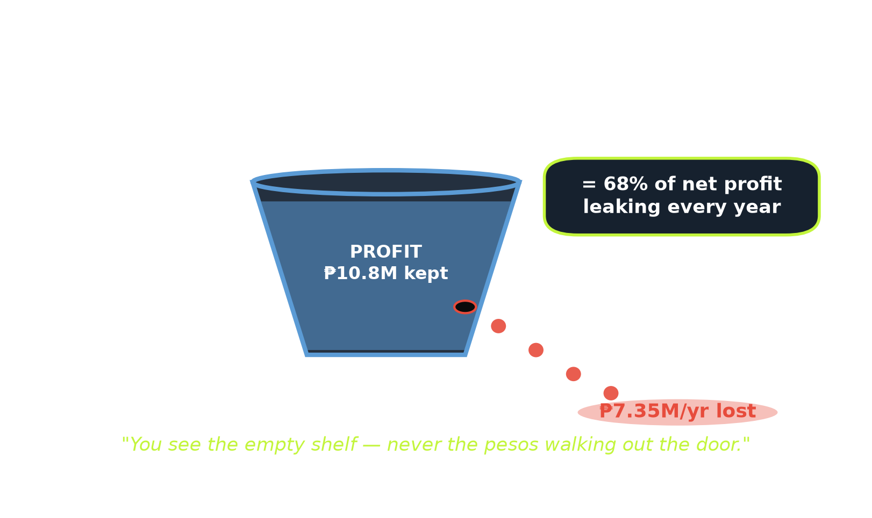
B · WHY IT MAKES SENSE
THE LEAK YOU CAN'T SEE
Now read Exhibit C — and do this one calculation with us.
● Freeze-dried candy sells 300 units/day — but is out of stock 11 days a month (Exhibit C).
● 300 × 11 × 12 = 39,600 units never sold → × ₱180 = ₱7.13M → × 50% margin (Exhibit A) = ₱3.56M lost on ONE product.
● Across all fast-movers: ₱7.35M/yr in lost gross profit = 68% of net profit (Exhibit A).
● Exhibit D shows the control gap: stock updates happen by hand twice a day, while ordering relies on visual checks and gut feel.
Shipping is the biggest cost. Stockouts are the biggest quantified recoverable opportunity.
Source — Exhibit C (velocity) · Exhibit A (margin) · Exhibit D (manual ops)
PopCart PH · LAMBO 2026 · [School] · [Team]
04
Notes:
The aha — the analytical and emotional center. The reader does the math and feels the loss.

Slide 6
B · WHY IT MAKES SENSE
WHY THE OBVIOUS MOVE BACKFIRES
Remember the 'build a hub' instinct? Let's put real numbers on it.
● Central Visayas: 48,100 orders/yr (Assumption B) at ₱155/order (Exhibit B).
● A hub cuts shipping ~₱50/order (Assumption D) → 48,100 × ₱50 = ₱2.4M saved.
● Base damage savings (~₱0.29M) + 15% growth (~₱2.34M GP) lift total benefit to only ~₱5.04M.
● Against ₱9M annual operating cost, the base case loses ~₱3.96M.
● Break-even needs roughly 40% regional growth — above the case's 15–30% planning range.
WHAT A HUB DOES TO THE MATH
₱5.04M total benefit
₱9M to run /yr
Base case still loses ~₱3.96M / year
Source — Exhibit B · Assumptions B/C/D/E · Exhibit A
PopCart PH · LAMBO 2026 · [School] · [Team]
05
Notes:
Payoff of S3: the reader proposed the hub; the data talks them out of it. Trust is earned.

Slide 7
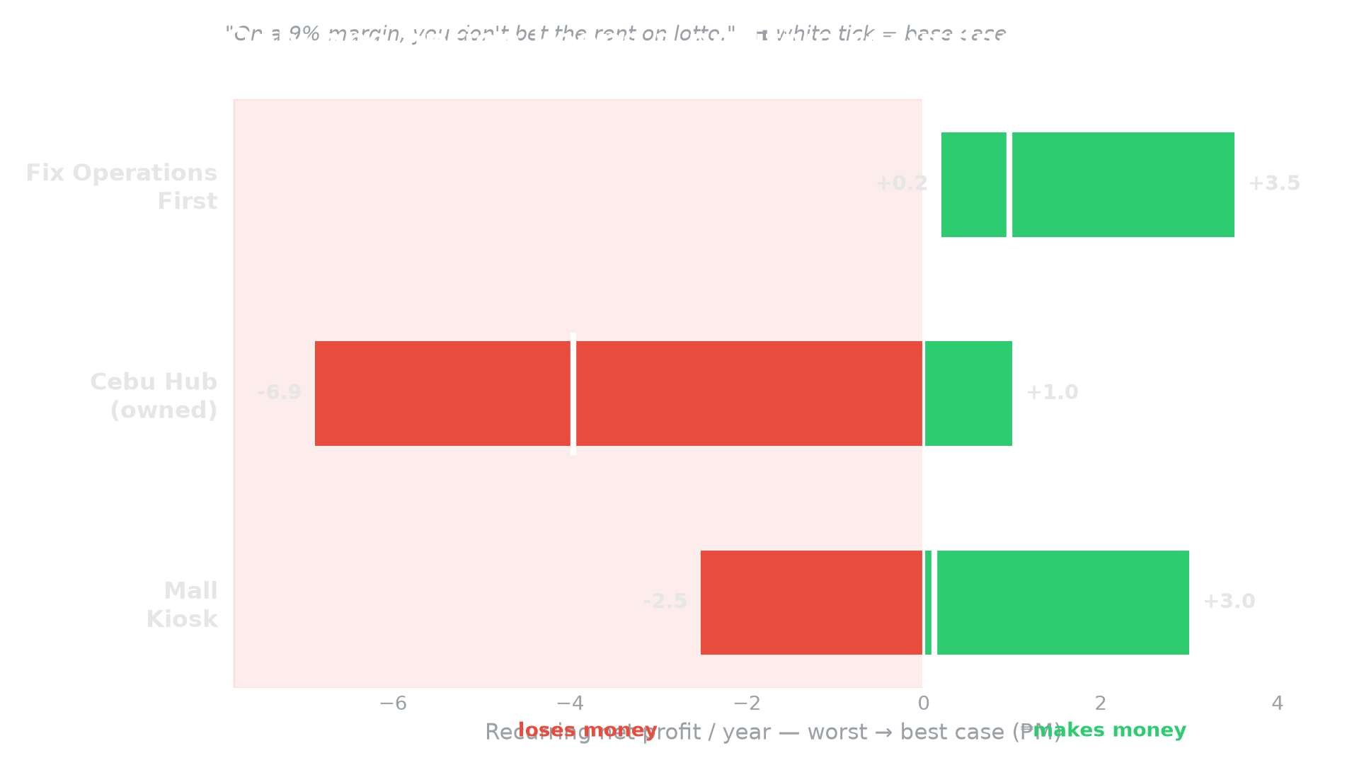
B · WHY IT MAKES SENSE
THE OPTIONS, SIDE BY SIDE
We modeled each option's range — because on a 9% margin, the downside matters as much as the upside.
● Fix Operations: +₱0.2M → +₱3.5M — the recurring floor stays positive.
● Cebu hub (owned): −₱6.9M → +₱1.0M — loses in 2 of 3.
● Mall kiosk: −₱2.5M → +₱3.0M — a coin-flip on foot traffic (Assumption F).
● Decision rule: protect the downside first; earn the upside through measured pilots.
Source — Model on Exhibit C + Assumptions C/D/E/F · full math in Appendix
PopCart PH · LAMBO 2026 · [School] · [Team]
06
Notes:
We handicapped the hub generously (50% margin) and discounted our own plan (30%) — Fix-Ops still wins.

Slide 8
C · HOW IT WILL WORK
FIX THE ENGINE FIRST, THEN EXPAND
One primary move, one supporting channel test, one gated pilot — each step must earn the next.
PRIMARY · MONTHS 1–6
GATED · MONTH 7+
YEAR 2 · DEFERRED
Fix operations
Cebu 3PL pilot
Kiosk / owned hub
Build stock visibility + earlier warnings. Test a small webstore and measure real orders.
Only if all partner costs fit below ~₱56/order — then prove it in an 8-week pilot.
Evaluated later from real operating and Cebu-pilot evidence; not funded in Year 1.
The principle: earn the right to expand. Year 1 builds operating proof that makes Year-2 growth safer.
PopCart PH · LAMBO 2026 · [School] · [Team]
07
Notes:
Resolves the 'do everything' trap the case penalizes. One real investment + a near-free hedge + a gated pilot.

Slide 9
C · HOW IT WILL WORK
AN EARLIER WARNING, WHILE THERE'S TIME
Ramen can have 20 days of stock left and still be late to reorder — because its supplier needs 30 days.
1 · UPDATE
2 · COMPARE
3 · WARN
4 · DECIDE
Bring daily sales, current stock, incoming orders, and supplier lead time into one sheet.
Ask: will available and incoming stock last until the next delivery arrives?
Flag the products likely to run short and show the projected gap.
Founder checks cash, supplier availability, and minimum order size before approving.
5 · LEARN Compare alerts with actual results weekly. Start with Excel + Power Query + barcode checks; add AI trend signals only after the basic data is reliable.
Source — Exhibit D (current process) · Exhibit C (lead times)
PopCart PH · LAMBO 2026 · [School] · [Team]
08
Notes:
Highest-weighted criterion (×5): real workflow, real tools, human-in-the-loop.

Slide 10
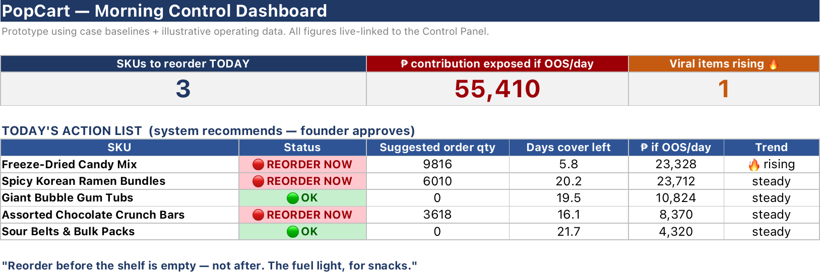
C · HOW IT WILL WORK
WE TESTED THE DECISION PROCESS
A working prototype shows how an earlier warning changes when the evidence changes.
Prototype — case baselines + clearly labeled illustrative operating data
Example: ramen shows ~20 days of stock cover, but its supplier needs 30 days (Exhibit C) — so the warning appears before the shelf is empty. This is not PopCart's live inventory and it does not place orders automatically.
PopCart PH · LAMBO 2026 · [School] · [Team]
09
Notes:
The credibility spike — the slide no other team can fake.

Slide 11
C · HOW IT WILL WORK
WHAT YEAR 1 SOLVES — AND DEFERS
A credible strategy states what the primary move improves — and what still needs a separate pilot.
PROBLEM
BASELINE (SOURCE)
AFTER YEAR 1
HOW
Stockouts
11 days/mo (Exhibit C)
~6 base; ~4–8 range
earlier warnings + 25–60% reduction
Inventory visibility
2×/day manual (Exhibit D)
every 2h after pilot
scheduled refresh + barcode checks
Channel risk
90% TikTok (Exhibit D)
second channel tested
webstore sales must be earned, not assumed
Shipping / delay / damage
₱155, 5–7d, 4.2% CV (Exhibit B)
not promised by primary move
only after a successful 3PL pilot
Source — Exhibit B · Exhibit C · Exhibit D · Assumption D
PopCart PH · LAMBO 2026 · [School] · [Team]
10
Notes:
Directly answers Q4 and proves we read every exhibit, not just the convenient ones.

Slide 12
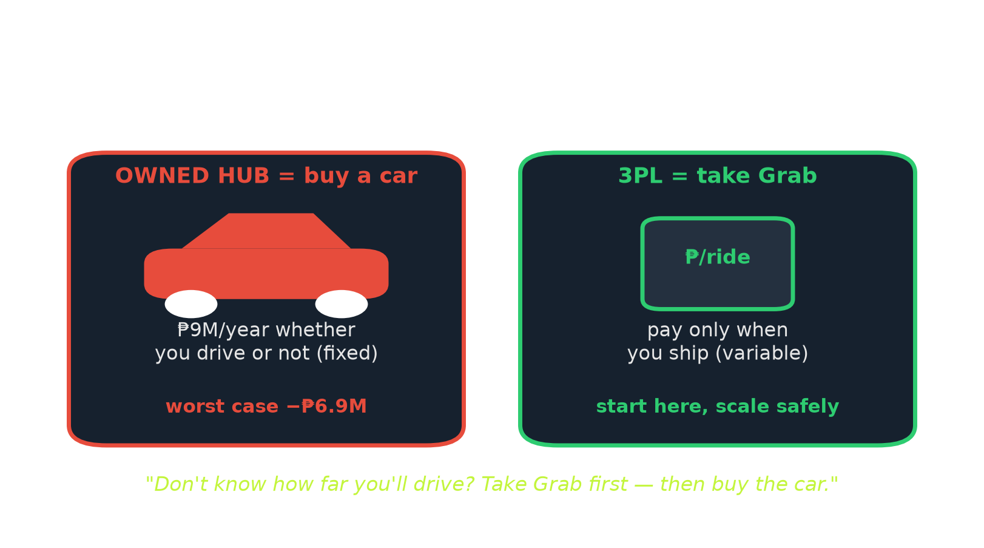
C · HOW IT WILL WORK
TEST CEBU BEFORE OWNING THE HUB
A 3PL is an outside warehouse that stores and ships selected products for a per-order fee.
● Owned hub: ₱7.2–10.8M/yr operating cost whether volume arrives or not (Assumption C).
● 3PL pilot: smaller commitment, per-order charges, selected products only.
● Cebu before Davao: higher volume (26% vs 17% — Exhibit B / Assump. B).
● Gate: storage + transfer + pick-pack + returns + minimums must fit below ~₱56/order.
● Proof: 8-week pilot; measure total cost/order, delivery time, damage, and stock availability.
Source — Exhibit B · Exhibit D · Assumptions B/C/D
PopCart PH · LAMBO 2026 · [School] · [Team]
11
Notes:
Q2 fully answered: where (Cebu via 3PL) and when (only when the unit economics earn it).

Slide 13
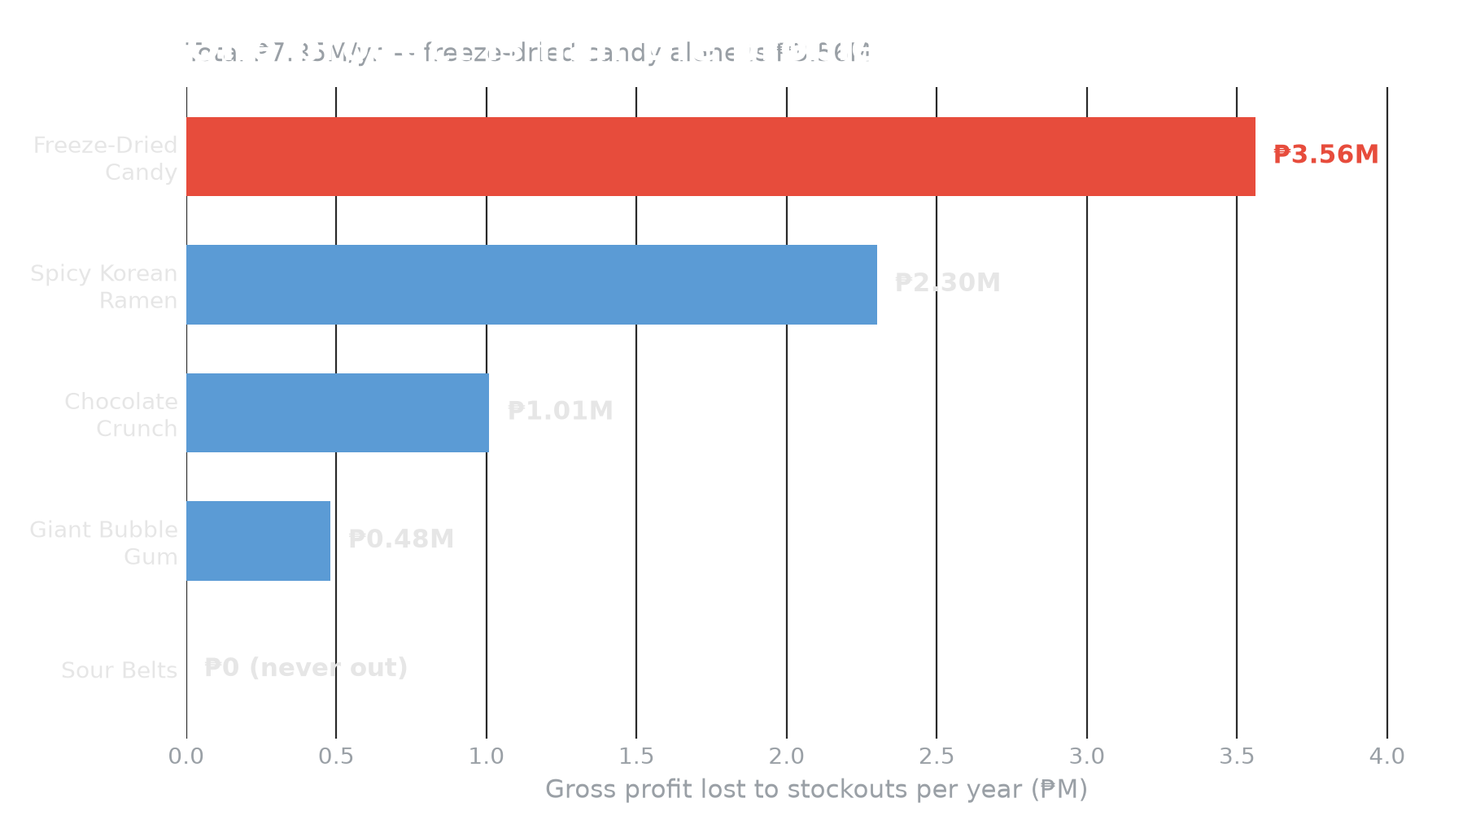
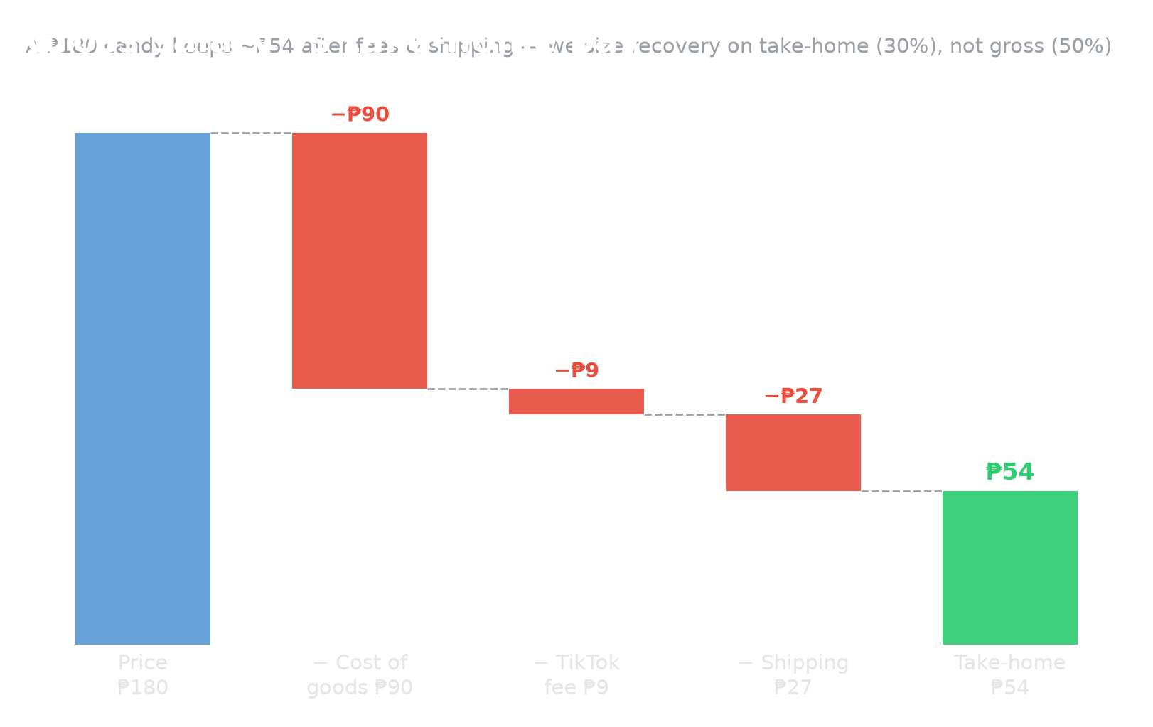
D · FINANCIAL LOGIC
THE HONEST MONEY
We could have claimed the full ₱7.35M. Here's the number we'd actually keep.
Base math: ₱14.70M lost sales × 42.5% recovery = ₱6.25M recovered revenue. At 30–40% money left after product, platform, and shipping costs: ₱1.87–2.50M. Less ₱0.90M annual system cost = ₱0.97–1.60M recurring benefit; one-time setup = ₱1.40M.
Source — Exhibit A · Exhibit C · Assumption D
PopCart PH · LAMBO 2026 · [School] · [Team]
12
Notes:
Honesty is scored. Discounting our own upside is what makes the number believable.

Slide 14
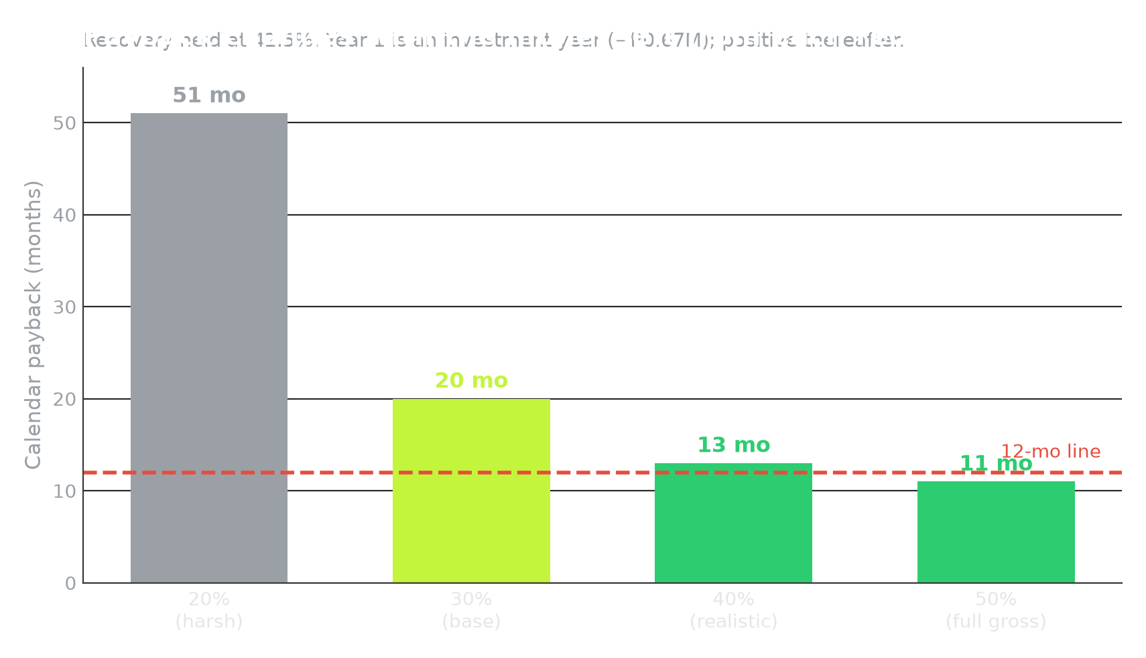
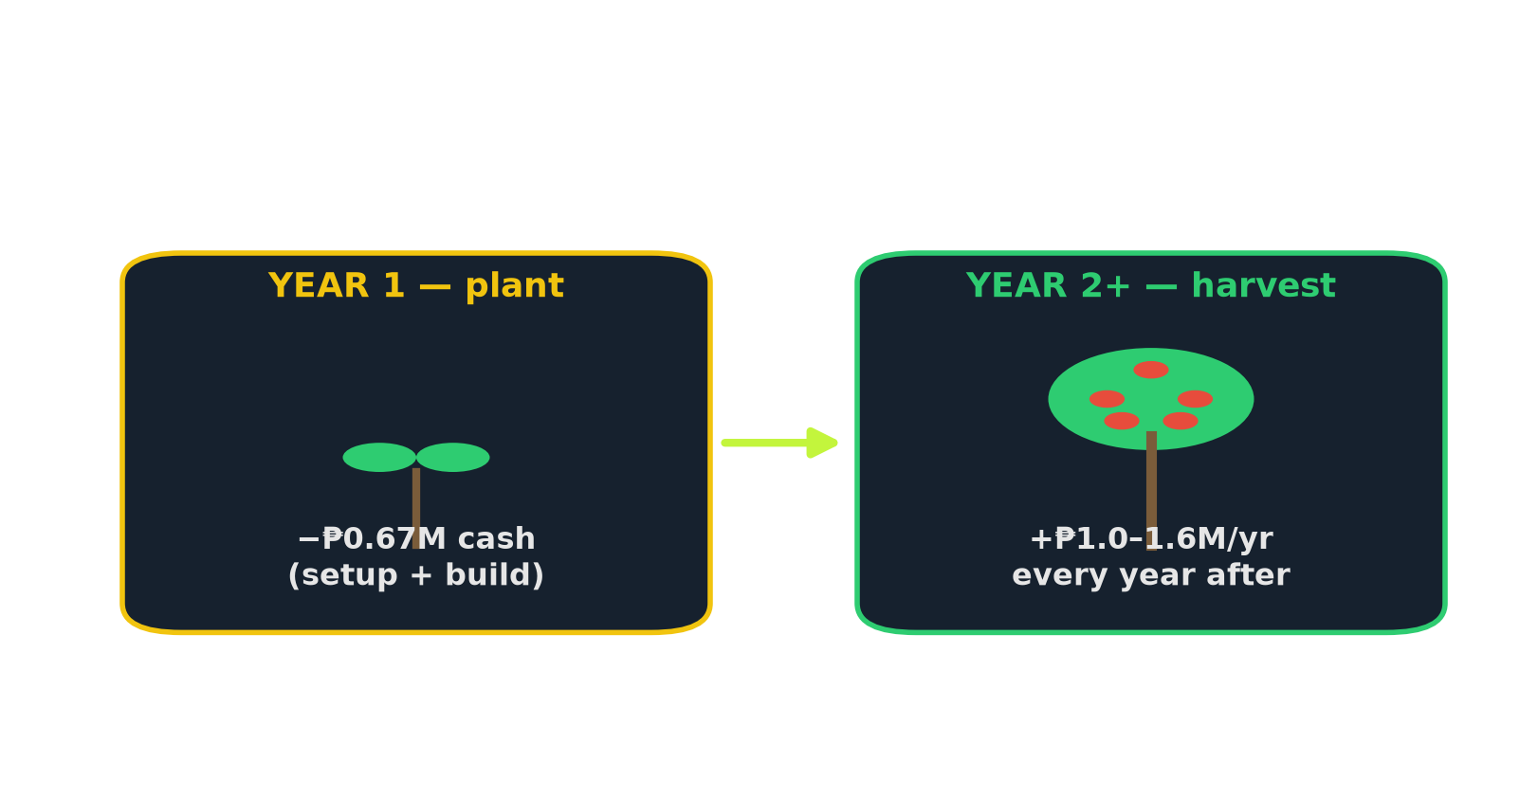
D · FINANCIAL LOGIC
PAYBACK, WITHOUT PRETENDING
Expected payback is ~13–20 months at 30–40% take-home margin — slower if fewer sales are recovered.
Year 1 is an investment year (−₱0.67M cash); net-positive thereafter. The case allows a payback beyond 12 months if stated honestly. The hub never pays back in its base case.
Source — Model on Exhibit C + Assumptions C/D
PopCart PH · LAMBO 2026 · [School] · [Team]
13
Notes:
Pre-empts the toughest finance question before a judge can raise it.

Slide 15
E · ROADMAP & RISK
BUILD THE HABIT, THEN TEST EXPANSION
Each phase produces evidence for the next decision — with a clear stop point if the numbers fail.
M1
M2–3
M4–6
M7 · GATE
M8–9
M10–12
BASELINE
PILOT
STABILIZE
QUOTE
IF GO: PILOT
DECIDE
Count stock; clean SKU + supplier list; confirm lead times.
5 fast movers; daily warnings; log founder decisions.
2h updates; target 6–8 stockout days; webstore test.
All-in cost <~₱56/order; cash available for split stock.
8 weeks; track cost, speed, damage, and availability.
SOPs + Year-2 go/no-go on expansion and kiosks.
People: warehouse manager + two admins run the daily process; founders approve purchase orders and the Cebu go/no-go.
PopCart PH · LAMBO 2026 · [School] · [Team]
14
Notes:
The Month-7 diamond is the proof of discipline the case rewards.

Slide 16
E · ROADMAP & RISK
STOP THE LEAK. EARN THE GROWTH.
We tried to break our own plan — here's where it held, and where it lands.
RISKS → MITIGATIONS
EXPECTED IMPACT
● Staff adoption → familiar Excel/Power Query workflow + training.
● Channel shock → webstore test by Month 6; measure orders before claiming diversification.
● Recovery below model → track stockout days + recovered sales monthly; adjust or stop.
● Hub under-use → deferred behind a unit-economics gate.
● Long leads, ramen 30d (Exhibit C) → pre-order + 2nd supplier.
~6
2h
₱1M
stockout days
update cycle
recurring / yr
from 11 (Exhibit C)
from 2×/day (Exh. D)
base ₱0.97M; up to ₱1.6M
“Success isn't found in the newest hub —
it's in the precision of the shelf.”
PopCart PH · LAMBO 2026 · [School] · [Team]
15
Notes:
Red-team + impact + payoff line that ties back to the cover. The engine, fixed.

Slide 17
APPENDIX A — AI DISCLOSURE
AI was our analytical partner — and we checked every number it produced against the exhibits.
TOOL
WHERE WE USED IT
AI assistants ([Claude / Gemini / ChatGPT])
Structured the exhibits; ranked the money leaks; drafted copy; red-teamed the strategy
Python (written with AI help)
popcart_model.py — scenario financials & payback; build_prototype.py — the reorder prototype
Google Trends / public web
Market context on TikTok Shop PH & snack e-commerce
[Canva / PowerPoint]
Slide design, charts, and this deck
"AI was an analytical and drafting partner. Every figure was verified against the case exhibits. No output was presented as fact without human checking."
PopCart PH · LAMBO 2026 · [School] · [Team]
16
Notes:
Fill in the exact tools your team used before submitting.

Slide 18
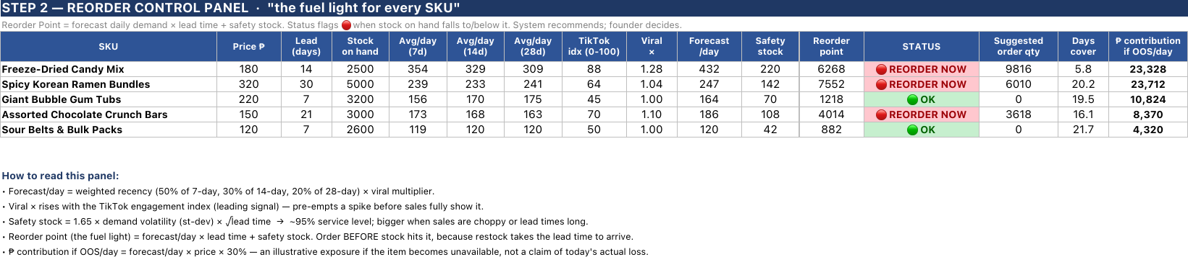
APPENDIX B — THE WORKING MODEL
Every cell is a real formula — the README tab documents the math, so it's fully auditable.
Reorder Control Panel — forecast, safety stock, reorder point, status, suggested qty (live formulas)
Forecast/day = weighted 7/14/28-day × viral multiplier · Safety stock = 1.65 × volatility × √lead-time (~95% service) · Reorder point = forecast × lead-time + safety stock
PopCart PH · LAMBO 2026 · [School] · [Team]
17
Notes:
Upload PopCart_Reorder_System.xlsx to Google Sheets to demo live if you reach the semifinal.

Slide 19
APPENDIX C — ASSUMPTIONS & SOURCES
We'd rather show our working than hide it — here is every assumption behind the numbers.
● AOV ₱650; 185,000 orders/yr (Assumption A/B). Blended gross margin 50% (Exhibit A).
● Contribution margin ~30% on recovered sales — nets out platform fees + shipping (the honest value, not 50% gross).
● Stockout recovery 25–60% (Assumption D); base case 42.5%.
● Damage loss/order ~₱480 (COGS + wasted shipping).
● Hub growth credited generously at 50% — we handicap the option we reject; Fix-Ops still wins.
● Expansion costs from Assumption C; 3-month build before benefits flow; tools at MSME low-end.
● Prototype daily-sales & TikTok index are illustrative samples — the logic is the deliverable.
PopCart PH · LAMBO 2026 · [School] · [Team]
18
Notes:
State assumptions clearly and disclose AI — both explicitly rewarded by the rubric.

