Slide 1
Overview of Component Models
October 29, 2008

Slide 2
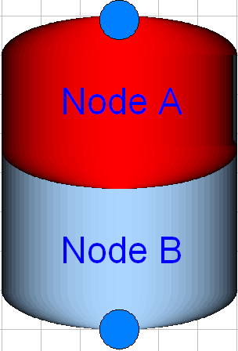
Basic Model Aspects
Boundary conditions (port conditions)
Mass balance (conservation of mass)
Energy Balance (conservation of energy)
Port A
Port B
Notes:
Key point: controller interpolation allows improved performance over a broad range of objectives

Slide 3
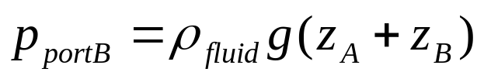
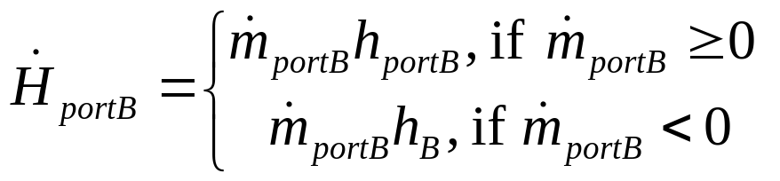
Thermal Energy Storage Tank
Boundary conditions
  p_{portB}: pressure at port B
  h_{portB}: enthalpy of fluid at port B
  mdot_{portB}: mass flow rate through port B
  Hdot_{portB:}: enthalpy flow rate through port B
z_{A}
z_{B}
Port B
Notes:
Key point: controller interpolation allows improved performance over a broad range of objectives

Slide 4
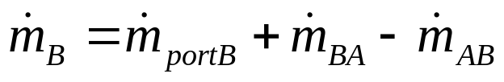
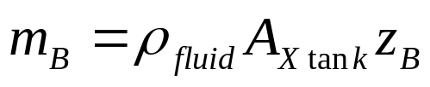
Thermal Energy Storage Tank
Conservation of mass
  m_{B}: mass of fluid node B
  mdot_{portB}: mass flow rate through port B
  mdot_{BA}: mixing induced by inlet/outlet jetting and buoyancy at port B
  mdot_{AB}: mixing induced by inlet/outlet jetting and buoyancy at port A
mdot_{BA}
mdot_{AB}
m_{B}
mdot_{portB}
Notes:
Key point: controller interpolation allows improved performance over a broad range of objectives

Slide 5
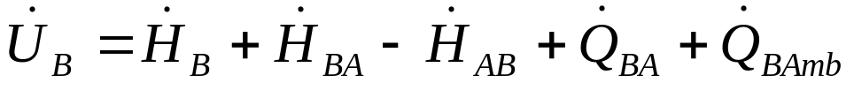
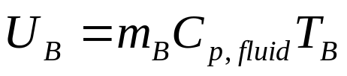
Thermal Energy Storage Tank
Conservation of energy
  U_{B}: internal energy of node B
  Hdot_{portB}: enthalpy flow rate through port B
  Hdot_{AB}: enthalpy flow rate due jetting/buoyancy induced mixing
  Qdot_{BA}: conductive heat transfer across thermocline
Hdot_{AB}
Qdot_{BA}
Hdot_{AB}
U_{B}
Qdot_{Bamb}
Hdot_{portB}
Notes:
Key point: controller interpolation allows improved performance over a broad range of objectives

Slide 6
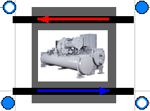



DOE2 Chiller Model
Evaporator Energy Balance
  Q_{evap}: heat flow rate into fluid flowing through evaporator
  Q_{desired}: cooling capacity required to cool leaving water to set point
  Q_{avail}: available cooling capacity
  CapF_{Temp}: biquadratic capacity factor function

Slide 7
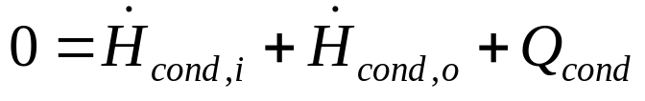



DOE2 Chiller Model
Condenser Energy Balance
  Hdot_{cond,i}: Enthalpy flow rate through condenser inlet
  Hdot_{cond,o}: Enthalpy flow rate through condenser outlet
  Q_{cond}: heat flow rate into fluid flowing through condenser
  Power: heated rejected to condenser from hermetic comporessor

Slide 8

DOE2 Chiller Model
Power calculation
  COP_{nom}: nominal coefficient of performance
  EIRF_{Temp}(T_{evap,o},T_{cond,i}): power input to cooling capacity ratio, biquadratic function
  EIRF_{PLR}(PLR): power input to cooling capacity ration, quadratic function
  PLR: power load ratio
  CCR: chiller cycling ratio

Slide 9
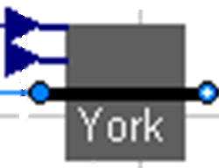
York Cooling Tower Model
Great implementation by Michael Wetter
Approach: temperature difference between cooling tower outlet and wetbulb temperatures
FR_{air}: air flow rate ratio
FR_{water}: water flow rate ratio
T_{wb}: inlet wetbulb temperature of air
T_{range}=T_{i}-T_{o}: difference between inlet and outlet water temperatures

Slide 10
York Cooling Tower Model
Great implementation by Michael Wetter
Approach: temperature difference between cooling tower outlet and wetbulb temperatures
FR_{air}: air flow rate ratio (user defined)
FR_{water}: water flow rate ratio
T_{wb}: inlet wetbulb temperature of air (user defined)
T_{range}=T_{i}-T_{o}: difference between inlet and outlet water temperatures

Slide 11
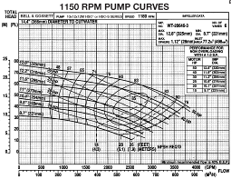
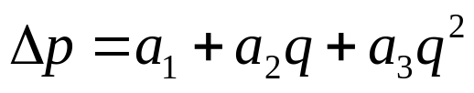
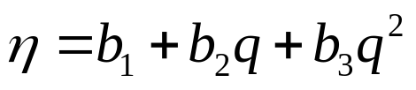
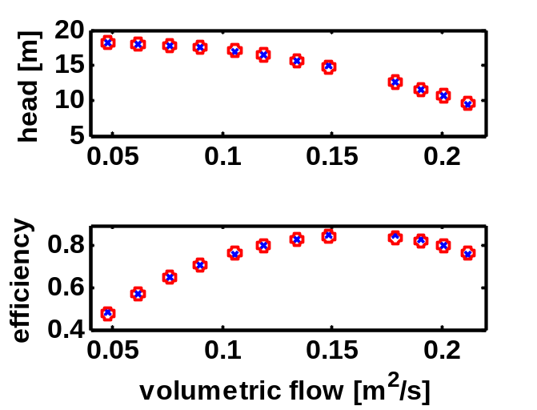
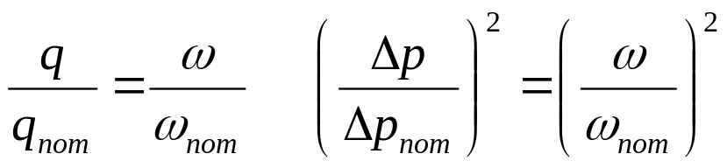
Quadratic Pump Model
Δp: pressure difference across pump
q: volumetric flow rate through pump
η: efficiency of pump
Power= Δp q/ η : power required to drive pump
Scaling flow and pressure with speed
quadratic curve fit

