Slide 1
CAS Applied Data Science
Module 2 – Statistical Inference for Data Science
Voting report in the Swiss National Council
Lisa Asticher, Kim Lan Vu, Emilie Zucchinetti
Bern, October 7, 2022

Slide 2
Question and Hypothesis
For the May 2022 special session of the National Council, can we identify any correlation as regard to Council members casting their vote against the majority of their parliamentary group ?
Hypothesis:
The parties in the center are less clear-cut, opportunity for higher frequencies of voting deviation
Age could be an indicator for more vote deviance, as older people are more likely to be longer in office and rely less on coalition majority
A 2020 article from the RTS showed that women's votes swing 1 in 10 votes in the national council, therefore we expect more deviation from women than men.

Slide 3
Data
Voting report in the National Council
Voting report inform the public about how Council members cast their votes on each item of business in the National Council and in the Council of States
Special session in May 2022
96 items of business, 200 Council members
Councillor name, date of birth, parliamentary group, canton
Format: xlsx
Source: www.parlament.ch

Slide 4
Data cleaning and pre-processing
Voting report in the National Council during the Special session in May 2022
Converting the raw data into a csv table (1 row = 1 vote)
For each item of business, evaluating how the majority of each parliamentary group voted, comparing it with the individual vote and adding the corresponding data in the table
Party Grouping: Left (Social Democrats, Green Group), Center (Center Group), Right (Green Liberal Group, Liberals Group, Swiss People’s Party)
Adding data about age, gender and regional affiliation of the Councillors
Deleting unnecessary and irrelevant data
Numbering the items of business, renaming the parliamentary group

Slide 5
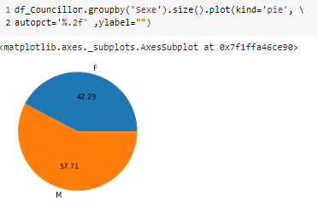
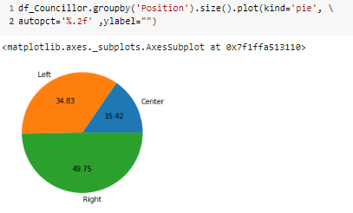
Descriptive Statistics
Repartition of the dataset
Men are more represented than women.
The two positions right and left are the most represented. Only 15% of the councillors belong to a party from the center.

Slide 6
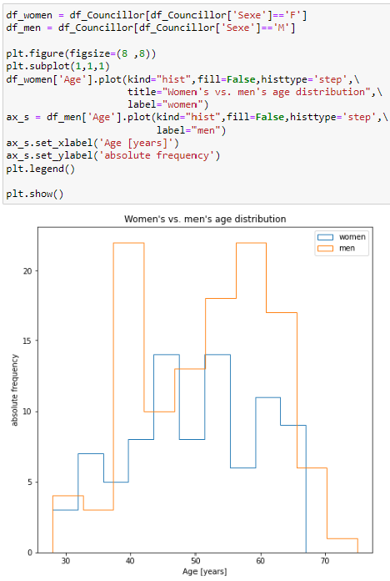
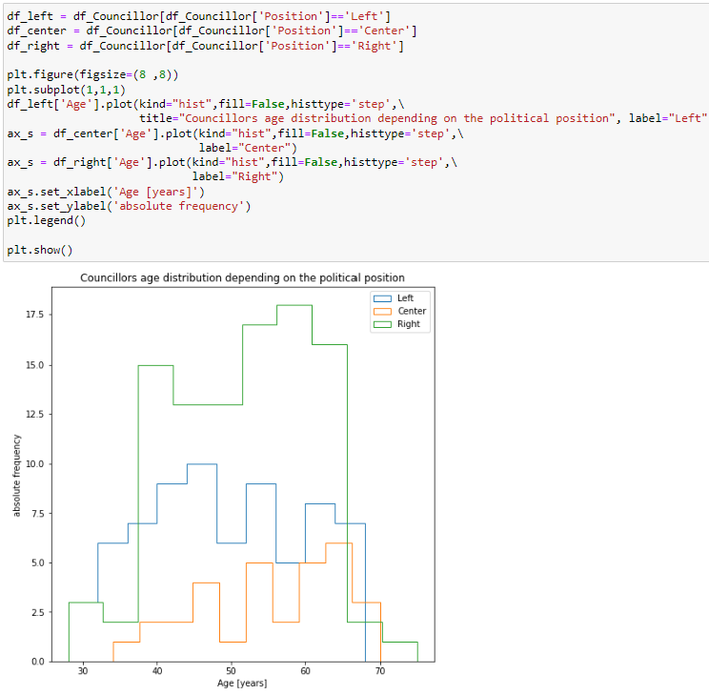
Descriptive Statistics
Most men councillors are aged between 55 and 65 years. Women are well represented from age 45, probably when the children are starting to get older.
Most young people belong to a left party, but the tendency reverses at age 40 where most people belong to a right party. The center grows in popularity with age.

Slide 7
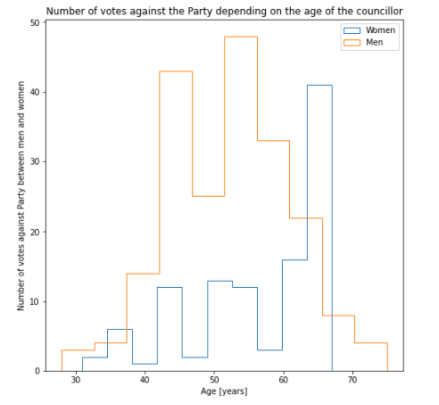
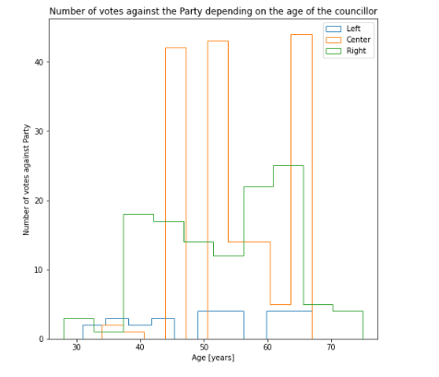
Descriptive Statistics
Do age, gender or opinion affect votes against the party ?
It seems that men tend to disagree more with their party than women. Older people also seem to disagree more with their party.
Most people voting against the Party seem to belong to the center. Having less extreme views in politics, they are maybe more likely to change their point of view depending on the subject.

Slide 8
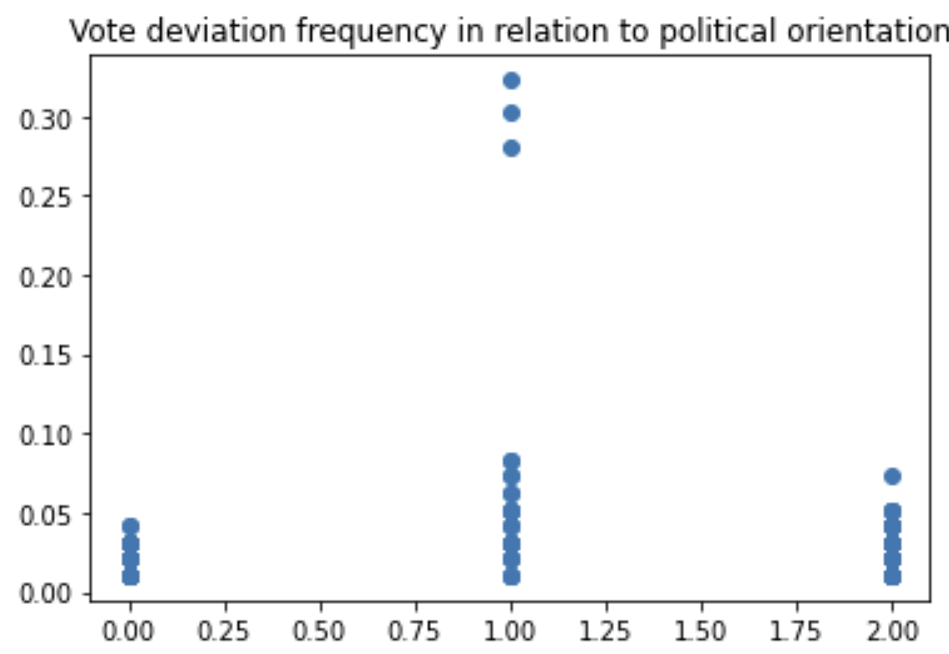
Data Analysis
Left
Center
Right

Slide 9
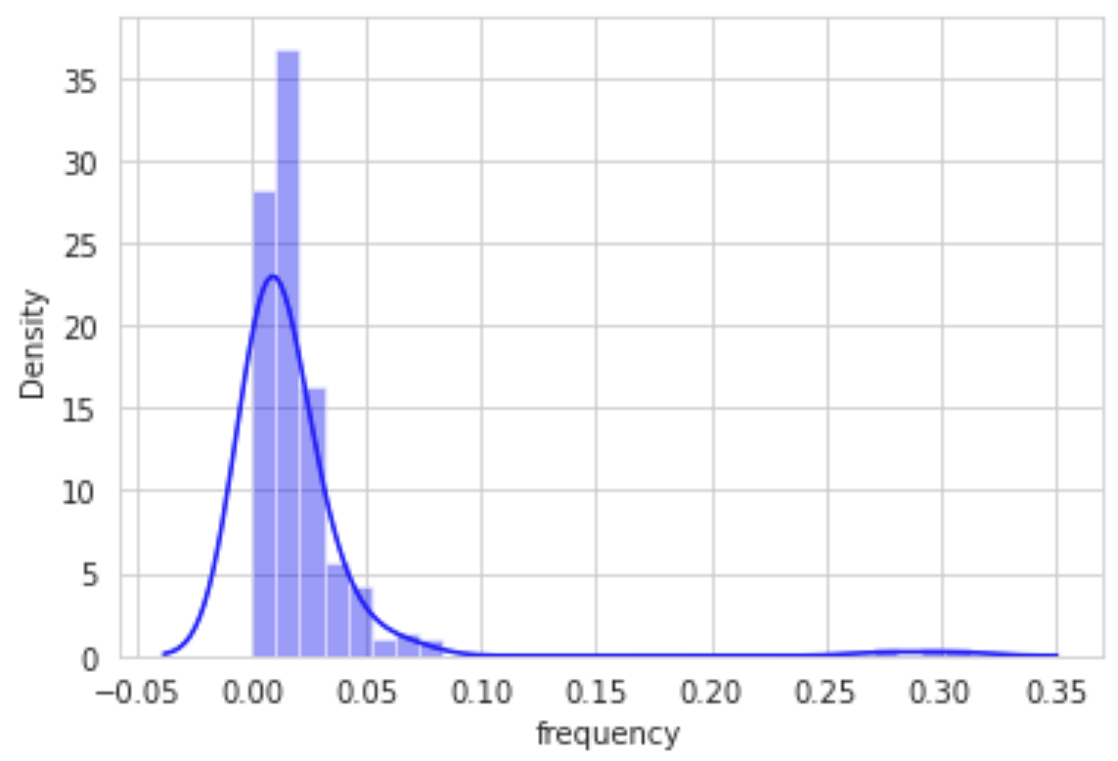
Data Analysis
Distribution of voting deviation frequency

Slide 10
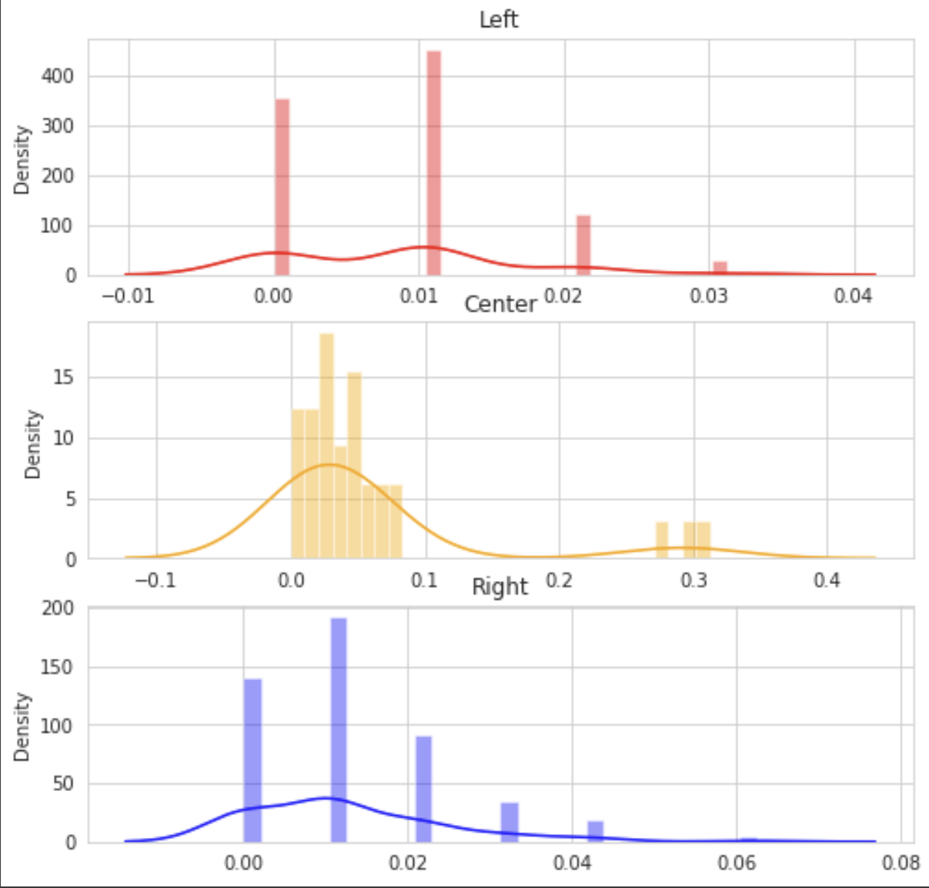
Data Analysis
Distribution of voting deviation frequency

Slide 11
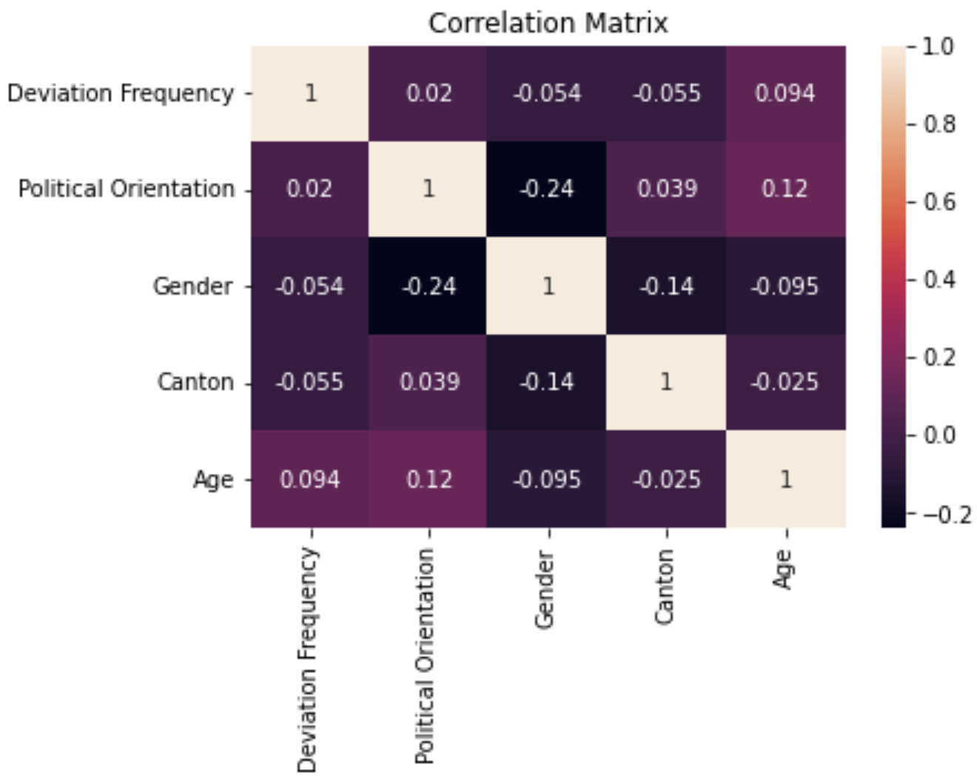
Data Analysis
Apparently no correlations?

Slide 12
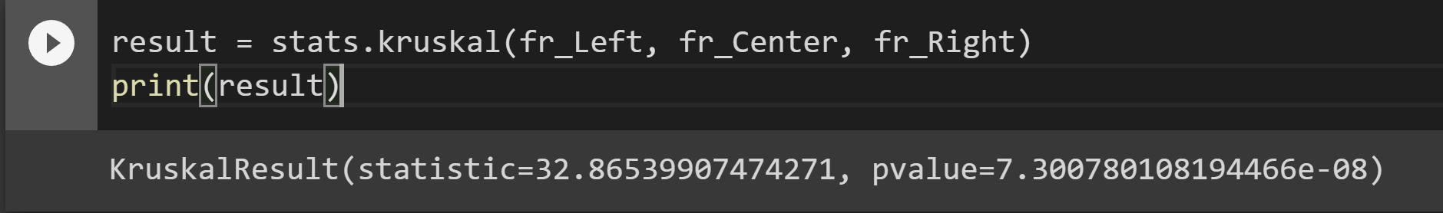
Data Analysis
Let’s try with a test!
This Kruskal-Wallis test allows us to see if there is a statistically significant difference between the medians of the three groups, corresponding to the three political orientations. It works even if the data is not normally distributed and skewed.
The test statistic equals 32.87. The corresponding p-value is less than 0.05, we can therefore reject the null hypothesis that the median frequency of deviant voting is the same for all three groups.
Question: How do we interpret this result?

Slide 13
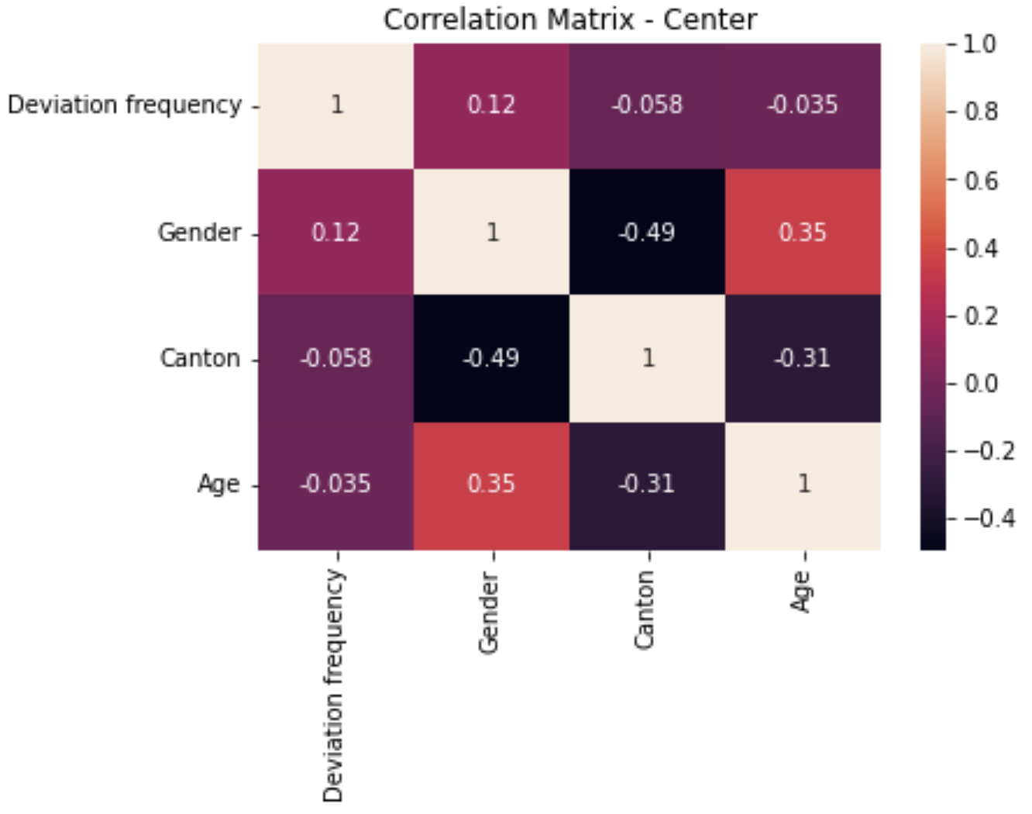
Data Analysis
A deeper look within the “deviant” group
No variable seems to explain the variance of voting deviation frequency for the Center, not even gender, as shown by the results of the .Mann–Whitney U test

Slide 14
Conclusion & Discussion
Raw Dataset, with no predestined use and little assumptions
Lots of Data Wrangling and Data Exploring
Voting deviation is an interesting topping - but little conclusions so far…
Special session of 3 days only, maybe a need for a bigger dataset with more sessions and voting objects?
Or a need for more individual parameters (=parameters linked to politicians, such as the list of interest of each politicians)
Addition of variables related to the voting object and the social and political context (e.g. type and content of policy, force of Lobby, media coverage) as a necessary condition for further investigations → Text Analysis & Machine Learning?

Slide 15
Sources
Les femmes font basculer un vote sur dix au Conseil national, RTS Info, 2020: https://www.rts.ch/info/suisse/11546799-les-femmes-font-basculer-un-vote-sur-dix-au-conseil-national.html
2022, SESSION SPÉCIALE MAI (XLSX), Link to the original dataset: https://www.parlament.ch/centers/documents/_layouts/15/DocIdRedir.aspx?ID=DOCID-53009006-8935

