Slide 1
Behind the Secrets of LLM
Kyuri Im | Lyoungah Kim
SemEval Project
10.02.2025

Slide 2
21.01.2025
Current Status
Apply BERT-Base model for pretrained-BERT
Use Probability-ranking for emotion detection
Probability threshold set to 0.5
TO-DO
Apply XLM-RoBERTa for multi-lingual support.
Loss Function : Binary Cross-entropy loss
Try different types of setting threshold
Dynamic Top-K: Select all emotions above a dynamically chosen threshold based on the sum or mean probability distribution.

Slide 3
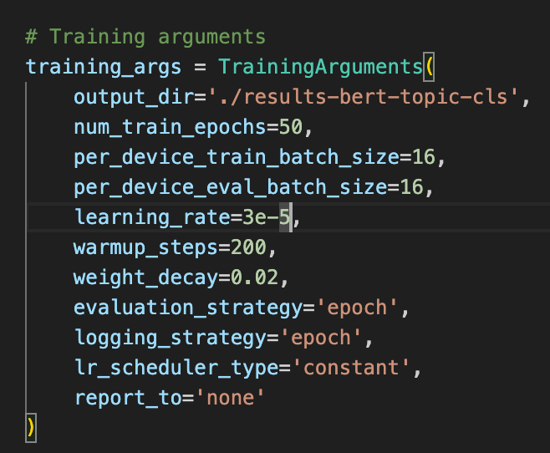
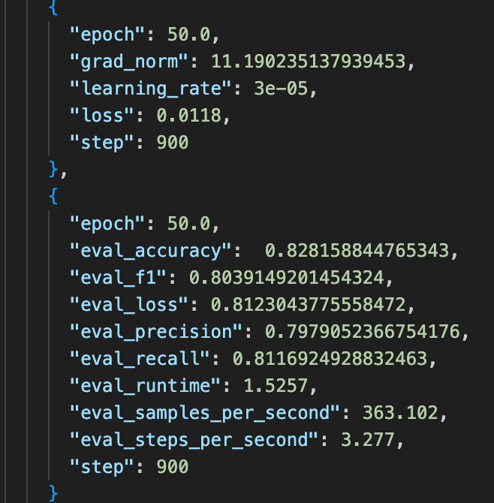
Current State :

Slide 4
Further Improvement on Performance
Pretrain RoBERTa with Cornell Movie-Dialog or GoEmotions
Cornell Movie-Dialog : A large-scale dataset of emotions in text, containing over 58,000 examples of text with emotions annotated.
GoEmotions :
Finetune with Optuna
Optuna : Set the range of hyperparameters and find the parameters that return the highest f1 score
-
Combination of DialogXL and RoBERTa
DialogXL contains conversational data
Combine strength of RoBERTa’s classification and DialogXL’s data to improve the emotion detection

Slide 5
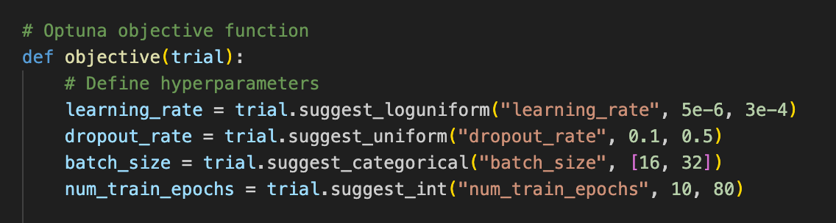
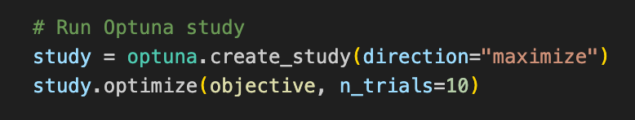
RoBERTa + Optuna
{'eval_loss': 0.8629946112632751, 'eval_accuracy': 0.8371841155234657, 'eval_f1': 0.8150111820748002, 'eval_precision': 0.807912934150558, 'eval_recall': 0.824642152016175, 'eval_runtime': 1.5379, 'eval_samples_per_second': 360.226, 'eval_steps_per_second': 3.251, 'epoch': 84.0}

Slide 6
RoBERTa + Optuna
Kyuri
Optuna Trial : 30
Epoch : 84
Eval F1 : 0.8083
Eval Acc: 0.8310
Lyoungah
Optuna Trial : 20
Epoch : 102
Eval F1 : 0.8173
Eval Acc : 0.8390

Slide 7
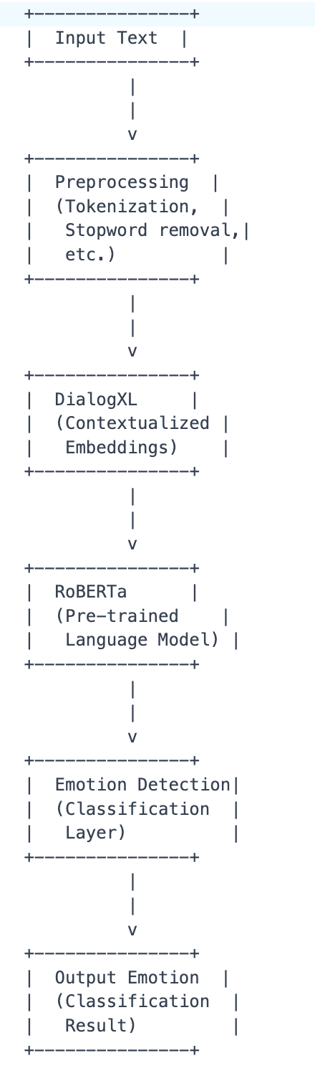
Input Text : The input text data that needs to be analyzed for emotion detection.
Preprocessing : This step involves tokenizing the input text, removing stopwords, and performing other necessary preprocessing tasks.
DialogXL : This is a contextualized embedding model that generates embeddings for the input text. DialogXL can capture the nuances of language and provide more accurate representations of the input text.
RoBERTa : This is a pre-trained language model that can be fine-tuned for specific tasks, including emotion detection. RoBERTa can provide additional contextual information and improve the accuracy of the emotion detection model.
Emotion Detection : This is a classification layer that takes the output from RoBERTa and predicts the emotion associated with the input text.
Output Emotion : The final output of the model, which is the predicted emotion associated with the input text.

Slide 8
Evaluation Metric
F1 Score Standard
what’s used in SemEval Competition
Macro Averaging :
Precision, F1, Recall treating all 5 emotions equally regardless of its frequency
Hamming Loss :
Measuring how often labels are misclassified across the dataset.
If the model incorrectly predicts "joy" for a text but correctly predicts "anger," Hamming Loss captures the specific misclassification
Subset Accuracy :
Scenarios where you need the model to predict all emotions for a given text perfectly

Slide 9
Evaluation Metrics
Besides F1 Score, Possible evaluation metrics
Area Under the Receiver Operating Characteristic Curve (AUROC) : This metric plots the true positive rate against the false positive rate at different thresholds, providing a comprehensive view of your model's performance.
Area Under the Precision-Recall Curve (AUPRC) : Similar to AUROC, this metric plots precision against recall at different thresholds, providing insight into your model's ability to detect emotions.
Use GPT4 or Llamma to perform evaluation and compare F1 score

Slide 10
SHAP
Text: Pretty much everyone objected to my wedding.
LABEL_0: 0.2411
LABEL_1: 0.4667
LABEL_2: 0.3089
LABEL_3: 0.3636
LABEL_4: 0.4072
Text: Additionally, there was snow on the ground outside, but we found no footprints around the house and no mud or water in the kitchen where the intruder had been walking.
LABEL_0: 0.2411
LABEL_1: 0.4667
LABEL_2: 0.3089
LABEL_3: 0.3636
LABEL_4: 0.4072
Text: A former boxing coach for the Soviet Union.
LABEL_0: 0.2411
LABEL_1: 0.4667
LABEL_2: 0.3089
LABEL_3: 0.3636
LABEL_4: 0.4072

