Slide 1
Behind the Secrets of LLM
Kyuri Im | Lyoungah Kim
SemEval Project
10.02.2025

Slide 2
21.01.2025
Current Status
Apply BERT-Base model for pretrained-BERT
Use Probability-ranking for emotion detection
Probability threshold set to 0.5
TO-DO
Apply XLM-RoBERTa for multi-lingual support.
Loss Function : Binary Cross-entropy loss
Try different types of setting threshold
Dynamic Top-K: Select all emotions above a dynamically chosen threshold based on the sum or mean probability distribution.

Slide 3
Evaluation Metric
F1 Score Standard
what’s used in SemEval Competition
Macro Averaging :
Precision, F1, Recall treating all 5 emotions equally regardless of its frequency
Hamming Loss :
Measuring how often labels are misclassified across the dataset.
If the model incorrectly predicts "joy" for a text but correctly predicts "anger," Hamming Loss captures the specific misclassification
Subset Accuracy :
Scenarios where you need the model to predict all emotions for a given text perfectly

Slide 4
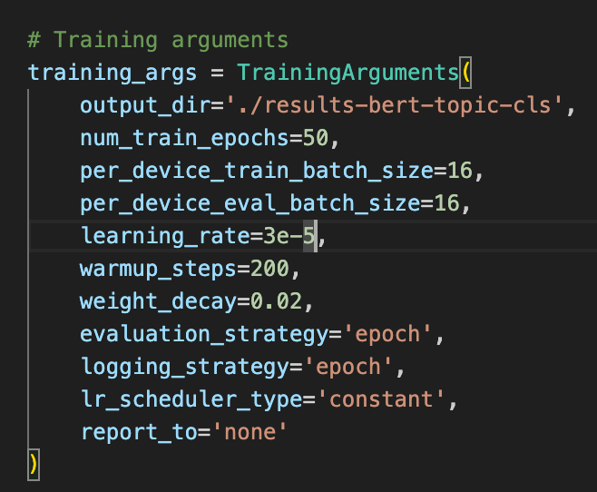
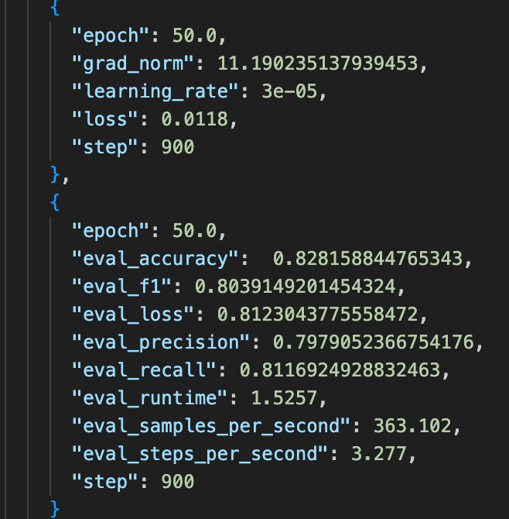
Current State :

Slide 5
SHAP

