Slide 1
VAA-Weekly-Progress
09/05 - 09/10

Slide 2
Context
Last week, we reviewed some papers on semi-supervised keypoint localization and the visual transformer pose estimator
We decided for this week to focus on solidifying a baseline model to proceed with, and comparing models pretrained on different datasets

Slide 3
Deciding on a Baseline System
OpenMMLab?
HRNet vs. RTMPose?
Read?
Performance?
Established benchmark datasets (e.g., AP-10k, AnimalPose)
Try your own images
What may cause trouble for pose estimators?
Pre-trained on AP-10k or pre-trained AnimalPose?
What are the benefits and drawbacks?
Why not both?
What does the dataset evaluation system look like?
How did AP-10k tackle the detection problem?

Slide 4
Deciding on a Baseline System
What do you choose?
Why do you choose it?
What is needed to get it working?
What could go wrong?

Slide 5
HRNET Evaluation
Trained on Animal Pose (w32 config):
Pros:
More accurate
Placement of wither kp on body focused pictures (on a higher place)
Marks both neck and wither
More accurate kp placement for average size blurry images
Cons:
Excessive number of kp’s on partially occluded objects
Excessive/lack of kp’s on weird poses
Misplaces head kp’s in blurry night time pictures
Trained on AP-10k (w48 config)
Pros:
More accurate kp’s for
Night time images (black and white)
Weird poses
Tracks hip kp more accurately in partial images
Small blurry images
Cons:
Does not see the head in blurry night time images
Adds additional hip kp in night time images

Slide 6
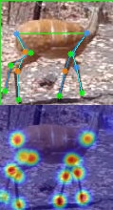
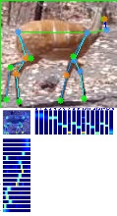
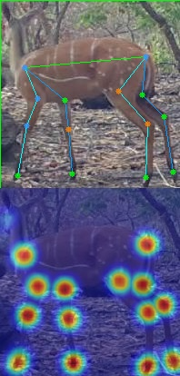
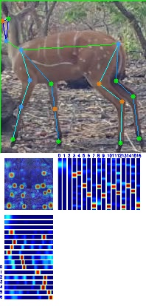
HRNet(w48) vs RTMPose
We ran both HRNet and RTMPose (pretrained on AP-10k) on our sample of antelope data. It appears that when predicting keypoints on the same image, RTMPose does a better job on detecting keypoints on the head.

Slide 7
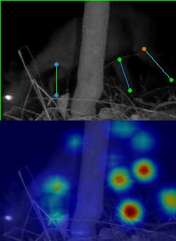
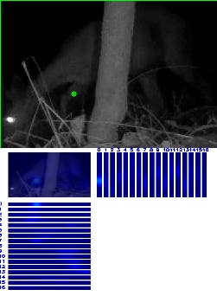
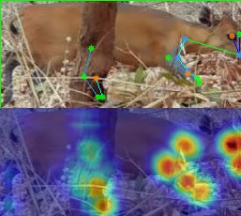
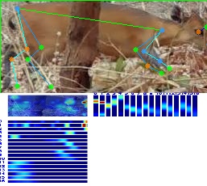
HRNet(w48) vs RTMPose
When detecting keypoints on an image with some obstruction, both models have difficulty. Note: in other night-time images, the two models perform at similar levels.

Slide 8
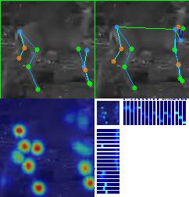
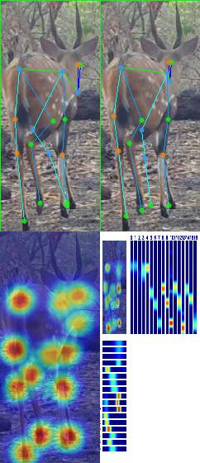
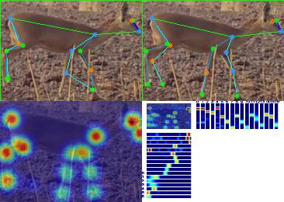
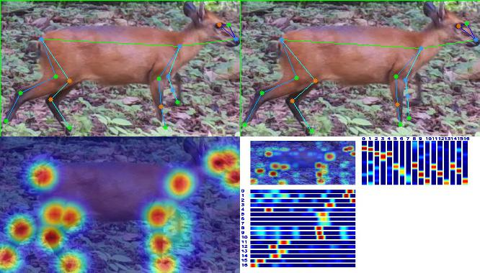
HRNet(w48) vs RTMPose
RTMPose seems to be slightly more robust, but both models suffer from the same challenges

Slide 9
RTMPose Evaluation
Trained on AP-10k:
Pros:
Tends to work well for when detecting the head using kps
Cut off images are labeled fairly well
Twisted/Weird poses still have relatively accurate kps
Some night time images have ideal kps
Cons:
Struggles with obstacles blocking animal of interest
Some blurry night images lack kps in necessary areas

Slide 10
Final Thoughts
We decided to proceed with RTMPose as our baseline model, because based on a qualitative analysis with a small subset of our data, it appears to have better performance compared to HRNet, specifically in images with occlusion and overall does a better job of identifying keypoints.

Slide 11
Next Steps
Train RTMPose on on Animal Pose data set and compare and contrast qualitative performance to determine on which training set results in better qualitative performance of RTMPose
Combine Animal Pose and AP-10K into one point(converting wither and neck points in Animal Pose to neck in AP-10K) and train RTMPose on the combined data set and test qualitative performance against RTMPose trained on each data set separately
Consider possible use of animal data sets as training data sets(AP-36K)

Slide 12
Personal Progress

Slide 13
Medha
Annotated 100 images with labels (Set 4)
Familiarized with OpenMMPose and analyzed outputs of two different models (HRNet and RTMPose) on our antelope data
Working on setup for OpenMMPose on personal deadcat
Met with team to decide on the baseline model to proceed with

Slide 14
Parth
Annotated 100 images with labels (Set 6)
Ran and analyzed RTMPose and HRNet Models trained AP-10K dataset
Tested the models on our data from Week 1
Decided on baseline model with team

Slide 15
Aryan
Annotated images from the B5_1.0_batchsupport_all_ant
Ran both models on previous data for a comparative analysis

Slide 16
Josh
Annotated 100 images with labels (Set 1)
Read abstracts and introductions of HRNet and RTMPose papers and watched talks to become familiar with the two models architectures and general advantages and disadvantages
Analyzed HRNet and RTMPose on set 1 of antelope images to qualitatively determine which network is more suited to be our baseline system
Discussed with team about which model to choose as baseline

Slide 17
Claire
Annotated 100 images with labels (Set 2)
Familiarized with OpenMMPose, and analyzed and compared results of running sorted antelope images with HRNet and RTMPose
Discussed with team about which model to choose as baseline

