Slide 1
VAA-Weekly-Progress
10/02-10/15

Slide 2
Context
Trained RTMPose to match OpenMMPose Stats
Working on algorithm to extract annotations for only antelopes and other subsets for future training
Updated hip and shoulder keypoints to two keypoints each for increased accuracy
Notes:
aryan

Slide 3
Agenda
Further updates to keypoint definition
Understanding the json format of annotations to help with clarifying how to label occlusions
Brainstorming for the abstract
Notes:
aryan

Slide 4
Goals
Finalize keypoint definitions and adjust occlusion handling - Medha and Claire
Document AP10K JSON format and make it easier for people to do individual work on species similarity - Parth
Script to parse AP10k annotations by species or groups of species - Josh
Work on identifying similar species using annotations - Armaan and Aryan, everyone else with free time
Finish setting up Tensorboard for experiment tracking -Shaan
Solve issue for exporting annotations out of Label Studio - Shaan
Brainstorm and draftf Abstract for expo - Everyone (deadline 17th October)
Notes:
Talk about abstract submission
Finalise labelling method we are using

Slide 5
Keypoint Definitions - Redesigned
Used more high quality images (Roan Antelope)
Simplified our method of occlusion handling
Redefined root of tail
Question: In the context of the root of tail (for a specific pose), should we be labeling the point consistently with other points (and have it be occluded) or label it at the visible end of the back (but not be consistent with the definition)?
New Definition and Old Definition
Notes:
Medha

Slide 6
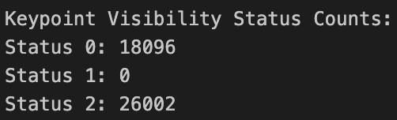
AP10K JSON format
Written documentation of the JSON data files in AP10K dataset that we will use to train the RTMPose models
Clarifies scheme needed for our data as well (specifically for visible vs non visible parts for keypoints)
Key finding: For keypoints the scheme is list([x, y, v]) for each keypoint type.
v=0 not labeled, v=1: labeled but not visible, and v=2: labeled and visible
Unfortunately v=2 is used for every labeled keypoint
Documentation of AP10K JSON Format: https://docs.google.com/document/d/1IYtKTpvS9_zEnk1fIRkd3QTxB-bGhruuK6Y4xPpCNrM/edit?usp=sharing
AP10k Test Set Labels
Notes:
Parth

Slide 7
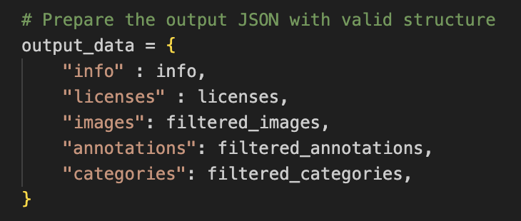
AP10k Annotation Parsing Script
Fixed Python Script from previous week so now proper subsets of the AP10k image data(folder of images) and annotations(new annotation file) can be created of species or groups of species.
Notes:
Josh

Slide 8
Next Steps
Evaluate new labeling scheme by measuring average precision per keypoint from everyone’s labels on a sample of images to identify any weaknesses in scheme
Conduct statistical analysis on labels and develop our own method of quantifying species similarity
Set up our first formalized experiment- Get enough images labeled to form a train, val, test split (ideally >300)
Notes:
Aryan
Ideally a 60 20 20 split
Applications:
3D understanding, modelling

Slide 9
Rough Plan for Abstract
Train RTMPose on our data from default weights
Train on our data from pre-trained AP10k weights
Train on AP10k antelopes + similar species by taxonomy save checkpoint, and continue training with our data
Train on AP10k antelopes + similar species by our own definitions save checkpoint, and continue training with our data
Evaluate all trained models on our test set
Find implications ?
Context:
Method
Results
Implications
Notes:
Aryan
Include purpose->methods->results->implications
Professor- >
Finetune on antelopes only
And similar antelopes also
Species similarity -> limit to ap10k

Slide 10
Personal Progress

Slide 11
Shaan
Annotated 100 images with labels (Set 3)
Figured out issue with importing and exporting data while retaining filenames, set up input and output folders to sync label studio project to
Parsed AP10k labels to see how visibility tags were assigned
Finally sorted out issues with Cisco VPN so now able to access DeadCat without being on campus

Slide 12
Medha
Annotated 100 images with labels (Set 4)
Made finalized keypoint definitions
Replaced all images with high quality images from 4 different angles
Simplified Occlusion Handling
Met with group to discuss method of labeling some trickier points

Slide 13
Parth
Annotated 100 images with labels (Set 6)
Documented COCO JSON format of AP 10k dataset
Identified root keys in the JSON and important identifiers within each section of the root keys
Met with group to discuss finalizing keypoint definition
Discussed research abstract with group

Slide 14
Aryan
Annotated 100 images with labels
Met with group and discussed how to handle occlusions on specific trickier areas

Slide 15
Armaan
Annotated 100 images with labels (set 5)
Finalized occlusion handling
Discussed method of handling tricker occlusions with team
Discussed next steps and research abstracts with group

Slide 16
Josh
- Fixed the Python script on deadcat to parse the annotations json file of the ap10k dataset to create a new annotations file with only the desired
species(it only keeps annotations from images with the desired species). It also takes the parsed annotations, finds the associated images and
creates a new folder with all the images correlating to the parsed annotation file. I fixed the parser script by making the parsed json annotation file a proper AP10k annotation file(I added license, info, images, and categories sections to the json file)
- Wrote up and submitted individual mid-semester review, and the senior design project document(description of the project, its goals, criteria, methods...)

