Slide 1
VAA-Weekly-Progress
10/16-10/22

Slide 2
Context
Last week, we met to complete and submit our project’s abstract
We continued our work on replicating MMPose accuracy and training with subsets of antelope
With our finalized keypoint definitions and occlusion handling, we could proceed to annotate several antelope images on Label Studio

Slide 3
Agenda and Goals
Finalized project abstract
Replication of MMPose accuracy shown with TensorBoard
Training AP-10k antelope subset on RTMPose
Annotations of antelope images on Label Studio
Notes:
Downstream applications:
e.g.) when an antelope is grazing (check how long they are grazing before checking their surroundings → might have correlation with locations where they’re more comfortable)

Slide 4
Abstract
Our research explores two major factors that impact the generalizability of keypoint estimation models to more difficult data. Specifically, we focus on in-the-wild antelope images captured from motion-triggered camera traps in Senegal, West Africa.
The first major factor we will focus on is how our model’s performance changes based on varied subsets of training data. To do so, we leverage the AP-10k dataset to explore different training strategies, such as whether training on a small subset of visually similar species helps the model generalize better.
Our second area of exploration is testing our keypoint labeling scheme, which is more rigorous than the labeling scheme of the AP10k dataset. Using our data, we created keypoint labels based on several different definitions – some are visually distinct, while others are more biologically correct. By training and testing with these different keypoint definitions, we want to explore what kind of keypoint definition helps the model generalize better. Our results improve keypoint detection for animals and, in a broader sense, contribute to the abundance estimation of animals in the wild.

Slide 5
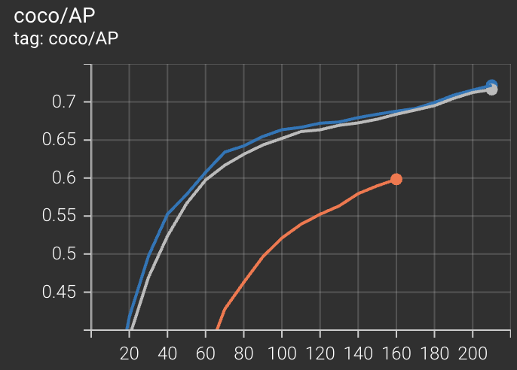
Replicating MMPose Accuracy
*Specify –work-dir ‘./training_logs’
at the end of a training commands
 | Results on DeadCat | MMPose
AP | 0.716 | 0.722
AP50 | 0.946 | 0.939
AP75 | 0.792 | 0.788
AP M | 0.579 | 0.569
AP L | 0.718 | 0.728
Haoyu
Us
Prev.

Slide 6
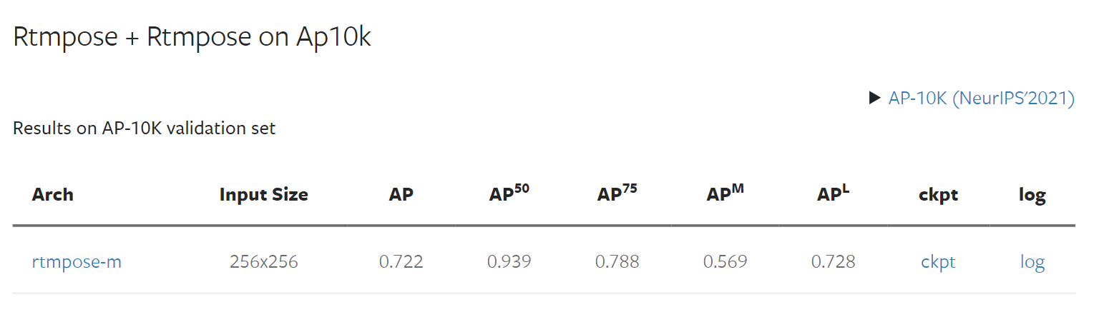
Antelope Subset Training
140 training images
40 testing images
20 validation images
"coco/AP": 0.7365, "coco/AP .5": 0.9074, "coco/AP .75": 0.7969, "coco/AP (M)": -1.0, "coco/AP (L)": 0.7365
Notes:
https://yanfengliux.medium.com/the-confusing-metrics-of-ap-and-map-for-object-detection-3113ba0386ef

Slide 7
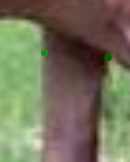
Annotations
Image Timings:
Medha: 3:24, 2:17, 1:51, 1:25
Josh: 11:23, 5:58, 3:57, 2:58
Parth: 5:28, 4:32, 3:55, 2:31
Comments:
Medha: Confusion on inner vs outer shoulder, should shoulder be estimated horizontally or where it leaves the body?
Josh: Confusion on paw locations, root of tail inconsistencies.

Slide 8
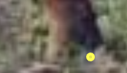
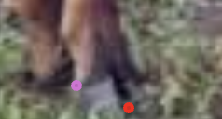

Slide 9
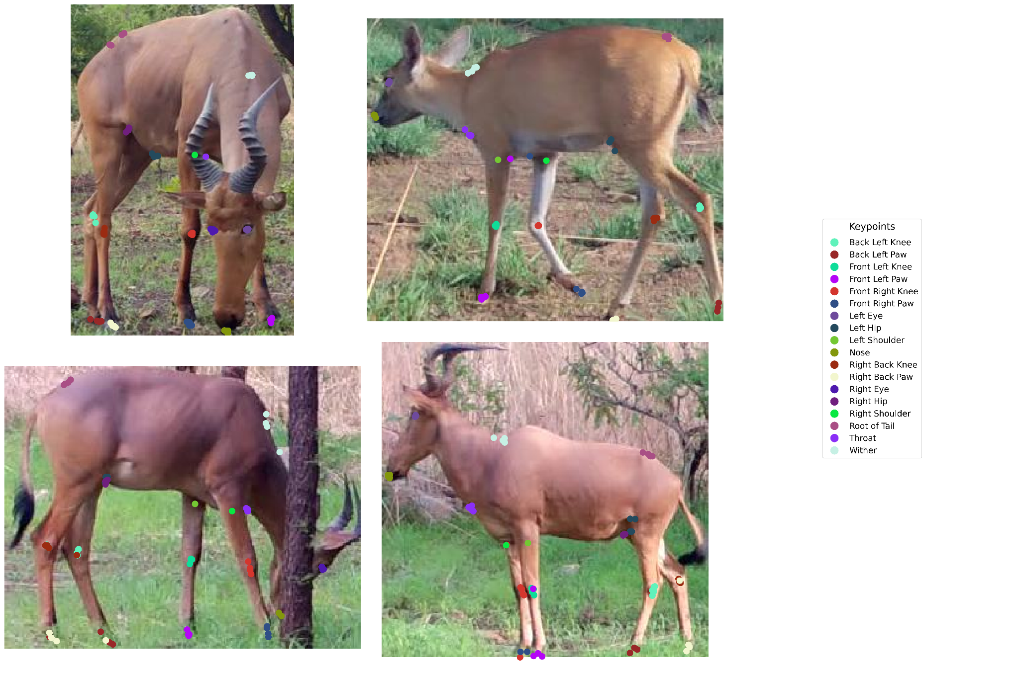
New Labeling Scheme

Slide 10
Next Steps
Training AP-10k Bovidae-family subset on RTMPose
Exploring similarity between animal species(visual and taxonomical)
Look into avenues for computing the visual similarity between animal species
Brainstorming downstream applications of project

Slide 11
Personal Progress

Slide 12
Shaan
Finally managed to replicate expected results with RTMPose on AP10K
Organized tensorboard runs in DeadCat
Updated Label-Studio config with new labeling scheme and put 4 sample images in a project for the team to label

Slide 13
Medha
Worked on creating rough draft of abstract and then helped adjust with the team
Trained RTMPose on antelope subset of AP10K
Need to understand the metrics used for evaluation and figure out how to test model on images
Annotated images based on labeling instructions

Slide 14
Josh
- Helped write and submit Abstract
- Began labeling images using new keypoint definitions
- Began looking into how to determine the visual similarity between animal species

Slide 15
Parth
Helped edit and submitted the abstract on OUR Connect
Annotated images based on labeling instructions
Starting to look into ways of identifying animal similarity

Slide 16
Armaan
-Helped write and submit abstract
- Labeled images using new keypoint definitions
- Looked into determining visual similarity between animal species

Slide 17
Claire
Helped with abstract
Annotated images of antelope on Label Studio

