Slide 1

Machine Learning To Classify Fish Images
Taeho Kim
Shashwat Maharjan

Slide 2
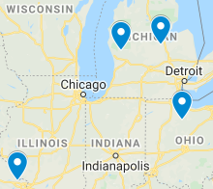
FIRST GOAL
Source Classifier from Fish Images from Four Sources
Tittabawassee
Muskegon
Sandusky
Illinois

Slide 3
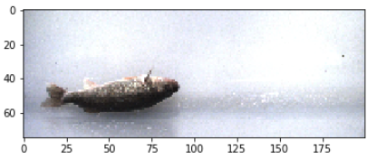
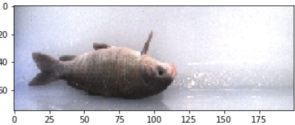
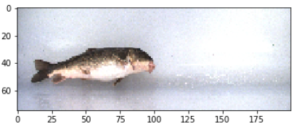
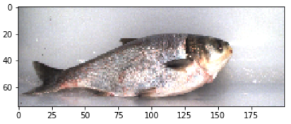
SECOND GOAL
Species Specific Size Classifier
Walleye
Smallmouth Buffalo
Small Carp
Common White Sucker

Slide 4
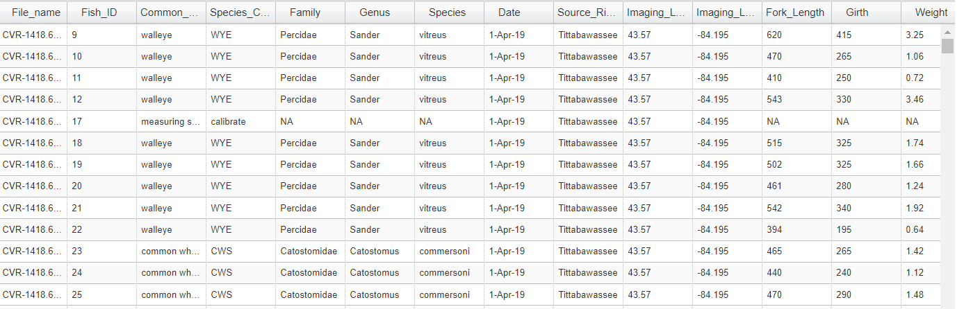
What we did
Data Collection
Data Preparation
Models
Extracted from
Fish Image Link
Image Data
Data Augmentation
VGG16
Targets
K-fold Validation

Slide 5
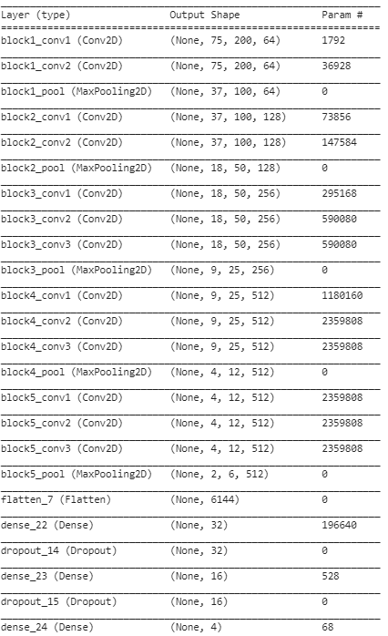
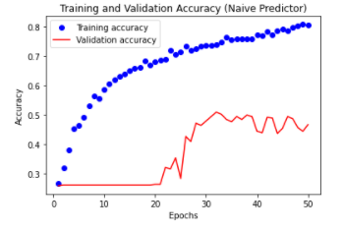
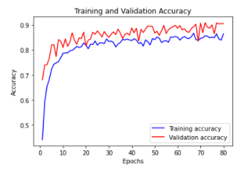
Source Classifier
Best Model
Training Accuracy: 87%
Validation Accuracy: 91%
Test Accuracy: 86%

Slide 6
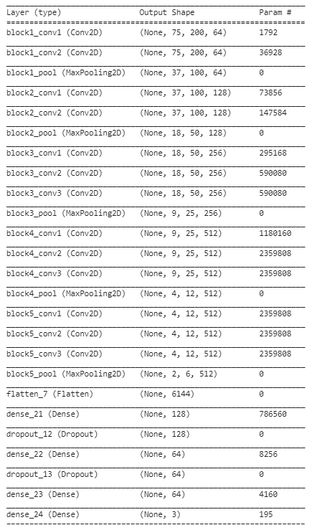
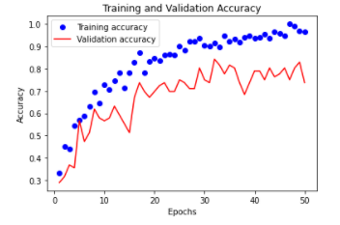
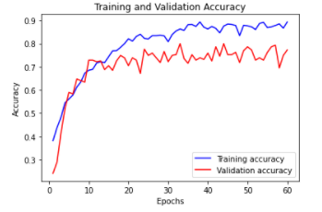
Small Carp Size Classifier
Best Model
Training Accuracy: 91%
Validation Accuracy: 80%
Test Accuracy: 82%

Slide 7
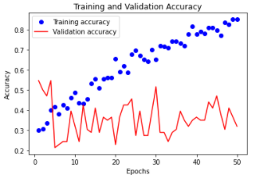
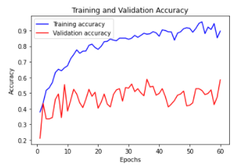
Smallmouth Buffalo
Training Accuracy: 93%
Validation Accuracy: 60%
Test Accuracy: 58%

Slide 8
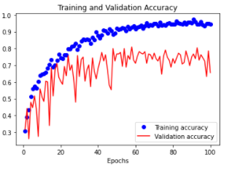
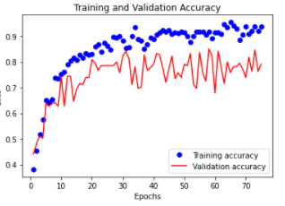
Walleye
Training Accuracy: 98%
Validation Accuracy: 83%
Test Accuracy: 84%

Slide 9
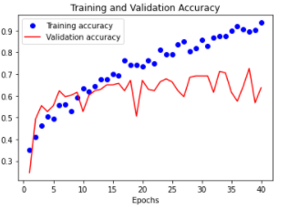
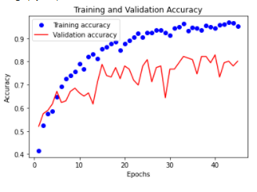
Common White Sucker
Training Accuracy: 95%
Validation Accuracy: 80%
Test Accuracy: 63%

Slide 10
Challenges and Takeaways

Slide 11
References
1.Akiba, T., Suzuki, S. & Fukuda, K. Extremely large minibatch sgd: Training resnet-50 on imagenet in 15 minutes.arXivpreprint arXiv:1711.04325(2017).
2.Bravata, N.et al.Applications of deep convolutional neural networks to predict length, circumference, and weight frommostly dewatered images of fish.Ecol. Evol.(2020).
3.Culurciello, E. Neural Network Architectures.https://towardsdatascience.com/neural-network-architectures-156e5bad51ba (2017). Online; accessed 18 September 2020.
4.Eickholt, J. FishL Low Resolution Images of Fish from the Great Lakes Region. https://osf.io/kqvg8/ (2020). Online;accessed 18 September 2020.
5.Goyal, K. Top 10 Neural Network Architetures in 2020 ML Engineers Need to Learn.https://www.upgrad.com/blog/neural-network-architectures/ (2020). Online; accessed 18 September 2020.
6.Iandola, F. N.et al.Squeezenet: Alexnet-level accuracy with 50x fewer parameters and< 0.5 mb model size.arXivpreprint arXiv:1602.07360(2016).
7.Joshi, R. P.et al.Machine learning the voltage of electrode materials in metal-ion batteries.ACS applied materials &interfaces11, 18494–18503 (2019).
8.Knudby, A., LeDrew, E. & Brenning, A. Predictive mapping of reef fish species richness, diversity and biomass in zanzibarusing ikonos imagery and machine-learning techniques.Remote. Sens. Environ.114, 1230–1241 (2010).
9.Mukherjee, S. Machine learning using the variational predictive information bottleneck with a validation set.arXivpreprint arXiv:1911.02210(2019).
10. Targ, S., Almeida, D. & Lyman, K. Resnet in resnet: Generalizing residual architectures.arXiv preprint arXiv:1603.08029(2016)

