Slide 1
Student result processing system
1

Slide 2
members:
1. Name : Fatema Zohra Prottyasha
Student ID : 170042039
2. Name : Maksuda Islam Lima
Student ID : 170042063
3. Name : Sharmin Naj Mou
Student ID : 170042074
2

Slide 3
Overall Scope of srps:
1.Student result processing system or SRPS is a virtual assistant for teachers and students to help them with the students’ academic records.
2.It’s a web based application that can be accessed from anywhere by the appropriate user.
3.The user of this application will be divided into 3 categories -
Student, Teacher, Admin
3

Slide 4
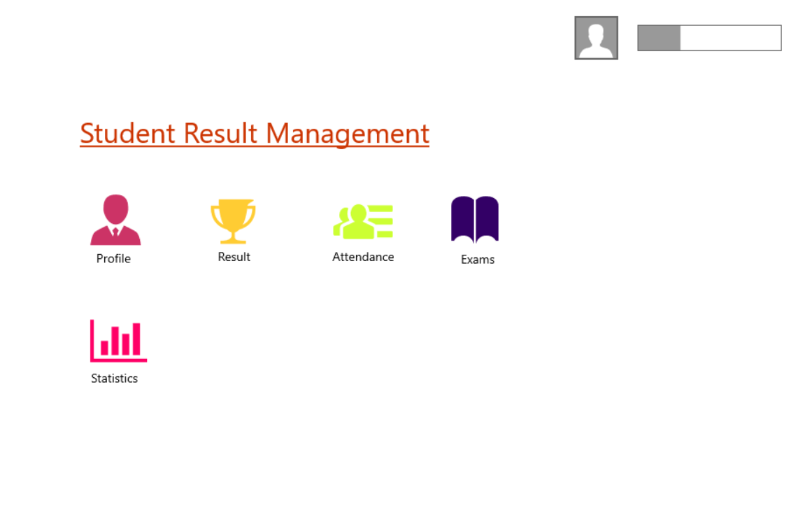
4. Teacher: This application will help the teachers to record, calculate and manage students’ over all academic performance. They can store and publish all quiz marks, mid marks, final semester marks and the attendance marks as well.
2
4

Slide 5
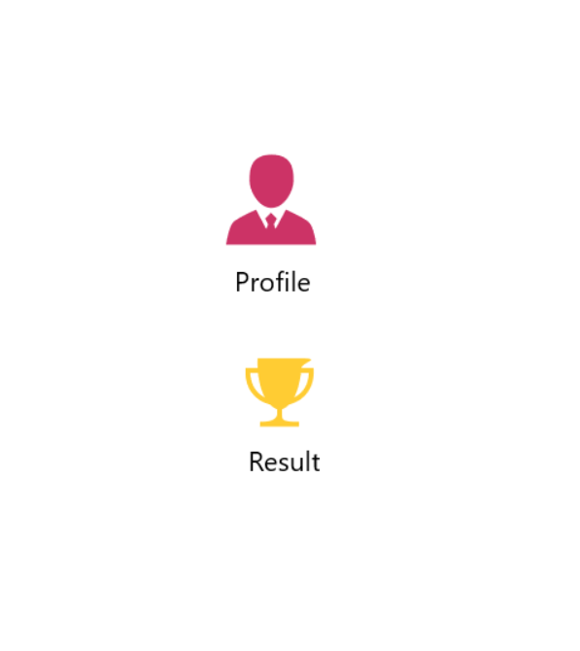
5. Student: The student categorized users can see their published result along with the option of printing their transcript.
5

Slide 6
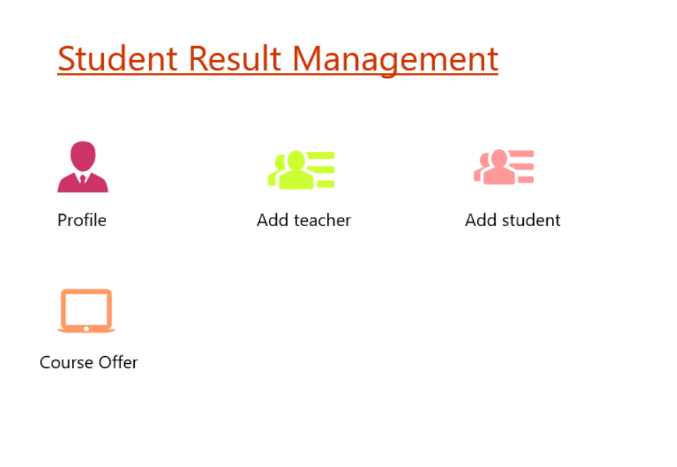
6. Admin: The admin will be the one assigning all the courses severally to the teachers and students , providing them their individual profiles , basically the admin is going to work as a middle man here.
6

Slide 7
Timeline :
MONTH | MILESTONE
January – February | UI Design
February – March | Implementing UI design using html
March – April | Connecting Database to UI using php
April – May | Completing the teacher and student part
7

Slide 8
Conclusion:
So, this was the basic idea of our proposed web application , “Student Result Processing System” . We really look forward to meet up all these ideas we shared here today.
Thank you All.
8

