Slide 1


Austin Ahne
Manuel Peralta
Edgar Suarez
Kima Brown

Slide 2
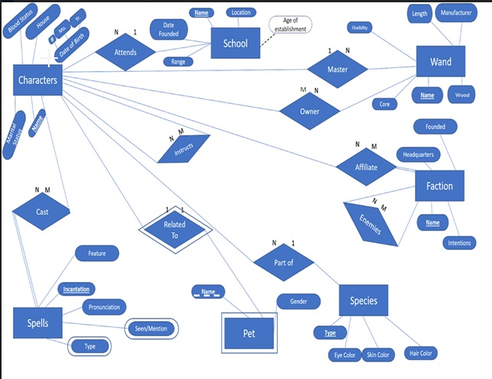
Introduction
Why Harry Potter?
Overview of ER Diagram

Slide 3
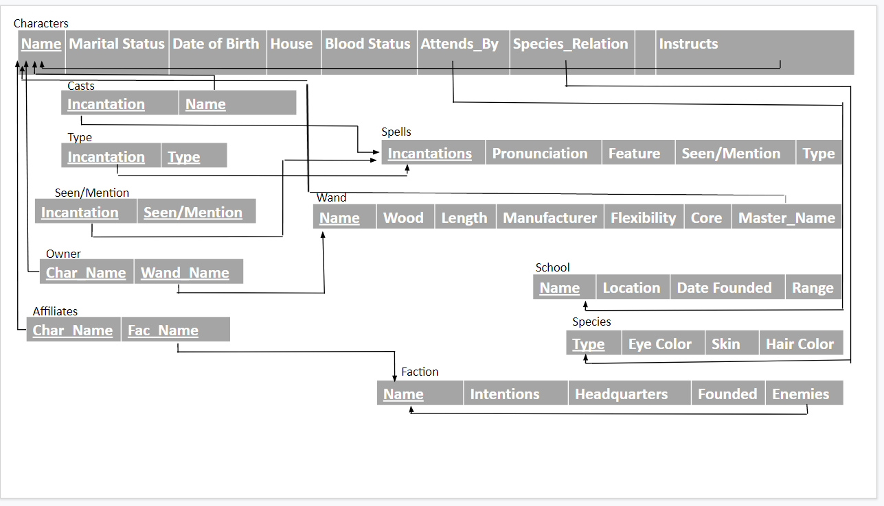
Relational schema diagram

Slide 4
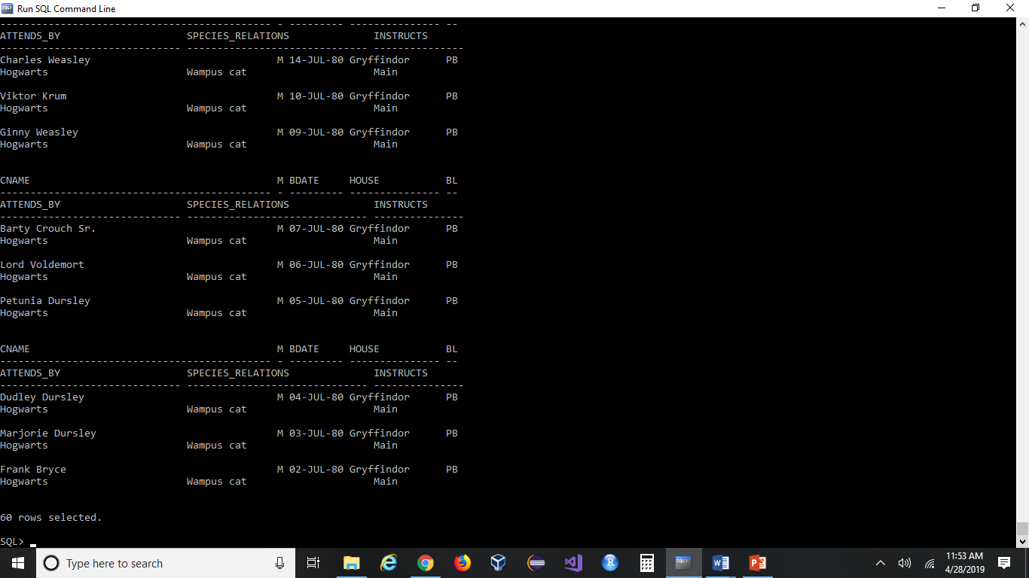
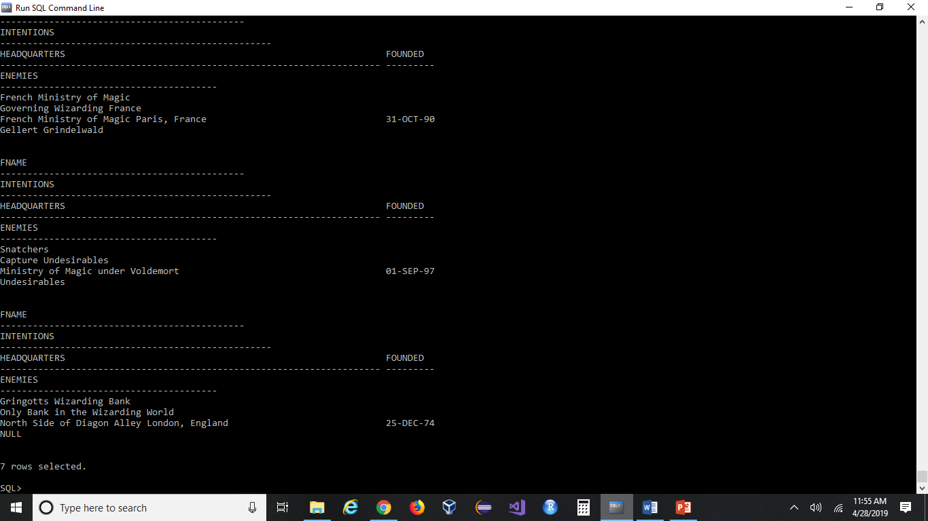
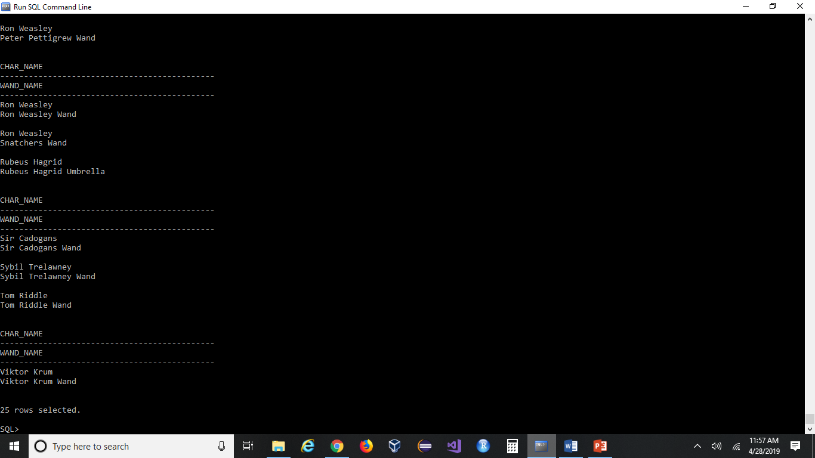
The loaded data
Screen Prints: (characters table, faction table and owner table.

Slide 5
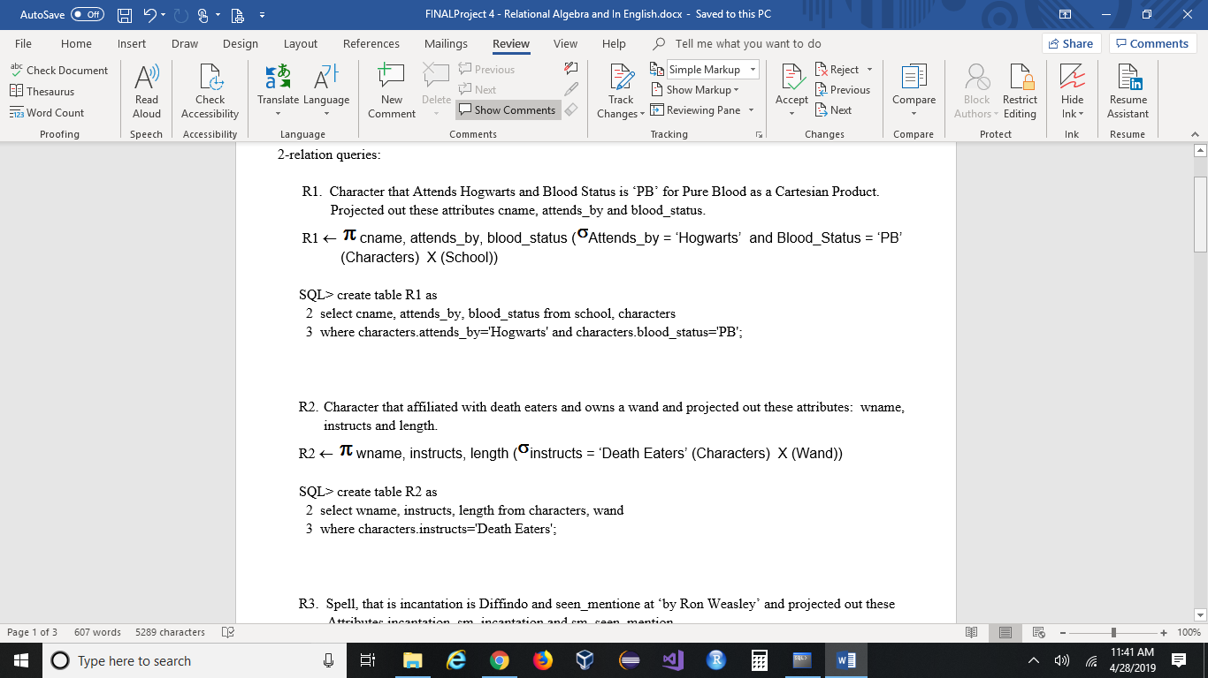
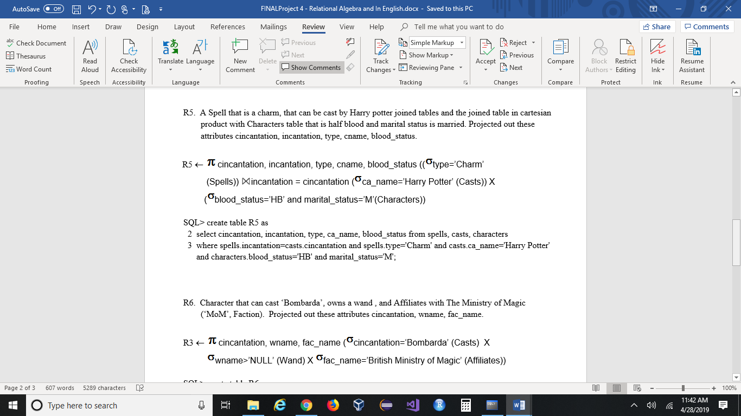
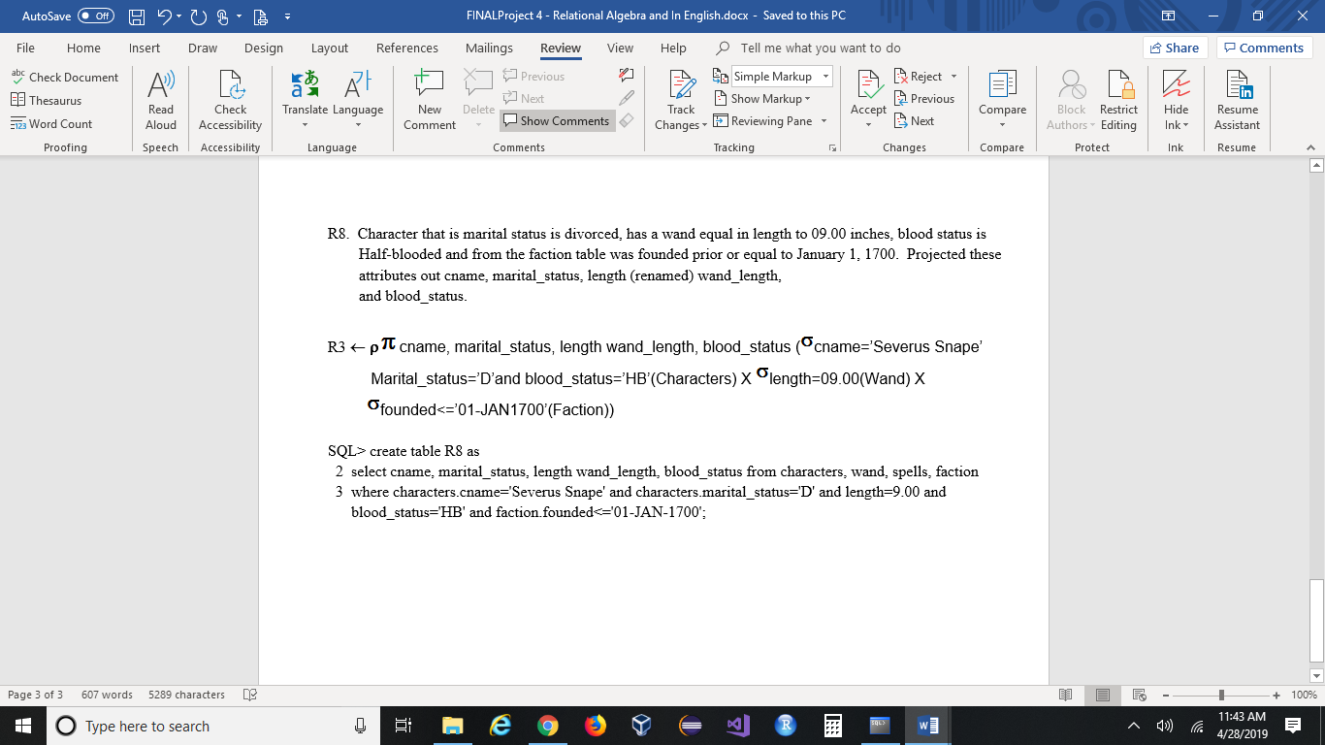
Three queries
English Explanation, Relational Algebra & Related Oracle DML Code:

Slide 6
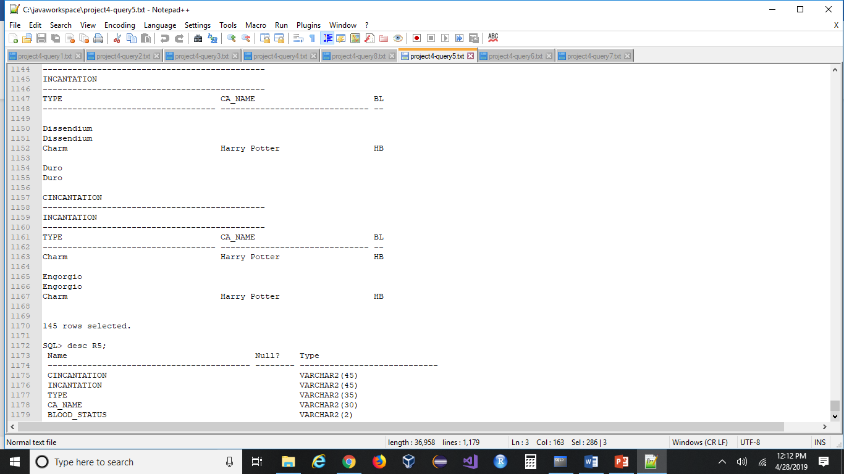
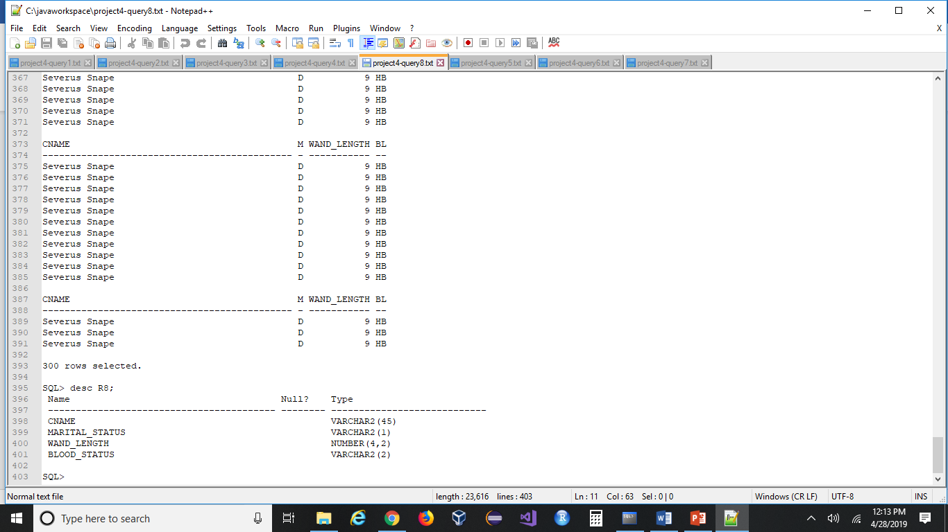
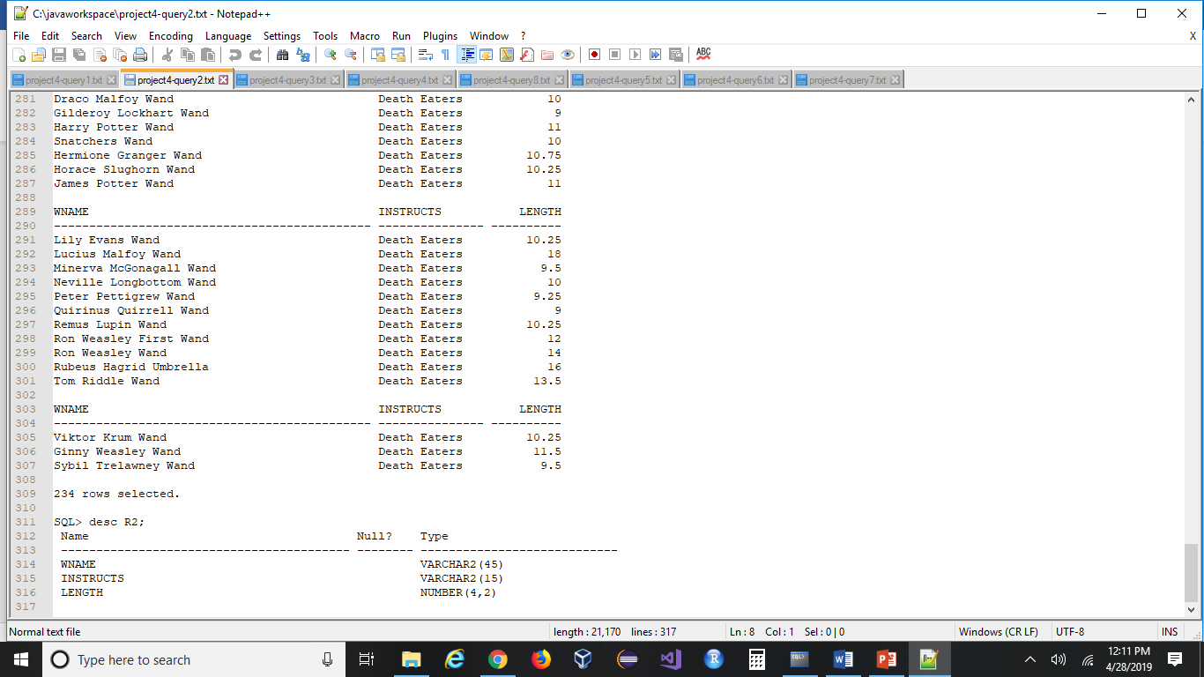
Oracle dml screenshots

