Slide 1
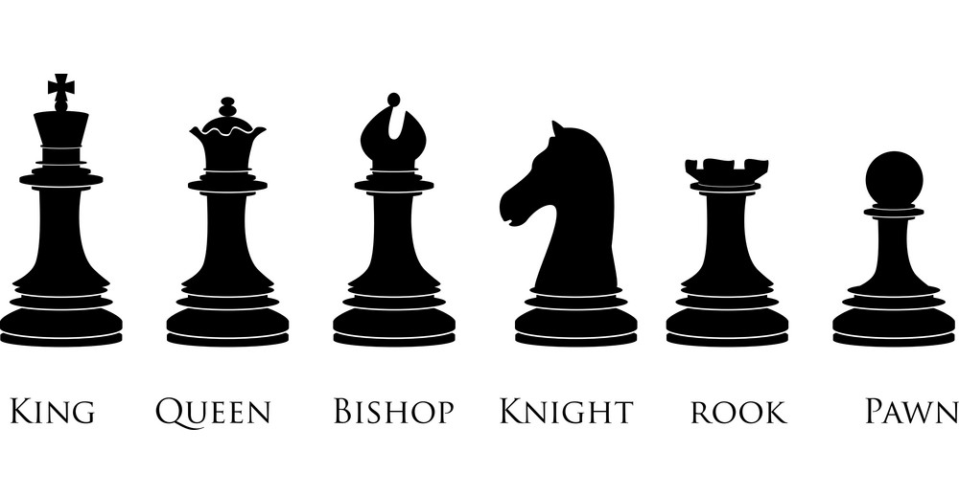
Chess
The proposed system at hand will provide a mouse-click game of chess for two users at a user-controlled speed.
David Black, Sydnee Phillips, Kima Brown,
Landon Beard, Shane Doolabh and Jared McCune

Slide 2
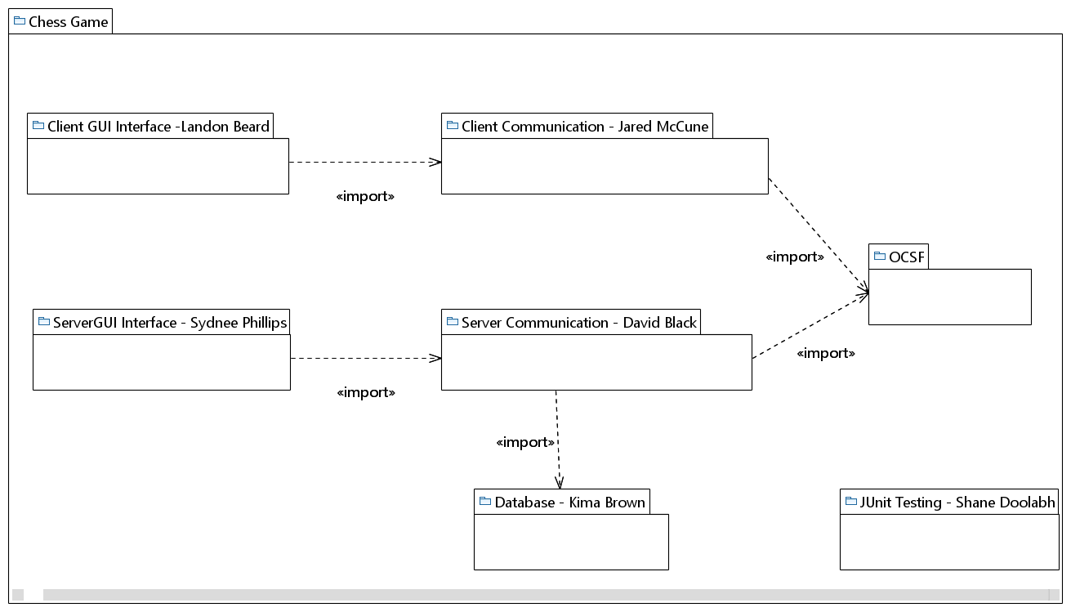
Package Diagram

Slide 3
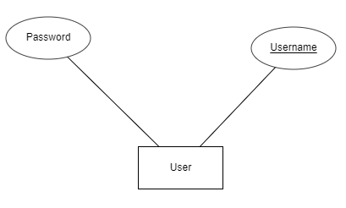
Database Design Diagram

Slide 4
Functional Requirements
The system checks to see if an instance of checkmate has occurred (Checkmate)

Slide 5
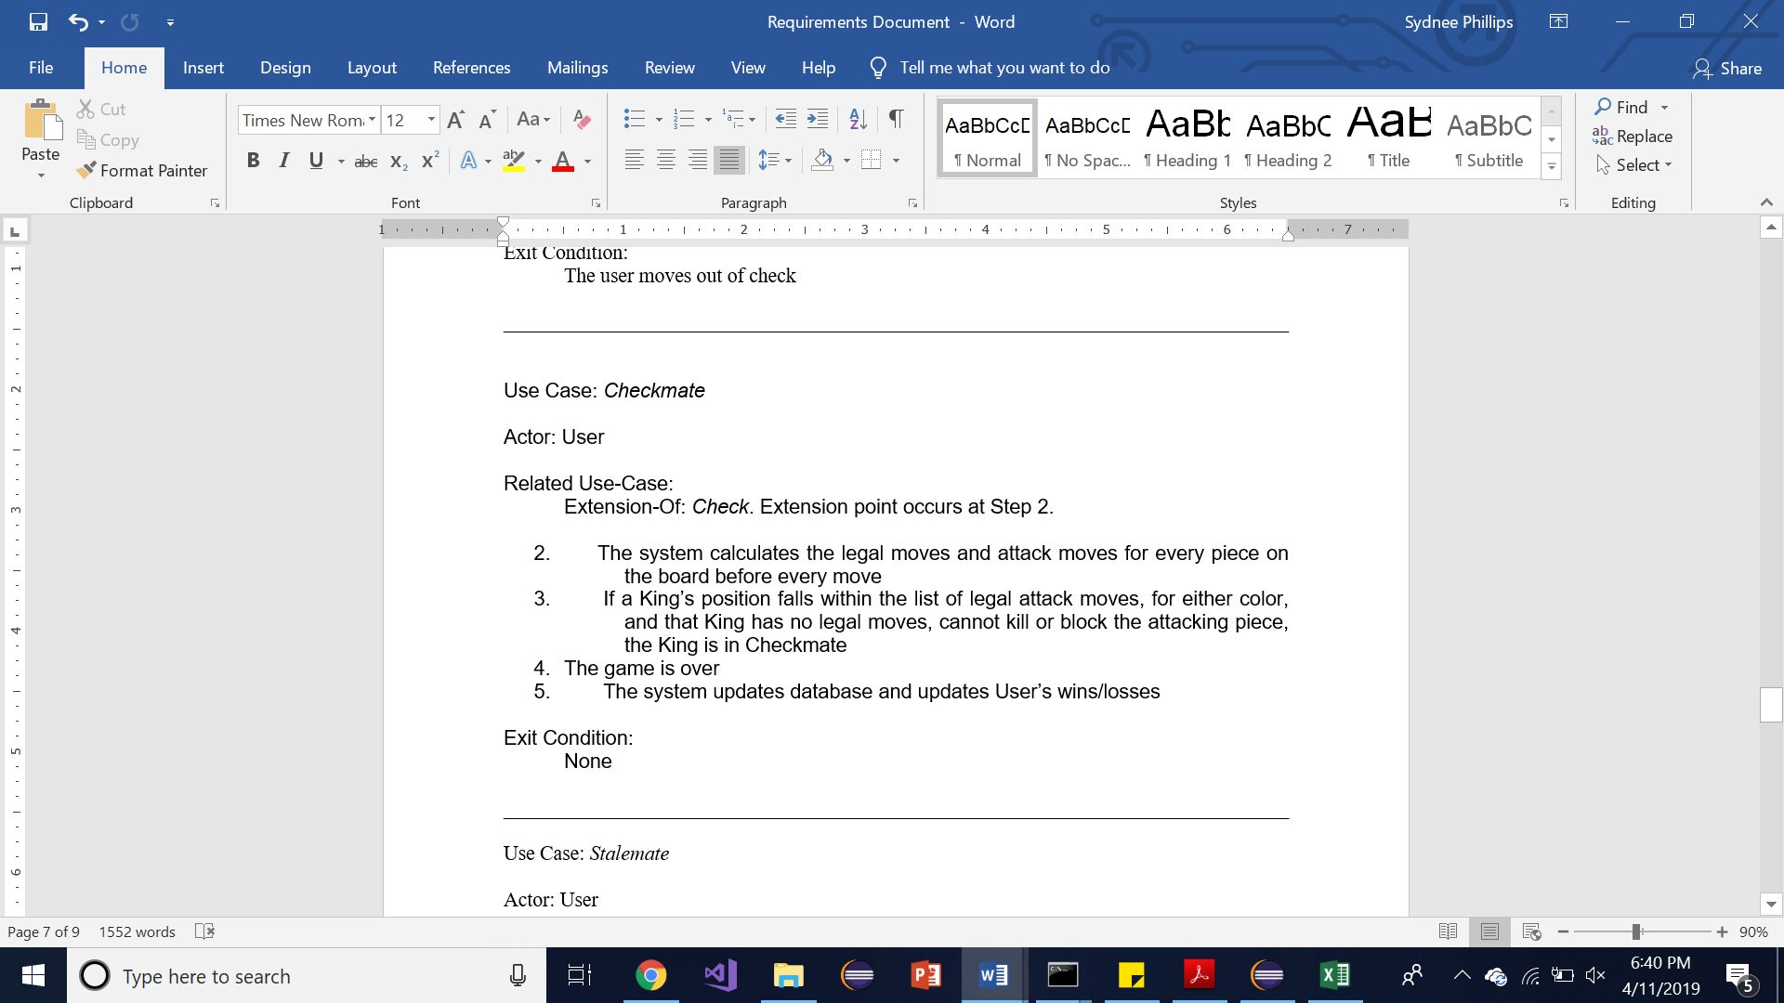
Use Case Description

Slide 6
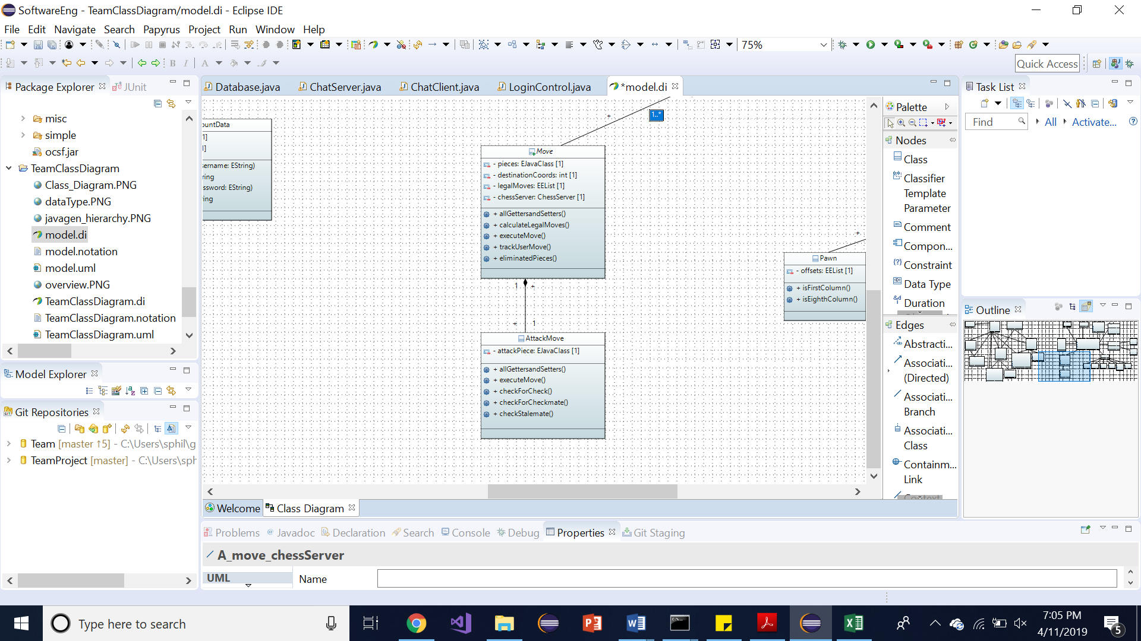
Class Diagram Example

