Slide 1

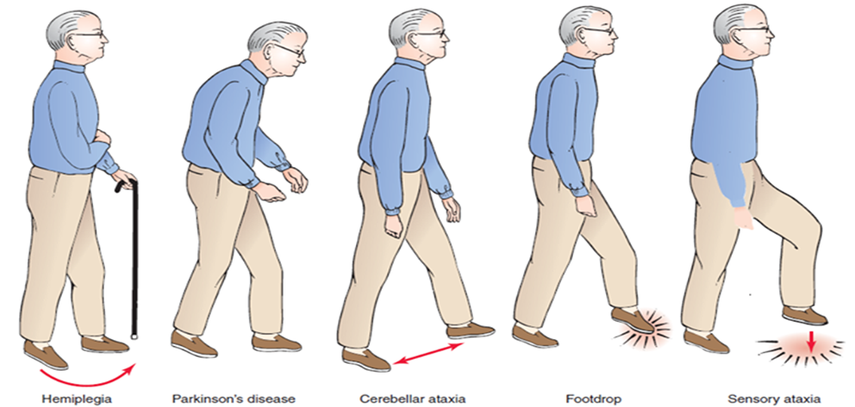
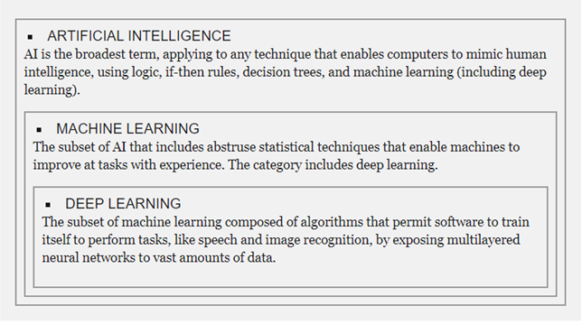
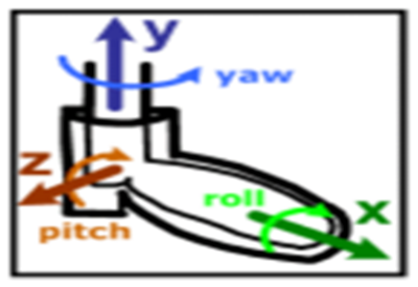
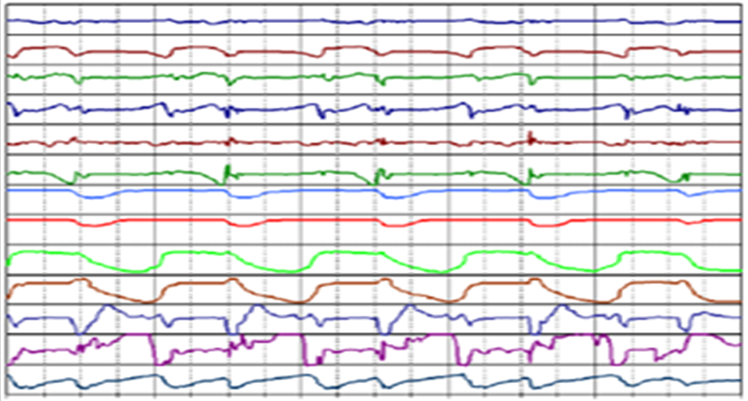
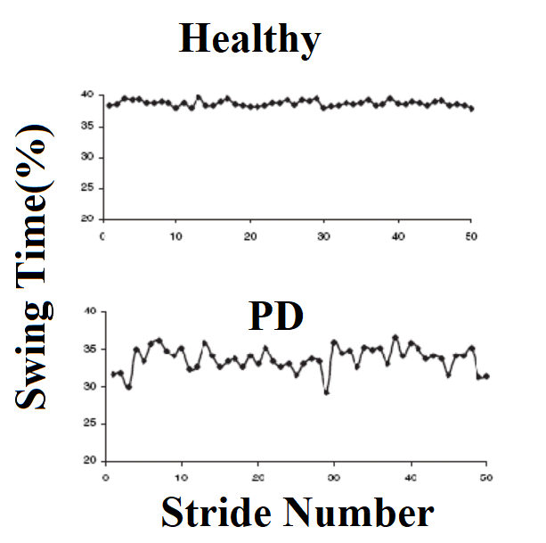
Deep Learning Based Assessment of Physiological Measurements for Neurological Disorders:
A Case Study on Gait in Parkinson's Disease*
Kima Brown and Olcay Kursun
Department of Computer Science, University of Central Arkansas
SUMMARY
BACKGROUND
MOVEMENT ANALYSIS: RANGE OF MOTION, BALANCE, GAIT
Gait disorders are considerable cause of falls in patients with neurological diseases. Grasping these disorders allows prevention and better awareness into underlying diseases. Mobile and wearable sensor technologies can serve as affordable and practical tools to assess the severity of neurological conditions.
It is important to assess the quality of motor-system control of the brain, which gait and balance analysis studies target.
In this study, we analyze gait-related measurement signals on the study of 93 Parkinson’s disease (PD) patients against a73 healthy controls.
PD is a chronic and progressive neurological disorder that causes tremor, rigidity, slowness, and postural instability.
The database includes the vertical ground reaction force records of subjects as they walked at their usual, self-selected pace for approximately 2 minutes on level ground.
Underneath each foot were 8 sensors that measure force as a function of time sampled at 100 Hz.
We applied several deep learning techniques to classify subjects as healthy or with Parkinsonism. Unsupervised networks can discover peaks and dips. Supervised CNN networks work well and our results show that they can be most useful when there are a large number of training examples. We could not get good results with recurrent networks (lstm).
We train and test the network using leave subject out cross validation. In training, we use equal number of positive and negative examples not to have bias in the classification accuracy: Undersampling gives 74.0% accuracy and oversampling (by creating new examples by shifting the time window) gives 79.7% accuracy.
These tools can help automate monitoring the debilitating gait symptoms of the patients with neurological diseases and thus help predict patients with severe gait disturbances that make them prone to falls.
PD is both chronic, meaning it persists over a long period of time, and progressive, meaning its symptoms grow worse over time. Although some people become severely disabled, others experience only minor motor disruptions. It is currently not possible to predict which symptoms will affect an individual, and the intensity of the symptoms also varies from person to person. It is not possible to predict what course the disease will take for an individual person. One commonly used scale neurologist uses for describing how the symptoms of PD have progressed in a patient is the Hoehn and Yahr scale.
Hoehn and Yahr Staging of Parkinson's Disease:
•Stage one -- symptoms on one side of the body only.
•Stage two -- symptoms on both sides of the body.
No impairment of balance.
•Stage three -- balance impairment. Mild to moderate
disease. Physically independent.
•Stage four -- severe disability, but still able to walk or
stand unassisted.
•Stage five – wheelchair-bound or bedridden unless
assisted.
When a person is comfortably standing with both legs parallel to each other, sensor locations inside the insole can be described (according to the Infotronic website) as lying approximately at the following (X,Y) coordinates, assuming that the origin (0,0) is just between the legs and the person is facing towards the positive side of the Y axis:
Sensor X Y
----------------------------
L1 -500 -800
L2 -700 -400
L3 -300 -400
L4 -700 0
L5 -300 0
L6 -700 400
L7 -300 400
L8 -500 800
R1 500 -800
R2 700 -400
R3 300 -400
R4 700 0
R5 300 0
R6 700 400
R7 300 400
R8 500 800
DEEP LEARNING ARCHITECTURE
CONCLUSIONS
Low-level features, such as peaks and dips
Higher-level features
Deep learning features are not hand-engineered, they resemble features manually extracted by expert researchers, such as peaks, dips at the lower levels and swing, stride at the higher levels. Data augmentation and handling imbalanced class distribution using over and undersampling improve the classification accuracy. Our test accuracy is near 80% and it is expected to increase with higher number of examples or transfer learning from other signal processing deep learning systems.
Classification (Parkinson or Healthy)
Input Signals
The X and Y numbers are in an arbitrary coordinate system reflecting the relative (arbitrarily scaled) positions of the sensors within each insole. During walking, the sensors inside each insole remain at the same relative position, but the two feet are no longer parallel to each other. Thus, this coordinate system enables a calculation of a proxy for the location of the center of pressure (COP) under each foot.
References:
Infotronic website; http://www.infotronic.nl/
PhysioNet: ww.physionet.org/physiobank/database/gaitpdb
Fortune: http://fortune.com/ai-artificial-intelligence-deep-machine-learning
*Acknowledgements: This work was supported in part by URC Summer Research project “Deep Learning for Analyzing Post-Concussion Tactical Agility Assessment Tasks”.
Notes:
Right now there is not room to add in a description of the Methods Figures – however, if you feel this is necessary, we can try and re-configure the poster to accommodate those descriptions
Red highlighted words = keep them or not?
Figure 4 explanation (final bullet for Results and Outcomes): advice/input on wording

