Slide 1
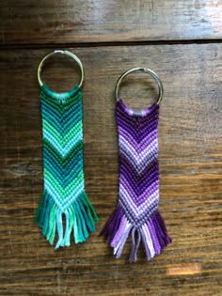
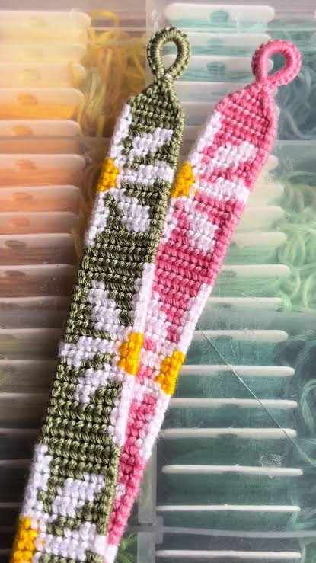
AI Bracelet Builder
Describe it, we’ll knot it
Image Sources:
https://pin.it/740S3Xd9l
https://www.tiktok.com/@madebyeleanorr_/video/7271335455419845921?is_from_webapp=1&sender_device=pc
Notes:
Space on the right is left for your bracelet photo.

Slide 2
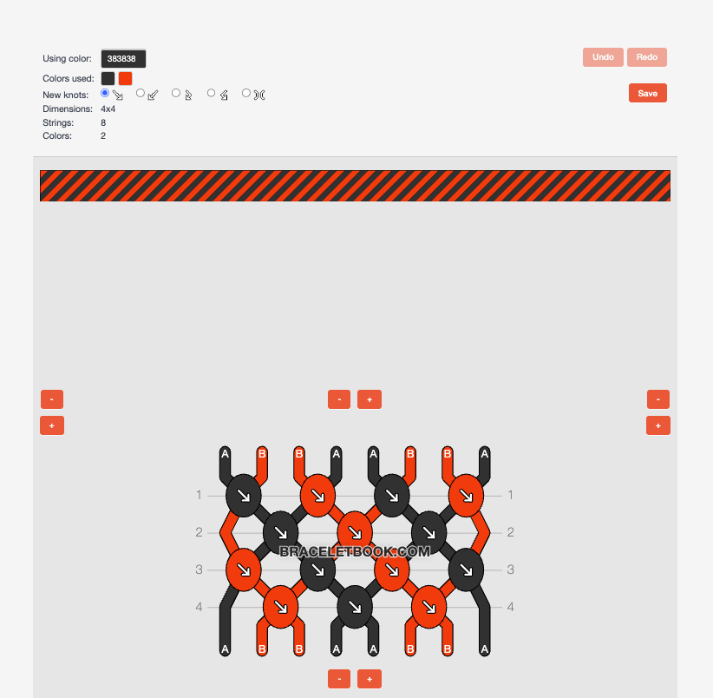
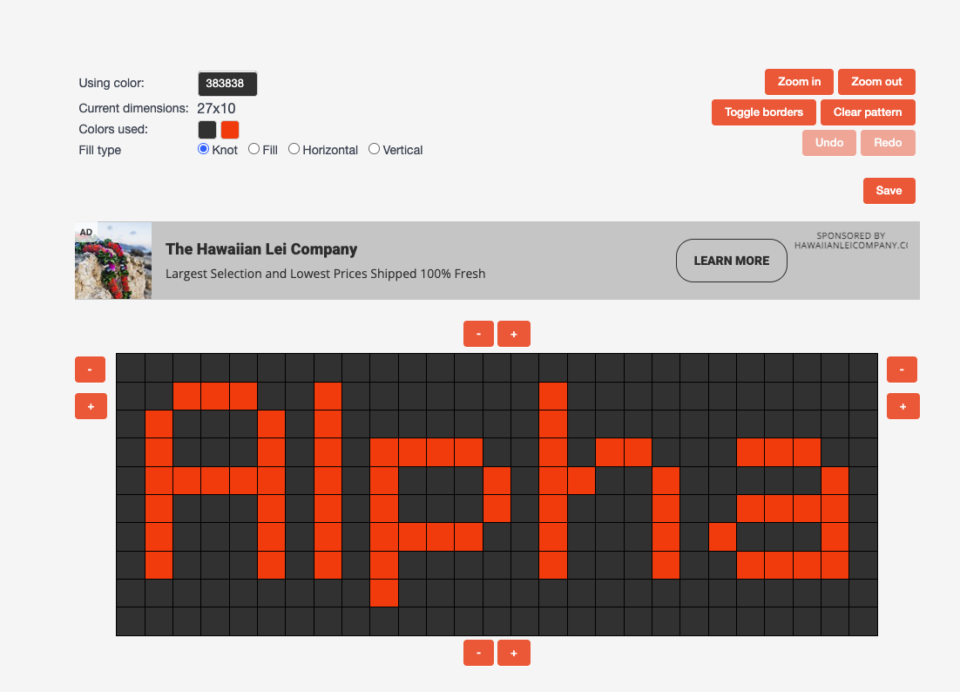
The problem
Strings cut too long or too short
Designing from scratch is trial and error
Pattern tools are confusing
Image Source: https://www.braceletbook.com/
Notes:
Space on the right is left for your bracelet photo and a BraceletBook screenshot.
Points: overly long strings waste thread and make knotting slower; running short means weaving in new thread; designing from scratch is trial and error; current tools make it hard to see what the finished bracelet will look like.

Slide 3
The opportunity
1.3M
790K
30K
monthly visits to BraceletBook
BraceletBook users
Reddit community members
Huge demand, but still no easy way to design.
Notes:
BraceletBook: about 791,785 users and about 1.3M visits a month (Similarweb, Aug 2025), roughly 218,000 patterns. r/friendshipbracelets: about 30,154 members. Friendship bracelets surged in 2023, linked to Taylor Swift. Benchmark: Ravelry (knitting) had about 1M monthly active users in 2020.

Slide 4
What we built
Describe the bracelet you want. Get a pattern you can knot, with exact string lengths.
AI patterns
Easy pixel editor
String lengths
Share and remix
Notes:
AI starting patterns from a description, a pixel-art editor where you paint knots, automatic string lengths, and a library where you can share patterns and remix others with credit.

Slide 5
How it works
1
2
3
4
You describe it
AI writes a recipe
Engine builds the pattern
You get string lengths
link to demo
Notes:
Transition to the live demo here.
The AI (a free local model) turns the description into a short recipe (text, motifs, colours, width). Normal code builds the grid from that recipe, so results are reliable. Show the "Show AI recipe" toggle during the demo.

Slide 6
How we make money
Free
Premium
Affiliate
Ads
$2.99 / month for unlimited AI
Links to thread shops
Free first, so switching to us is easy.
Notes:
Free tier: editor, calculator, sharing, and a few AI generations a month, supported by ads. Premium: $2.99/month or $19.99/year for unlimited AI, photo-to-pattern, no ads, printable patterns. Not $1/month because card fees would take about a third of it. Affiliate: the string calculator already produces a shopping list. 13+ only, no private messaging, moderated comments.

Slide 7
Getting users
Months 1–2
Months 3–6
Months 6–12
Free string calculator on Reddit and search
Beginner creators on TikTok and YouTube
Design challenges and craft store partners
Notes:
Phase 1: release the calculator alone, post in bracelet subreddits, target searches like "how much string for a friendship bracelet" (about 39% of BraceletBook traffic comes from search). Phase 2: micro-creators get free premium, a creator page, and a referral code; they design on camera. Phase 3: monthly challenges, every shared pattern links back to us, thread brands, craft stores, summer camps.

Slide 8
Competition
Feature | Us | BraceletBook | Codecraft | Friendship Bracelets Pro | MakeBead
Works in browser | ✓ | ✓ | ✗ | ✗ | ✓
Create patterns in the app | ✓ | ✗ | ✓ | ✓ | ✗
Photo-to-pattern | ✓ | ✓ | ✗ | ✗ | ✓
String calculator | ✓ | ✗ | ✓ | ✗ | ✓
AI text-to-pattern | ✓ | ✗ | ✗ | ✗ | ✗
Share and browse patterns | ✓ | ✓ | ✗ | ✗ | ✗
Library size | Small at launch | ~218,000 | ✗ | ✗ | ✗
Notes:
Keep the library size row: BraceletBook clearly wins there, and our answer is seeding the library with creators. Verify the "?" cell before presenting. Our edge is AI generation plus beginner focus, since features alone are easy to copy.

Slide 9
Financial projections
 | Revenue |  |  | Costs
 | Ads | Subscriptions | TOTAL REVENUE | App stores | Servers | AI computing | Storage and moderation | Marketing | Domain and tools | TOTAL COSTS | PROFIT
Year 1 | $2,880 | $3,050 | $5,930 | $125 | $600 | $500 | $100 | $3,000 | $300 | $4,625 | $1,305
Year 2 | $11,520 | $12,199 | $23,719 | $100 | $1,800 | $1,500 | $200 | $4,500 | $300 | $8,400 | $15,319
Year 3 | $28,800 | $30,498 | $59,298 | $100 | $4,000 | $3,500 | $500 | $3,000 | $300 | $11,400 | $47,898
Notes:
Assumptions: 12 pages per user per month, $4 ad revenue per 1,000 page views, 2% of users convert to premium at $2.99/month with about 85% kept after fees.
Users: 5,000 in Year 1, 20,000 in Year 2, 50,000 in Year 3.
Year 1 users: 10 micro-creators x 20,000 followers x 2% sign-up = 4,000, plus about 1,000 from Reddit, search, and word of mouth.
Marketing: $3,000 in Year 1 pays about 10 creators. Year 2 rises to $4,500 to keep growth going. Year 3 drops back to $3,000 because most new users come for free through search, shared pattern links, and word of mouth.
If asked about Years 4 and 5 (with marketing kept at $3,000): profit of $89,336 and $141,634. Founder salaries are not included.

Slide 10
Where we are and what we need
Now
Month 1
Month 3
Month 6
Prototype built
String calculator live
Editor and sharing
AI premium
Our ask: $10,000
Notes:
Mobile apps follow in months 9 to 12. Tie the ask to milestones: development time, creator marketing, and moderation. Example: "This gets us to 20,000 users by the end of Year 2."

