Slide 1
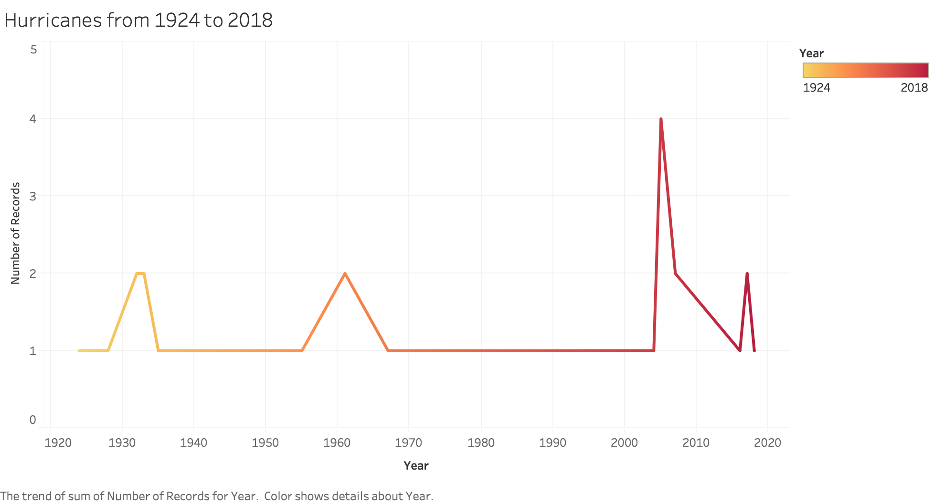
Notes:
We have analyzed the data from NHC (National Hurricane Centre) and NOAA (National Oceanic and Atmospheric Administration) for the hurricane. Data from 1924 to 2018 from National Hurricane Centre is used for our analysis. After analyzing the data, We have concluded that there is lot more increase in the number of hurricanes in the last 20 years than the previous years. Number of tropical storms also increased a lot in the past 20 years. This also shows the increase in the chances of hurricanes.

Slide 2
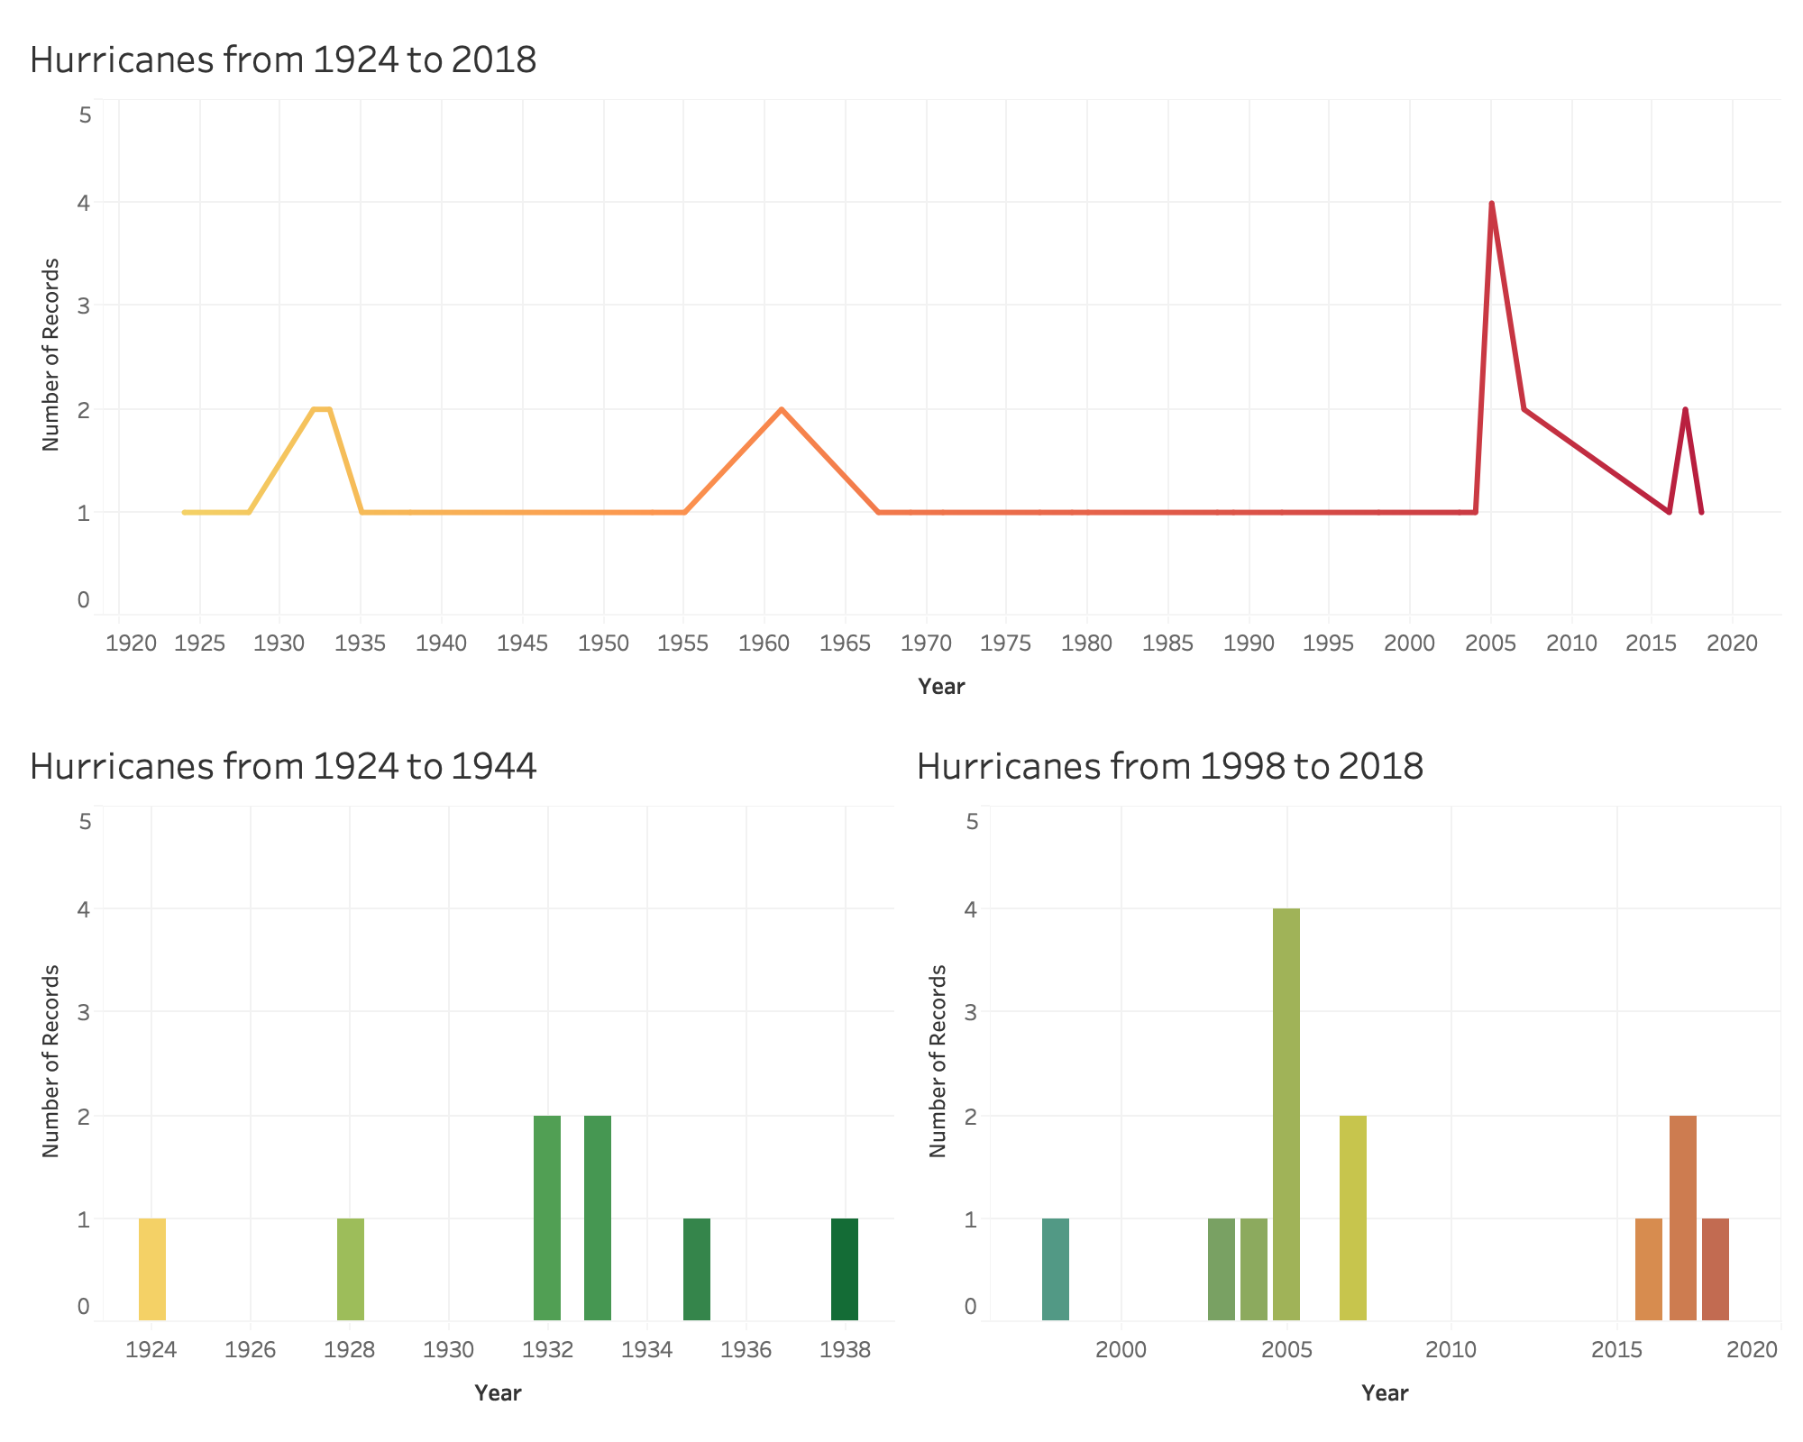
Notes:
Here we are comparing the data from 1924 to 1944 with the last 20 years data.

Slide 3
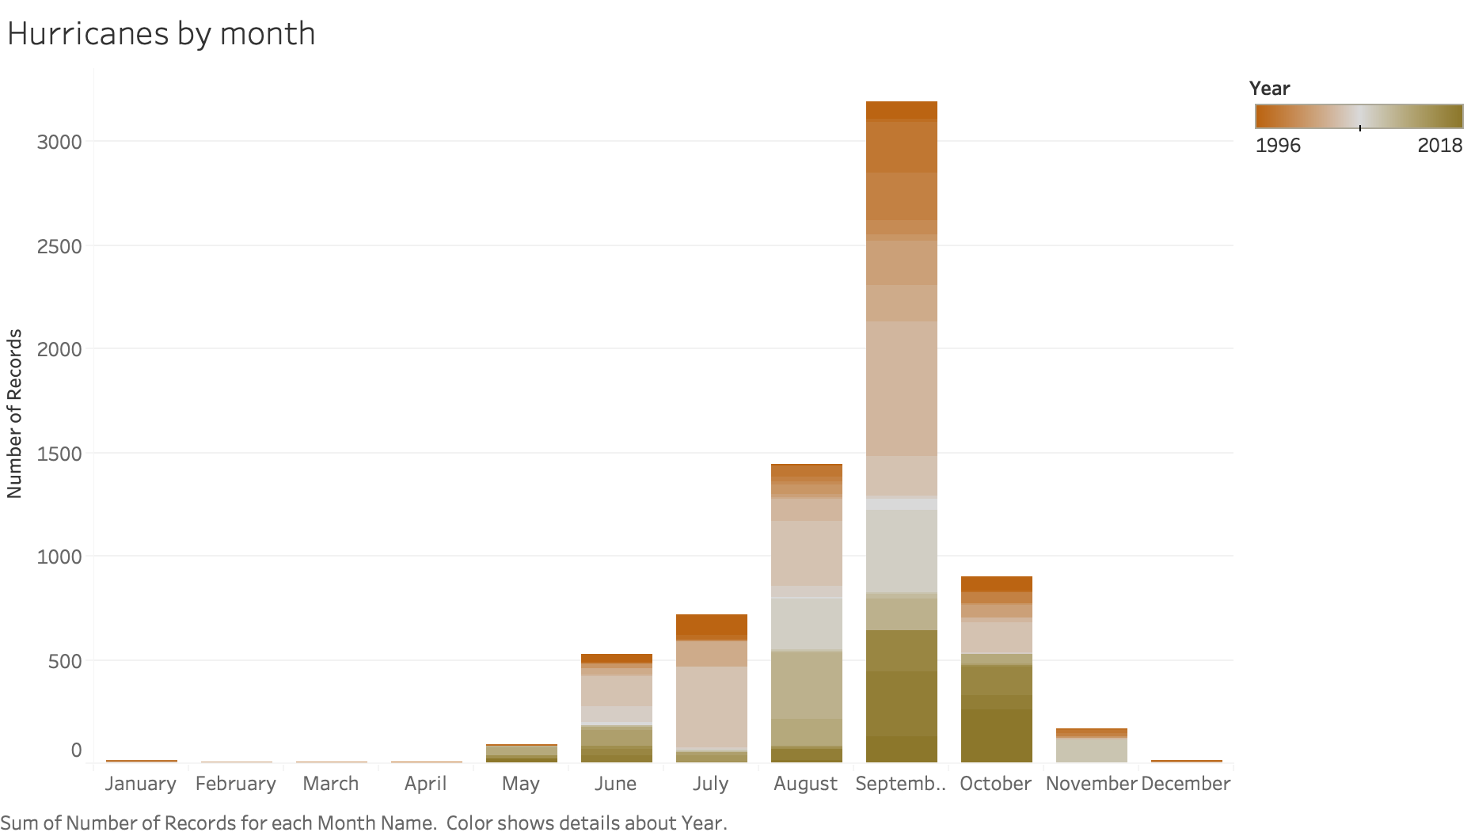
Notes:
From our analysis we are concluded that most of the hurricanes occurs in the Summer months.

Slide 4
ML Linear Regression Model
Mean Squared Error (MSE): 0.364
R-squared (R2 ): 0.0
Notes:
We have used linear regression model to predict the Number of hurricanes in a given year to the Average temperature for that year. Created dependent and independent variables(X= Average Temperature, y= Hurricane Count). And tried to fit the model. We scored the predictions with MSE ( Mean Squared Error) and R-squared.

Slide 5
Combination graph of hurricane and avg. temperature

Slide 6
ML Linear Regression Model
Mean Squared Error (MSE): 0.364
R-squared (R2 ): 0.0
Notes:
We have used linear regression model to predict the Number of hurricanes in a given year to the Average temperature for that year. Created Hurricane Count as dependent variable and Average Temperature as independent variable(X= Average Temperature, y= Hurricane Count). And tried to fit the model. We scored the predictions with MSE ( Mean Squared Error) and R-squared.

Slide 7
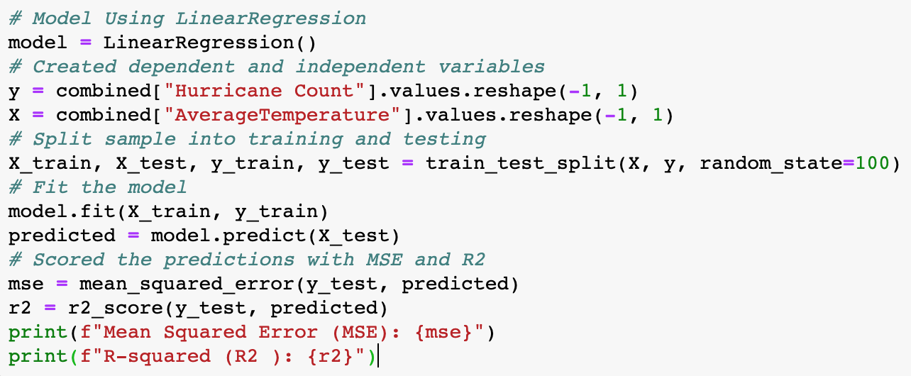
Linear Regression Model

