Slide 1
Good Morning! 早上好! 안녕하세요!
Day 5

Slide 2
Day 1
Welcome
Project Introduction
Introduction to Project Development Process
Business Requirement Development
System Requirement Development
System(High Level) Design
Time Management

Slide 3
Day 2 (Mini project)
Yolo객체 인식 모델 활용과 성능 평가 방법 이해
Custom Dataset과 Fine Tuning으로 자체 객체 인식 모델 구현 및 평가
(Optional)Segmentation,Tracking,경량화 모델 등 개별 요구사항에 적합한 모델 탐색 및 성능 검증
YOLOv8 기반 데이터 수집/학습/deploy (Detection Alert)
감시용 데이터 수집(bus, truck, tank 등)
감시용 데이터 라벨링
YOLOv8 기반 학습
YOLOv8 Object Detection
Porting to ROS
Create Detection Alert Node
Generate Topics to send image and Obj. Det. results
Create Subscriber node and display image and print data from the Topic

Slide 4
Day 3 (Mini project)
AMR(Autonomous Mobile Robot) Turtlebot4 개발 환경 구축
로봇 개발 환경에 완성 모델 서빙 및 테스트 / 로봇 H/W, 제반 환경의 한계점 도출
Tracking 데이터 수집(bus, truck, tank 등)
Tracking 데이터 라벨링
YOLOv8 기반 학습
YOLOv8 Object Tracking
Turtlebot4 시뮬레이션 환경 구축
SLAM과 Map 생성 및 파라미터 튜닝(Localization, AMCL)
AutoSLAM으로 맵 생성

Slide 5
Day 4 (Mini project)
Turtlebot4 Navigation과 파라미터 튜닝(Local Costmap, Global Costmap)
Turtlebot4 API를 활용한 Initial Pose Navigate_to Pose 구현
Turtlebot4 API를 활용한 Navigate_Through_pose, Follow Waypoints 구현
로봇 개발 환경에 적용 및 테스트 / 로봇 H/W, 제반 환경의 한계점 도출
AMR기반 카메라 인식 autonomous driving 시스템 with obstacle avoidance 구축 (AMR Controller)
Digital Mapping of environment
Goal Setting and Obstacle Avoidance using Navigation
Object Tracking w/ AMR camera
Control logic between navigation/obj. tracking/ obj. following (teleop)
Porting to ROS
Create AMR Controller Node
Create and send Obj. Tracking Image and data to Sysmon
Integrate and test with Detection

Slide 6
Day 5 (Mini project)
Flask 를 이용한 웹 서버 구축 (System Monitor)
Flask/HTML Intro
Deploy YOLOv8 Obj. Det results to web
Log in 기능 구현
Sysmon 웹기능 구현
알람 기능 구현
SQLite3를 이용한 데이터베이스 구축 및 연동 (System Monitor)
SQLite3 기본 기능 구현
DB 기능 구축
알람이 울리는 경우 DB에 저장하는 기능 구현
저장된 내용 검색하는 기능 구현

Slide 7
Day 5 (Mini project)
Porting to ROS
Update Sysmon Node code
Update the database with received Obj. Det. Data from Detection Alert Node
Display the content of DB on System Monitor web page
And finally, Integration and Test of Detection Alert & System Monitor

Slide 8
Day 6 (final project)
시스템 설계 및 프로세스 정립
비즈니스 요구 사항 업데이트
역할 분담 및 일정 조율
개발 환경 구축(맵 디자인, SW 개발,문서 통합 관리)
멀티 로봇 환경 구축 및 네비게이션
멀티 로봇 개별 업무 수행
멀티 로봇 협동 업무 수행
(Optional)Turtlebot4 각종 센서 데이터의 이해와 적용

Slide 9

프로젝트 rule number ONE!!!
Have Fun Fun Fun!

Slide 10
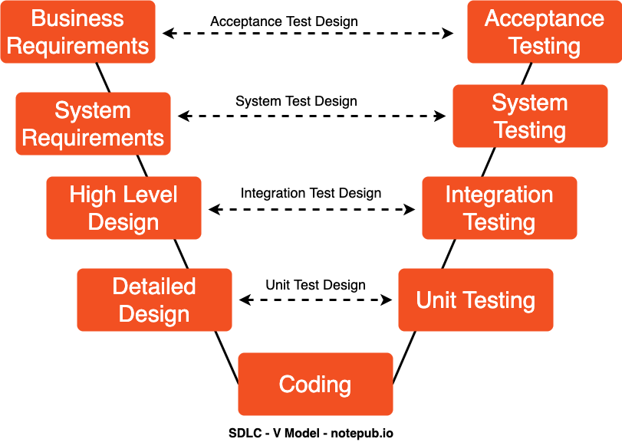
SW Development Process
Agile-SPRINTs

Slide 11
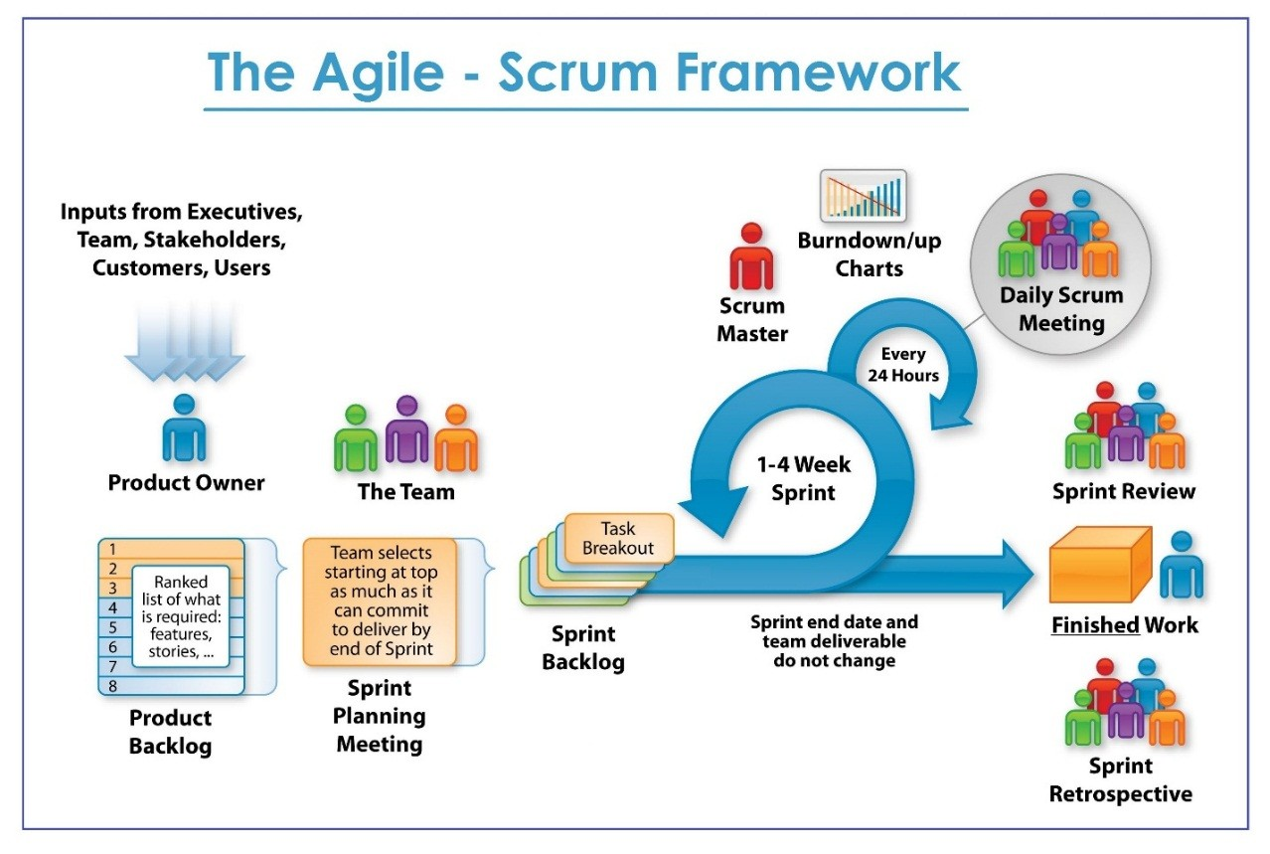

Slide 12
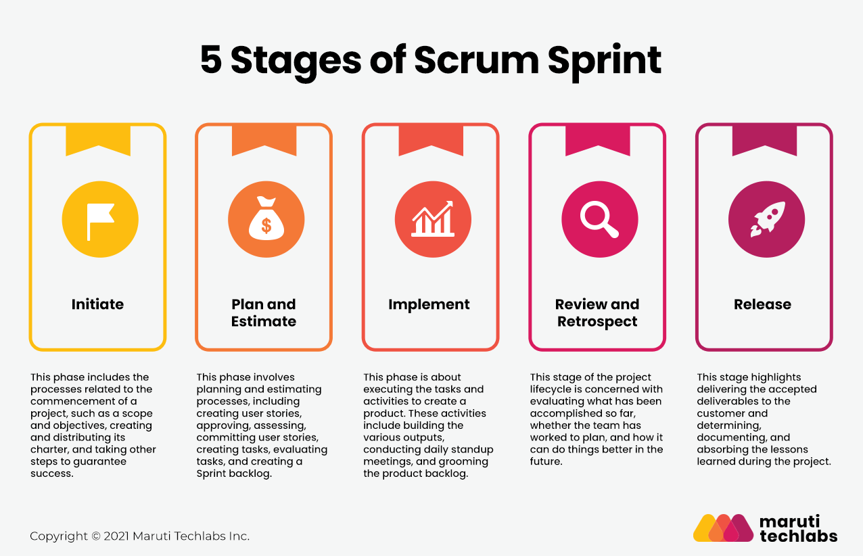

Slide 13
Project Sprints
Detection Alert
Camera Capture
Object Detection
Send messages to other subsystems
AMR Controller
Receive messages and act accordingly
Move using (SLAM) with Obstruction avoidance
Target Acquisition (Obj. Det.) and Tracking
Follow target using camera and motor control
System Monitor
Receive and Display Detection Camera and info
Receive and Display AMR Camera and info
Store, display, and report Information and Alerts

Slide 14
System Monitor sprint

Slide 15
Sprint 3 – System monitor

Slide 16
Team Exercise 9
Perform Detail Design of System Monitor Module using Process Flow Diagram

Slide 17
Detail Design Review by each team
Using the process flow diagram present team’s design

Slide 18
Sprint 3 – System monitor

Slide 19
Coding Hints
Flask Basic Review
SQLite Basic Review
Webpage
Login page
Two video window
Alert Report
Status Captured and Following
Database – SQLite
Login Data
Status Data

Slide 20
Introduction to Flask
What is Flask?
A lightweight web framework for Python.
Why Flask? Simple, flexible, good for beginners and small projects.
pip install Flask
<project>/
├ app.py # Main Flask application file
└ templates/ # Folder for HTML templates
└── index.html

Slide 21
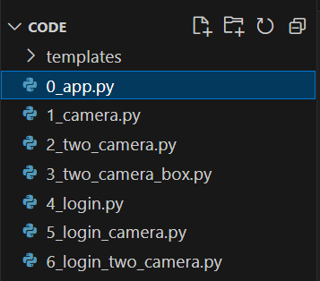
Flask Hints
HTML Reference:
HTML elements reference - HTML: HyperText Markup Language | MDN
https://developer.mozilla.org/en-US/docs/Web/HTML/Element
CSS
CSS: Cascading Style Sheets | MDN
https://developer.mozilla.org/en-US/docs/Web/CSS

Slide 22
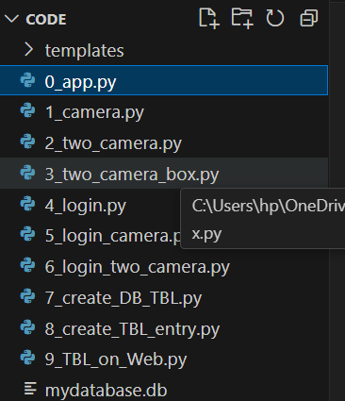
Coding Hints
Flask Basic Review
sudo apt install sqlite3
SQLite Basic Review
SQLite is a lightweight, self-contained, serverless SQL database engine.

Slide 23
Coding Hints
Flask Basic Review
SQLite Basic Review
Webpage
Login page
Two video window
Alert Report
Status Captured and Following
Database – SQLite
Detection Alert Data

Slide 24
Coding Hints
Database – SQLite viewer
sudo apt install sqlitebrowser
VSCode sqlite viewer extension

Slide 25
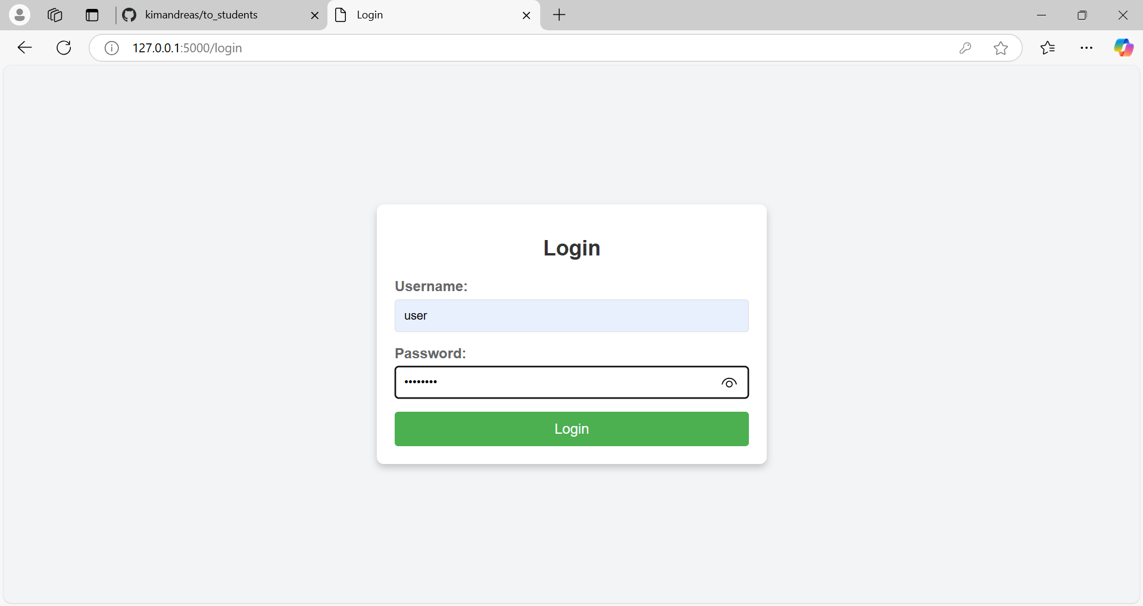

Slide 26
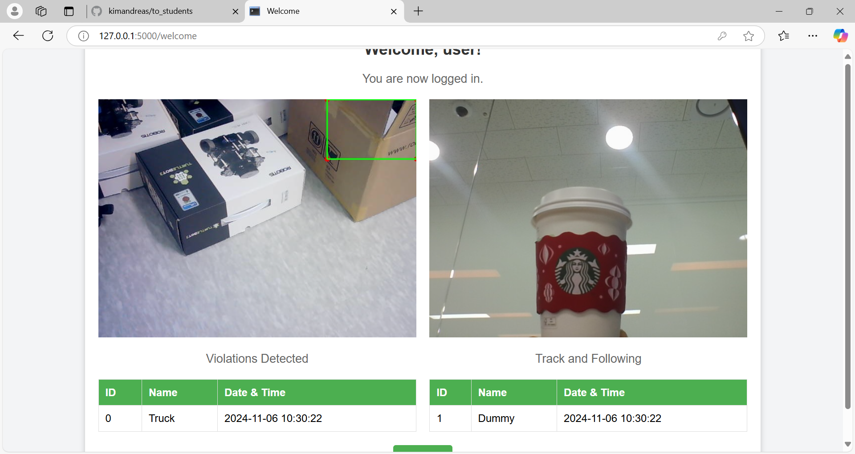

Slide 27
Expected outcome
Sysmon with two windows and related Detection and tracking info
ROS Nodes, Services, Topics

Slide 28
Sprint 3 – System monitor

Slide 29
Team Exercise 10
Perform coding and testing of System Monitor Module

Slide 30
Results & Code Review by each team
Show actual results against the expected results and explain the code written

Slide 31
System Integration & Test

Slide 32
Team Exercise 11
Perform integration and testing of Detection, AMR Controller, and System Monitor Module

Slide 33
Demonstration of solution by each team
Show actual results against the expected results and explain

Slide 34
프로젝트 rule number ONE!!!
Are we still having FUN!

