Slide 1
Good Morning! 早上好! 안녕하세요!
Day 3

Slide 2
Day 1
Welcome
Project Introduction
Introduction to Project Development Process
Business Requirement Development
System Requirement Development
System(High Level) Design
Time Management

Slide 3
Day 2 (Mini project)
Yolo객체 인식 모델 활용과 성능 평가 방법 이해
Custom Dataset과 Fine Tuning으로 자체 객체 인식 모델 구현 및 평가
(Optional)Segmentation,Tracking,경량화 모델 등 개별 요구사항에 적합한 모델 탐색 및 성능 검증
YOLOv8 기반 데이터 수집/학습/deploy (Detection Alert)
감시용 데이터 수집(bus, truck, tank 등)
감시용 데이터 라벨링
YOLOv8 기반 학습
YOLOv8 Object Detection
Porting to ROS
Create Detection Alert Node
Generate Topics to send image and Obj. Det. results
Create Subscriber node and display image and print data from the Topic

Slide 4
Day 3 (Mini project)
AMR(Autonomous Mobile Robot) Turtlebot4 개발 환경 구축
로봇 개발 환경에 완성 모델 서빙 및 테스트 / 로봇 H/W, 제반 환경의 한계점 도출
Tracking 데이터 수집(bus, truck, tank 등)
Tracking 데이터 라벨링
YOLOv8 기반 학습
YOLOv8 Object Tracking
Turtlebot4 시뮬레이션 환경 구축
SLAM과 Map 생성 및 파라미터 튜닝(Localization, AMCL)
AutoSLAM으로 맵 생성

Slide 5
Day 4 (Mini project)
Turtlebot4 Navigation과 파라미터 튜닝(Local Costmap, Global Costmap)
Turtlebot4 API를 활용한 Initial Pose Navigate_to Pose 구현
Turtlebot4 API를 활용한 Navigate_Through_pose, Follow Waypoints 구현
로봇 개발 환경에 적용 및 테스트 / 로봇 H/W, 제반 환경의 한계점 도출
AMR기반 카메라 인식 autonomous driving 시스템 with obstacle avoidance 구축 (AMR Controller)
Digital Mapping of environment
Goal Setting and Obstacle Avoidance using Navigation
Object Tracking w/ AMR camera
Control logic between navigation/obj. tracking/ obj. following (teleop)
Porting to ROS
Create AMR Controller Node
Create and send Obj. Tracking Image and data to Sysmon
Integrate and test with Detection

Slide 6

프로젝트 rule number ONE!!!
Have Fun Fun Fun!

Slide 7
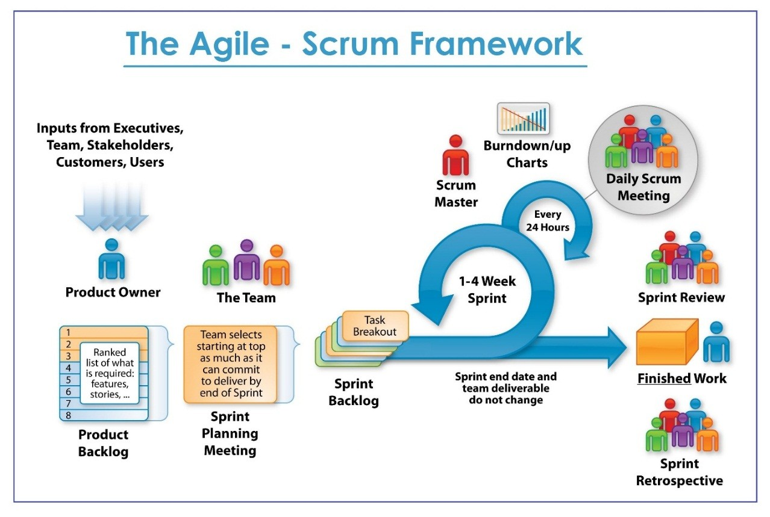

Slide 8
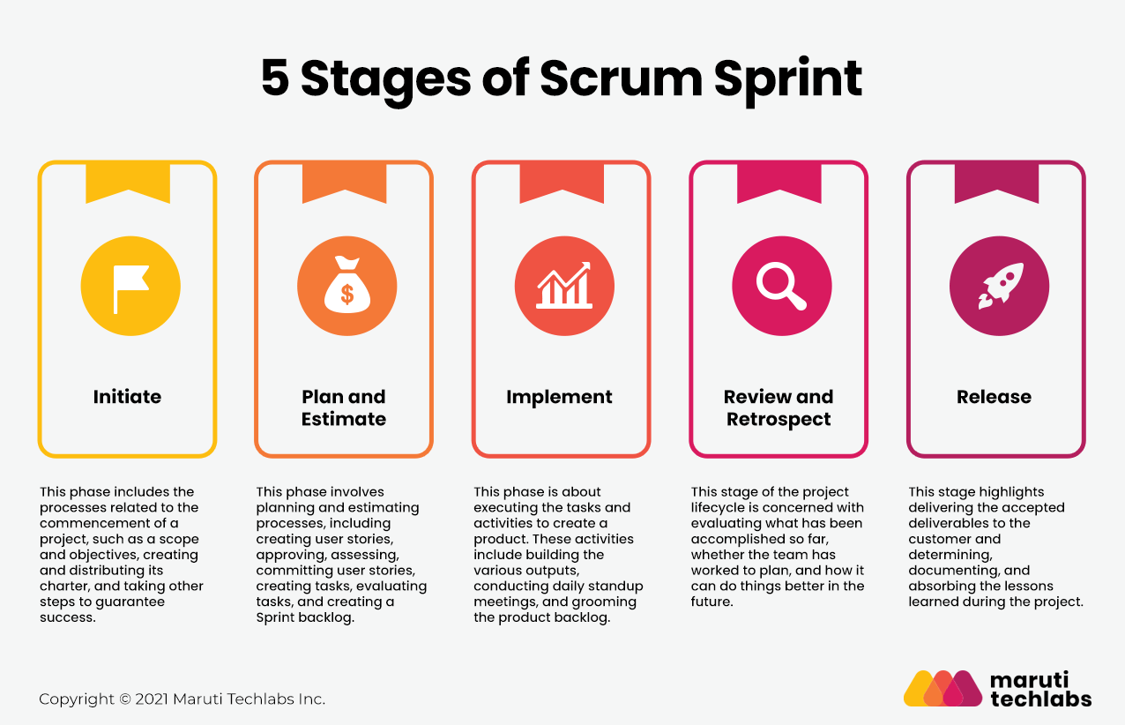

Slide 9
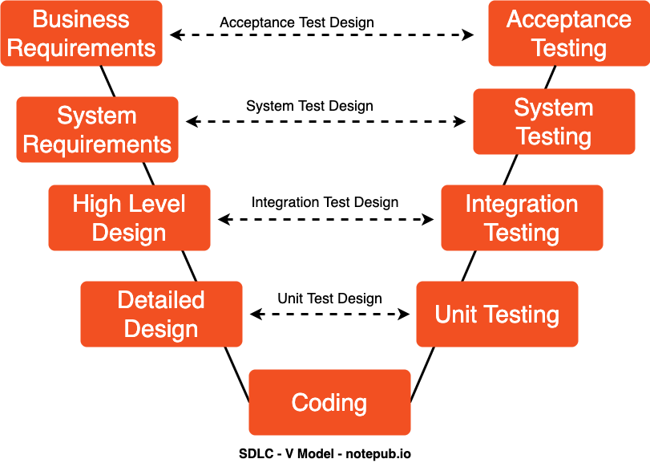
SW Development Process
Agile-SPRINTs

Slide 10
Project Sprints
Detection Alert
Camera Capture
Object Detection
Send messages to other subsystems
AMR Controller
Receive messages and act accordingly
Move using (SLAM) with Obstruction avoidance
Target Acquisition (Obj. Det.) and Tracking
Follow target using camera and motor control
System Monitor
Receive and Display Detection Camera and info
Receive and Display AMR Camera and info
Store, display, and report Information and Alerts

Slide 11
Team Exercise 5
Perform coding and testing of Detection Alert Module

Slide 12
Results & Code Review by each team
Show actual results against the expected results and explain the code written

Slide 13
Project Sprints
Detection Alert
Camera Capture
Object Detection
Send messages to other subsystems
AMR Controller
Receive messages and act accordingly
Move using (SLAM) with Obstruction avoidance
Target Acquisition (Obj. Det.) and Tracking
Follow target using camera and motor control
System Monitor
Receive and Display Detection Camera and info
Receive and Display AMR Camera and info
Store, display, and report Information and Alerts

Slide 14
Running Obj. Det on a real robot

Slide 15
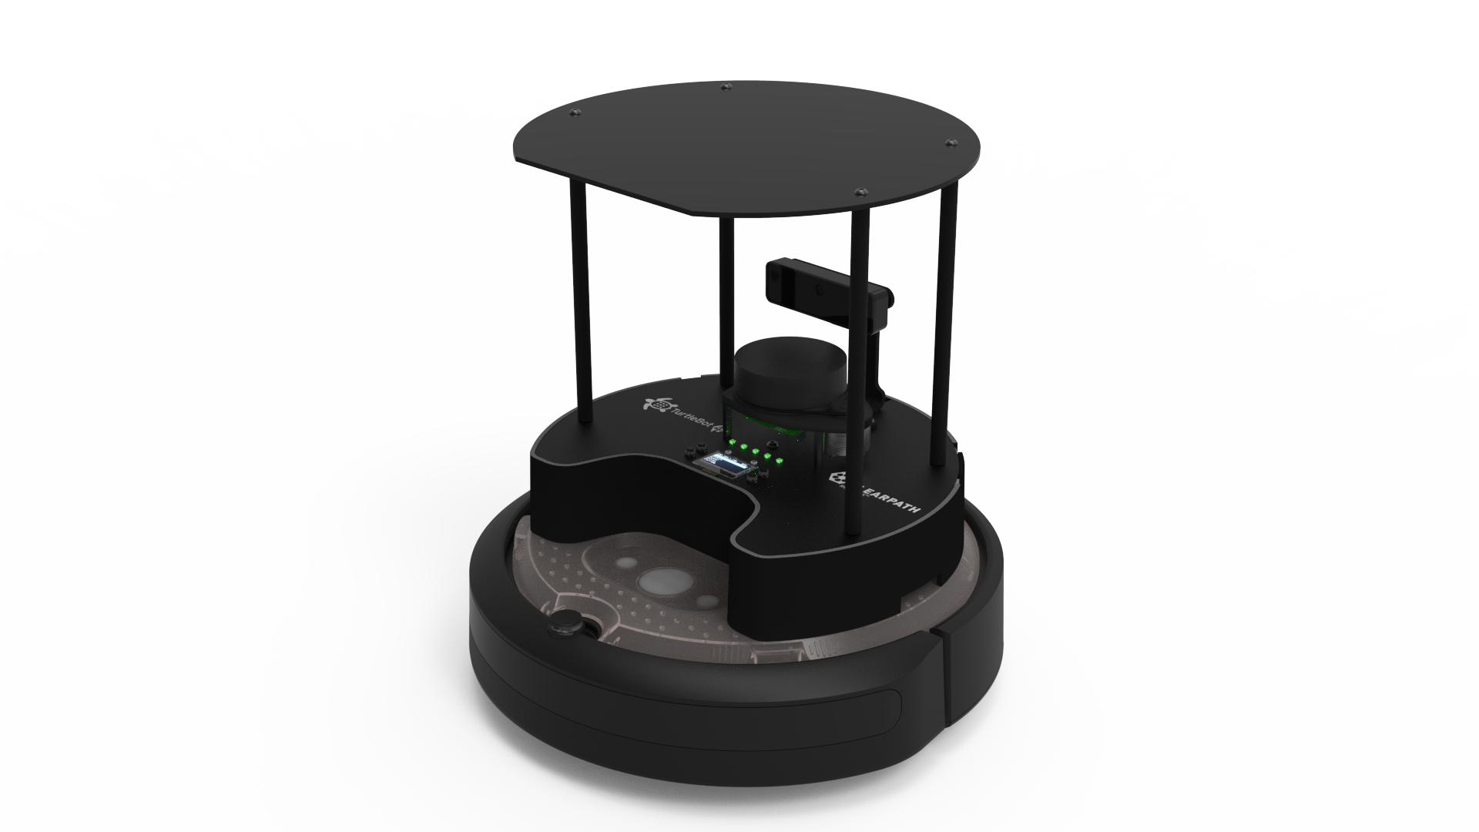
AMR Introduction
User Manual · Turtlebot4 User Manual
https://turtlebot.github.io/turtlebot4-user-manual/

Slide 16
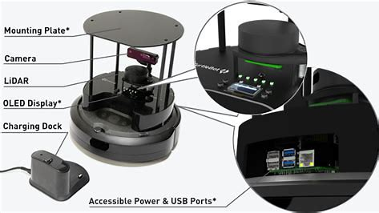

Slide 17
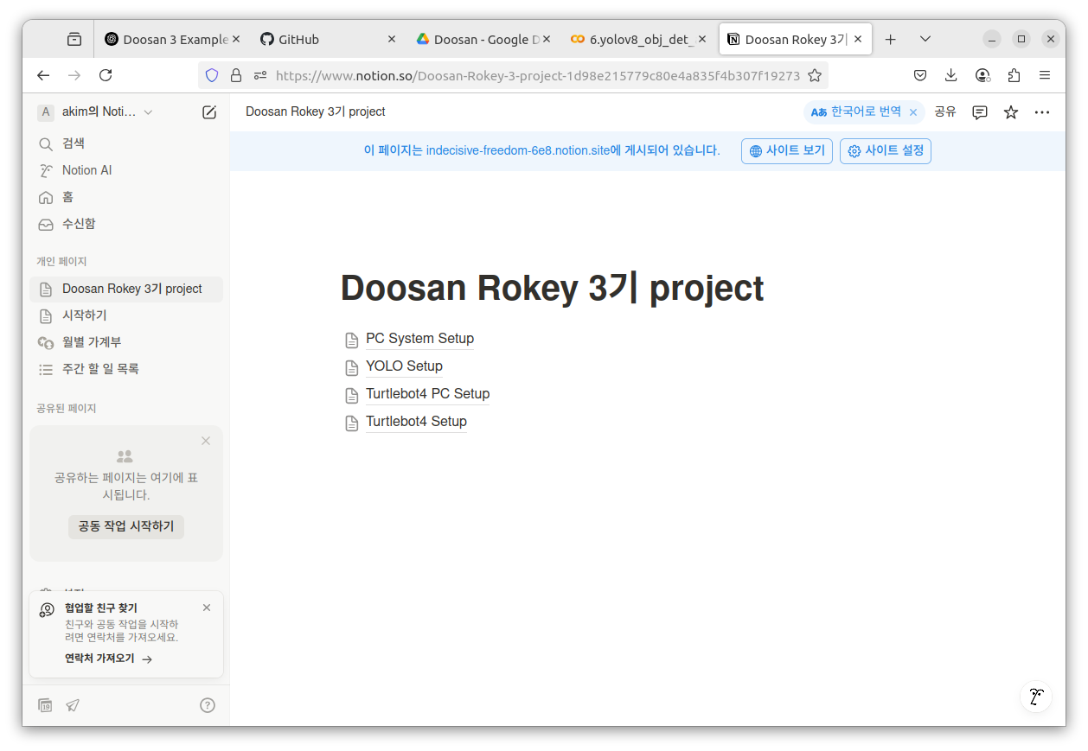
Setup PC for AMR
Turtlebot4 PC Setup
https://indecisive-freedom-6e8.notion.site/Turtlebot4-PC-Setup-1d98e215779c80e887b6c1dff4f151be

Slide 18
Power on and off AMR
로봇 전원 켜기
Power off
TurtleBot 4를 도크에 놓기
도크의 녹색 LED가 몇 초 동안 켜지고 TurtleBot 4가 켜집니다. 로봇이 부팅될 때까지 잠시 기다리세요.
로봇 버튼과 표시등에 대한 자세한 내용은 Create®3 설명서를 참조하세요.
Turtlebot4 를 도크에서 불리 하기
신호음이 들릴 때까지 Create3의 전원 버튼을 5초 동안 길게 누릅니다.
전원 버튼을 놓습니다.

Slide 19
Connecting to AMR -- SSH
Connect your PC to WiFi router that your AMR is connected
Ex: RokeyAP_Test
Obtain the ip address shown on the OLED display of the Turtlebot4
EX: 192.168.10.16
Open a terminal window
dpkg -l | grep openssh
If not installed…
sudo apt install openssh-server –y
Connect to AMR via SSH
ssh ubuntu@192.168.10.16
PW: rokey1234
Do NOT INSTALL any packages to AMR WITHOUT speaking with me first!!!

Slide 20
How to SETUp AMR
Turtlebot4 Setup
https://indecisive-freedom-6e8.notion.site/Turtlebot4-Setup-1d98e215779c801b8e74eff67eb6305e

Slide 21
How to TEST PC – AMR Connection
ros2 topic list (will need to execute it twice)
#Check the list
ros2 run teleop_twist_keyboard teleop_twist_keyboard --ros-args -r /cmd_vel:=/robot <n>/ /cmd_vel

Slide 22
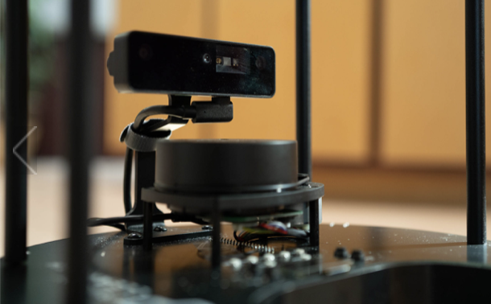
Object Tracking with AMR Camera

Slide 23
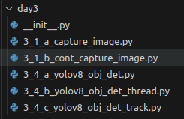
Coding Hints
Image Capture

Slide 24
Coding Hints
Image Capture
Data Labelling
labelImg

Slide 25
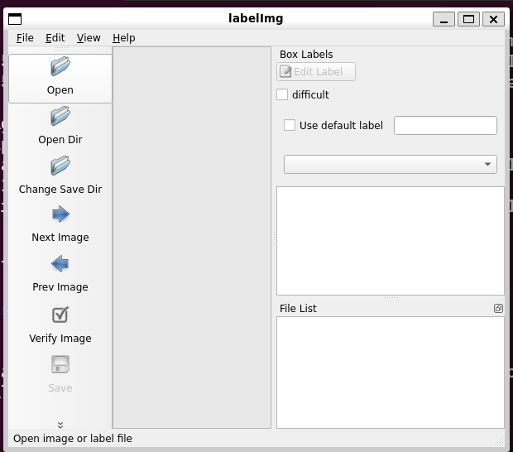
Coding Hints
Data Labelling : use previously installed LabelImg
Or
pip3 install labelImg
May also need “pip3 install PyQt5 lxml”
labelImg

Slide 26
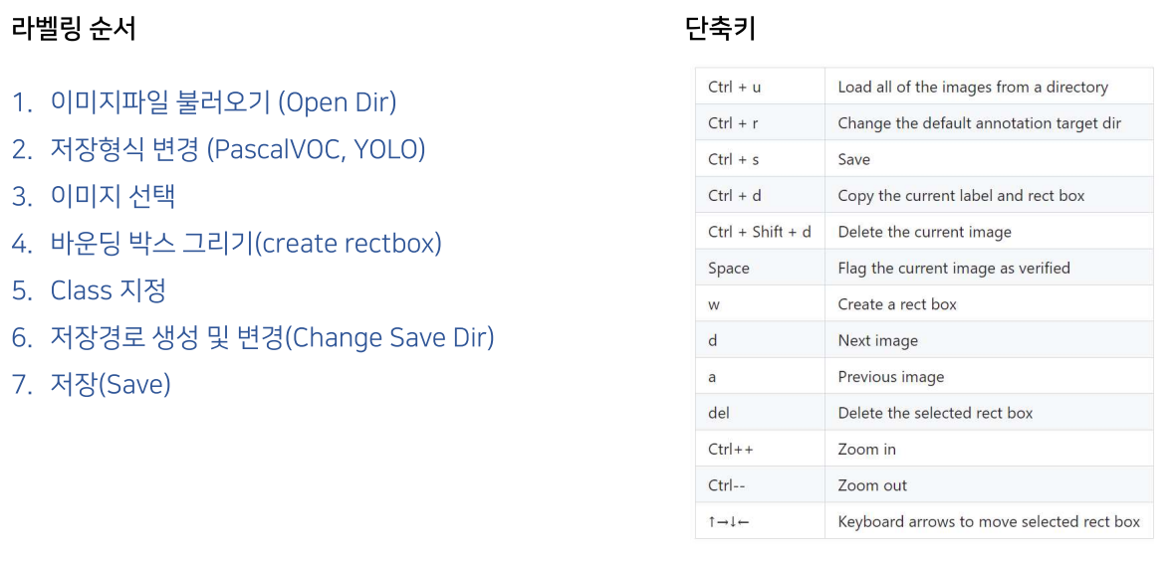
Coding Hints
Data Labelling : LabelImg

Slide 27
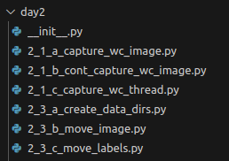
Coding Hints
Image Capture
Data Labelling
Data Preprocessing

Slide 28
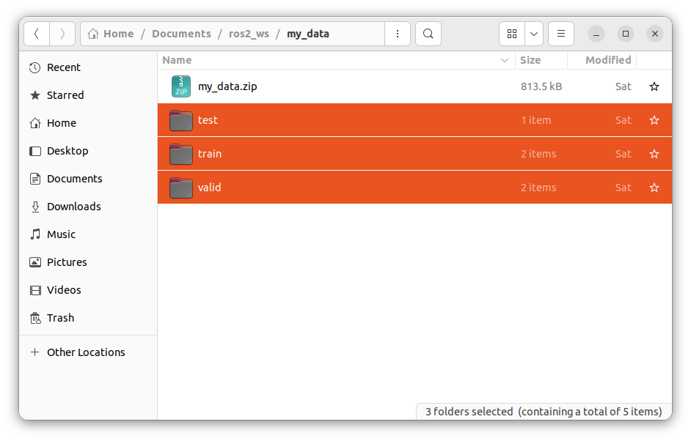
Zip train data Set

Slide 29
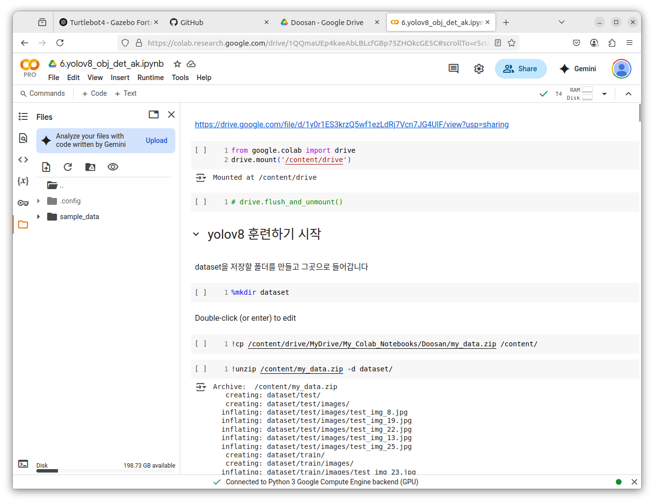
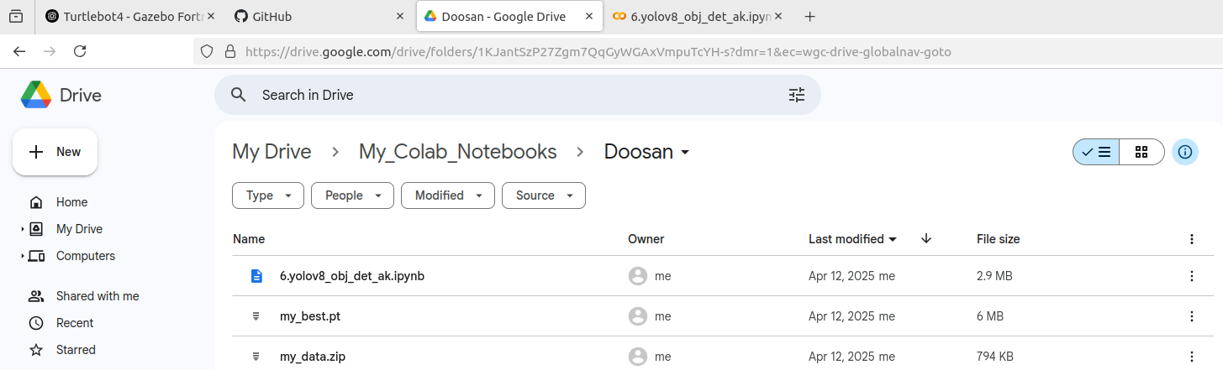
Using google Collab. To create custom model

Slide 30
Perform Yolo Training & Inference for AMR Controller

Slide 31
Undock/dock amr
undock
dock
ros2 topic list
Check the list
ros2 action send_goal /robot<n>/undock irobot_create_msgs/action/Undock “{}”
ros2 topic list
Check the list
ros2 action send_goal /robot<n>/dock irobot_create_msgs/action/Dock “{}”

Slide 32
Coding Hints
Image Capture
Data Labelling
Preprocessing
Yolo8 Object Det

Slide 33
Running in simulation

Slide 34
operating a robot(SIM)
Term1
ros2 launch turtlebot4_ignition_bringup turtlebot4_ignition.launch.py rviz:=true
Term2
ros2 topic list
ros2 topic echo <topic> --once
/oakd/rgb/preview/image_raw
/oakd/rgb/preview/depth
….

Slide 35
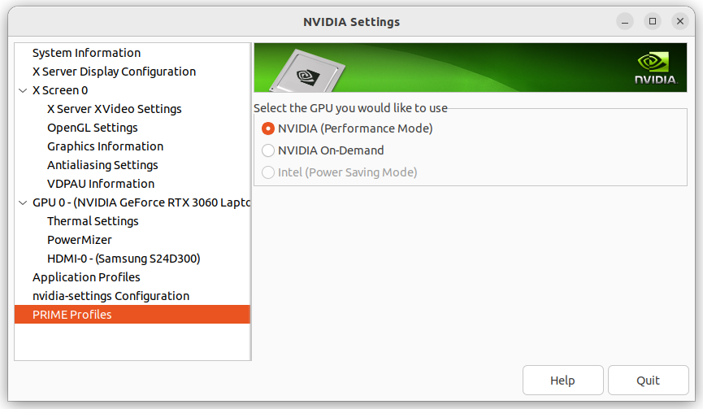
Setup Nvidia gpu for slam

Slide 36
digital Mapping using SLAM (SIM)
Term1
ros2 launch turtlebot4_ignition_bringup turtlebot4_ignition.launch.py nav2:=true slam:=true rviz:=true
Term2 (save map after mapping finishes)
ros2 service call /slam_toolbox/save_map slam_toolbox/srv/SaveMap "name: data: 'map_name’”
Ex:: ros2 service call /slam_toolbox/save_map slam_toolbox/srv/SaveMap "name: data: ‘my_map'"

Slide 37
digital Mapping with Auto – SLAM (SIM)
Term1
ros2 launch turtlebot4_ignition_bringup turtlebot4_ignition.launch.py nav2:=true slam:=true rviz:=true
Undock the robot
Term2
ros2 launch explore_lite explore.launch.py
Term3 (save map after mapping finishes)
ros2 service call /slam_toolbox/save_map slam_toolbox/srv/SaveMap "name: data: 'map_name’”
Ex:: ros2 service call /slam_toolbox/save_map slam_toolbox/srv/SaveMap "name: data: ‘my_map'"

Slide 38
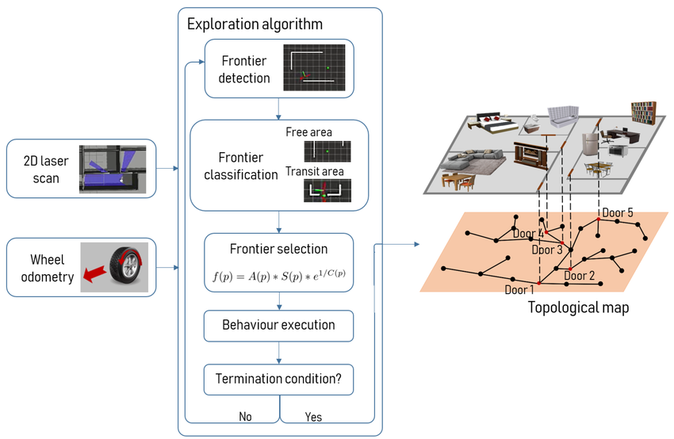
Auto slam concept/algorithm

Slide 39
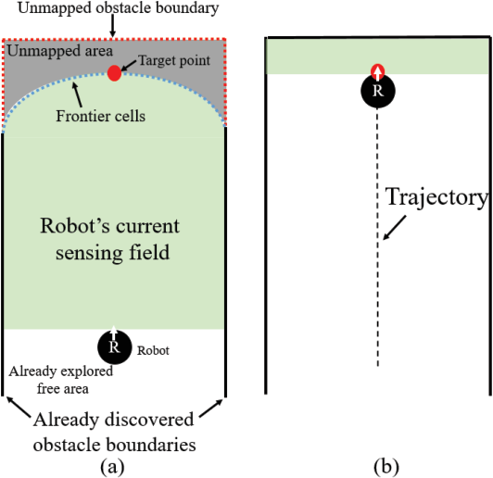
Algorithm Detail
Map Subscription
explore_lite subscribes to the SLAM-generated occupancy grid (/map topic) and identifies:
Free space: known, unoccupied areas
Occupied space: obstacles
Unknown space: unexplored
Frontier Detection
The map is scanned for cells that:
Are free, and
Are adjacent to at least one unknown cell.
These are marked as frontier cells.

Slide 40
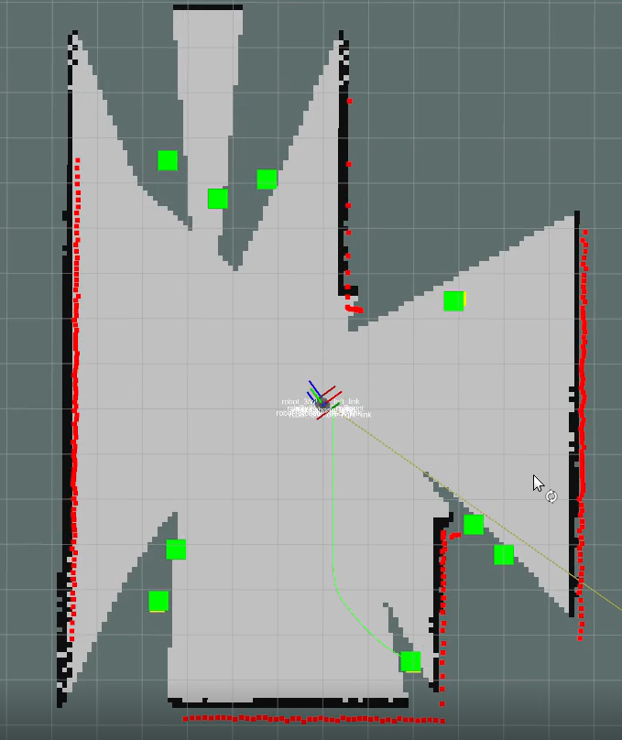
Algorithm detail
Frontier Grouping
Frontier cells are clustered into connected regions.
Each group represents a potential exploration target.
Goal Selection
For each frontier group, a representative point (typically the centroid or closest point) is selected.
The robot scores each group based on:
Distance from the robot
Information gain (how much new area might be revealed)
The best-scoring frontier is chosen as the next goal.

Slide 41
Algorithm detail
Termination
While (frontiers exist and reachable)
Select best frontier
Send as goal
If goal fails → blacklist
If (no frontiers or all blacklisted)
Terminate exploration

Slide 42
Checking Digital Map (SIM)
Check if correct
xdg-open <map-path>/map.pgm
Or,
eog <map-path>/map.pgm

Slide 43
Navigation w/ Digital map (SIM)
Term1
ros2 launch turtlebot4_ignition_bringup turtlebot4_ignition.launch.py nav2:=true slam:=false localization:=true rviz:=true

Slide 44
Parameter tuning???
slam
navigation
NEED TO UPDATE

Slide 45
Tutorial(sim)
TurtleBot 4 Navigator · User Manual
https://turtlebot.github.io/turtlebot4-user-manual/tutorials/turtlebot4_navigator.html
Terminal 1
ros2 launch turtlebot4_ignition_bringup turtlebot4_ignition.launch.py nav2:=true slam:=false localization:=true rviz:=true
Terminal 2
ros2 run turtlebot4_python_tutorials nav_to_pose
ros2 run turtlebot4_python_tutorials nav_through_poses
ros2 run turtlebot4_python_tutorials follow_waypoints
ros2 run turtlebot4_python_tutorials create_path
ros2 run turtlebot4_python_tutorials mail_delivery
ros2 run turtlebot4_python_tutorials patrol_loop

Slide 46
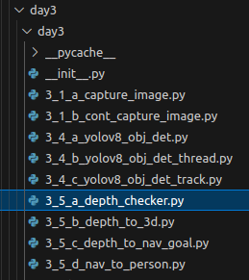
Using Depth (SIM)

Slide 47
프로젝트 rule number ONE!!!
Are we still having FUN!

