Slide 1
Good Morning! 早上好! 안녕하세요!
Day 4

Slide 2
Day 1
Welcome
Project Introduction
Introduction to Project Development Process
Business Requirement Development
System Requirement Development
System(High Level) Design
Time Management

Slide 3
Day 2 (Mini project)
Yolo객체 인식 모델 활용과 성능 평가 방법 이해
Custom Dataset과 Fine Tuning으로 자체 객체 인식 모델 구현 및 평가
(Optional)Segmentation,Tracking,경량화 모델 등 개별 요구사항에 적합한 모델 탐색 및 성능 검증
YOLOv8 기반 데이터 수집/학습/deploy (Detection Alert)
감시용 데이터 수집(bus, truck, tank 등)
감시용 데이터 라벨링
YOLOv8 기반 학습
YOLOv8 Object Detection
Porting to ROS
Create Detection Alert Node
Generate Topics to send image and Obj. Det. results
Create Subscriber node and display image and print data from the Topic

Slide 4
Day 3 (Mini project)
AMR(Autonomous Mobile Robot) Turtlebot4 개발 환경 구축
로봇 개발 환경에 완성 모델 서빙 및 테스트 / 로봇 H/W, 제반 환경의 한계점 도출
Tracking 데이터 수집(bus, truck, tank 등)
Tracking 데이터 라벨링
YOLOv8 기반 학습
YOLOv8 Object Tracking
Turtlebot4 시뮬레이션 환경 구축
SLAM과 Map 생성 및 파라미터 튜닝(Localization, AMCL)
AutoSLAM으로 맵 생성

Slide 5
Day 4 (Mini project)
Turtlebot4 Navigation과 파라미터 튜닝(Local Costmap, Global Costmap)
Turtlebot4 API를 활용한 Initial Pose Navigate_to Pose 구현
Turtlebot4 API를 활용한 Navigate_Through_pose, Follow Waypoints 구현
로봇 개발 환경에 적용 및 테스트 / 로봇 H/W, 제반 환경의 한계점 도출
AMR기반 카메라 인식 autonomous driving 시스템 with obstacle avoidance 구축 (AMR Controller)
Digital Mapping of environment
Goal Setting and Obstacle Avoidance using Navigation
Object Tracking w/ AMR camera
Control logic between navigation/obj. tracking/ obj. following (teleop)
Porting to ROS
Create AMR Controller Node
Create and send Obj. Tracking Image and data to Sysmon
Integrate and test with Detection

Slide 6
Day 5 (Mini project)
Flask 를 이용한 웹 서버 구축 (System Monitor)
Flask/HTML Intro
Deploy YOLOv8 Obj. Det results to web
Log in 기능 구현
Sysmon 웹기능 구현
알람 기능 구현
SQLite3를 이용한 데이터베이스 구축 및 연동 (System Monitor)
SQLite3 기본 기능 구현
DB 기능 구축
알람이 울리는 경우 DB에 저장하는 기능 구현
저장된 내용 검색하는 기능 구현

Slide 7
Day 5 (Mini project)
Porting to ROS
Update Sysmon Node code
Update the database with received Obj. Det. Data from Detection Alert Node
Display the content of DB on System Monitor web page
And finally, Integration and Test of Detection Alert & System Monitor

Slide 8

프로젝트 rule number ONE!!!
Have Fun Fun Fun!

Slide 9
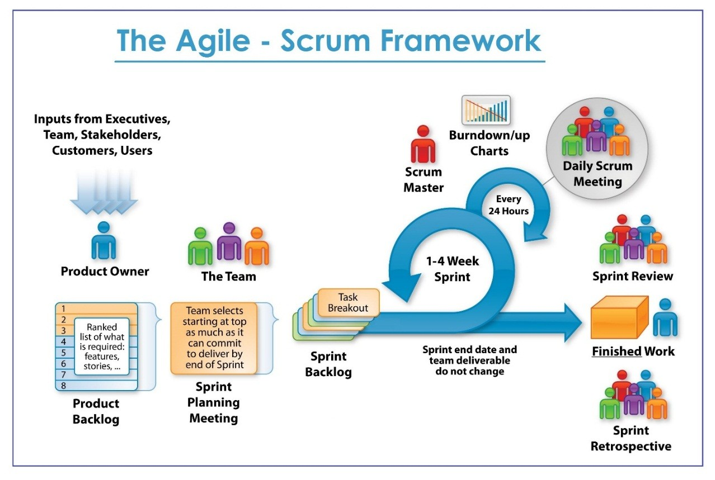

Slide 10
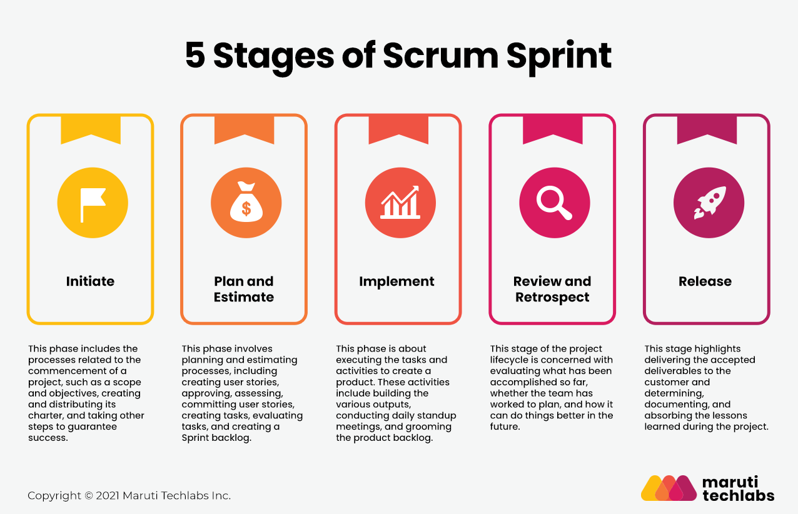

Slide 11
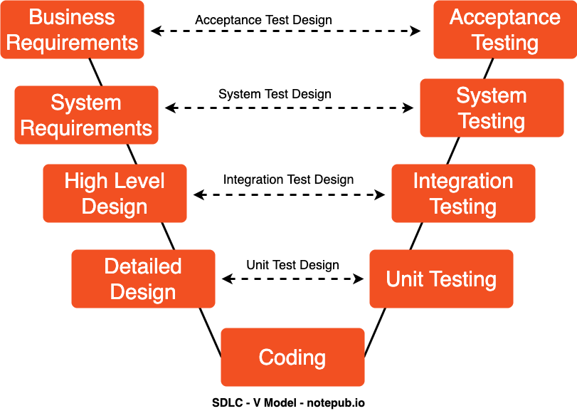
SW Development Process
Agile-SPRINTs

Slide 12
Project Sprints
Detection Alert
Camera Capture
Object Detection
Send messages to other subsystems
AMR Controller
Receive messages and act accordingly
Move using (SLAM) with Obstruction avoidance
Target Acquisition (Obj. Det.) and Tracking
Follow target using camera and motor control
System Monitor
Receive and Display Detection Camera and info
Receive and Display AMR Camera and info
Store, display, and report Information and Alerts

Slide 13
Team Exercise 5
Perform coding and testing of Detection Alert Module

Slide 14
Results & Code Review by each team
Show actual results against the expected results and explain the code written

Slide 15
Project Sprints
Detection Alert
Camera Capture
Object Detection
Send messages to other subsystems
AMR Controller
Receive messages and act accordingly
Move using (SLAM) with Obstruction avoidance
Target Acquisition (Obj. Det.) and Tracking
Follow target using camera and motor control
System Monitor
Receive and Display Detection Camera and info
Receive and Display AMR Camera and info
Store, display, and report Information and Alerts

Slide 16
Running in simulation

Slide 17
Simulation Summary
Topics
Sensors
Teleops
SLAM
Navigation

Slide 18
Controlling actual robot

Slide 19
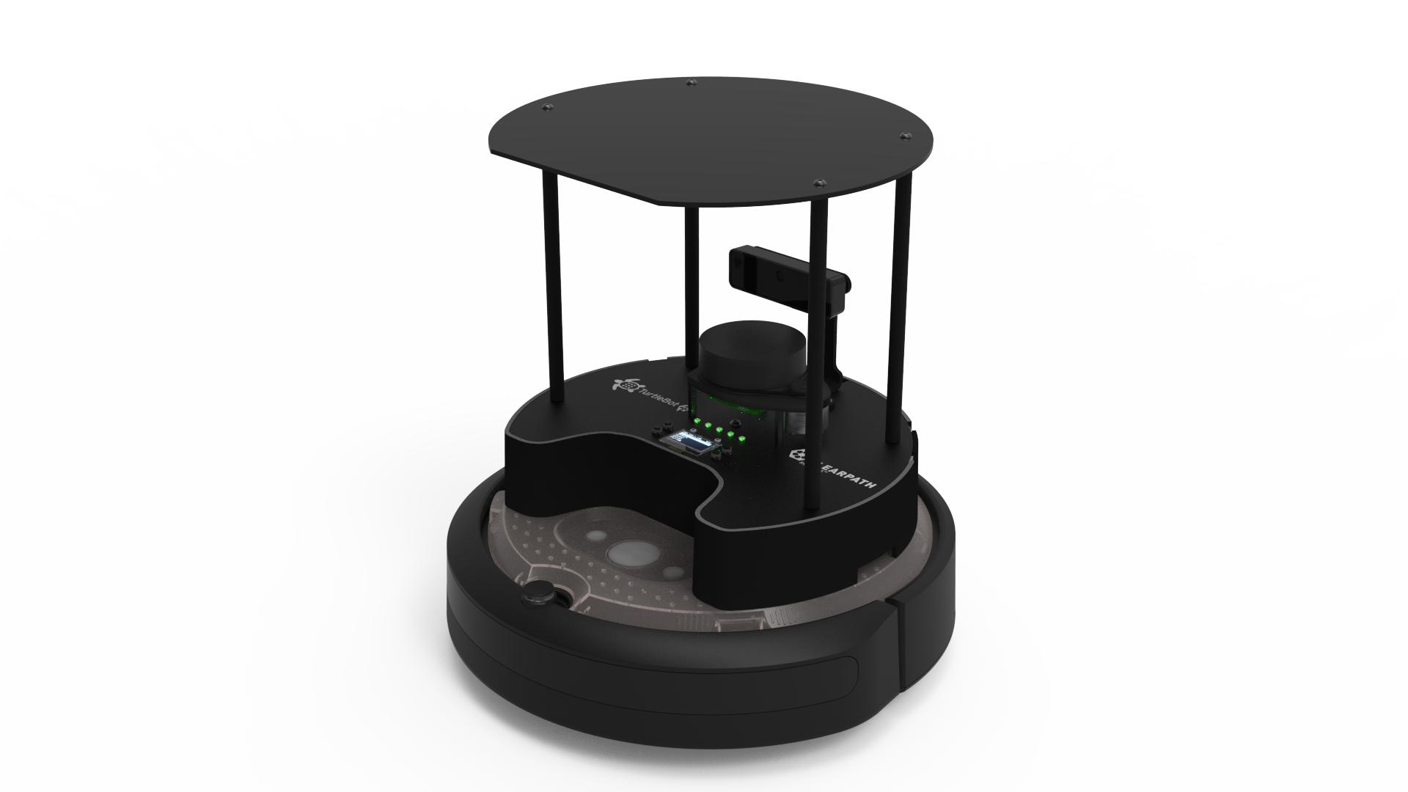
AMR Introduction
User Manual · Turtlebot4 User Manual
https://turtlebot.github.io/turtlebot4-user-manual/

Slide 20
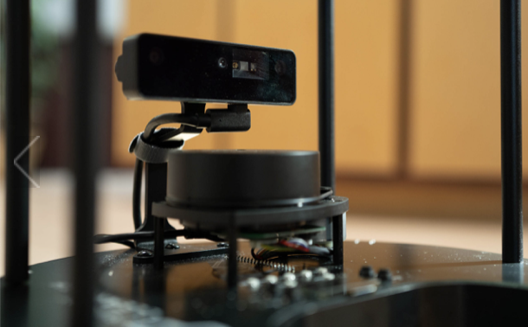
Object Tracking with AMR Camera
Summary
Data Collection
PreProcessing
Training
Inferences
ROSify

Slide 21
Controlling the AMR Movement
Teleop with keyboard
Navigation with SLAM

Slide 22
Driving your robot
Driving your TurtleBot 4 · User Manual
https://turtlebot.github.io/turtlebot4-user-manual/tutorials/driving.html
ros2 run teleop_twist_keyboard teleop_twist_keyboard namespace:=robot <n>

Slide 23
digital Mapping (SLAM)
Generating a map · User Manual https://turtlebot.github.io/turtlebot4-user-manual/tutorials/generate_map.html
Terminal 1
ros2 launch turtlebot4_navigation slam.launch.py namespace:=robot <n>
Terminal 2
ros2 launch turtlebot4_viz view_robot.launch.py namespace:=robot <n>

Slide 24
digital Mapping (SLAM)
Terminal 1
ros2 launch turtlebot4_navigation slam.launch.py namespace:=robot <n>
Terminal 2
ros2 launch turtlebot4_viz view_robot.launch.py namespace:=robot <n>
Terminal 3
cd <map_directory>
ros2 run nav2_map_server map_saver_cli -f “<map_name>" --ros-args -p map_subscribe_transient_local:=true -r __ns:=</namespace>

Slide 25
digital Mapping (Auto – SLAM)
Terminal 1
ros2 launch turtlebot4_navigation slam.launch.py namespace:=robot <n>
Terminal 2
ros2 launch turtlebot4_viz view_robot.launch.py namespace:=robot <n>
Terminal 3
ros2 launch explore_lite explore.launch.py namespace:=robot <n>

Slide 26
Digital Mapping
Check if correct
xdg-open <map-path>/map.pgm
Or,
eog <map-path>/map.pgm

Slide 27
Navigation w/ map
Navigation · User Manual
https://turtlebot.github.io/turtlebot4-user-manual/tutorials/navigation.html
2D_Pose_Estimate
Nav2_Goal
Terminal 1
ros2 launch turtlebot4_navigation localization.launch.py namespace:=robot<n> map:=$HOME/Documents/room/room_map.yaml
Terminal 2
ros2 launch turtlebot4_navigation nav2.launch.py namespace:=robot <n>
Terminal 3
ros2 launch turtlebot4_viz view_robot.launch.py namespace:=/robot <n>

Slide 28
Parameter tuning???
slam
navigation
NEED TO UPDATE

Slide 29
Tutorial
turtlebot4
cd /opt/ros/humble/share/turtlebot4_bringup/config
sudo cp oakd_pro.yaml oakd_pro_orig.yaml
sudo cp oakd_pro_new.yaml oakd_pro.yaml
sudo reboot
sudo systemctl status turtlebot4.service
sudo systemctl restart turtlebot4.service
ros2 topic list

Slide 30
Tutorial Exercise
Make copy and Update the tutorial code to successfully execute in the project environment

Slide 31
Tutorial
Terminal 1
ros2 launch turtlebot4_navigation localization.launch.py namespace:=robot<n> map:=$HOME/Documents/room/room_map.yaml
Terminal 2
ros2 launch turtlebot4_navigation nav2.launch.py namespace:=robot <n>
Terminal 3
ros2 launch turtlebot4_viz view_robot.launch.py namespace:=/robot <n>

Slide 32
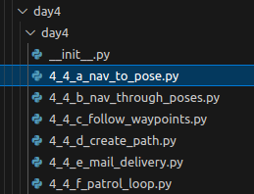
Tutorial
Terminal 4
ros2 run day4 create_path --ros-args -r __ns:=/robot<n>
ros2 run day4 nav_to_poses --ros-args -r __ns:=/robot<n>
ros2 run day4 nav_through_poses --ros-args -r __ns:=/robot<n>
ros2 run day4 follow_waypoints --ros-args -r __ns:=/robot<n>
ros2 run day4 mail_delivery --ros-args -r __ns:=/robot<n>
ros2 run day4 patrol_loop --ros-args -r __ns:=/robot<n>

Slide 33
Using Depth (Robot)
NEED TO UPDATE

Slide 34
AMR controller sprint

Slide 35
Sprint 2 – AMR controller

Slide 36
Team Exercise 6
Perform Detail Design of AMR Controller Module using Process Flow Diagram

Slide 37
Design hint
Initial Pose
nav2
rviz2 – 2D estimate pose
ros2 topic echo /initialpose
How do you find AMR current position and orientation?
Sending Goals
nav2
Rviz2 – send goals
ActionClient
NavigateToPose.send_goal_async()
Stopping Navigation NavigateToPose.cancel_all_goals_async()
Sending multiple goals
ActionClient
/follow_waypoints
Manual control of AMR Odometry
How to move forward, backward, left and right???
NEED TO UPDATE

Slide 38
What is the follow Algorithm?
Left/Right?
Forward/Backward?
Velocity?
Camera position?
Depth? Local/Global Coordinate transform?

Slide 39
Detail Design Review by each team
Using the process flow diagram present team’s design

Slide 40
Sprint 2 – AMR controller

Slide 41
Coding hint
Initial Pose
nav2
rviz2 – 2D estimate pose
ros2 topic echo /initialpose
Sending Goals
nav2
Rviz2 – send goals
ActionClient
NavigateToPose.send_goal_async()
ros2 topic echo /amcl_pose
Stopping Navigation
ActionClient
NavigateToPose.cancel_all_goals_async()
Sending multiple goals
ActionClient
/follow_waypoints
Manual control of AMR Odometry
Twist
/cmd-vel
NEED TO UPDATE

Slide 42
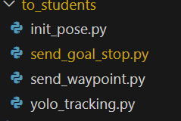
Coding hint
NEED TO UPDATE

Slide 43
Expected outcome
AMR navigates to avoid obstacles, ignores dummies, track, and follow target

Slide 44
Sprint 2 – AMR controller

Slide 45
Team Exercise 7
Perform coding and testing of AMR Controller Module

Slide 46
Using TurtleSIM to test following logic
Step1: PC Term 1
Step2: PC Term 2
source ~/bashrc
ros2 run turtlesim turtlesim_node --ros-args -r /turtle1/cmd_vel:=/cmd_vel
source ~/bashrc
ros2 run turtlebot3_teleop teleop_keyboard
NEED TO UPDATE

Slide 47
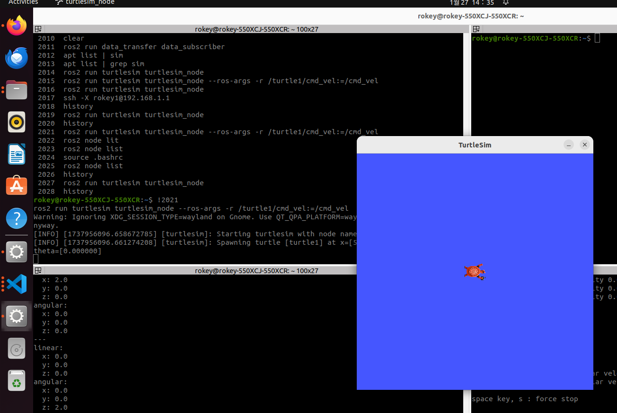

Slide 48
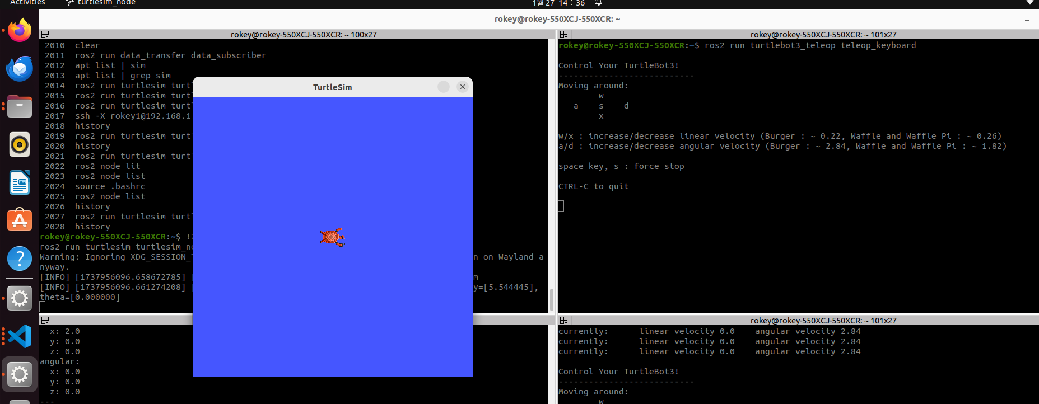

Slide 49


Slide 50
Using TurtleSIM to test following logic
Step1: PC Term 1
Step2: PC Term 2
source ~/bashrc
ros2 run turtlesim turtlesim_node --ros-args -r /turtle1/cmd_vel:=/cmd_vel
source ~/bashrc
ros2 run turtlebot3_teleop teleop_keyboard
Replace with your code

Slide 51
Results & Code Review by each team
Show actual results against the expected results and explain the code generated

Slide 52
Sprint 1&2 – Detection Alert/AMR Controller Integration & Test

Slide 53
Expected outcome
Detection Alert and AMR Controller able to pass topics for necessary actions between

Slide 54
Team Exercise 8
Perform integrate and test of Detection Alert and AMR Controller Modules

Slide 55
Results & Code Review by each team
Show actual results against the expected results and explain the code written

Slide 56
프로젝트 rule number ONE!!!
Are we still having FUN!

