Slide 1
Basic info
First implemented by JPMorgan
  fast messaging, small message overhead
So free that you don't even have to implement it correctly :)
The AMQP protocol is defined on a binary level
RabbitMQ supports also SSL, STOMP, XMPP
Clustering RabbitMQ using Pacemaker for HA
RabbitMQ implements AMQP 0.9.1

Slide 2
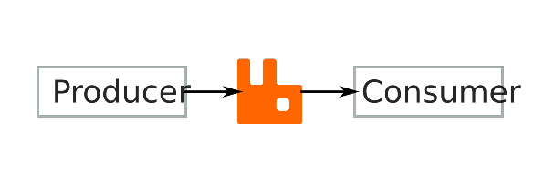

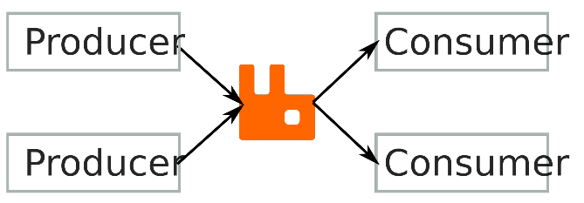
Use cases
Decoupling
Reliable RPC
Aggregation,
Distribution &
Duplication

Slide 3
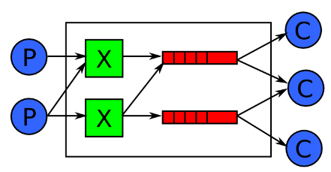
Model
Producers
Exchanges
Bindings
Queues
Consumers

Slide 4
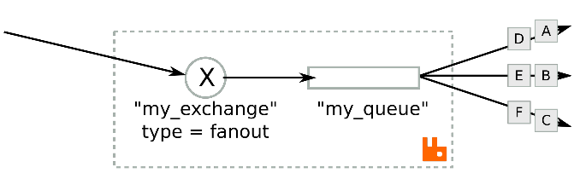
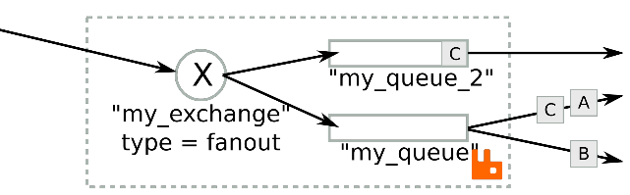
Fanout
Distribution when using just one queue
Duplication when delivering to multiple queues

Slide 5
Exchange types
Fanout
  Copy to all listening queues
Topic
  Copy to queues matching message routing key
Headers
Direct
  No routing (synchronous delivery/RPC)

Slide 6
Exchange Properties
Passive
  Checking if an exchange already exists
Durable
  Will persist over restarts
Auto Delete
  Disappears when no-one is connected

Slide 7
Queue Properties
Passive
  Must already exist
Durable
  Continues to exists after broker restart
Exclusive
  Only one consumer connection is allowed
Auto-delete
  Disappears when all consumers have disconnected
Alternate-exchange: deliver dropped messages

Slide 8
Message Properties
Routing Key (used by the topic exchange)
Immediate
  Message won't be acknowledged before it's received by the consumer / is unroutable if all target queues doesn't have consumers (TODO: correct ?)
Delivery-mode: transient/persistent
  Persistent messages may be redelivered
Priority (0-9)
Expiration (ms)

Slide 9
Cloud / future
Cloud
  Hosted directly on server, or
  Using Nasa Nebula (?)
AMQP version 1.0 is final. Changes:
  Exchange/bindings replaced by linking queues
  Complete addresses for

