Slide 1
The Weberian Economy
How Institutional Persistence Shapes Local Entrepreneurship
Kimball Weeks University of Oregon
WEAI conference 2026

Slide 2
What do I mean by a Weberian economy?
“
The idea of duty in one’s calling prowls about in our lives like the ghost of dead religious beliefs.
— Max Weber, The Protestant Ethic and the Spirit of Capitalism (1905)
Religious institutions
churches, across generations
Habits & capacity
work ethic · literacy · trust · networks
Economic life
new-firm formation
Do U.S. counties whose religious institutions persisted over time generate more entrepreneurship today?
2

Slide 3
Where it fits
Religion, human capital & growth. Weber (1905); Becker & Woessmann (2009) — Protestantism raised 19th-century Prussian economic prosperity not through a distinct work ethic, but by promoting literacy and schooling.
Church density & U.S. business. Deller et al. (2018); Conroy & Deller (2020) — contemporary church density predicts small-business activity and survival.
Religiosity & dynamism. Petach & Powell (2023) — higher modern religious adherence is associated with lower GDP growth.
The gap. Past literature measure religious intensity now, or at one moment. None measure institutional continuity: whether religious organizations endure across generations. That temporal dimension is this paper's entry point.
Why look at continuity? human capital, trust, and civic capacity is a stock that accumulates only through sustained institutional presence, so whether religious institutions endured across generations should shape today's economy more than how intense they were at any single point
3

Slide 4
Motivating example
Two counties in Montana, observationally matched on income, education, and population. differing mainly in long-run institutional continuity.
 | Custer, MT | Fergus, MT
Population (2010) | 11,699 | 11,586
Median income (1989) | $52,199 | $52,322
HS+ attainment (1990) | 77.1% | 77.4%
Church density 1890 (per 1,000 people) | 2.83 | 1.99
Church density 2020 (per 1,000 people) | 1.75 | 3.23
Church persistence index (normalized) | −0.60 | +0.27
New establishments / 1,000 (2022) | 2.91 | 3.02
4

Slide 5
Data
▸ data & sample detail
Variable | Source | Years
Church congregations (per 1,000) | Assoc. of Religion Data Archives (ARDA) | 1890, 1990, 2010, 2020
New establishment births (outcome) | Census Business Dynamics Statistics | 1989, 2010, 2022
Median household income (real $2023) | U.S. Census / NHGIS | 1989, 2010
Educational attainment (HS+ share) | U.S. Census / ACS | 1990, 2010, 2023
Population | U.S. Census / NHGIS | 1890, 1990, 2010, 2023
Sample ≈ 2,968 counties (82–95% of the continental U.S.). 1890 is the only near-comprehensive enumeration of local religion before the federal religious census (1906–1936); noisy, but anchors the long run.
5

Slide 6
What does this paper do?
1
A new measure of institutional continuity (church persistence index)
2
Correlation between church persistence and entrepreneurship (new business establishments in 2022) and robustness of results
3
Are we working through a human capital channel as weber predicts?
6
Notes:
Quantify

Slide 7
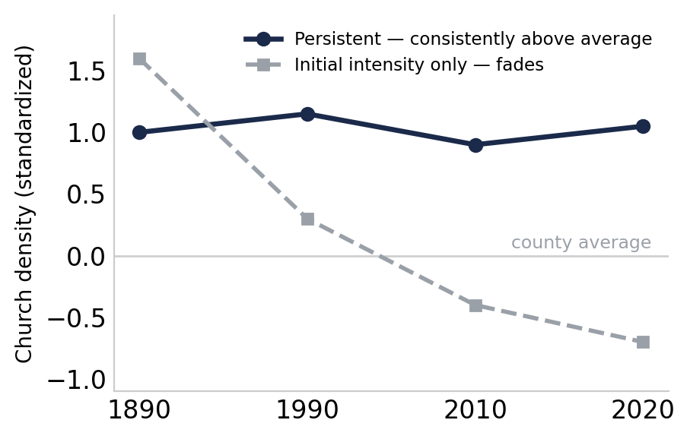
What is institutional persistence?
Persistence is whether a county's religious institutions endured continuously across generations.
measured from church density in 1890, 1990, 2010, and 2020.
High persistence
Low persistence
A high-persistence county stayed above average in all four decades consistency, not a single peak.
Two counties, same 1890 starting point — only one stays churched across the century.
7

Slide 8
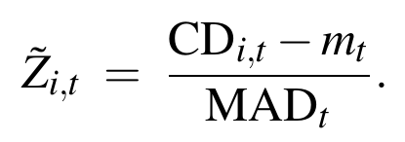
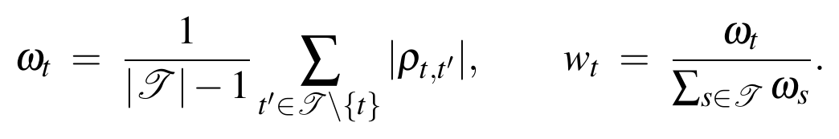
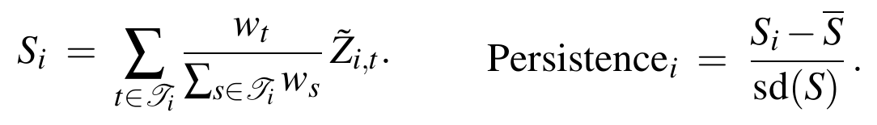
The church persistence index
▸ construction detail
1890
1990
2010
2020
Persistence index
standardize → weight by rank-agreement → composite
1. Robust standardization within each decade for county i and year t
2. Weight decades by cross-decade rank agreement (Spearman ρ) for the fours years in T and average
3. Weighted composite, then re-standardize across counties
8

Slide 9
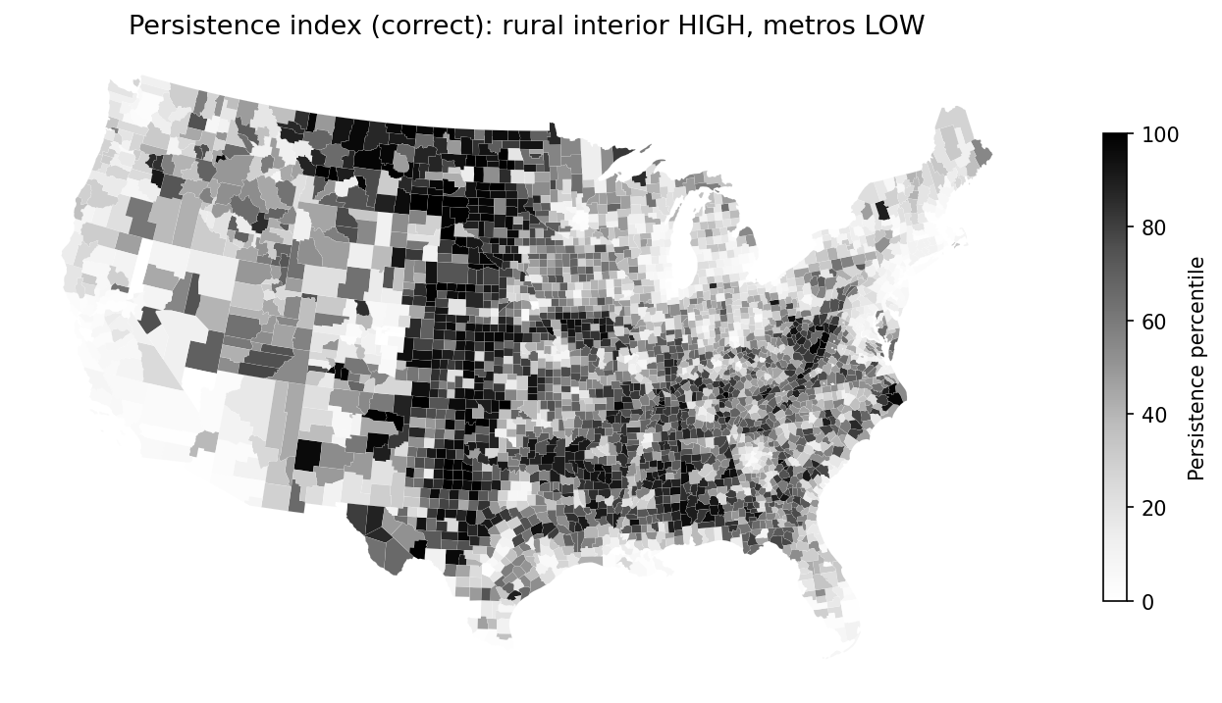
Spatial distribution
▸ all four heatmaps
Rural interior, not the coasts. Highest in the northern Plains and Upper Midwest, and across the rural South and Appalachia.
Lowest in the metros.
Northeast corridor, coastal California, Pacific Northwest, South Flordia.
Inverse of population
9

Slide 10
Empirical specification
▸ full robustness tables
Baseline (county i in state s):
Controls Zᵢ: standardized 1989 income · standardized 1990 education · log population (2010).
Estimation. OLS with state fixed effects and HC3 robust standard errors; standardized controls are z-scored prior to estimation.
Key outcome: New establishment births 2022
10
Notes:
No causaility

Slide 11
Main result
▸ robustness & diagnostics
 | log(1 + NewEstab 2022)
Church persistence index | 0.0559*** (0.014)
Income 1989 (std) | 0.0682*** (0.012)
Education 1990 (std) | 0.2118*** (0.018)
log(Population 2010) | 1.0197*** (0.010)
State fixed effects | Yes
Observations | 2,968
R² | 0.954
+5.75%
establishment births per capita,
per one-SD of persistence
= 100·(e^0.0559 − 1). Among counties alike today in size, income, and educational history, those whose institutions endured make more new businesses.
11

Slide 12
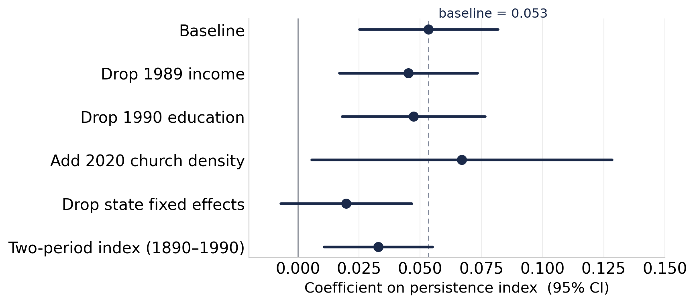
Robustness
▸ all robustness tables (A1–A7)
Stable across:
dropping any single control; adding 2020 church density; a two-period (1890–1990) index.
without state FE the estimate weakens (identification is within-state) but stays within confidence interval of all other estimates
12

Slide 13
Was Weber right? the human-capital channel
Persistence
index
0.401***
Education 2023
HS+ attainment
0.209***
New firm births
log(1+NewEstab)
direct association — ≈ 91% of the total
Mediation. Adding Education₂₀₂₃ to the baseline attenuates β₁ from 0.0559 → 0.0509 (λ = 0.014***). Education mediates only ≈ 9%, the channel is real but partial; most of the effect operates elsewhere.
13

Slide 14
Mechanism: beyond formal schooling
Decomposition of the persistence effect
9%
≈ 91% (not separately identified)
Trust, norms & networks. Repeated congregational interaction builds bonding social capital; churches act as low-cost financial middlemen for informal contracts, reputational checks, and credit introductions.
Substitute civic infrastructure. Where public capacity was thin, churches supplied meeting space, youth and adult education, and informal insurance, scaffolding for entry.
Caveat. The intensive-margin pattern (more enterprise per resident, not more residents) fits this story, but the residual is interpreted, not measured. Denomination-level data, further decomposition, and casual identification is the next step.
14

Slide 15
Continuity vs. initial conditions
▸ 1890-population variant (A4)
The sharpest test: 1890 church density alone, then both measures together.
log(1 + NewEstab 2022) | (a) 1890 only | (b) Both
Persistence index | — | 0.0532***
1890 church density | 0.0003 | −0.0022
Controls & state FE | Yes | Yes
Observations | 2,610 | 2,610
Result. 1890 density is indistinguishable from zero, alone or alongside the index; persistence survives. This challenges the deep-roots framing (Becker & Woessmann 2009; Nunn 2009): what institutions do over time matters more than how intense they were at the start.
15

Slide 16
Adding contemporary church density
 | log(1 + NewEstab 2022)
Persistence index | 0.1002*** (0.028)
Church density 2020 (per 1,000) | −0.0334 (0.019)
Income 1989 (std) | 0.0673*** (0.012)
Education 1990 (std) | 0.2100*** (0.018)
log(Population 2010) | 1.0196*** (0.010)
State FE · N · R² | Yes · 2,968 · 0.954
Persistence survives and strengthens when present-day church density is included; 2020 density itself is insignificant and negative. The result reflects long-run continuity, not contemporary religiosity and mirrors Petach & Powell (2023)
16

Slide 17
Limitations
Causal identification. Correlation association. Persistence isn't randomly assigned.
Unobserved confounders. May proxy for slow-moving traits like political culture, migration selectivity, social capital.
Measurement & heterogeneity. 1890 is noisy; the index pools very different denominations (Mormon Utah ≠ rural South).
17

Slide 18
Conclusion
1.
Persistence matters. A one-SD increase in church persistence is associated with ≈ 5.75% more new establishment births per capita conditional on income, education, population, and state fixed affects.
2.
Continuity, not initial conditions. 1890 density alone predicts nothing; what institutions do over time is what carries.
3.
A partial human-capital channel. ~9% runs through schooling; trust, networks, and civic coordination are the suggested remainder.

Slide 19
Thank You
Kimball Weeks – University of Oregon
Kimballw@uoregon.edu
Comments and questions welcome.

Slide 20
What would make this causal
find a shock that changed institutional continuity for reasons unrelated to the local economy, then compare counties that got the shock to those that didn't.
1
Migration waves. Origin-county push factors differentially disrupted local church networks
2
Church consolidations & mergers. Mid-20th century denomination mergers altered local religious infrastructure for organizational, not economic, reasons affecting the number of churches in some counties but not others
3
Natural disasters. Events that destroyed or rebuilt congregational stock shifted institutional continuity exogenously.
Plus: matched county designs, placebo outcomes, and linking counties to micro data on firm founding teams and credit relationships to pin down the channel.
Weeks · WEAI
20

Slide 21
Appendix · Summary statistics
↩ back
Variable | Mean | SD | Min | Max | N
Persistence index | 0.00 | 1.00 | −1.72 | 3.44 | 3,055
Persistence index (1890–1990) | 0.00 | 1.00 | −2.23 | 2.48 | 3,055
New establishments, 2022 | 273.5 | 1,113.2 | 0 | 38,467 | 3,004
Population, 1890 | 22,258 | 54,068 | 0 | 1,515,301 | 2,716
Population, 2010 | 98,233 | 315,734 | 90 | 9,818,605 | 3,055
Population, 2023 | 106,664 | 335,829 | 81 | 9,663,345 | 3,055
Median HH income, 1989 ($2023) | 58,136 | 15,572 | 21,016 | 144,959 | 3,055
Educational attainment, 1990 (%) | 68.8 | 11.9 | 18.1 | 95.5 | 3,055
New establishments, 1989 | 231.4 | 837.9 | 0 | 26,540 | 3,013
Estimation samples range from ~2,600 to ~3,055 counties depending on data coverage by year.
Weeks · WEAI
21

Slide 22
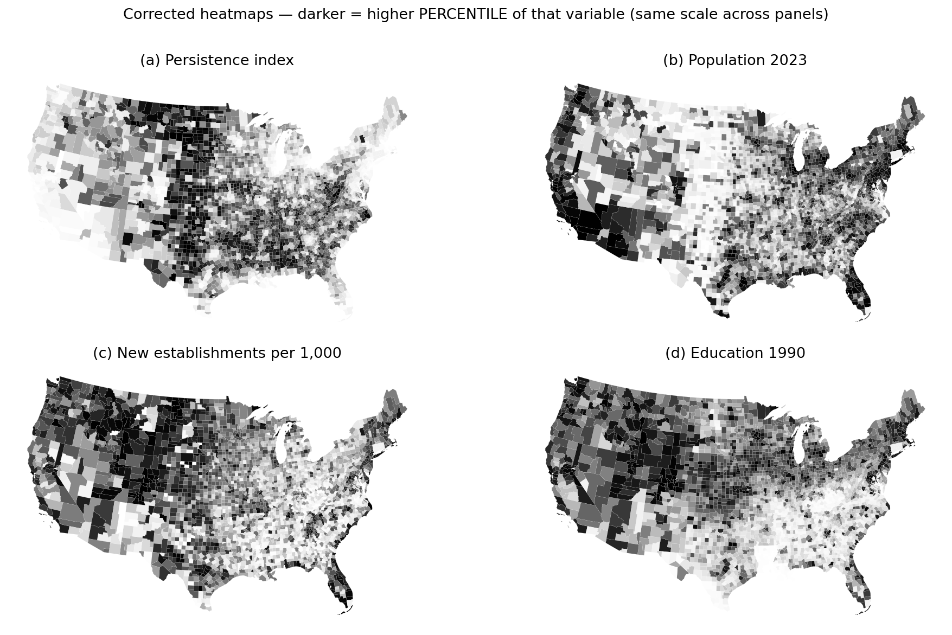
Appendix · Spatial distribution of key variables
↩ back
22

Slide 23
Appendix · Education channel
↩ back
 | (a) Education 2023 | (b) log(1+NewEstab)
Persistence index | 0.4007*** (0.141) | —
Income 1989 (std) | −0.2184 (0.127) | 0.0613*** (0.012)
Education 1990 (std) | 5.4929*** (0.188) | 0.2088*** (0.018)
log(Population 2010) | −0.2307*** (0.092) | 0.9962*** (0.008)
State FE | Yes | Yes
Observations | 3,055 | 2,968
R² | 0.655 | 0.954
(a) persistence → modern education; (b) historical schooling → firm births. The two legs of the human-capital chain.
*** p < 0.01. HC3 robust SE in parentheses.
Weeks · WEAI
23

Slide 24
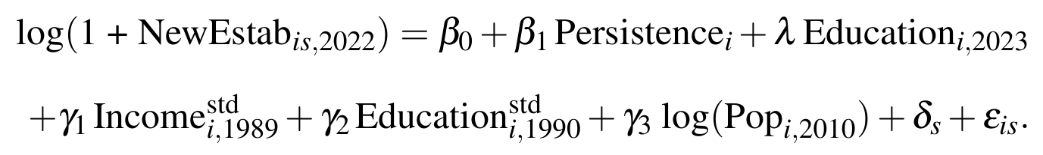
Appendix · Mediation (attenuation test)
↩ back
log(1 + NewEstab 2022) | Without Educ 2023 | With Educ 2023
Persistence index (β₁) | 0.0559*** | 0.0509***
Education 2023 (λ) | — | 0.0140***
Implied share mediated |  | ≈ 9%
Same common sample in both columns. The attenuation of β₁ when contemporary education enters is the share mediated by human capital — modest but nonzero.
Weeks · WEAI
24

Slide 25
Appendix · Robustness: drop-one controls
↩ back
Model | Persistence (SE) | R²
Baseline | 0.0559*** (0.014) | 0.954
No income 1989 | 0.0475*** (0.014) | 0.953
No education 1990 | 0.0485*** (0.014) | 0.950
No log(Pop 2010) | −0.8241*** (0.028) | 0.695
Persistence is stable to dropping income or education. Dropping log(Pop) flips the sign — population is intrinsic to the per-capita outcome, not an optional control (R² collapses to 0.70). State FE retained throughout; N = 2,968.
Bundled (no income & no education): 0.0081 (0.015), R² = 0.945 (Table A2).
Weeks · WEAI
25

Slide 26
Appendix · Population control & the intensive margin
↩ back
log(1 + NewEstab 2022) | (1) Pop 2010 control | (2) Pop 1890 control
Persistence index | 0.0559*** (0.014) | −0.6986*** (0.029)
Historical controls | Yes | Yes
State FE | Yes | Yes
Observations · R² | 2,968 · 0.954 | 2,652 · 0.756
Why the sign flips. Controlling for contemporary population (the right per-capita scale) gives the positive intensive-margin result. Substituting sparse, noisy 1890 population mis-scales the outcome (N falls to 2,652, R² to 0.76) and is not the headline specification.
Weeks · WEAI
26

Slide 27
Appendix · No state FE & alternative index
↩ back
log(1 + NewEstab 2022) | (A5) No state FE | (A6) Two-period index
Persistence / two-year index | 0.0205 (0.013) | 0.0375*** (0.011)
Income 1989 (std) | 0.0725*** (0.011) | 0.0642*** (0.012)
Education 1990 (std) | 0.1776*** (0.011) | 0.2092*** (0.018)
log(Population 2010) | 0.9893*** (0.009) | 1.0103*** (0.009)
State FE · N · R² | No · 2,968 · 0.936 | Yes · 2,968 · 0.954
Without state FE persistence is positive but insignificant — identification is within-state. A two-period (1890–1990) index gives 0.0375*** — the result is not driven by the modern decades alone.
Weeks · WEAI
27

Slide 28
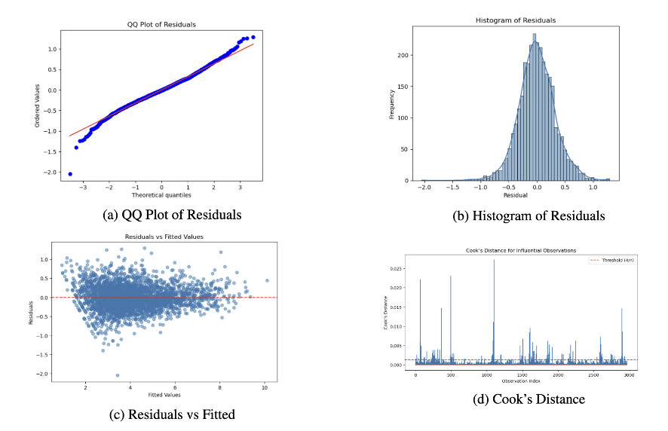
Appendix · Residual diagnostics
↩ back
QQ, histogram, residuals-vs-fitted, and Cook's distance for the baseline OLS. Approximate normality, no extreme outliers (all below the 0.5 cutoff). Breusch–Pagan rejects homoskedasticity (LM = 261.58, p < 0.001) — hence HC3 robust SE throughout.
Weeks · WEAI
28

Slide 29
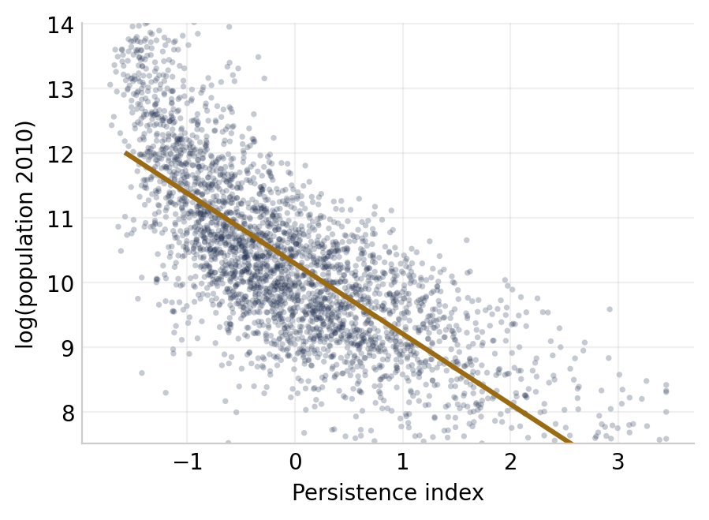
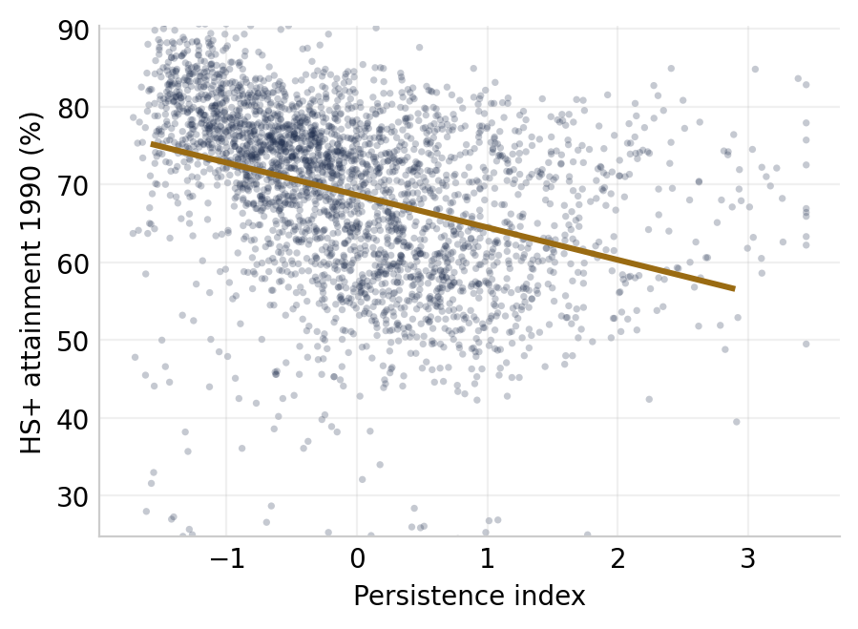
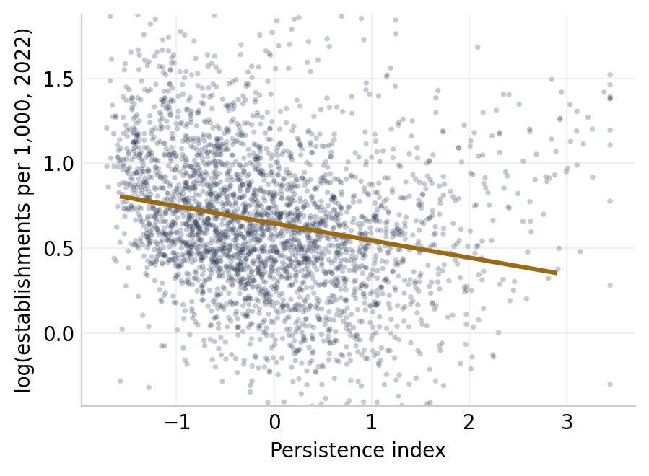
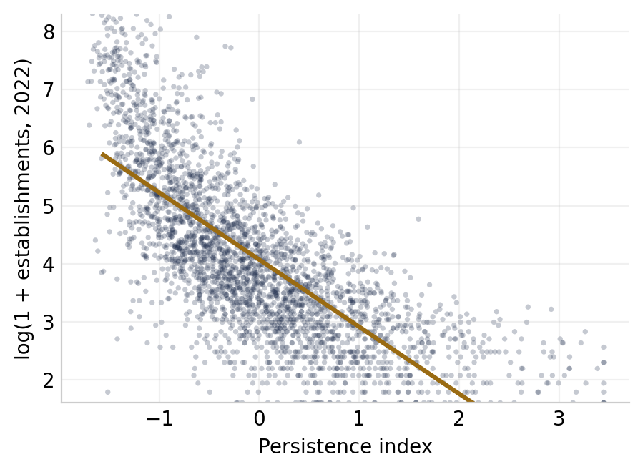
Scatter plots
29

Slide 30
Appendix · Clustering SE's by state
 | Coeff | HC3 SE (p) | Clustered SE (p)
Persistence index | 0.0559 | 0.014 (0.000) | 0.020 (0.006)
Income 1989 (std) | 0.0682 | 0.012 | 0.023 (0.003)
Education 1990 (std) | 0.2118 | 0.018 | 0.032 (0.000)
log(Pop 2010) | 1.0197 | 0.010 | 0.018 (0.000)
30

Slide 31
Appendix · Persistence index, in detail
↩ back
Goal: reward consistent above-average church density across all four decades — continuity, not a single peak.
1.
Robust z within each decade. Median/MAD standardization, winsorized at ±3.5 — resistant to 1890's fat tails and outliers.
2.
Spearman-agreement weights. Each decade weighted by its average rank-correlation with the others; noisy decades (1890) are down-weighted endogenously.
3.
Weighted composite. Sum of weighted z-scores; weights re-normalize over observed years for counties missing a decade.
4.
Re-standardize across counties. Final index is mean 0, SD 1 — so a one-SD move is interpretable across counties.
Validation: results hold with a simpler equal-weight index and with a 1890–1990 two-period index (β = 0.0375), so the weighting scheme is not doing the work.
Weeks · WEAI
31

Slide 32
Appendix · Data & sample
↩ back
Church counts. ASARB / ARDA U.S. Religion Census (1890, 1990, 2010, 2020) and Carroll (1894) for the 1890 enumeration. Densities are congregations per 1,000 residents.
Outcome. New establishment births from the Census Business Dynamics Statistics — a firm's first period of positive employment; consistent across counties and time.
Controls. Median household income (real $2023) and educational attainment from U.S. Census / ACS via IPUMS NHGIS (Manson et al. 2025).
Exclusions. Connecticut and Rhode Island (no functional counties) and Alaska (non-aligned boroughs); a few counties with incomplete 1890 coverage (e.g. parts of OK, MT).
Estimation samples: ~2,600 (1890-dependent specs) to 3,055 counties — 82–95% of the continental U.S.
Weeks · WEAI
32

