Slide 1
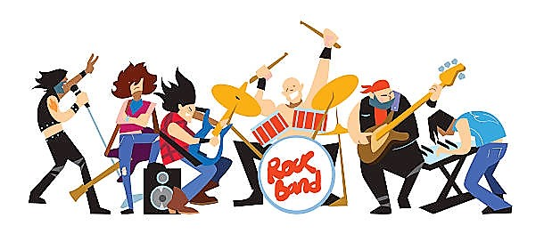



RockPy
General guidelines when writing chart hits for the 21st Century
By: Darrin Cates, Kimberly Erin, and Rachel Pontow

Slide 2


Motivations
Is there a formula for creating a hit song?
Are there common components that chart-topping songs have?
Has this changed over time? If so how?

Slide 3


Our Questions
How does the positivity/negativity of lyrics affect popularity?
How does word repetition affect popularity?
How does the beats per minute affect popularity?
How does acousticness, duration, energy, instrumentalness, loudness, and valence affect popularity?
How have these changed over time?

Slide 4

Summary
What did we find?
Acoustic songs don’t tend to be as popular
Negative lyrics, while around 25% in popularity, are becoming more popular
Top songs are increasingly using repetition
Song length is at about 2.5 minutes to 5 minutes with few exception after 2010
Songs that have high energy and you can dance to have will do better than songs that you can’t dance to
Instrumentals don’t do very well on the chart toppers-best to stay away
Keep you music LOUD
Chart toppers can be happy or sad sounding. The sound seems to have no impact on chart toppers these days
Average 120 BPM
Has this changed over time? If so how?

Slide 5




Data Collection
Song Source:
Billboard 1964-2015 Songs + Lyrics csv from Kaggle.com
Sentiment Analysis:
VADER Sentiment Analysis
Beats Per Minute:
Get Song Bpm API Beats Per Minute:
Spotify Attributes (Spotify API):
Acousticness, Danceability, Duration, Energy, Instrumentalness, Loudness, Valence

Slide 6
Data Exploration
The Process
Asked ourselves what we wanted to learn
Identified the data sources
Worked through a retrieval plan
Cleaned the data
Analyzed trends
The Struggles
Complicated API’s (Spotify)
Unclear Documentation (Get Song BPM)
Slowness of API calls
Insights
Use time delays to make API calls. 5 seconds in a delay, makes a world of difference

Slide 7
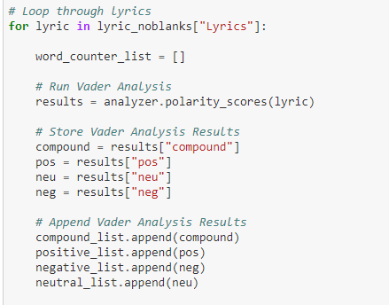
Sentiment Analysis

Slide 8
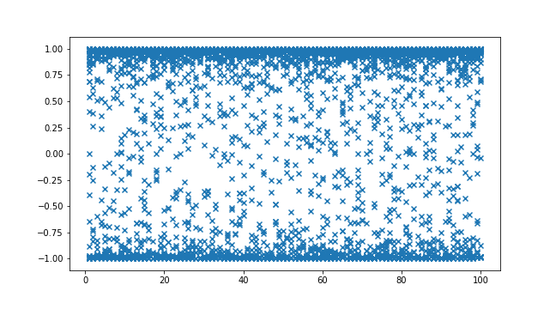
Sentiment Analysis
Sentiment Vs Chart Ranking
Positive: > 0.75
Negative: <-0.75
Sentiment Value
Chart Rank

Slide 9
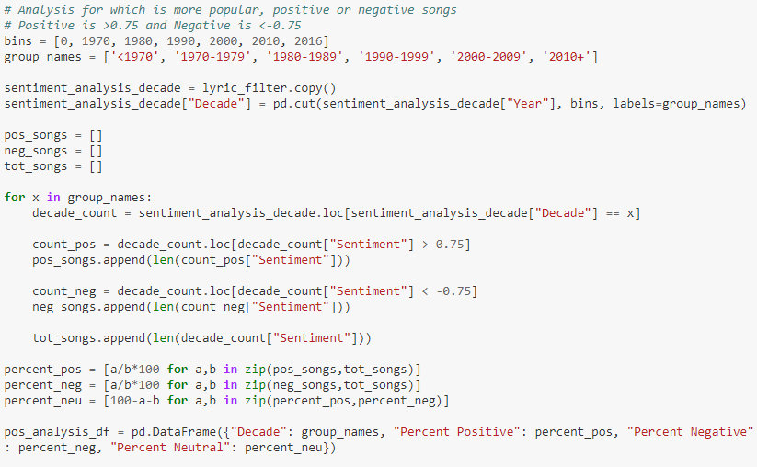
Sentiment Analysis

Slide 10
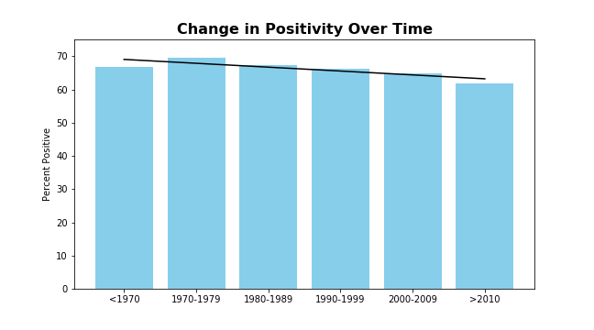
Positivity by Decade

Slide 11
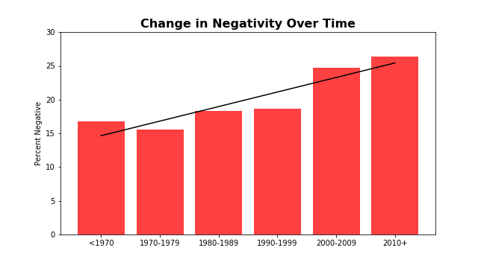
Negativity by Decade

Slide 12
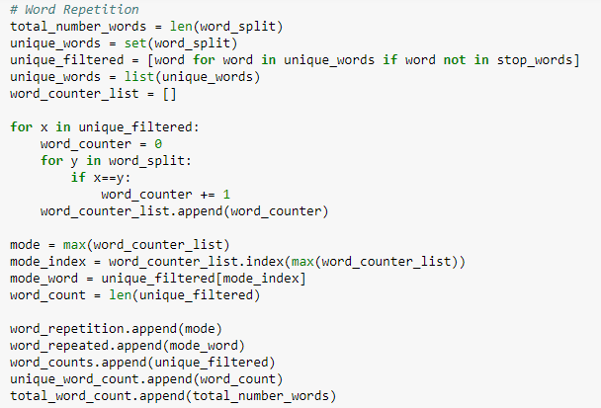
Repetition Analysis

Slide 13
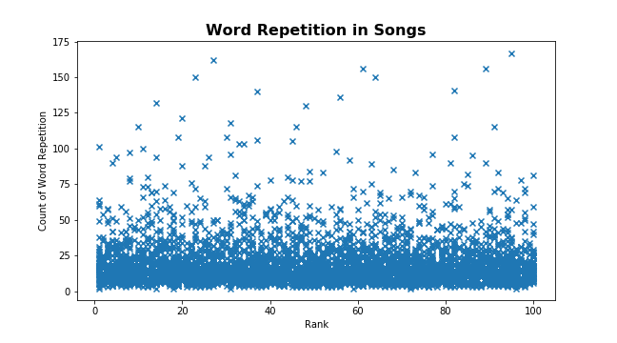
Repetition by Top 100

Slide 14
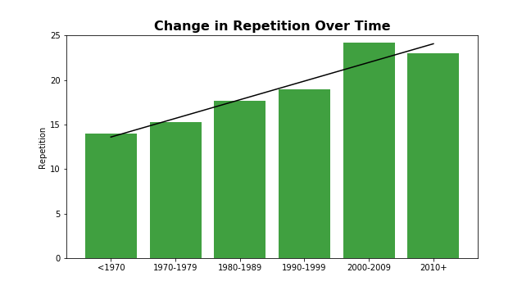
Repetition by Decade

Slide 15
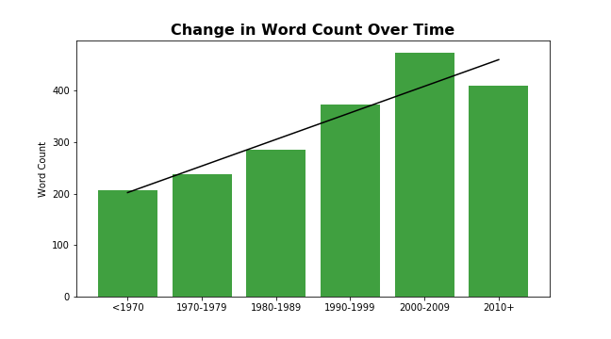
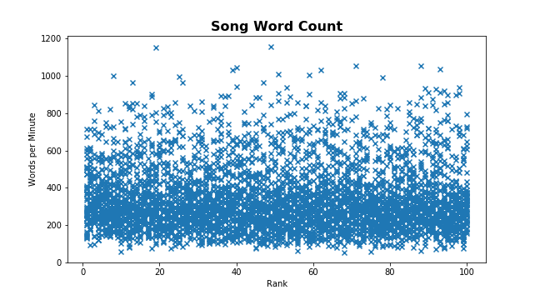
Word Count Analysis

Slide 16
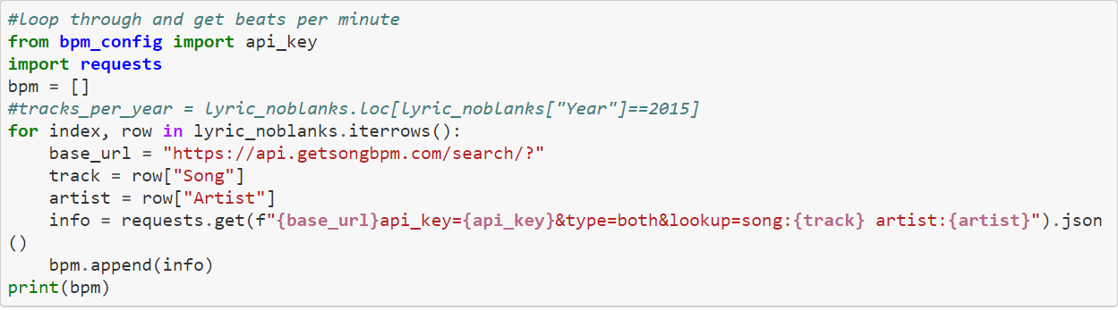
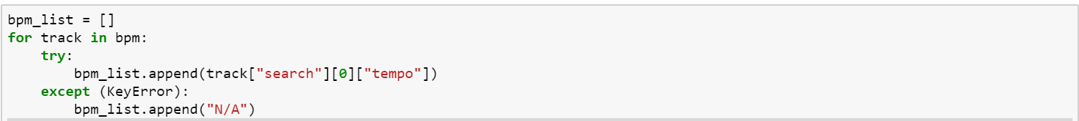
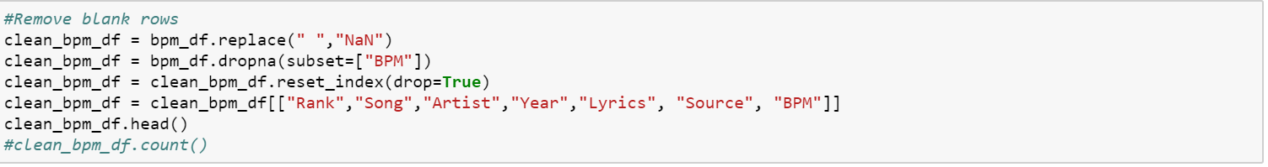
Beats Per Minute (BPM) Analysis

Slide 17
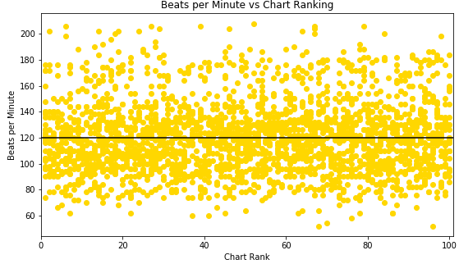
BPM by Chart Rank
Average Beats Per Minute: 120
Max Beats Per Minute: 208
Min Beats Per Minute: 52

Slide 18
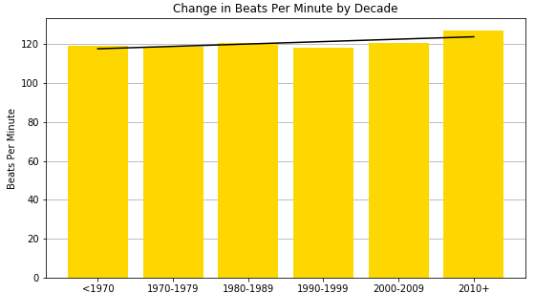
BPM by Decade
Decade | Average BPM
<1970 | 119.042373
1970-1979 | 118.607375
1980-1989 | 120.415771
1990-1999 | 118.209446
2000-2009 | 120.700219
2010+ | 126.850000

Slide 19


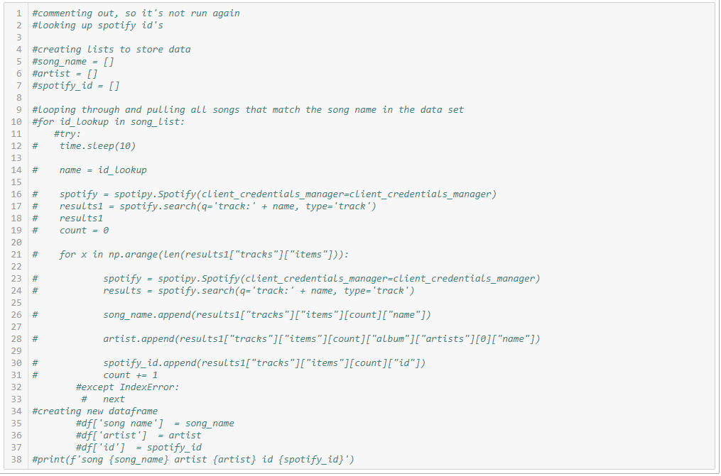

Spotify API
The quest for song ID’s
Was unable to call Spotify to look up only 1 specific ID with Artist and song
Made API call with the song name and pulled all track ID’s for future lookups
Took all songs and pulled out only the songs that matched both the song name and artist name from original dataset and appended the Spotify ID

Slide 20
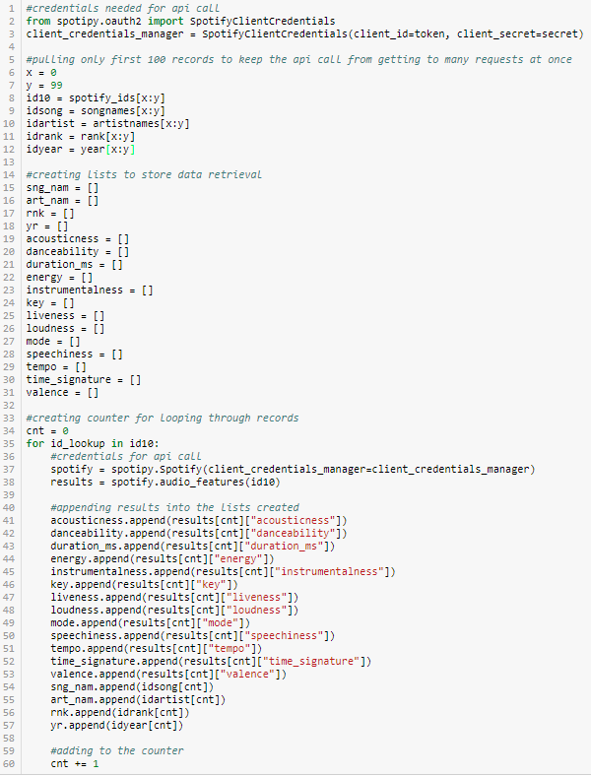
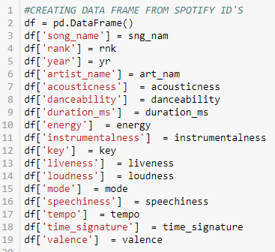


Spotify API
Pulling the Data Points
Made another Spotify API Call to collect the attributes for each of the songs in the list
This was ran multiple times to make all of the API calls as only 100 songs could be looked up at once
Created a new dataframe with the new data
Ran a conversion on milliseconds to convert the song duration to minutes

Slide 21

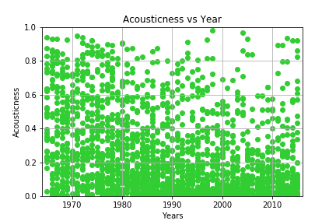
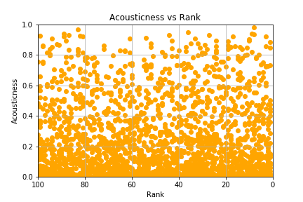
Acousticness
Definition:
A confidence measure from 0.0 to 1.0 of whether the track is acoustic. 1.0 represents high confidence the track is acoustic
Year
Rank

Slide 22

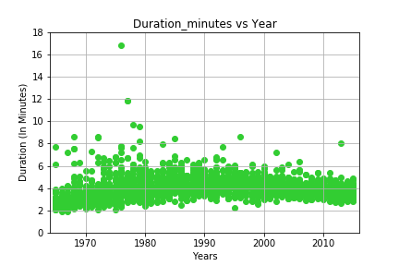
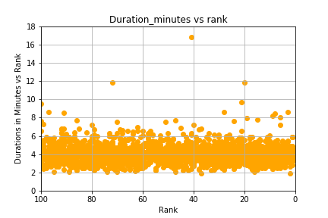
Duration
Definition:
Length of Song
Year
Rank

Slide 23

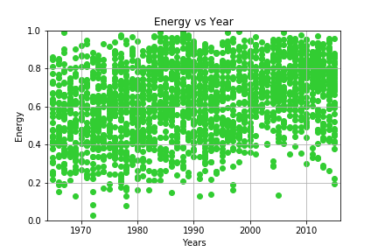
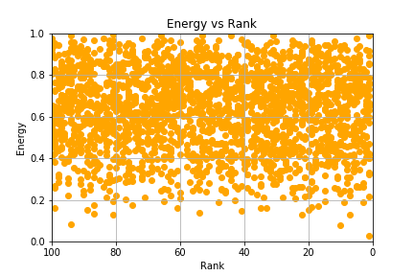
Energy
Energy is a measure from 0.0 to 1.0 and represents a perceptual measure of intensity and activity. Typically, energetic tracks feel fast, loud, and noisy. For example, death metal has high energy, while a Bach prelude scores low on the scale. Perceptual features contributing to this attribute include dynamic range, perceived loudness, timbre, onset rate, and general entropy
Definition:
Year
Rank

Slide 24

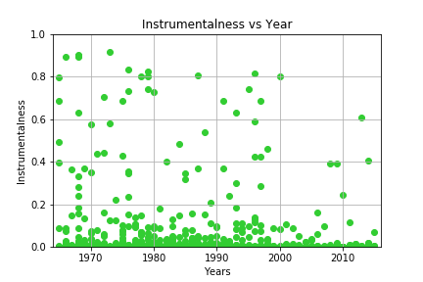
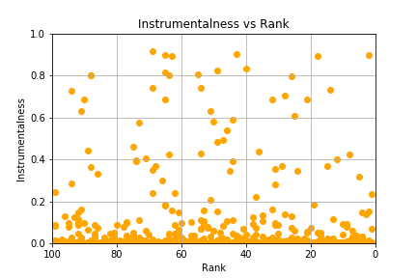
Instrumentalness
Predicts whether a track contains no vocals. “Ooh” and “aah” sounds are treated as instrumental in this context. Rap or spoken word tracks are clearly “vocal”. The closer the instrumentalness value is to 1.0, the greater likelihood the track contains no vocal content. Values above 0.5 are intended to represent instrumental tracks, but confidence is higher as the value approaches 1.0.
Definition:
Year
Rank

Slide 25

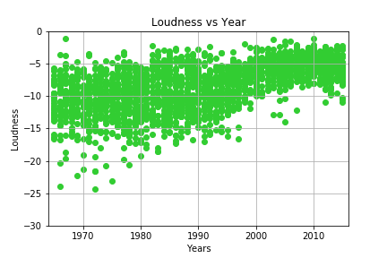
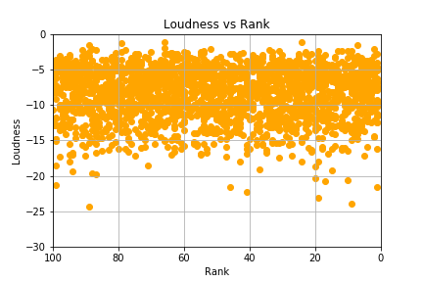
Loudness
Definition:
The overall loudness of a track in decibels (dB). Loudness values are averaged across the entire track and are useful for comparing relative loudness of tracks. Loudness is the quality of a sound that is the primary psychological correlate of physical strength (amplitude). Values typical range between -60 and 0 db.
Year
Rank
LOUDNESS war
The loudness war (or loudness race) refers to the trend of increasing audio levels in recorded music which many critics believe reduces sound quality and listener enjoyment. Increasing loudness was first reported as early as the 1940s, with respect to mastering practices for 7" singles.
https://en.wikipedia.org/wiki/Loudness_war

Slide 26

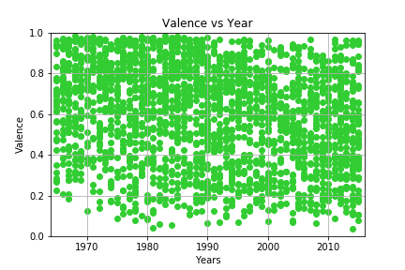
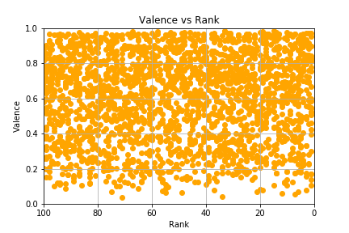
Valence
Definition:
A measure from 0.0 to 1.0 describing the musical positiveness conveyed by a track. Tracks with high valence sound more positive (e.g. happy, cheerful, euphoric), while tracks with low valence sound more negative (e.g. sad, depressed, angry).
Year
Rank

Slide 27

Conclusion
Keep your song length between 2.5 – 5 minutes
Don’t write instrumentals
More likely to have a pop hit with positive words in your song
Keep the beats per minute around 120 bpm

Slide 28
2 more weeks
Break out songs based on Genre and review for trends
Trend what the guidelines would be for the year 2050
Complete regression analysis for the Spotify data
Add in a review of Time Signatures and Key Signatures
Analyze the song structures
Address the record label, producer, artist

Slide 29

Questions?

