Slide 1
Statistical Graphics and Communication
Introduction to data visualization
Kim hochstedler
November 20, 2019
1
Notes:
Add in agenda slide after this.

Slide 2
Goals
I. The importance of data visualization
Describe why data visualization is important.
Identify the main goal of data visualization.
II. General principles of statistical graphics
Explain 3 principles to keep in mind when making graphs.
2

Slide 3
The importance of data visualization
3

Slide 4
What do we get from tabular data?
Variable | Mean | Standard Deviation | Correlation
Salary (thousands of $) | 54.2 | 16.7 | -.06
Driving time to work (minutes) | 47.8 | 26.9
REGRESSION STATISTICS
Intercept = 53.4, Slope = -0.10
4

Slide 5
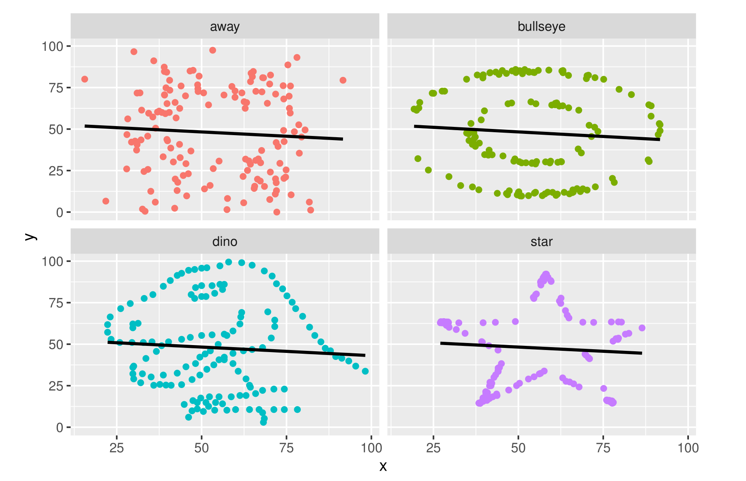

What do thE data actually look like?
5
Example from DatasauRus
Notes:
Add in regression lines to each of these.

Slide 6
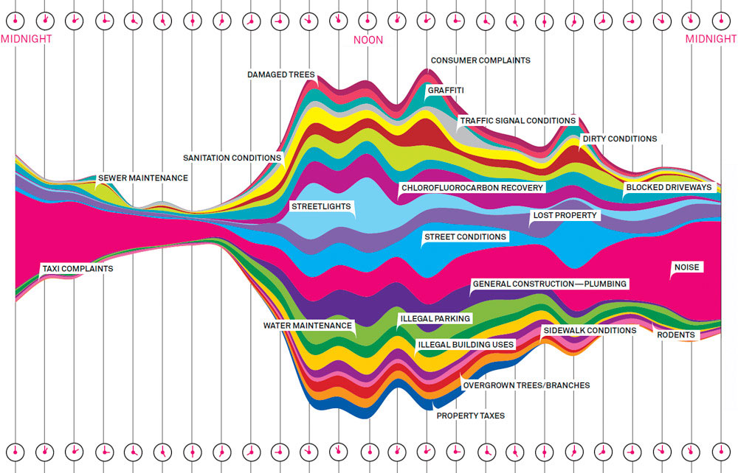
Statistical graphics
Graphics: visually display
data using…
points
lines
coordinate systems
numbers
symbols
words
color, etc.
-Balance aesthetics and information.
-Goal: show the data so viewers can make appropriate conclusions.
Ex. Type of 311 calls by time of day in NYC.
6
Example from JunkCharts

Slide 7
Goals of statistical graphics
Goal: show the data!
Introduce the viewer to think about substance, not graphical methodology.
Avoid distorting the data.
Present numbers in a small space.
Make large complicated data sets more coherent.
Encourage comparisons of different pieces of data.
Reveal data at several levels of detail.
Describe, explore, tabulate, identify relationships.
Be closely integrated with statistical/verbal descriptions of data set.
Graphs leading viewers to make misleading conclusions should be avoided.
Notes:
Remove?

Slide 8
General principles for making graphs
Graphs should stand alone.
Avoid distortion.
Use data ink effectively.
7

Slide 9
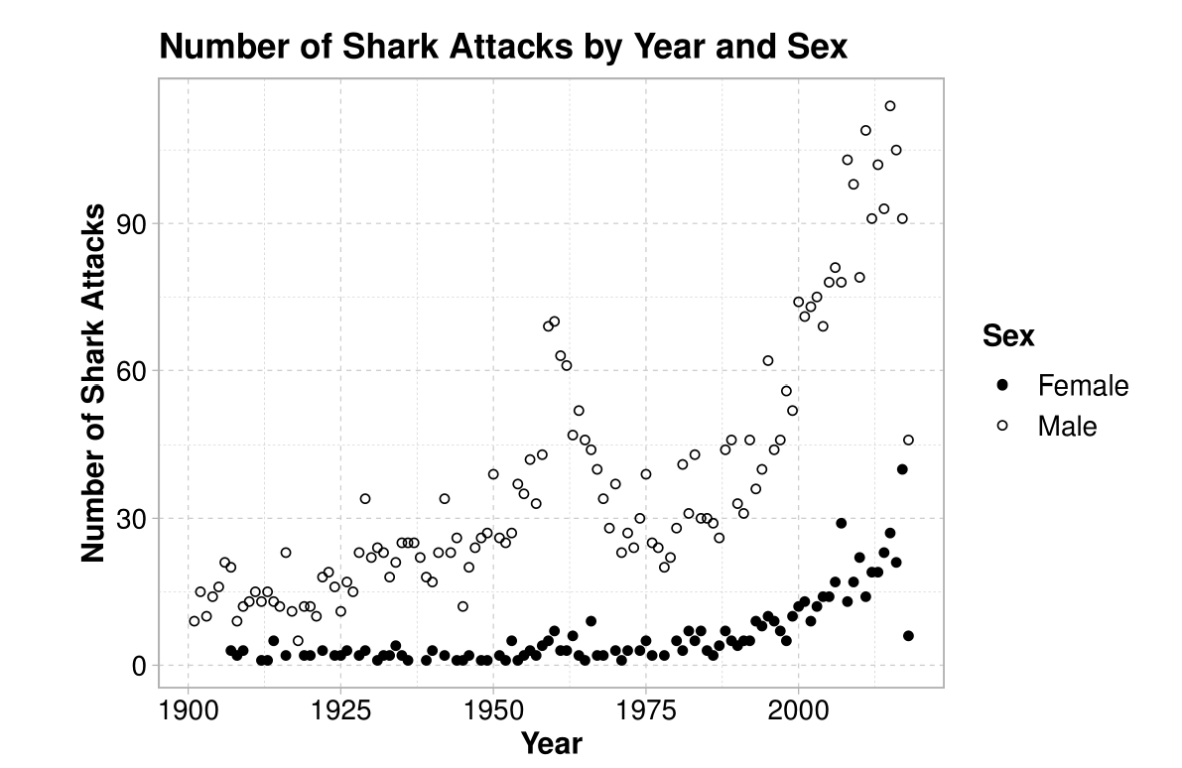
1. Graphs should stand alone. Example
What trends do you notice in this graph?
What explanations could you suggest for your observations?
8

Slide 10
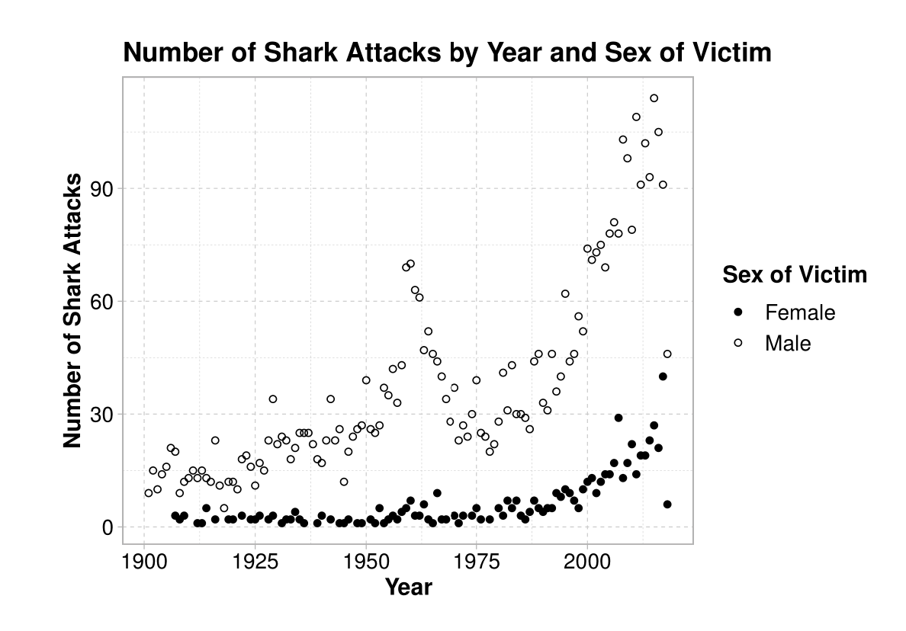
1. Graphs should Stand Alone.
Readers should be able to draw meaning from the graph in isolation.
Readers do not need extensive supplementary text to understand the graph.
Think like an “outsider” when making a graph.
9

Slide 11
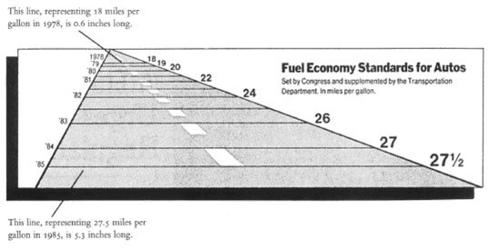
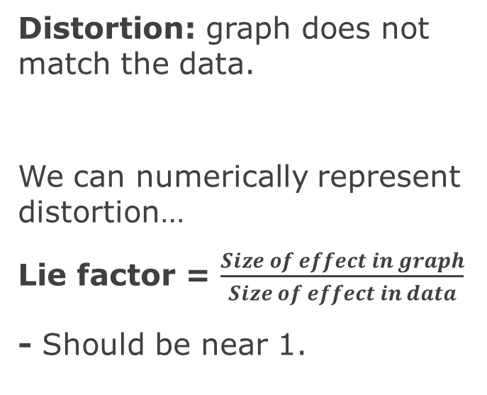
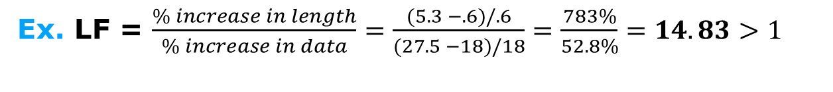
2. Avoid distortion.
This line, representing 18 miles per gallon in 1978 is 0.6 inches long.
Distortion: graph does not match the data.
We can numerically represent distortion…
Lie factor = $\frac{Size of effect in graph}{Size of effect in data}$
- Should be near 1.
This line, representing 27.5 miles per gallon in 1985 is 5.3 inches long.
Ex. LF = $\frac{\% increase in length}{\% increase in data}=\frac{(5.3 −.6)/.6}{(27.5 −18)/18}=\frac{783\%}{52.8\%}=14.83>1$
10
Lie Factor: InfoVis Wiki

Slide 12
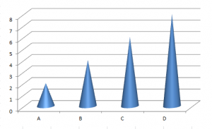
3. Use Data ink effectively.
Data ink: “non-erasable” and “non-redundant” core of the graphic.
Data ink should present information about the data.
Avoid unnecessary decoration.
11
Forbes Bad Graph Contest
Notes:
Make a good example.

Slide 13
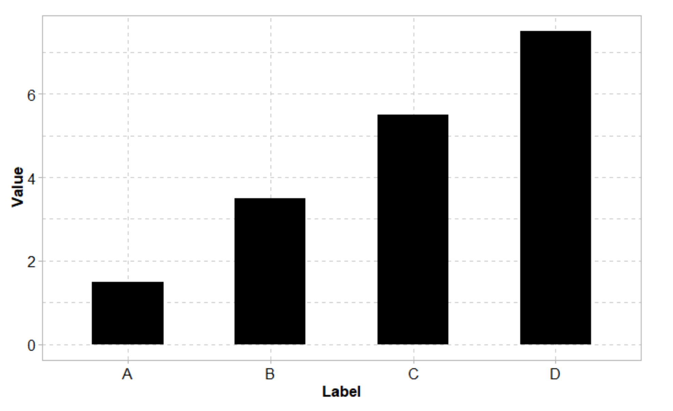
3. Use Data ink effectively.
Data ink: “non-erasable” and “non-redundant” core of the graphic.
Data ink should primarily present information about the data.
Avoid unnecessary decoration.
12
Forbes Bad Graph Contest
Notes:
Make a good example.

Slide 14
Conclusions
It is important to visualize data … summary statistics are not enough!
Good graphics should…
1. Stand alone.
2. Avoid distortion.
3. Use “data ink” effectively.
Consider these principles in your own work and when you see data visualizations in the media.
Any questions or final thoughts?
13
Notes:
Make this into a conclusion slide.

