Slide 1
Bayesian methods to compare dose levels to placebo in a small n sequential multiple assignment randomized trail (snSMART)
Kimberly A. Hochstedler¹, Fang Fang¹, Roy N. Tamura², Thomas M. Braun¹, and Kelley M. Kidwell¹
¹University of Michigan
²University of South Florida

Slide 2

Rare diseases
More than 8,000 rare diseases affect over 30 million people in the US.
Only 4% of rare diseases have an approved treatment.

Slide 3


Motivating problem
We combat these issues with a “small n, sequential, multiple assignment randomized trial” (snSMART).
Disease Population
Rare Disease Population
Same requirements for evidence of effectiveness in clinical trials.
Difficulties in designing a trial for a smaller rare disease population (sample size, power).
Fewer approved treatments for rare diseases.

Slide 4
snSMART vs. SMART designs
Stages of a SMART design are used to develop dynamic treatment regimes (DTRs).
Stages of an snSMART design are used to garner more information on a small sample of patients.
Initial treatment
Evaluate response
Determine next treatment
Single superior dose of treatment
Stage 1 data
Stage 2 data

Slide 5
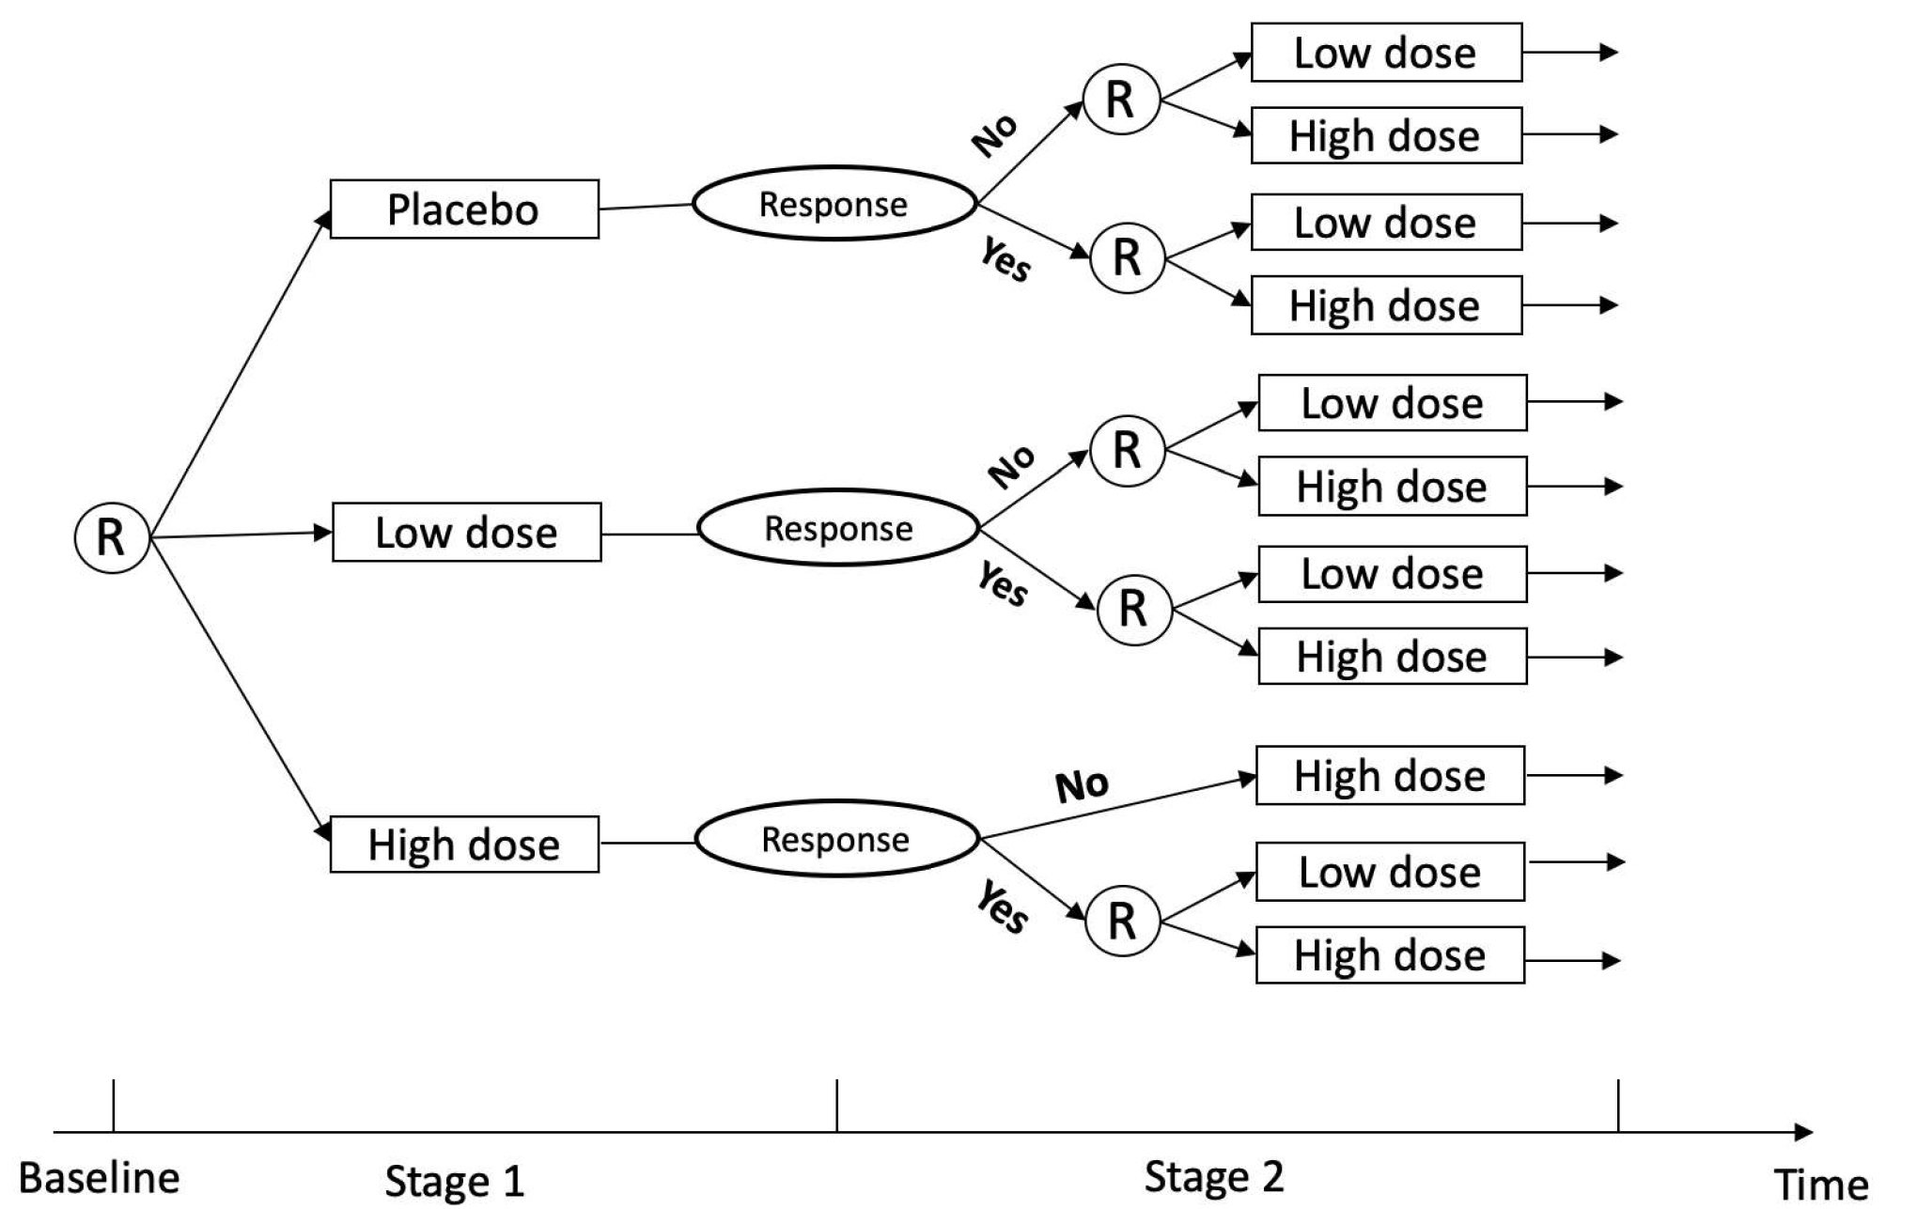
Our design
Advantages
Compare to placebo.
Compare dose levels.
No placebo randomization in stage 2.

Slide 6
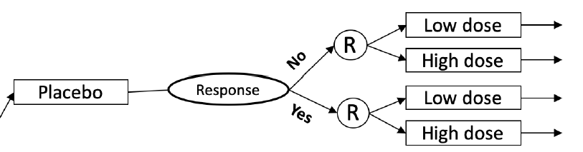
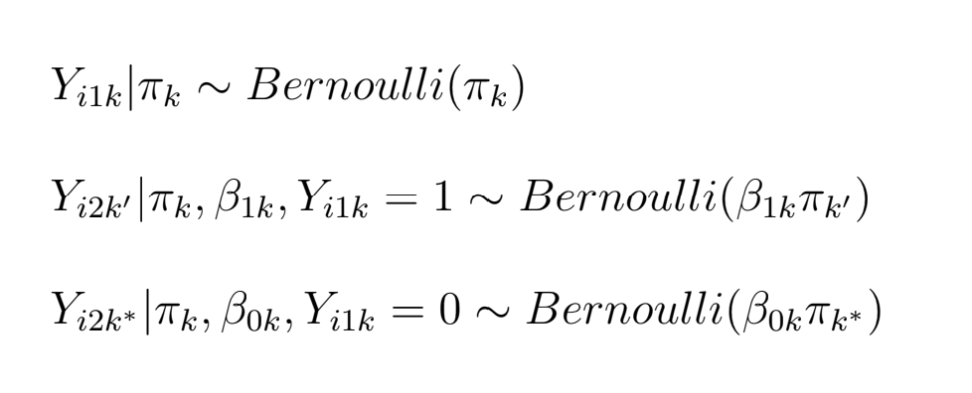
Analysis Method 1: Bayesian Joint Stage Model (BJSM)
Connect stage 1 and stage 2 outcomes with linkage parameters, β.
Observed response outcome.
Response rate * β

Slide 7

BJSM Prior Settings
β ~ Gamma(2,2)
π_{P} ~ Beta(3, 17)
Log$(\frac{πH}{πP}$) ~ Normal(.2, 100)
Log$(\frac{πL}{πP}$) ~ Normal(.2, 100)

Slide 8
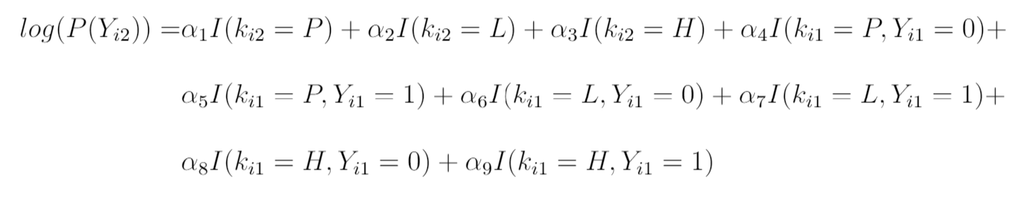
Analysis Method 2: Log Poisson Joint Stage Model (LPJSM)
1:1 correspondence to parameters in BJSM model equations.
Y_{ij} is the response of subject i in stage j.
I(k_{ij} = k) is the indicator for treatment k = P, L, H for subject i in stage j.

Slide 9
Simulations
Generate simulation scenarios
Analyze data using …
1. BJSM
2. LPJSM
Compare bias and rMSE.
Scenario 1 is null scenario (P = L = H).
Scenario 2 is dose-response scenario (P < L < H).
Run 2000 simulations in each setting with N = 30 patients per treatment arm (N = 90 patients total).

Slide 10
Results: Null scenario
 | BJSM |  | LPJSM
 | Bias | rMSE | Bias | rMSE
π_{P} | -0.001 | 0.039 | 0.018 | 0.063
π_{L} | -0.003 | 0.048 | 0.022 | 0.062
π_{H} | -0.007 | 0.043 | 0.020 | 0.062
π_{L} – π_{P} | -0.003 | 0.062 | 0.004 | 0.081
π_{H} – π_{P} | -0.006 | 0.058 | 0.002 | 0.087
Smaller bias in BJSM compared to LPJSM.
Efficiency gains in BJSM.

Slide 11
Results: Dose-response scenario
 | BJSM |  | LPJSM
 | Bias | rMSE | Bias | rMSE
π_{P} | 0 | 0.039 | 0.009 | 0.063
π_{L} | -0.005 | 0.057 | 0.014 | 0.068
π_{H} | -0.013 | 0.064 | -0.001 | 0.075
π_{L} – π_{P} | -0.005 | 0.070 | 0.004 | 0.092
π_{H} – π_{P} | -0.013 | 0.074 | 0.011 | 0.101
Smaller bias in BJSM compared to LPJSM.
Efficiency gains in BJSM.

Slide 12
Conclusions and Next Steps
BJSM yields estimators with lower bias and higher efficiency than LPJSM.
We are writing up our results for publication.
Extensions…
- Extend method to non-binary outcomes.
- Sample size calculations based on this snSMART design.
- Extend design to more than 2 dosage levels.

Slide 13


Thank you!
Kimberly A. Hochstedler - hochsted@umich.edu

