Slide 1
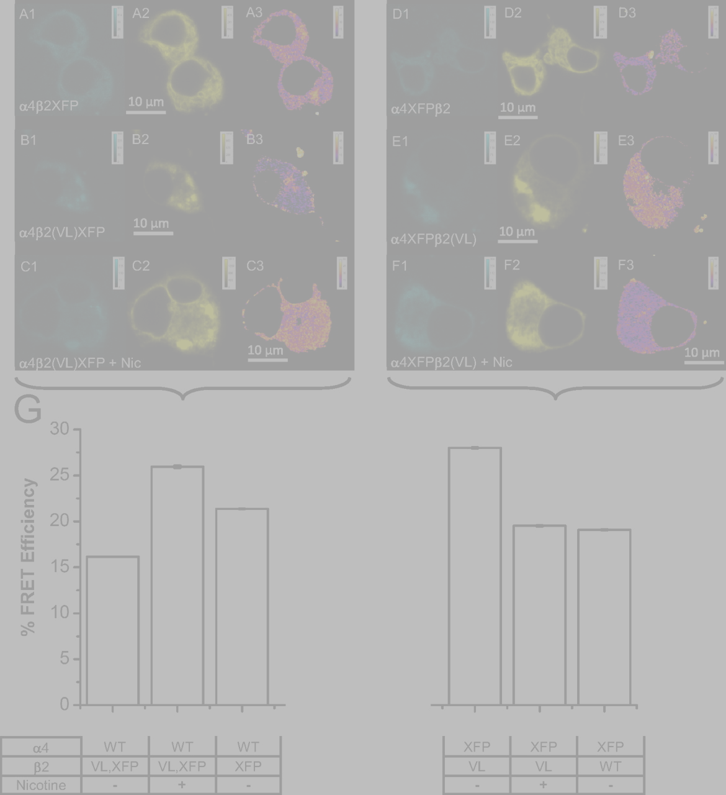
3-D clustering to identify multiple oligomerization states by FRET
Kim Scott
Mentor: Henry Lester
SURF Seminar Day: October 17, 2009
Image: Son et al. 2009

Slide 2
Nicotinic Acetylcholine Receptors (nAChRs)
(α4)₃(β2)₂:
EC50 ~100μM
Pentameric ion channels found throughout the brain
Composed of a variety of possible subunits in varying stoichiometries
Open in response to acetylcholine (naturally), nicotine (much stronger!)
Presumed to underlie the mechanisms of nicotine addiction, tolerance, & withdrawal… plus its protective effect against Parkinson’s
α
β
β
α
α
α
β
β
α
β
(α4)₂(β2)₃:
100 times as sensitive!
Notes:
Upregulation favors the high-sensitivity receptor

Slide 3
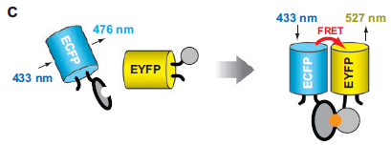
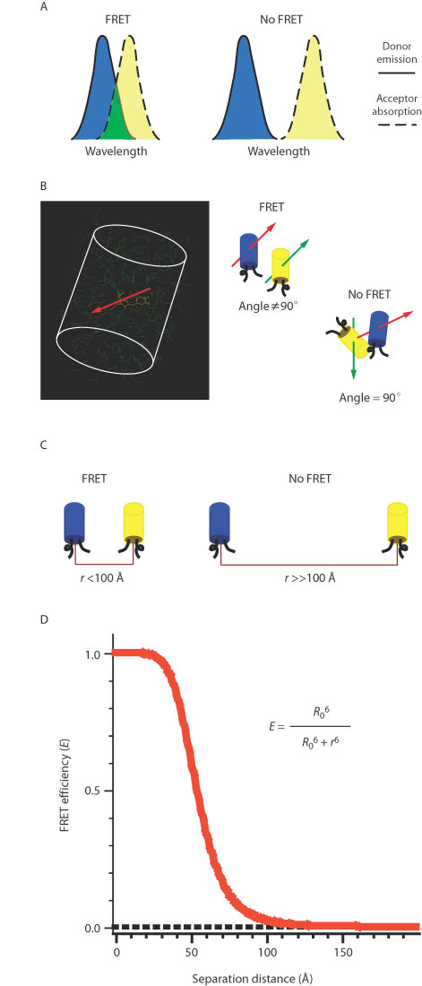

FRET microscopy
FRET
no FRET
(Vogel et al., 2006)
(Wang et al., 2008)
Notes:
Single-molecule vs. live-cell
Nanoruler

Slide 4
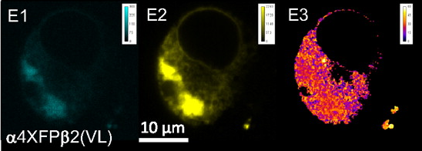
Extending FRET to study stoichiometry
Donor Acceptor FRET
Goal: to estimate the prevalence of distinct nAChR stoichiometries from the distributions of donor, acceptor, and net FRET pixel values.
(Son et al., 2009)
Challenges:
Multiple stoichiometries of assembled receptors, partially assembled receptors of unknown geometry, and unpaired donors and acceptors all present.
Heterogeneous population even within single pixels
Unknown subcellular localization of FRETing oligomers
Notes:
(Best paper describes modeling for single-molecule FRET with multiple species--even there the widths of the multimodal FRET efficiency histogram are fairly broad)
Outline:
Will first discuss the current technique used in the lab, which was my starting point this summer.
Why it doesn’t make sense—the key reasons.
Then more productive: advocating a new approach, clustering.
Demonstrate that under various theoretical conditions it works.
What I’m working on now.

Slide 5
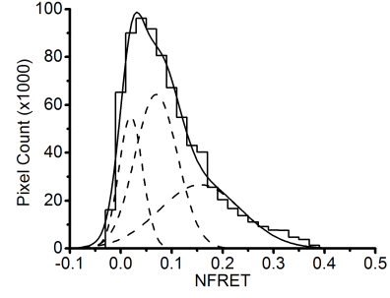
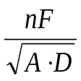
Current NFRET histogram analysis
Raw data
unmixing
FRET
donor (D)
acceptor (A)
PixFRET bleedthrough compensation
net FRET (nF)
normalization:
Fig 8H, Moss et al., submitted to JGP
NFRET

Slide 6
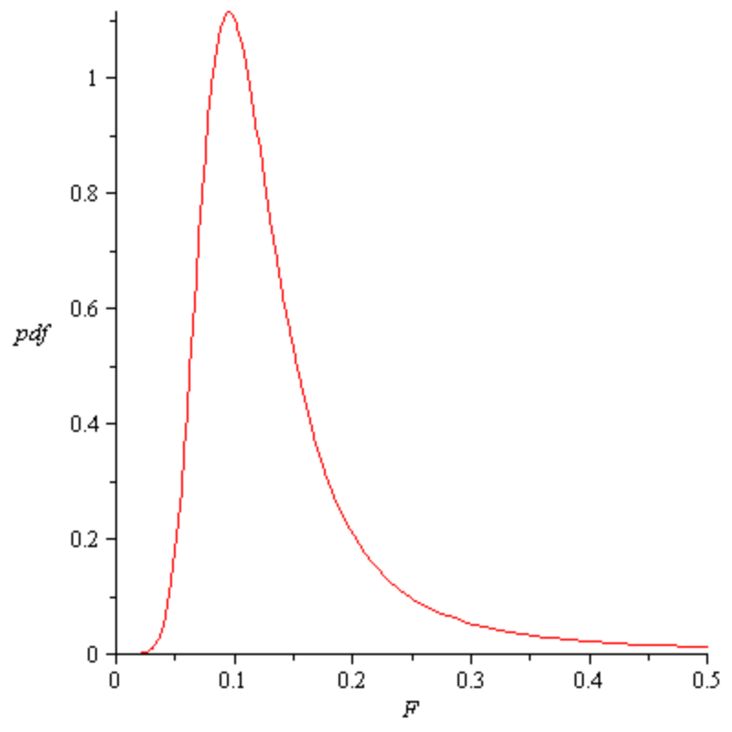
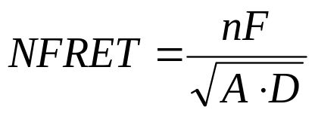
Dangers of fitting NFRET histograms
Single oligomer NFRET values with
nF ~ N(1, 0.2)
A ~ N(10, 4)
D ~ N(10, 4)
  (Xia and Liu, 2001)
1) NFRET distribution from a single oligomer with varying nF, A, and D measurements is skew.
Notes:
Useful technique for making picture, because a function of
a) efficiency
b) ratio of complexes to total donor + acceptor
BUT…

Slide 7
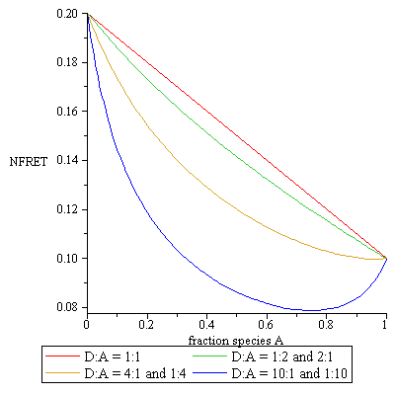

Dangers of fitting NFRET histograms
  (Xia and Liu, 2001)
Given that a fraction f of the total FRETing constructs are of type A, the NFRET value T(f) =
2) NFRET from multiple species combines nonlinearly (sometimes non-monotonically)
Notes:
A function of
a) efficiency
b) ratio of complexes to total donor + acceptor
NFRET linear in f only for constant denominator, e.g. A_{a} = A_{b} and D_{a} = D_{b}.

Slide 8
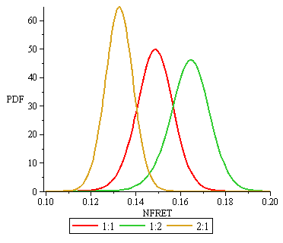
Dangers of fitting NFRET histograms
Two independently normally-distributed species with fixed nF, A, and D values per oligomer:
←A:B ratio
3) Even “ideal” situations (with no variation in nF, A, and D) give skew distributions of NFRET values.
Notes:
Even if we take the red line from the previous figure…
Population A:
A_{a} = 10, D_{a} = 10, nF_{a} = 1
NFRET = 0.1
Population B:
A_{b} = 10, D_{b} = 10, nF_{b} = 2
NFRET = 0.2

Slide 9
The case for direct clustering instead
Raw data
Why collapse 3D information to 1D unnecessarily?
Clustering automatically assigns pixels to populations.
Deals more readily with unpaired fluorescence.
unmixing
FRET
donor (D)
acceptor (A)
PixFRET bleedthrough compensation
net FRET (nF)
normalization:
NFRET

Slide 10
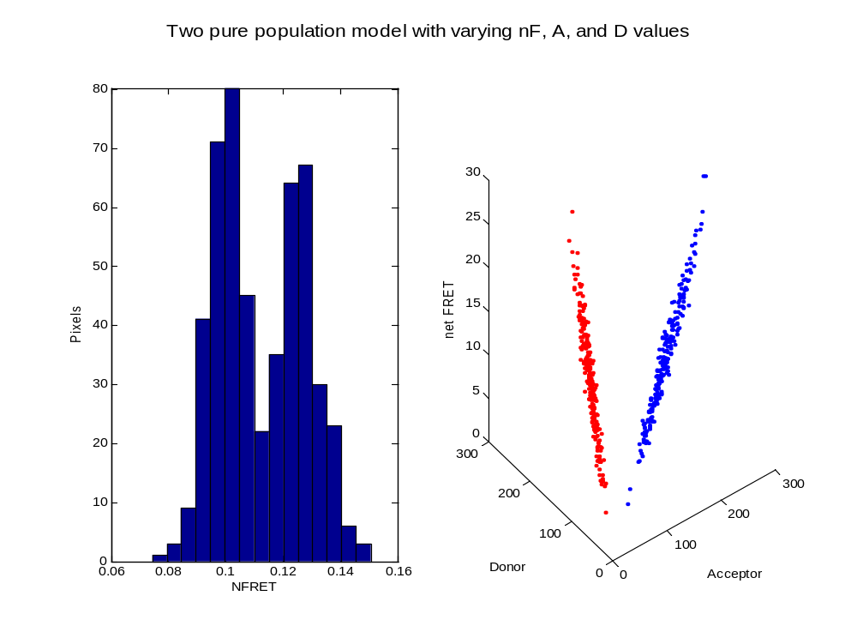
Two pure population model
Species A, mean NFRET 0.1: nF ~ N(1, 0.2) A ~ N(7, 0.7) D ~ N(14, 1.4)
Species B, mean NFRET 0.125: nF ~ N(1.25, .25) A ~ N(14, 1.4) D ~ N(7, 0.7)

Slide 11
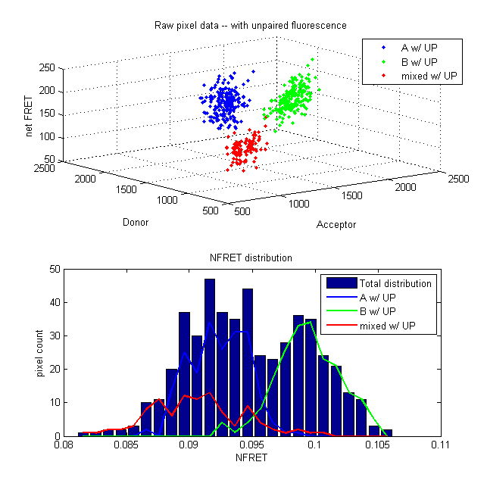
Segments with unpaired donor/acceptor
Same species A and B, concentrations
[100 50 50] and
[ 50 100 50]
Total unpaired concentration
[ 25 25 25]
Unpaired fluorophores have same properties as lesser of donor & acceptor in FRETing species

Slide 12
Choice of clustering algorithm
Projective k-means
  Clusters points along lines (representing varying concentrations of a single ratio of species, plus unpaired fluorescence)
  Doesn’t split high- and low-concentration regions
Gaussian mixture (GM) model
  Fits points to a set of Gaussian clusters
  Doesn’t ignore concentration
  May be more robust to impure “segmentation”
Both easily extended to probabilistic clustering.

Slide 13
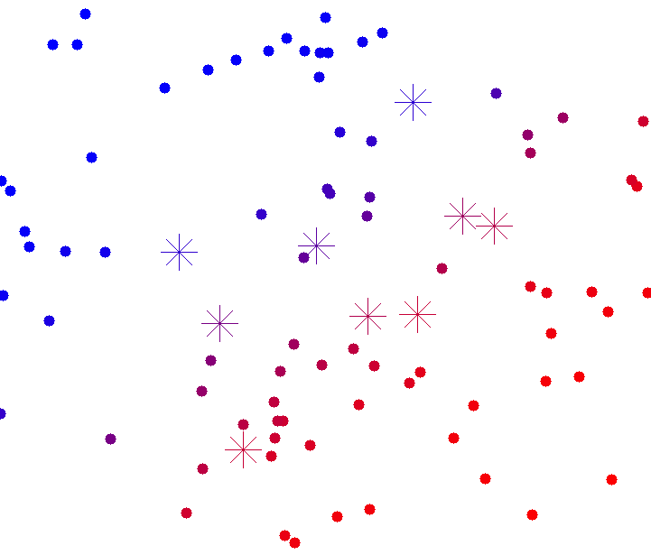
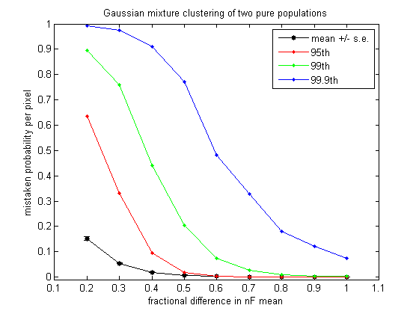
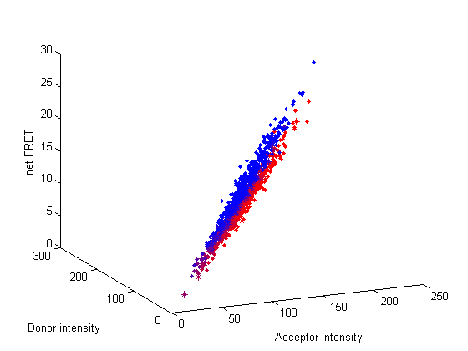
Performance of GM clustering
25 images each, 2000 pixels per image. 20% uncertainty in nF, 10% in A and D
Average concentration 10 oligomers (small) in both populations.

Slide 14
Performance of GM clustering
Accurately and reproducibly clusters pixels from pure-population and segmented models, even with unpaired fluorescence
Consistently identifies the number of clusters using Bayesian information criterion (introduces a parameter penalty to avoid overfitting)

Slide 15
Next steps
Next focus is on clustering real data from two experiments: with three and one putative populations of nAChRs
Use of membrane-specific and non-FRETing distributions to calibrate expected clusters
Modeling varied transfection ratios and matching clusters across cells

Slide 16
Acknowledgments
Henry Lester
Fraser Moss
Rigo Pantoja
Rahul Srinivasan
Crystal Dilworth
Lester lab
Amgen Foundation
Caltech SFP office

