Slide 1
TINONS1 Nonlinear SP and Pattern recognition
Wednesday 12.15-14.00, Friday 10.15-12.00 + Friday 8.15-10.00 (without teacher)
Literature – Duda, Hart and Stork, Pattern Classification, 2nd edition, 2001
Cases – One extensive case, results in mandatory report
Exam – 2/3 oral exam (20 min.)
1/3 report

Slide 2
Examples
Speech recognition / Speaker recognition
Face/image recognition
Signal detection – e.g. in radar images
Text modelling – e.g. document similarity
Google
…

Slide 3
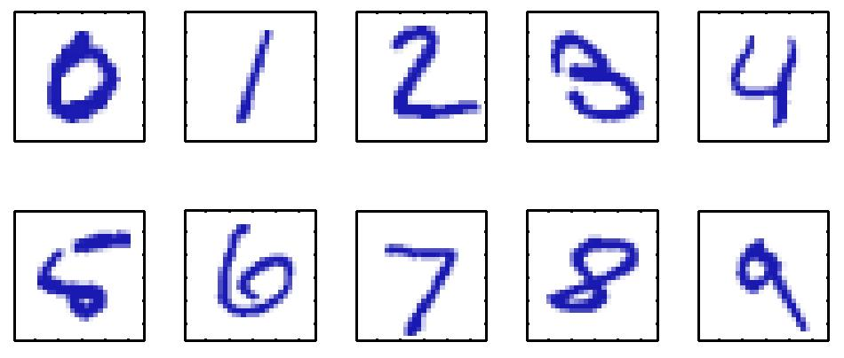
Example : digit recognition
- Feature vector/matrix x = [0 0 0 … ; 0 0 120 0 .. ; 0 0 255 ..], that is, often high-dimensional –> problems
Classification problem
Requires a training and (preferably) test set
Generalizability is important
Distinguishes between supervised and unsupervised learning (and semi-supervised..)

Slide 4
Typical pattern recognition system
Feature
vector
Probability
estimates
Signal
Preprocessing/Feature extraction
Classification/regression
Post-processing
Decision

Slide 5
Developing a system
Creating a training/test dataset
Finding good features
Choosing the model for classification (or regression)
Train/learn the parameters of the model from training set
Test/evaluate on the test set
Apply suitable postprocessing (e.g. loss function)

Slide 6
Case - Music Genre recognition
Input signal – e.g. sound file
Features could be rhythm, vocal, etc.. Or simply frequency content in different bands
System could output classes such as jazz, pop, rock..
Task is classification, ie. to find function f
f : R^{M} → {1, 2, …, number of classes}
(R – real numbers, M – dimensions)

Slide 7
Case – Face recognition
Input – eg. RGB image
Features – eg. Area of face, width, height, color, or simply image matrix as column vector
Output : Identity (”Frank vs. Bill”), gender (”boy vs. girl”), obesity score?

Slide 8
Case – Gesture recognition
Input – eg. accelerometry/gyro data sequence (eg. from wiimote/android)
Features – perhaps just raw data sequence in single movement
Output – recognize gesture (supervised/unsupervised)
Control system based on gestures

Slide 9
Case – EEG/EKG signals
Input – EEG/EKG signals
Output
EEG: Degree of mental activity (regression problem)
EKG: Detection of irregular heart beat pattern

Slide 10
Other..
Speaker recognition / verification
Bird sound classification
Video tracking (eg. Kinect)
Document classification / clustering
Kickstarting the MSc. project
...

Slide 11
Introduction – linear regression
-> MATLAB DEMO.. intro.m
simple case - y : R → R, y(x,w) = w x
Learn the parameters w from training set
Model selection -> choosing a linear model
Should really test on another set..

Slide 12
Linear regression
Training – minimizing a cost (or error) function
eg. E(w) = ∑_{n} (y(w,x_{n}) - t_{n})²
t_{n} is ”target” ie. known output for x_{n}
E(w*) is a measure that tells how well the model corresponds to the observed data..
w* is here the found minima that minimizes E(w)

Slide 13
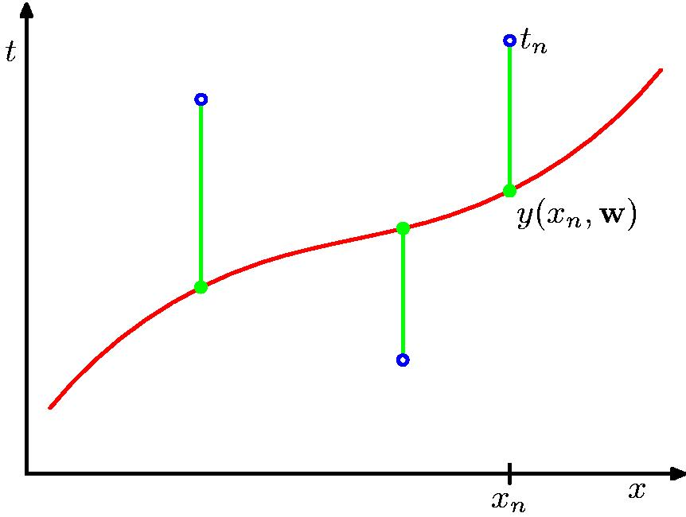
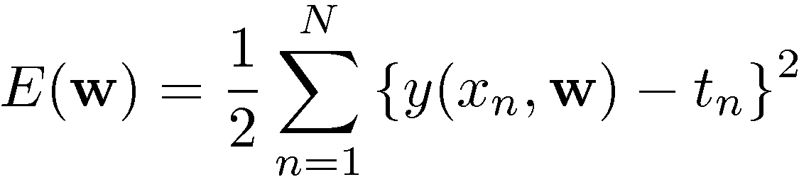
Sum-of-squares error

Slide 14
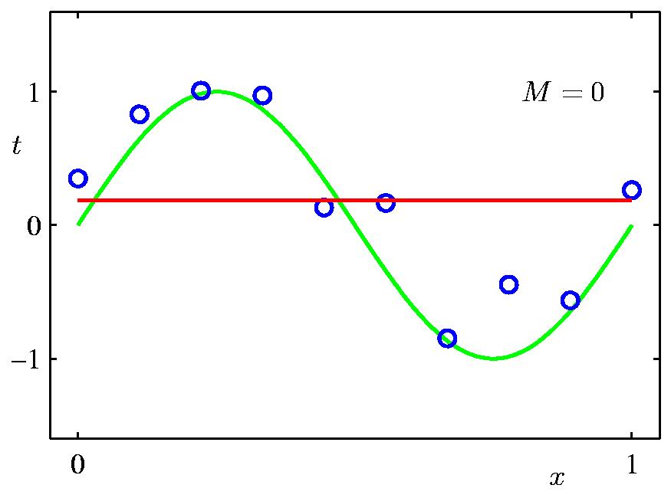
Polynomial regression - 0th order

Slide 15
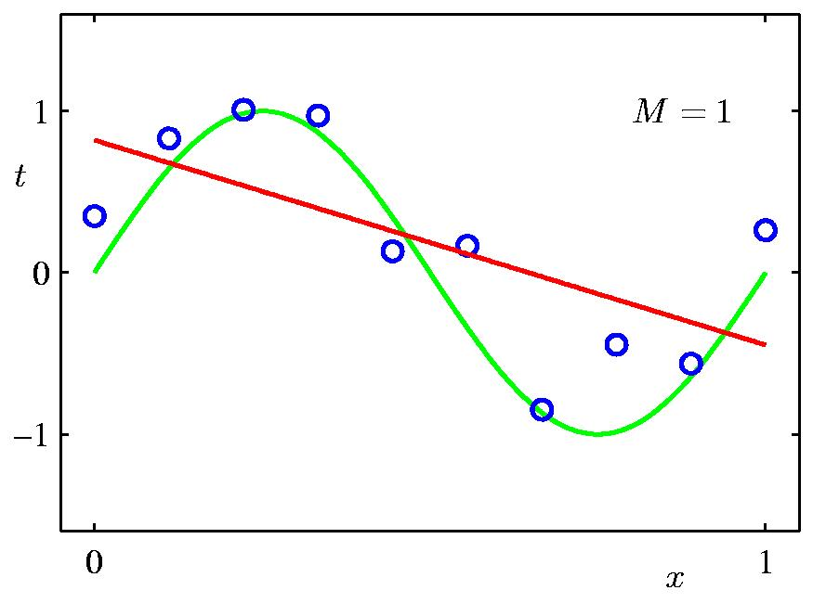
1th order

Slide 16
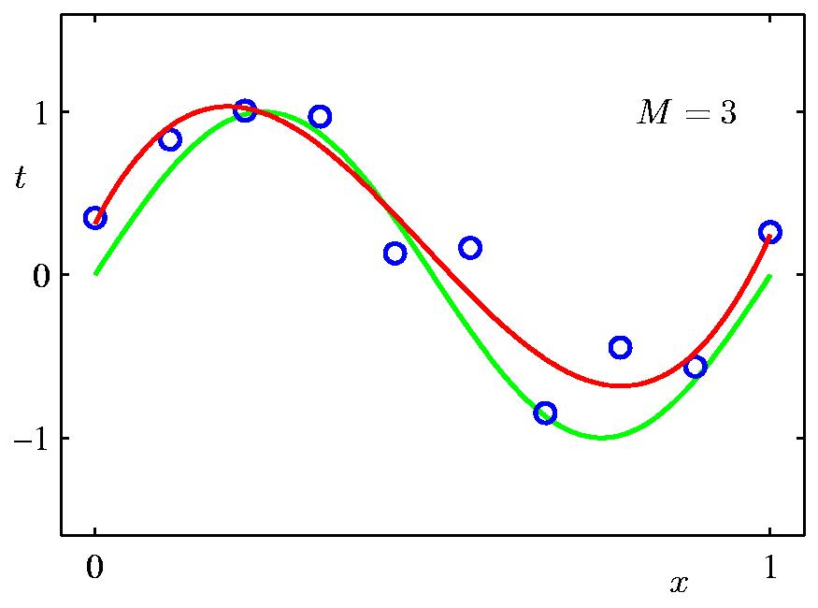
3th order

Slide 17
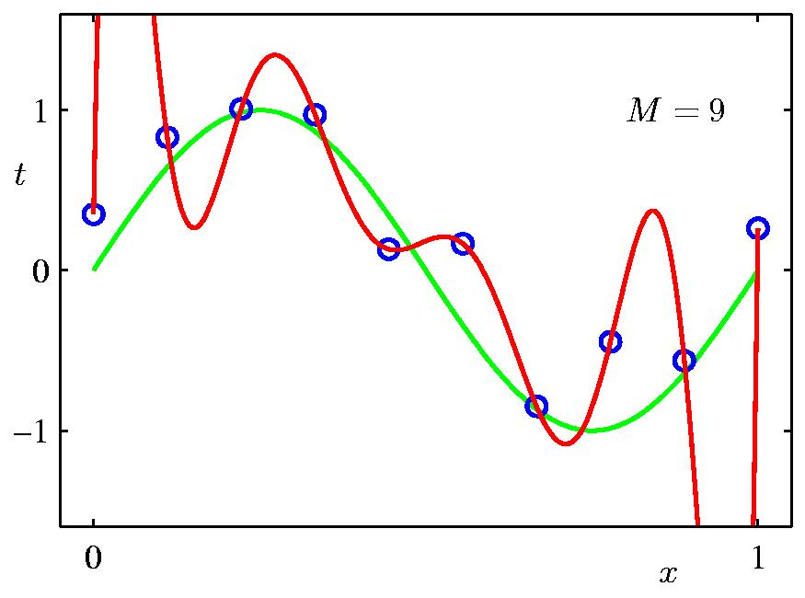
9th order

Slide 18
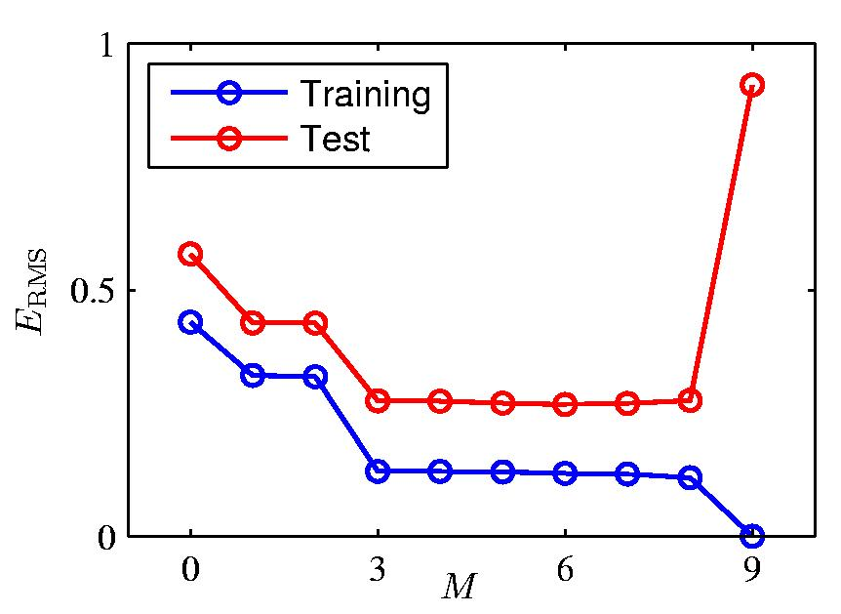
Over-fitting

Slide 19
Introduction - Linear classifier
-> MATLAB DEMO.. intro.m
Topics
discriminant functions, 1-of-K coding, decision boundary, classification error/accuracy, confusion matrix, outliers ..
Limitations
linear decision boundary

