Slide 1
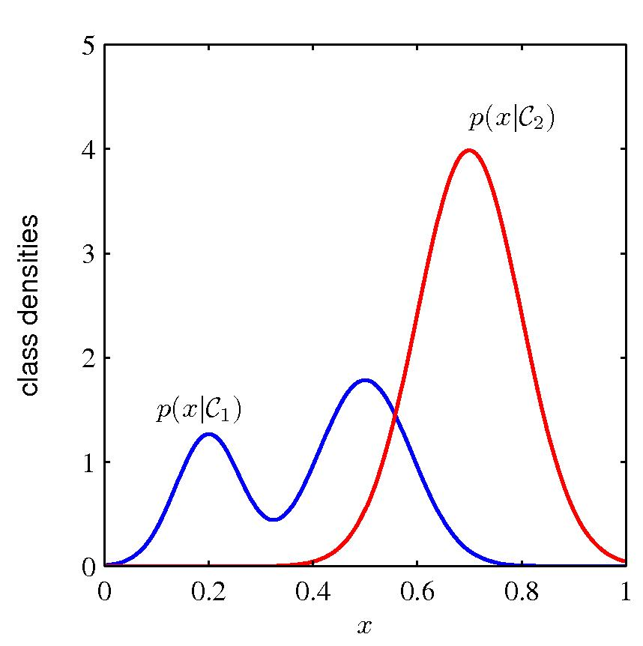
Probabilistic models

Slide 2
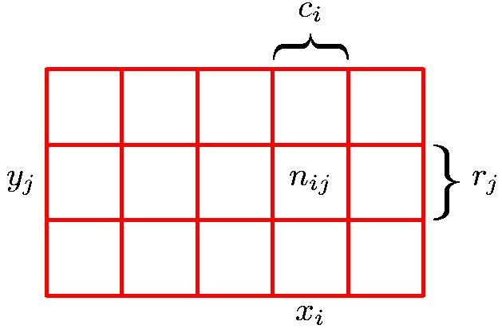
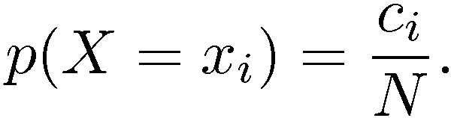
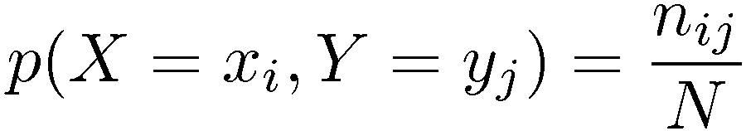
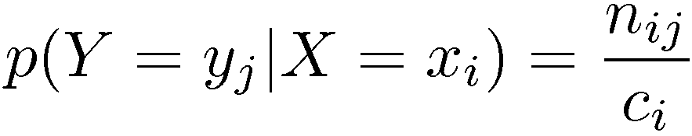
Probability theory
Marginal Probability
Conditional Probability
Joint Probability

Slide 3
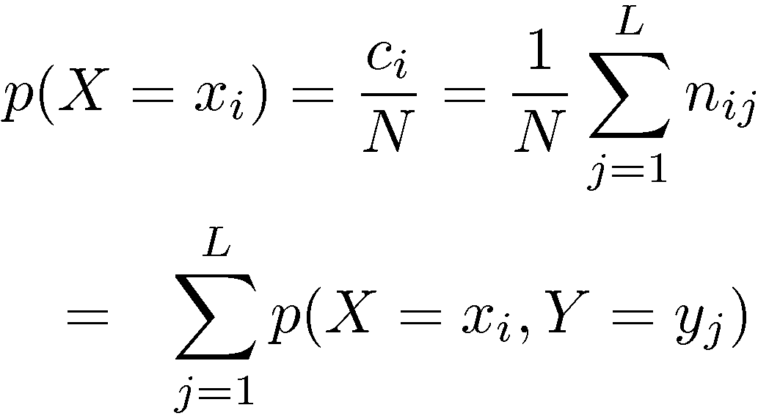
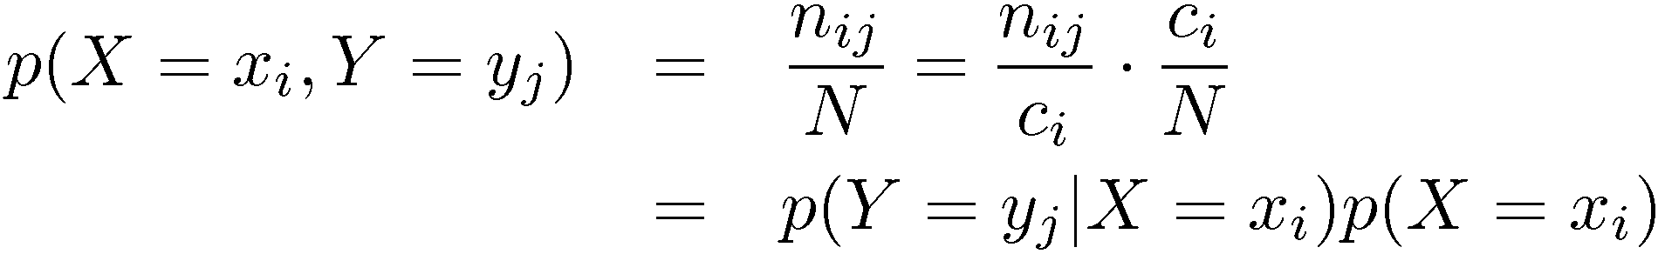
Probability theory
Sum Rule
Product Rule

Slide 4
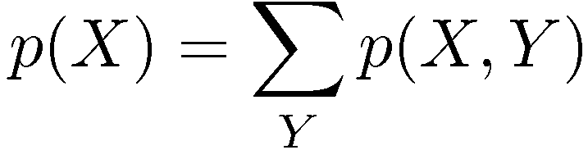

Probability theory
Sum Rule
Product Rule

Slide 5
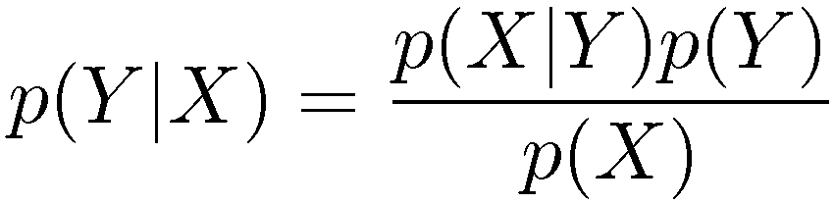
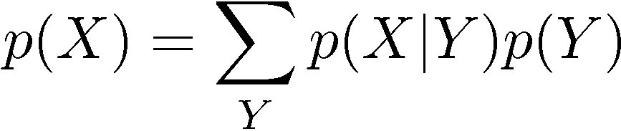
Bayes’ theorem
posterior ∝ likelihood × prior

Slide 6
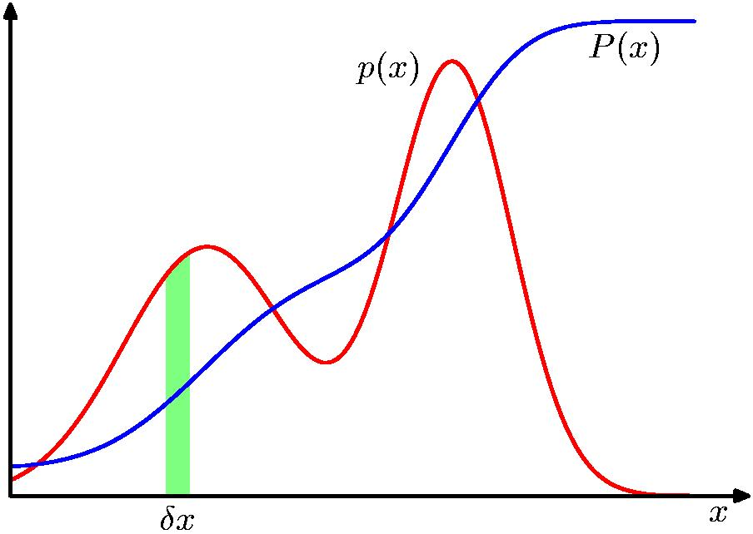
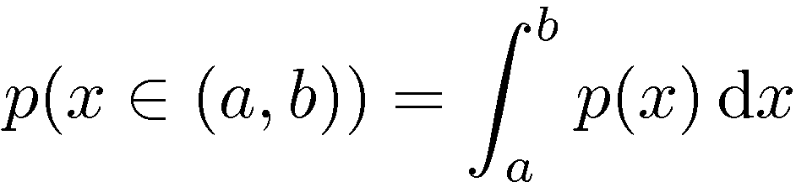
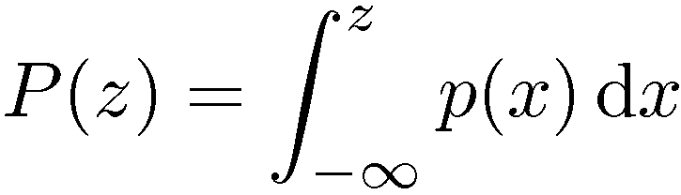
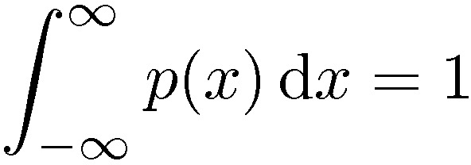

Probability densities

Slide 7
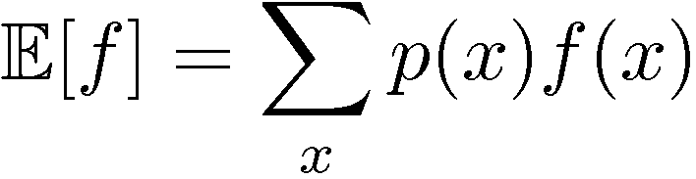
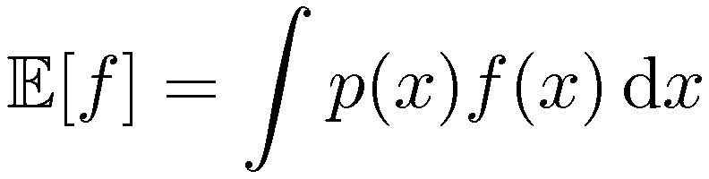
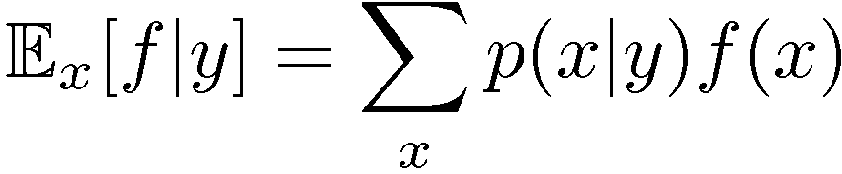
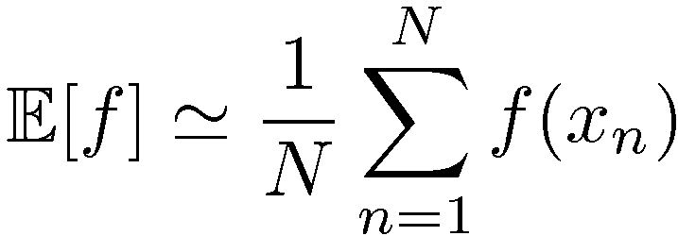
Expectations
Expectation of f(x)
Special cases:
f(x) = x gives the mean value of x
f(x) = (x - µ)² gives the variance of x
(µ is the mean value of x)
Conditional Expectation
(discrete)
Approximate Expectation
(discrete and continuous)

Slide 8
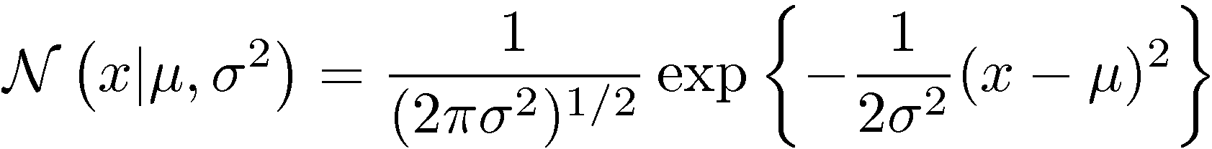
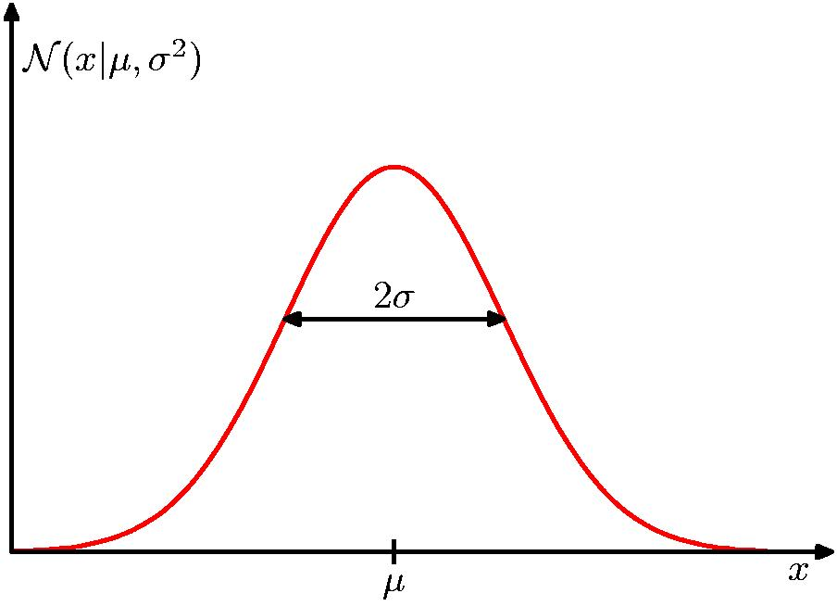
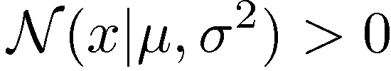
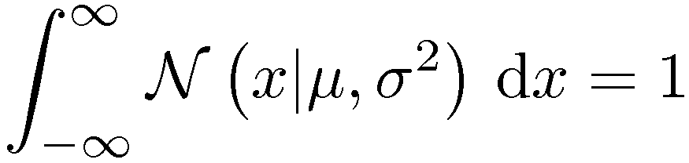
Gaussian (=normal) distribution

Slide 9
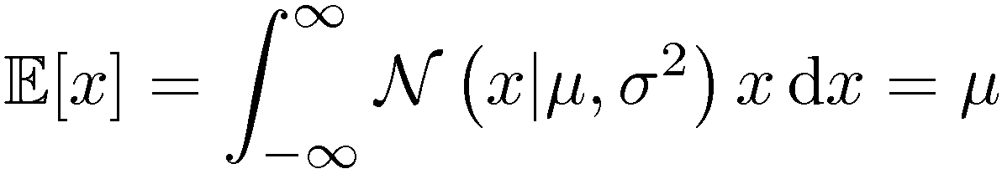
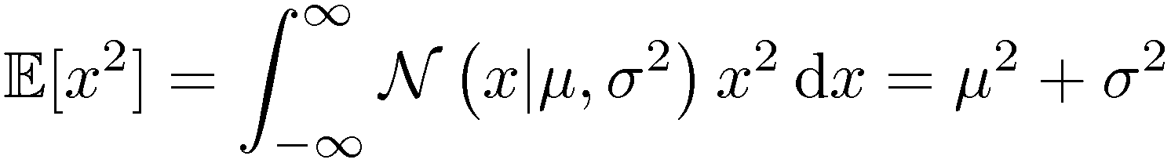
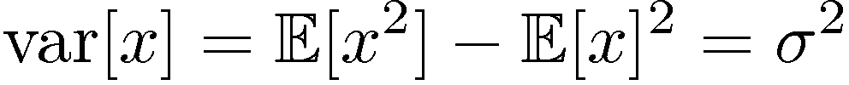
Gaussian mean and variance

Slide 10
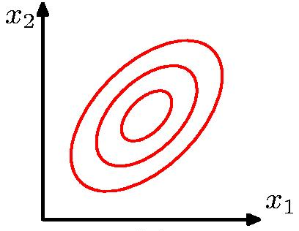
Multivariate Gaussian (ie. more than one dimension..)

Slide 11
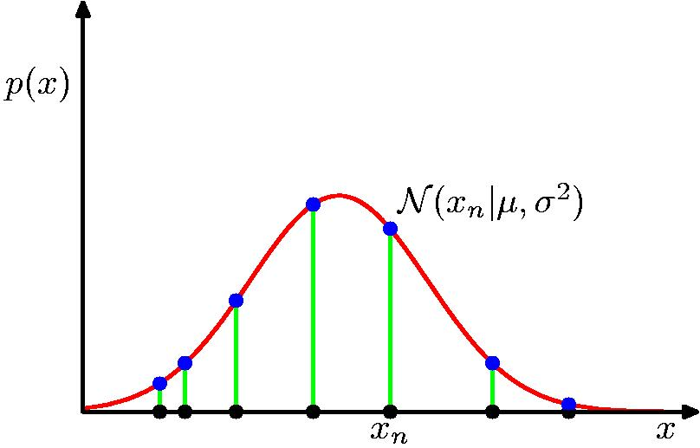
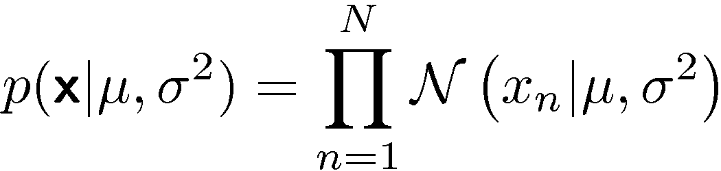
Gaussian parameter estimation
Likelihood function =
Important assumption – Independent and identically distributed data (i.i.d)

Slide 12
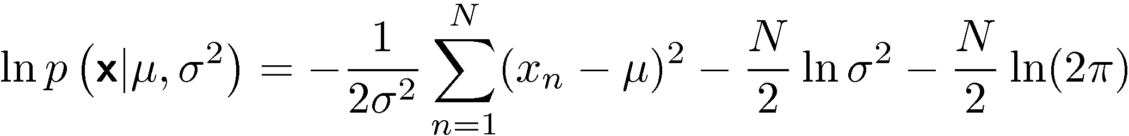
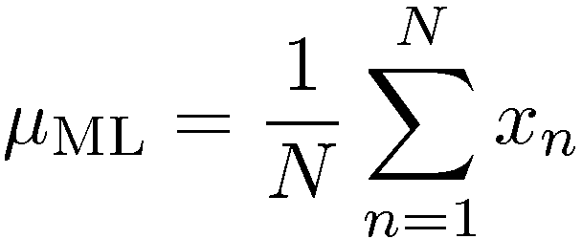
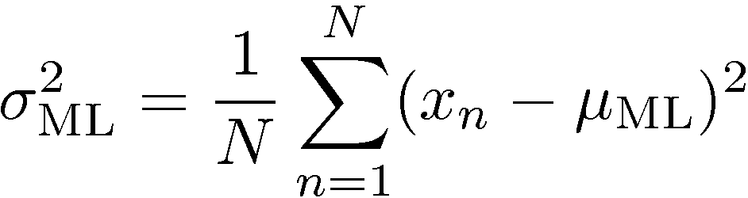
Maximum (log-) likelihood
Log-Likelihood function
L(µ,σ|x) =
µ_{ML} og σ_{ML} are found by maximizing L(µ,σ |x). That is :
µ_{ML} = arg max_{µ} L(µ,σ |x)
σ_{ML} = arg max_{σ} L(µ,σ |x)
Gaussian distribution:

Slide 13
How about the ”blue” distribution - What is the mean ? the most probable value ? the median ?

Slide 14
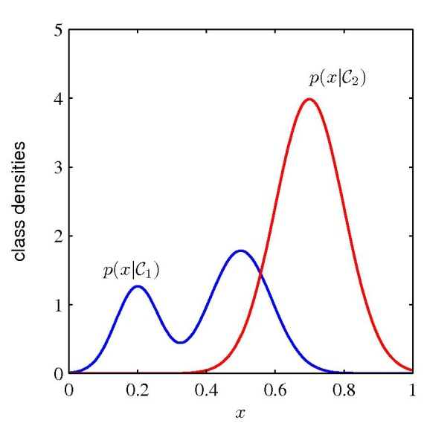
Classification using probabilistic models (in the max-likelihood approach using generative models)
Choose probabilistic model/distribution for p(x|C)
e.g. Gaussian distribution
(Sometimes) choose initial model parameters
Number of mixtures, hyperparameters,..
Infer/learn parameters of the model by maximizing the Log-likelihood function for each class separately – using a training data set
e.g. µ and σ for the Gaussian for each class
Find the posterior class probabilities P(C | x) using Bayes’ theorem (see next slide for details..)
Now, we’re ready to use P(C | x) on a new (test) set.

Slide 15
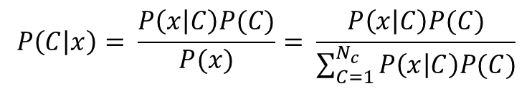
Bayes’ theorem for classification
$$P\left(C | x\right)= \frac{P\left(x | C\right)P(C)}{P(x)}= \frac{P\left(x | C\right)P(C)}{\sum_{C=1}^{N_{c}}{P\left(x | C\right)P(C})}$$
P(C|x) – Posterior class probability
P(C) – probability of (some) class C
P(x) – probability density of random variable x at value x ! (sloppy notation, but that’s normal..)
N_{c} – Number of classes
NOTE: Arg max_{C} P(C|x) = Arg max_{C} P(x|C)P(C)
- and if all class have same prior probability (ie. P(C) uniformly
distributed), then Arg max_{C} P(C|x) = Arg max_{C} P(x|C)

