Slide 1
Mini Project 2
CSI2P(II) Chen

Slide 2
Contents
Introduction
Tower Game Tutorial
Mini Project 2 Requirement

Slide 3
Contents
Introduction
Tower Game Tutorial
Mini Project 2 Requirement

Slide 4
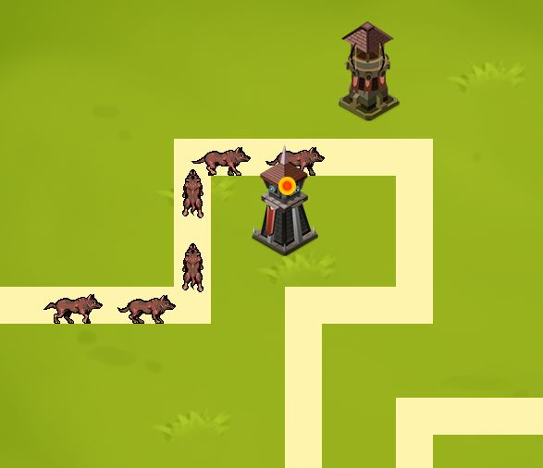
Tower Games
Copyright © TAs of CSI2P(II)Yang

Slide 5
Project Goal
Complete and implement functions of “Tower Game” by using OOP concept and C++ programming skills learned from class
Get more familiar with Allegro, and develop your own final project
Mini project II will teach you how to use concept of class to construct a strategy game

Slide 6
Contents
Introduction
Tower Game Tutorial
Mini Project 2 Requirement

Slide 7
Tower Game Tutorial
Flow chart of Tower Game
Classes and methods introduction

Slide 8
Tower Game Tutorial
Flow chart of Tower Game
Classes and methods introduction

Slide 9
Game Initializer
Game Play
Game Destroy

Slide 10
Game Play
Begin
Run

Slide 11
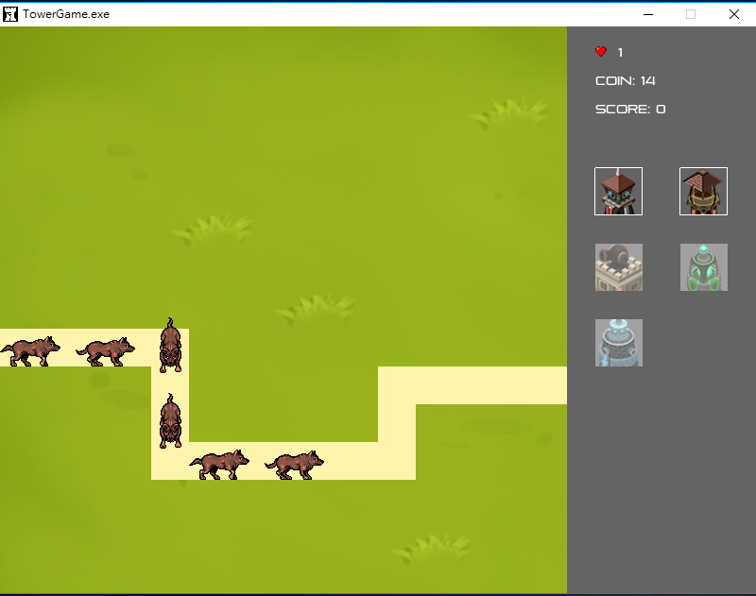
RUNNING
Void GameWindow::game_run()

Slide 12
Tower Game Tutorial
Flow chart of Tower Game
Classes and methods introduction

Slide 13
GameWindow.h
Define entire structure of tower game
A series of functions control the procedure of the game, ex: game_play(), game_destroy()…etc.
You can first trace game_play() to know how the process of this game is and add your code.

Slide 14
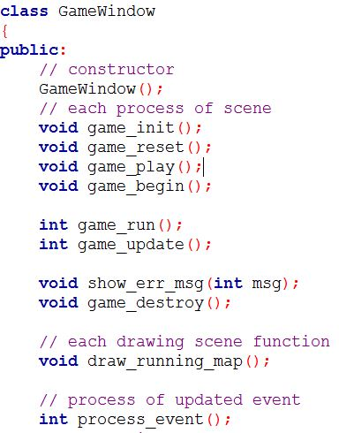
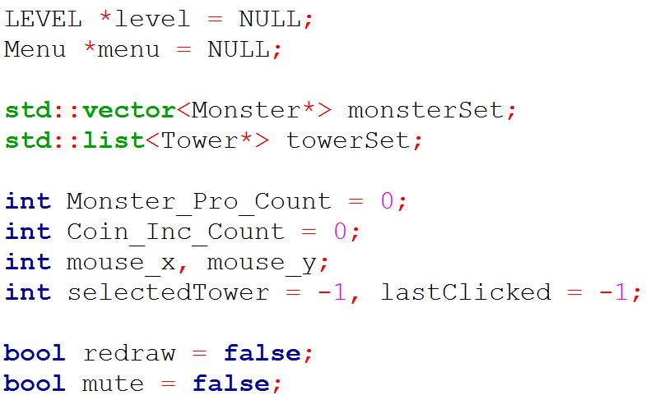
Game Functions
Variables

Slide 15
void game_init()
Description:
Initialize all needed elements (bitmaps, sounds, ……)
Besides, after sound samples are built, you also need to attach them to mixer(current use default mixer).

Slide 16
int game_update()
Description:
The most important core for whole game routine
Return the next game status
Control the actions of each objects in game, including tower attack trigger, monster moving action, updating attack set…etc.

Slide 17
global.h
Define some global variable for some function to use.
Don’t change the value of any variable in other files if you don’t understand whether the changes will cause any error or not.

Slide 18
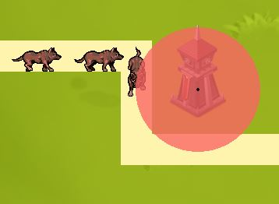
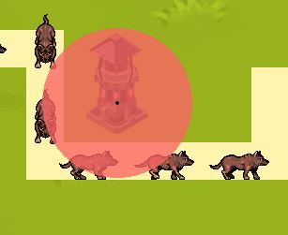
Circle.h
Define a class named “Circle”
This class is used to set the valid range of tower, monster and attack.

Slide 19
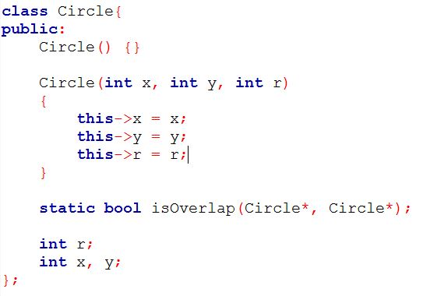
Class View

Slide 20
static bool isOverlap (Circle*, Circle*)
r1
Description:
Check if is the distance between centers of both circles less than r1 + r2 or not.
r2

Slide 21
Level.h
Define LEVEL class to store the information of a level.
One container to record the path that monster follows. The path arguments all are stored in a text file
you can find in main folder
You can also see that it already define the speed of producing a monster and the maximum number of monsters in a level.

Slide 22
void LEVEL::setLevel(const int level)
Description:
set up level content read from .txt in game folder
including total number of monsters, the path for monsters to follow

Slide 23
Menu.h
Define a class to record and show information of current level
There are two important methods:
int MouseIn
static bool isInRange

Slide 24
int MouseIn(int, int)
Description:
Detect if mouse hovers over any tower image on menu.
Return the image index if coin is enough to pay
otherwise return -1

Slide 25
static bool Menu::isInRange (int point, int startPos, int length)
Description:
Input
point: the testing point
startPos: the start position of a line
length: the length of the line
If the testing point is on the line or not
For MouseIn, it can simplify the statement

Slide 26
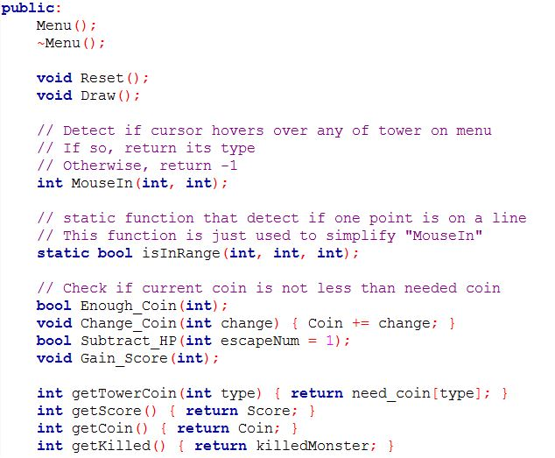
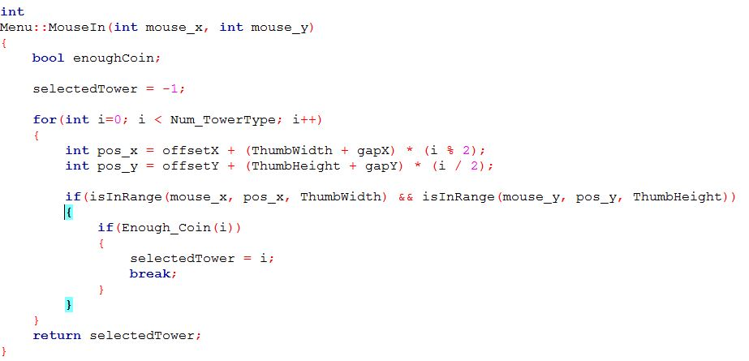

Slide 27
Slider.h
Define the functional class of slider.
In this game, it is used to create two sliders to adjust the volume of background and effect sound.
For mini-project2, you should use it to control volume.

Slide 28
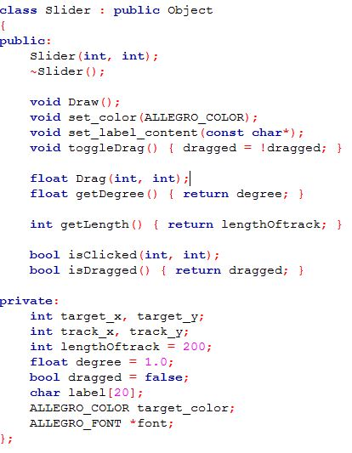
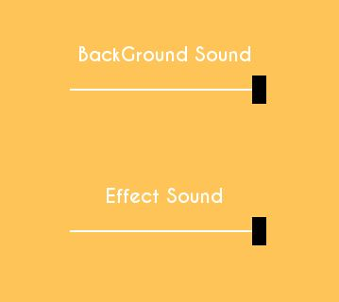
target
track

Slide 29
Monster.h
Define class for monster and this will be inherited by four subclasses.
Move(): determine animation image and direction of each step on map.
Load_Move(): according to class name of a monster, it will load its animatio images of four directions.

Slide 30
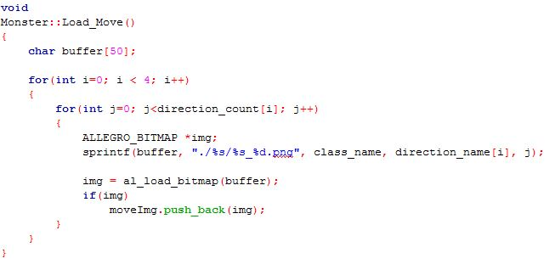
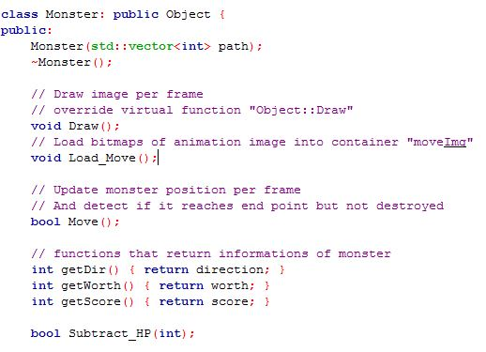

Slide 31
Tower.h
Define the class for tower and this will be inherited by other five subclasses.
UpdateAttack(): update attack set of the tower.
DetectAttack(): make sure if the tower needs to trigger attack
TriggerAttack(): Go through whole attack set to test if a monster will be destroyed by the attack of tower.

Slide 32
Each Time Frame
Detect
Attack
Trigger Attack
Update Attack

Slide 33
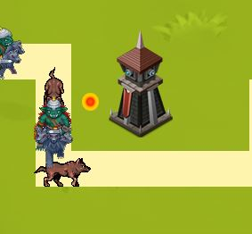
Attack.h
Define the class for describing the form of an attack.
You can see that attack only follows original straight line from the tower’s pivot toward the position where monster collided with the tower.

Slide 34
Contents
Introduction
Tower Game Tutorial
Mini Project 2 Requirement

Slide 35
Mini Project 2
Deadline: 6/8(五) Demo
Demo 請攜帶自己電腦, 若為桌電請先跟同學借好
與Mini1一樣會分成四組同時Demo，請準時來課堂

Slide 36
Grading
1. 加入開頭畫面 （20%）
一個背景(開頭畫面)
一個可以從開頭畫面切換到遊戲主體的按鍵(按鈕or鍵盤)
2. 加入 鍵盤、滑鼠 事件（至少各一個） （20%）
e.g. 按鍵p : 暫停、滑鼠右鍵 : 加錢…
3. 用Slider調整聲音大小（20%）

Slide 37
Grading
4. 塔能夠正確攻擊 （20%）
以正常頻率發射攻擊(不要一秒50發)
在塔的範圍內必須要觸發攻擊
5. 新增一個塔，且有實際的作用（20%）
新增獨立的header file(可以參考Arcane.h、Archer.h…)
能夠從選單(menu，主畫面右邊)選取放到場上

Slide 38
However,
This is not our end today : )

