Slide 1
TowerGame Tutorial

Slide 2
Before we begin…

Slide 3


Maybe your dream is…

Slide 4
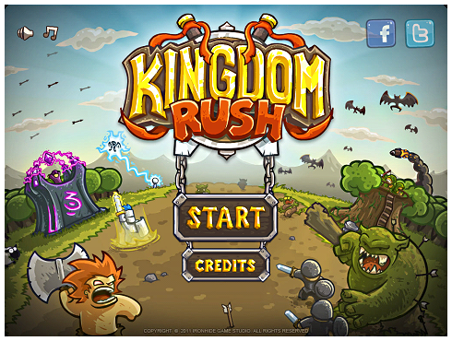
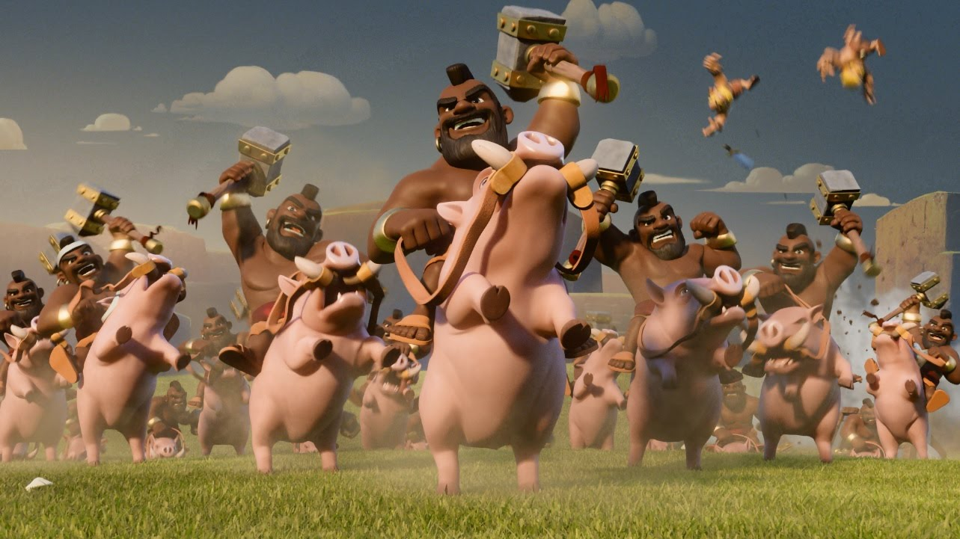

Or you think of…

Slide 5
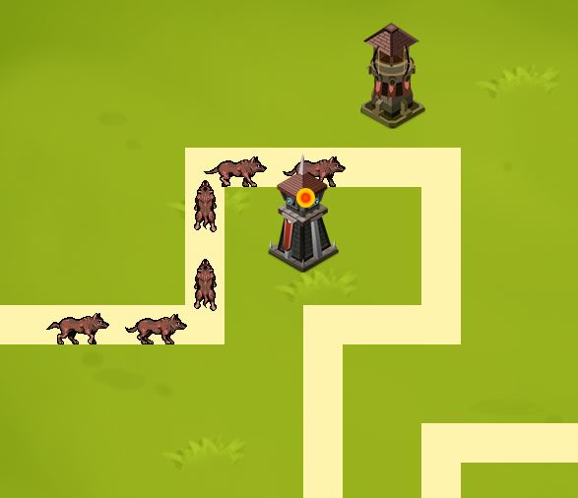
Actually…

Slide 6
Project Goal
Complete and implement functions of “Tower Game” by using OOP concept and C++ programming skills learned from class.
Get more familiar with Allegro, and develop your own final project.
Mini project II will teach you how to use concept of class to construct a strategy game.

Slide 7
Outline
Flow chart of TowerGame
Classes and member functions introduction

Slide 8
Outline
Flow chart of TowerGame
Classes and member functions introduction

Slide 9
Main Framework
Game Initial
Game
Begin
Game
Destroy
Game
Running

Slide 10

Game Initialize
Game Initial
Game
Begin
Game
Destroy
Game
Running
Description:
This state is responsible for registering event, initializing the resources that game needs, and creating Level, Menu object. That is, when game is in this state, you can prepare to load some data for your starting scene.

Slide 11

Game Begin
Game Initial
Game
Begin
Game
Destroy
Game
Running
Description:
This state is used to change the status of game from loading to running. In addition, in this state (function), it also triggers “timer” and “monster_pro”. Therefore, you may show your starting scene before changing to this state.
START

Slide 12
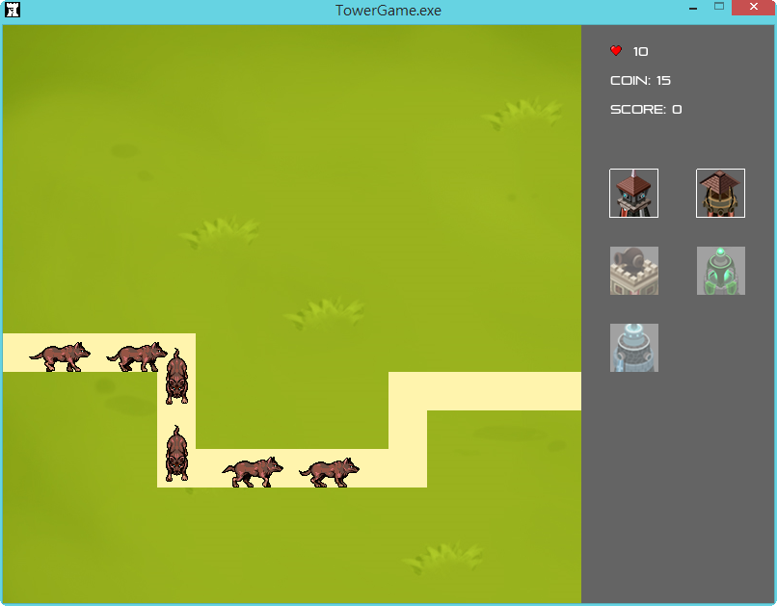
Game Running
Game Initial
Game
Begin
Game
Destroy
Game
Running
Description:
This state plays a very important role in tower game. It controls not only mov-ing object, like monsters and towers, but also the update of entire inner infor-mation, like menu and level.

Slide 13
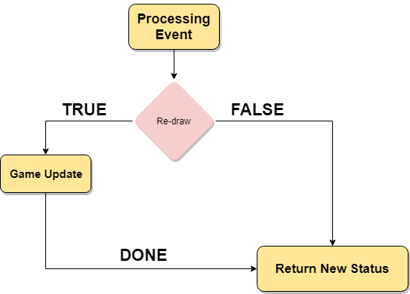
Game Running (cont’d)

Slide 14
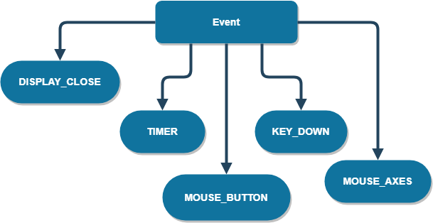
Processing Event

Slide 15









Game Update
Core

Slide 16


Game Update (cont’d)
Tower Set
Monster Set

Slide 17

Game Update (cont’d)
Detect Attack
Attack
Tower
-N
Transfer coordinate
Attack Set
HP
Weeeee
+N
Monster
Trigger Attack
Update Attack

Slide 18
Outline
Flow chart of TowerGame
Classes and member functions introduction
Notes:
TODO: 把.h code貼上 連結一下程式設計一 講過的 動畫怎麼貼….(如何對應) c的procedure 的概念 最後被 包裝到哪個class裡面
TODO: 多型的概念

Slide 19
Overview
Tower
Request Update
Menu
Attack
set
Circle
HP
Coin
Slider
BGM
EM
Coordinate
Attack
Monster
Level
Level Map
Circle

Slide 20
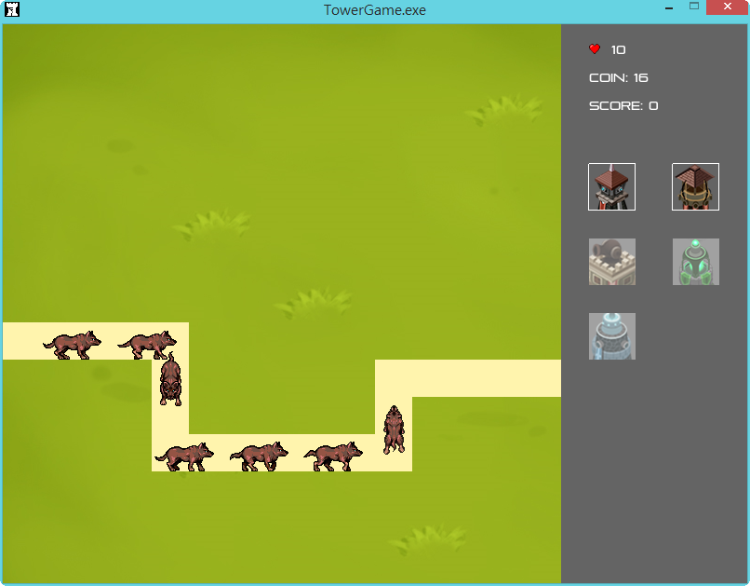
GameWindow

Slide 21
GameWindow.h
Description:
Define the entire game model
Contain different member functions to control each state in game status.
Consist of many objects, like Level, Menu, Monster and Tower.
Game
Initial
Game
Begin
Game
Running
Game
Destroy

Slide 22
void game_init()
Description:
Initialize all needed bitmaps
Set up sound sample instance for background and effect.
After sound samples are built, also attaching them to
mixer(current use default mixer).
Create level and menu object that controls inner information.

Slide 23
void game_begin ()
Description:
Draw initialized game scene onto display
Start the timer, including “timer” and “monster_pro”
For this function, it also can be regarded as the entry point of starting scene. Therefore, you may add some draw-command in it to draw starting scene.

Slide 24
int game_update()
Description:
The most important core for whole game routine
Return the next game status
Control the actions of each objects in game, including tower’s attack trigger, monster’s moving action, updating attack set…etc.

Slide 25

global

Slide 26
global.h && global.cpp
Description:
Define a lot of global variables that are commonly used in different classes, like TowerRadius, TowerWidth, TowerHeight and grid_width…etc.
Maybe, you will need to modify this file for some convenience. Then you have to initialize any new global variable somewhere (take global.cpp as reference)
Otherwise, please don’t modify this file for any reason.

Slide 27
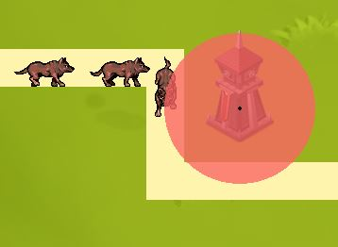
Circle

Slide 28
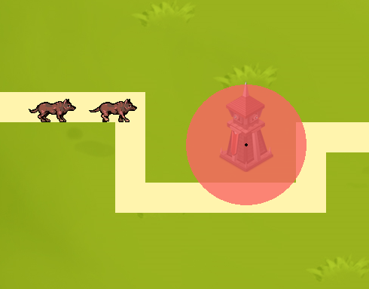
Circle.h
Define a class named “Circle”
This class is used to set the valid range of tower, monster and attack.
Range Collide
No collide

Slide 29
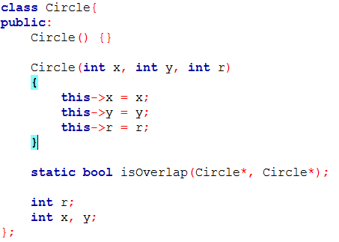
Class View

Slide 30
static bool isOverlap(Circle*, Circle*)
r1
Description:
Check if is the distance between centers of both circles less than r1 plus r2 or not.
r2

Slide 31
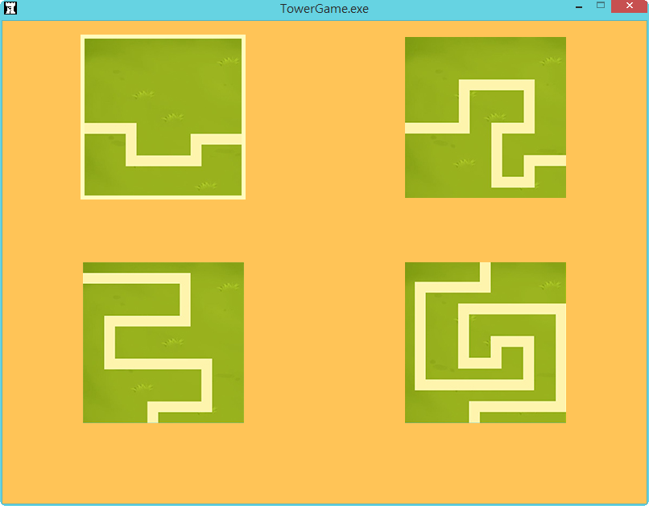
Level

Slide 32
Level.h
Define LEVEL class to store the information of a level.
One container to record the path that monster follows. The path arguments all are stored in a text file (you can find in main folder).
You can also see that it already define the speed of producing a monster and the maximum number of monsters in a level.

Slide 33
void LEVEL::setLevel(const int level)
Description:
set up level content read from .txt in game folder
Including total number of monsters, the path for
monsters to follow.

Slide 34
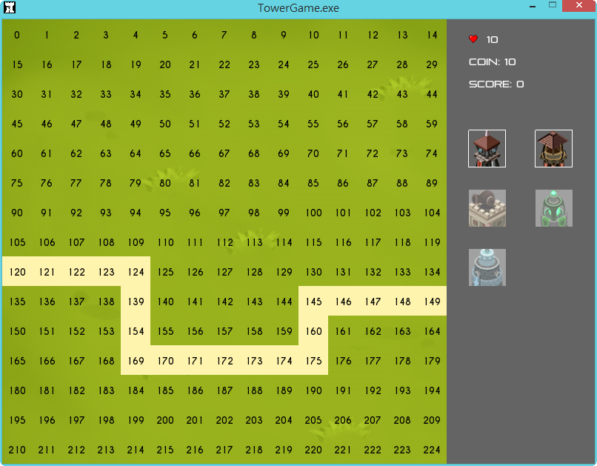
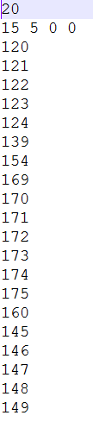
# of Monster
Monster
Path

Slide 35
Menu

Slide 36
Menu.h
Define a class to record and show information of current level.
There are two important member functions:
> int MouseIn(int, int)
> static bool isInRange(int , int , int)

Slide 37
int MouseIn(int, int)
Description:
Detect if mouse hovers over any tower image on menu.
Return the image index if coin is enough to pay, otherwise return -1

Slide 38
static bool Menu::isInRange(int point, int startPos, int length)
Description:
point: the testing point
startPos: the start position of a line
length: the length of the line
Used to know if the testing point is on the line or not.
For MouseIn, it can make the statement more simplifying.

Slide 39
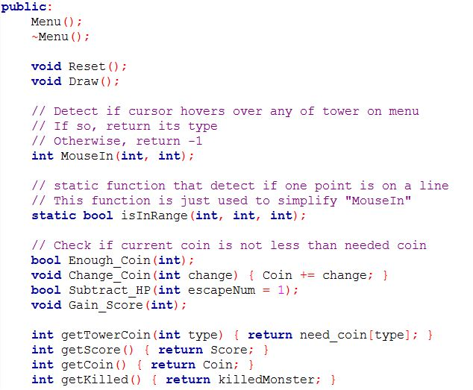
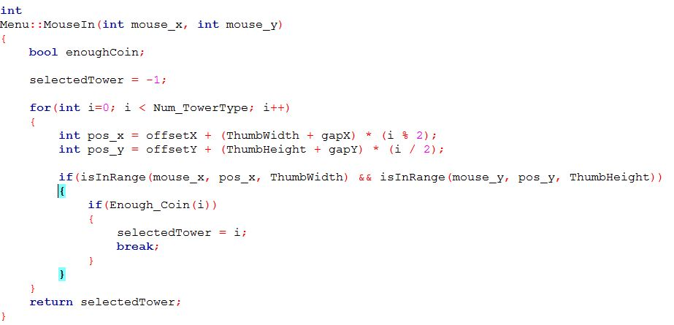

Slide 40
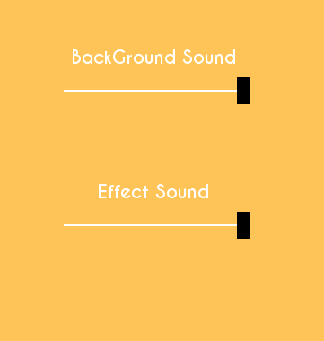
Slider

Slide 41
Slider.h
Define the functional class of slider.
In this game, it is used to create two sliders to adjust the volume of background and effect sound.
For mini-project2, you should use it to control volume.

Slide 42
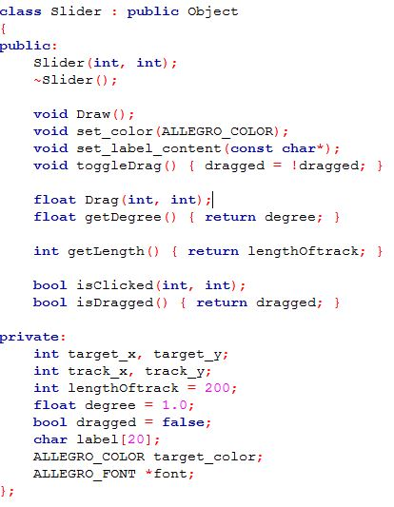
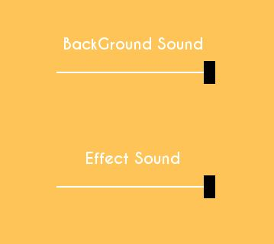
target
track

Slide 43
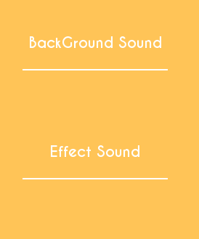

How to use it?
toggleDrag()
Drag()
Toggle Again!!

Slide 44
Monster

Slide 45
Monster.h
Define class for monster and this will be inherited by four subclasses.
Move(): determine animation image and direction of each step on map.
Load_Move(): according to class name of a monster, it will load its animatio images of four directions.

Slide 46
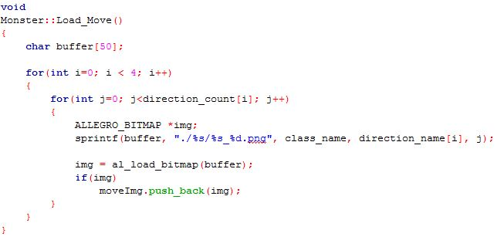
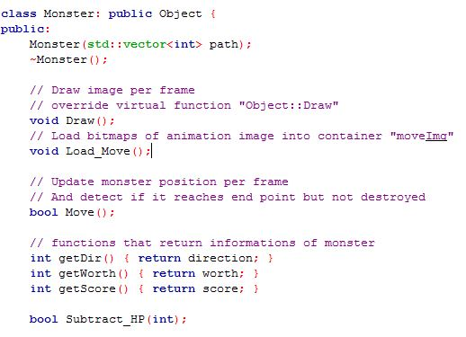

Slide 47

Tower

Slide 48
Tower.h
Define the class for tower and this will be inherited by other five subclasses.
DetectAttack(…): Make sure if the tower needs to trigger attack
TriggerAttack(…): Go through whole attack set to test if a monster will be destroyed by the attack of tower.
UpdateAttack(): This method will update attack set of the tower.

Slide 49
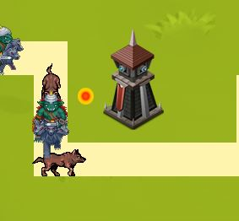
Attack.h
Define the class for describing the form of an attack.
You can see that attack only follows original straight line from the tower’s pivot toward the position where monster collided with the tower.

Slide 50
Each Time Frame
Detect
Attack
Trigger Attack
Update Attack

Slide 51
Mini Project 2 Requirements

Slide 52
Grading Policy
Basic Functionalities
1. 加入開頭畫面 （20%）
➔一個背景(開頭畫面)
➔一個可以從開頭畫面切換到遊戲主體的按鍵(按鈕or鍵盤)
2. 加入 鍵盤、滑鼠 事件（至少各一個） （20%）
➔e.g. 按鍵p : 暫停、滑鼠右鍵 : 加錢…
3. 用Slider調整聲音大小（20%）

Slide 53
Grading Policy
Basic Functionalities
4. 塔能夠正確攻擊 （20%）
➔以正常頻率發射攻擊(不要一秒50發)
➔在塔的範圍內必須要觸發攻擊
5. 新增一個塔，且有實際的作用（20%）
➔新增獨立的header file(可以參考Arcane.h、Archer.h…)
➔能夠從選單(menu，主畫面右邊)選取放到場上
(所需圖片可從助教提供的素材包做使用或是上網找自己喜歡的圖片)
Bonus (最多至學期成績2%)
1. 多個關卡且可自動接續
2. 畫面美術性
3. 加入創意元素

Slide 54
DEMO Date
日期： 6/08 （二）
時間： 13：30 ～ 15：10
地點： 台達105
佔總成績： 5%

